Slide 1

Digital Twin Energy Grids
A £1.2m competition from Innovate UK
Mel Cassley, Knowledge Transfer Manager, Intelligent Systems
Simon Hart, Head of Cyberphysical and Digital Twins
Innovate UK
23rd April 2024
Notes:
Mel
To make it easier for you to navigate and find the partner you’re looking for, we’ve created 4 colour coded categories based on your sector/horizontal The categories are:
Digital Twins
Data interoperability
Cyber Security
End Users
I’ll paste the link to the mural in the chat shortly
https://app.mural.co/t/ktn5092/m/ktn5092/1712911399827/3394063b82465db52006aee6a249d7b53f9c4729?sender=u13ffcbb9bf8af66c3f8c0979

Slide 2


Challenges
The UK energy sector is rapidly changing as energy generation, transmission and storage decarbonise.
At the same time, demand for electricity is increasing for heat, transportation, and the compute power of AI.
Digital Twins offer a potential solutions but what is needed to make them work?
Notes:
Mel
The future energy grid will involve challenges of scale, complexity, and uncertainty, involving a much greater number of suppliers and variety of energy sources.
Digital twinning is an approach that can be used to build, monitor, and improve the resilience of systems and critical components.
A national capability in digital twinning would support the development of improved energy affordability, stability, and security. It would enable the UK to adopt a whole energy systems approach.
It would also provide increased resilience in energy grids, greater understanding and awareness of potential issues and emergent behaviours, improved situational awareness and decision support, and the means to intervene in real time to prevent and mitigate the effects of crises.

Slide 3

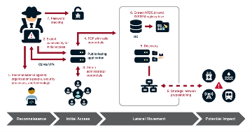
Digital Twins in Energy
Real-time demand forecasting
IoT, OT and Control Systems
Modelling the stability of energy networks
Predictive maintenance
Climate impact analysis
Cascade effects modelling
Energy Smart Appliance controls
Demand response and dynamic pricing
Hostile threat prediction and mitigation
Sandboxing and prototyping
Dispatch and grid inertia modelling
Grid frequency and phasor analysis
Human behavioural impacts
Energy storage optimisation
AI testbeds
The aim of this competition is to improve the cyber resilience of the UK’s energy networks by enabling the development of digital twins.
Notes:
Simon

Slide 4
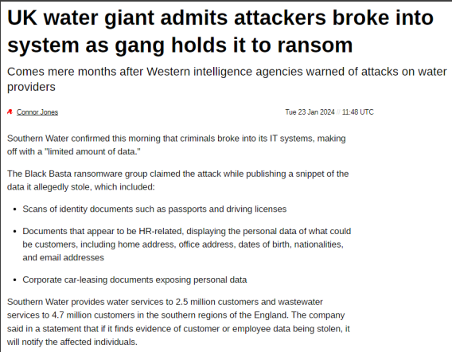
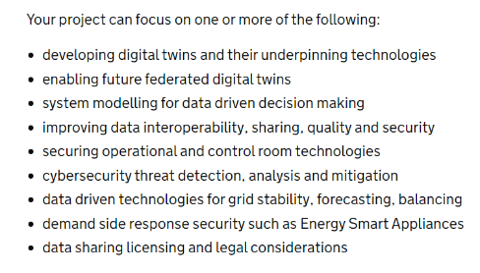
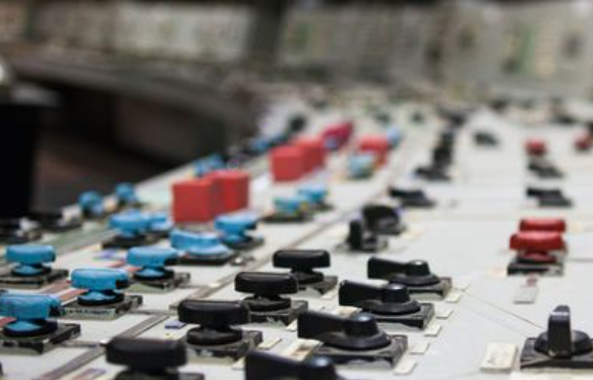
Competition Themes
Notes:
Simon

Slide 5
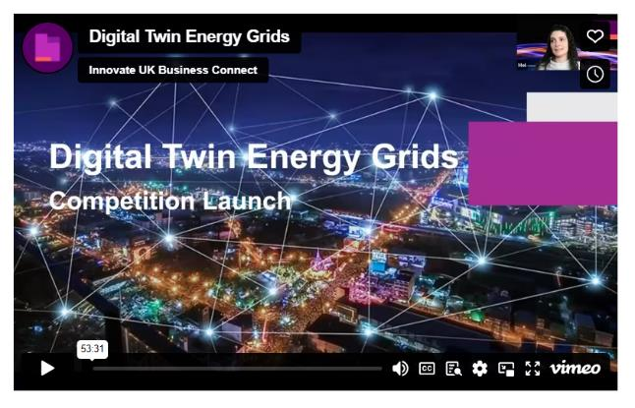
15th April Launch Event
“The aim of this competition is to improve the cyber resilience of the UK’s energy networks by enabling the development of digital twins.”
https://iuk.ktn-uk.org/events/digital-twin-energy-grids/
Notes:
Mel
Launch event on 15th featured NCSC, EPSRC, DAFNI, ENSIGN, DTNET to talk about the competition and how you can get support.

Slide 6




Project Partners
ENSIGN – Energy System Digital Twin
Notes:
Mel
This competition is supported by a number of existing programmes and partners

Slide 7
Eligibility Criteria
Total Competition Grant: | £1.2 million
Open to: | Collaborations only
Project must: | start by 1 October 2024 end by 30 September 2025 include at least one grant claiming SME carry out all of its project work in the UK intend to exploit the results from or in UK
Total Grant Funding Request: | between £100,000 and £300,000
Project Length: | between 6 and 12 months
Lead Organisation: | UK business of any size
Subcontractors: | Allowed
Notes:
Mel

Slide 8
Key Dates
Timeline | Dates
Competition Opens | 22 April 2024
Briefing Event | 25 April 2024
Submission Deadline | 24 May 2024 at 11:00
Applicants informed | 28 June 2024
Notes:
Mel
These are the key dates to bear in mind for this competition. It’s important to note that the submission deadline is at 11am on the dot. IFS will automatically close and so at 11:01 applications can’t be submitted. We strongly recommend that you submit your application as early as possible as traffic will be high on deadline day.
Please contact customer support in advance of the deadline if you experience any difficulties with submitting your application so that we can assist you in good time.

Slide 9
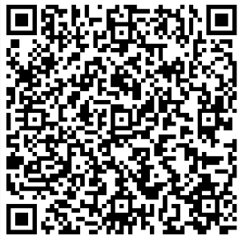
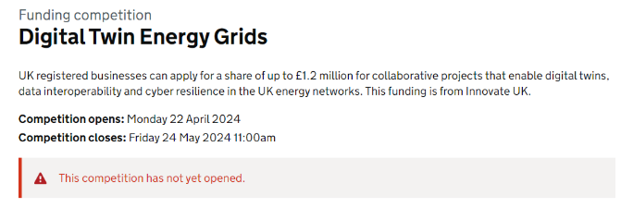
How to apply
Notes:
Mel

Slide 10





Thank You
@InnovateUK
Innovate UK
Innovate UK
@weareinnovateuk

