Slide 1
DT Hub website refresh a new look and layout
Daniel block, DT HUB product manager
9 APRIL 2024
Notes:
Good morning everyone, I’m Daniel Block, I’m Product Manager for the Digital Twin Hub, and I’m going to talk today about the DT Hub website refresh which was launched at the start of April with a move to a whole new platform.

Slide 2
history of the dt hub
First DT Hub redesign incorporating new features for a growing community
New look launched to coincide with first Connected Digital Twins Summit
DT Hub moves to Wordpress
31 March 2020
October 2021
April 2022
June 2023
February 2024
31 March 2024
DT Hub launched at Centre for Digital Built Britain (CDBB)
DT Hub moves to its new home at Connected Places Catapult (CPC)
DT Hub reaches 5,000 members
Notes:
Firstly though, I just want to set a bit of context as I’m aware that our audience is mixed between new and longer serving members.
The DT Hub has just celebrated its 4th birthday, having launched as a very timely new virtual community website just a week into the first COVID lockdown on the 31st March 2020. In fact, the new version of the DT Hub happened to go live exactly 4 years later to the day, on 31st March this year. That initial version was conceived at the Centre for Digital Built Britain.
The first redesign took place just over 18 months later in the autumn of 2021. This was a move towards opening up to a wider audience, and making more resources available to non-members, while offering new features to members too.
6 months later CDBB completed its 5 year mission and so the DT Hub continued its journey with Connected Places Catapult as its new home.
Then in June of last year we launched a new look along with some enhanced features such as Organisation Profile Pages and online learning modules in collaboration with the Open Data Institute. This design formed the foundations of this month’s new move to Wordpress, and just last month we also celebrated passing the milestone of 5,000 DT Hub members.

Slide 3
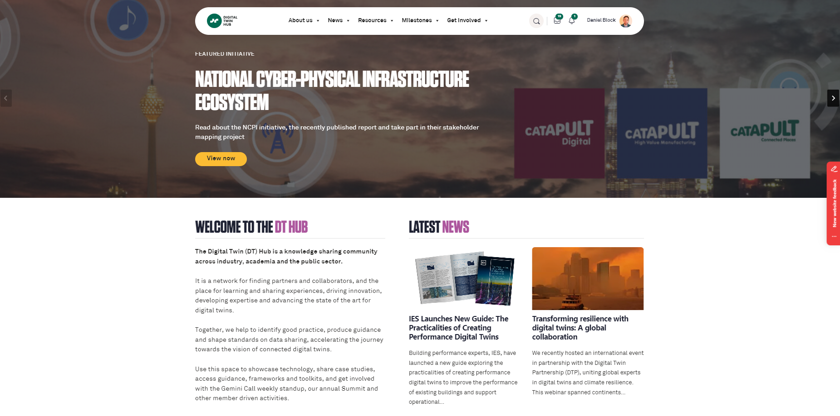
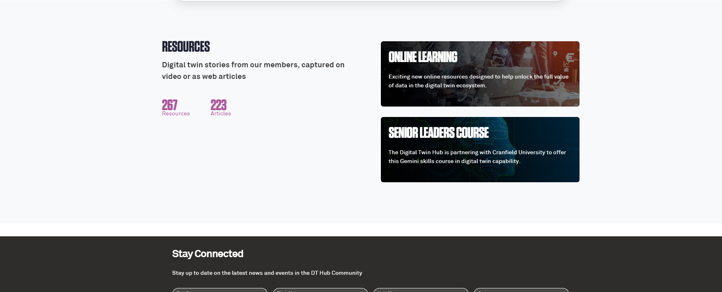
The new platform: wordpress
A more flexible website for a community at the forefront of innovation.
Greater access to plug-ins to allow us to evolve innovative new features and ways of publishing content
Notes:
So why have we moved to Wordpress?
For 4 years, the DT Hub has operated on a community platform called Invision. This platform has served us incredibly well over the years, and took us to 5,000 members. However, as we move forward and evolve our objectives and consider how most effectively we can serve a rapidly growing community, we have increasingly found that we are pushing the boundaries of what the Invision platform was designed to do.
And as well as having a growing community, we are operating in a fast changing world – both in terms of digital twins but in the wider world too. Certainly this can be seen on a global scale with the rapid advances in artificial intelligence and large language models. But also it is vital that we are moving to lead the conversation within the digital twin world – for example, over the years we have produced resources and reports which have proven to be valuable across the community, but even our Skills and Capability Framework which was only published a couple of years does not refer to some relevant job roles, because those roles didn’t exist when it was written! That’s how fast things move.
Wordpress gives us the flexibility to quickly adapt and to introduce new features and new ways of engaging with content which we believe will hugely enrich the user experience for DT Hub members.

Slide 4
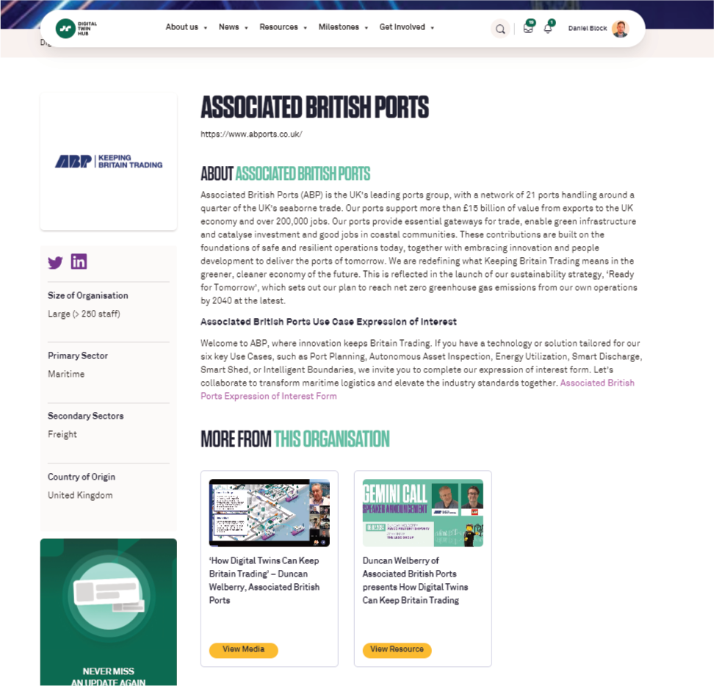
What’s new?
Better links between content types
and tagged content
Recommended related content
Improved user friendly search results
Notes:
Last year when we launched the new look website, I spoke about forging stronger connections between content across the DT Hub, to make articles, media items and resources easier to locate and group together.
We made some progress in this area, particularly with the launch of Organisation Profile Pages which collated all DT Hub content by a particular organisation in one handy place. These are replicated on the new website, with extra, improved functionality on the way. However, as I said earlier, these were merely the foundations for a larger, stronger community website which is still evolving.

Slide 5
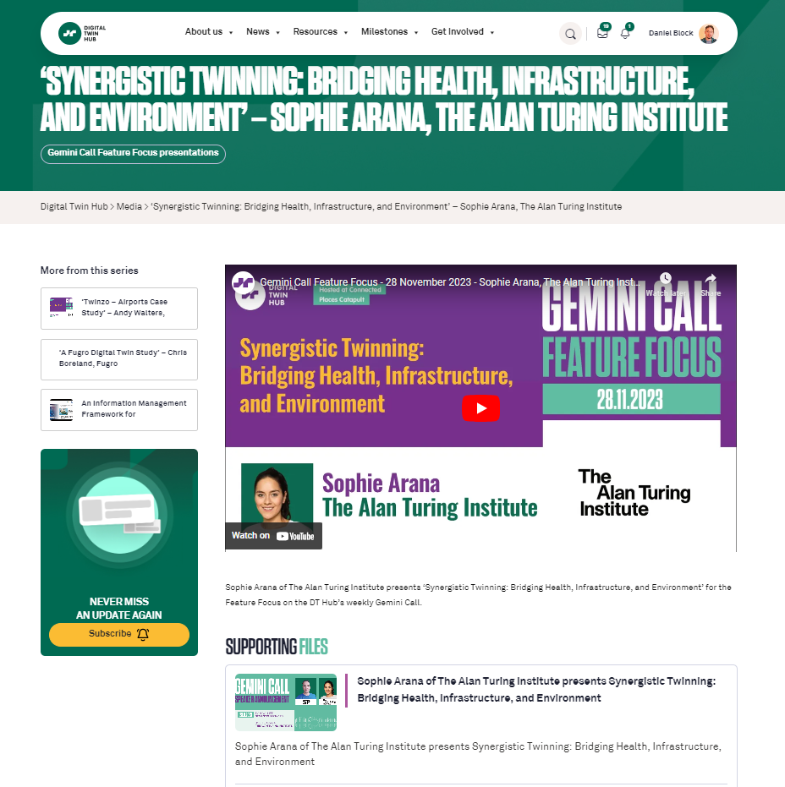
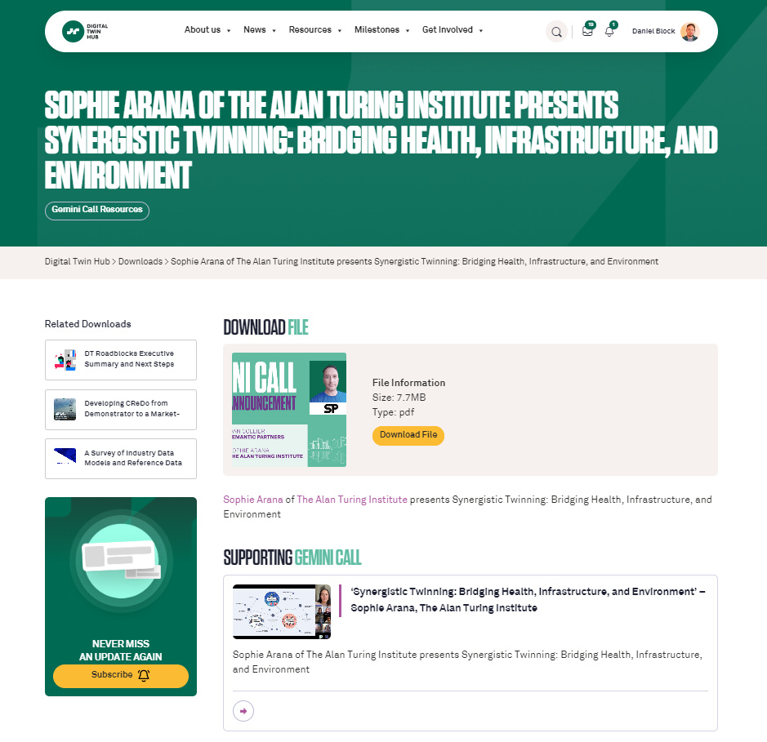
What’s new?
Better links between content types
and tagged content
Recommended related content
Improved user friendly search results
Notes:
We were somewhat constrained previously in being able to link different content types together, but this will no longer be a problem on Wordpress. The first, clearest example of this appropriately for today is the Gemini Call Feature Focus presentations. We now have a direct link between the Feature Focus video and the downloadable slide deck. So if you missed today’s Gemini Call and you’re watching this as an edited recording in the Media section of the DT Hub, you’ll be able to see a link to the slides I’m using on this same page and download them for reference. And if you found the slidedeck in the Downloads section and decided to seek out the video too, you’re now watching me from the link on the same page.
But not only that, you will be able to see related content on the same page too, which might include the Gemini Call when I talked about the website redesign last year, or because I mentioned it earlier in this presentation, perhaps even the Skills and Capability Framework document.
Another thing that’s already improved on the site is the user friendly search function. It now presents content in an easily viewable list of different content types, so if you know you’re looking for a blog post or a media item, it’s much easier to choose from the search results.
These are just a few of the benefits which exist on the site now, with many more on the way very soon.

Slide 6
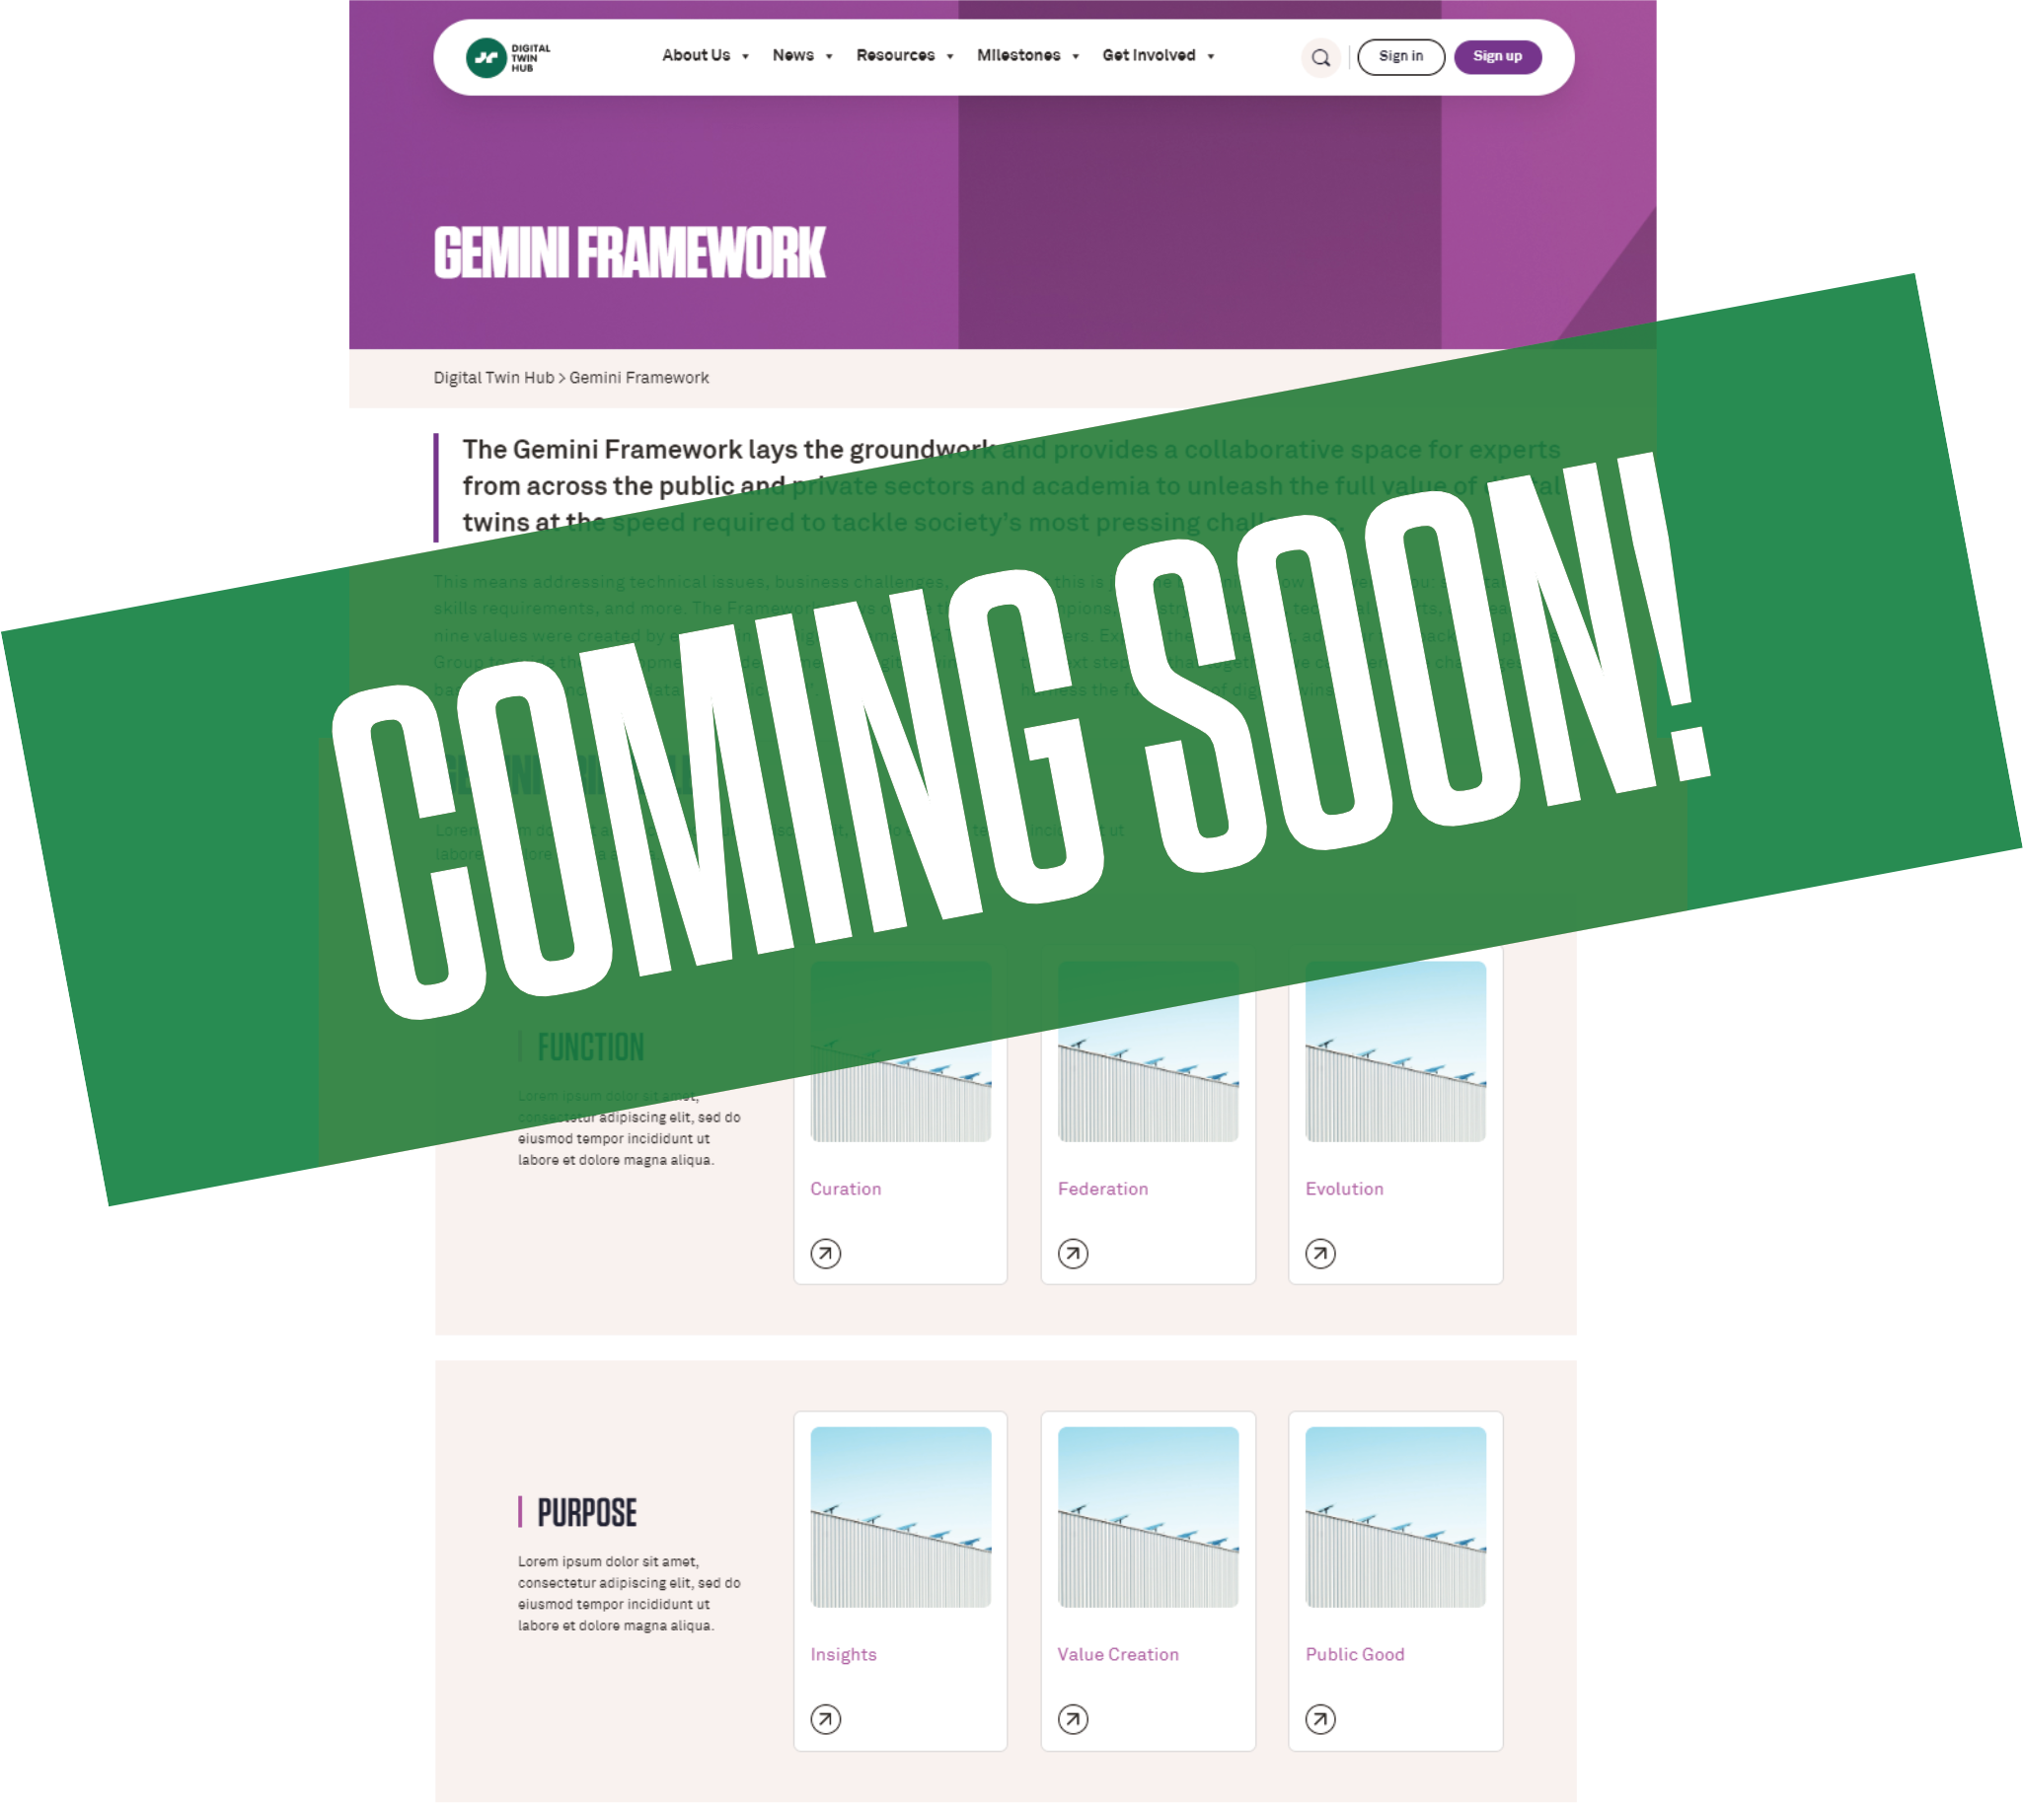
Watch this space
Gemini Framework
Smart search function
Much, much more
Notes:
One of the strengths of the DT Hub, certainly as a learning centre for digital twins, is a huge wealth of resources, whether they be the reports to which I have already referred, numerous case studies from innovators and asset owners across the UK and beyond or practical resources such as the popular DT Toolkit.
But with so much valuable content, and more being added all the time, with new working group publications being the latest new outputs on the DT Hub, it can be hard to quickly and easily find what you want and so we are in the process of developing tools and pages which bring those resources to the fore.
I’m going to tease you now by not exactly explaining how those tools will work but I can say that it really will be a big step forward in terms of user experience, and is nothing like anything we’ve done before on the DT Hub.

Slide 7
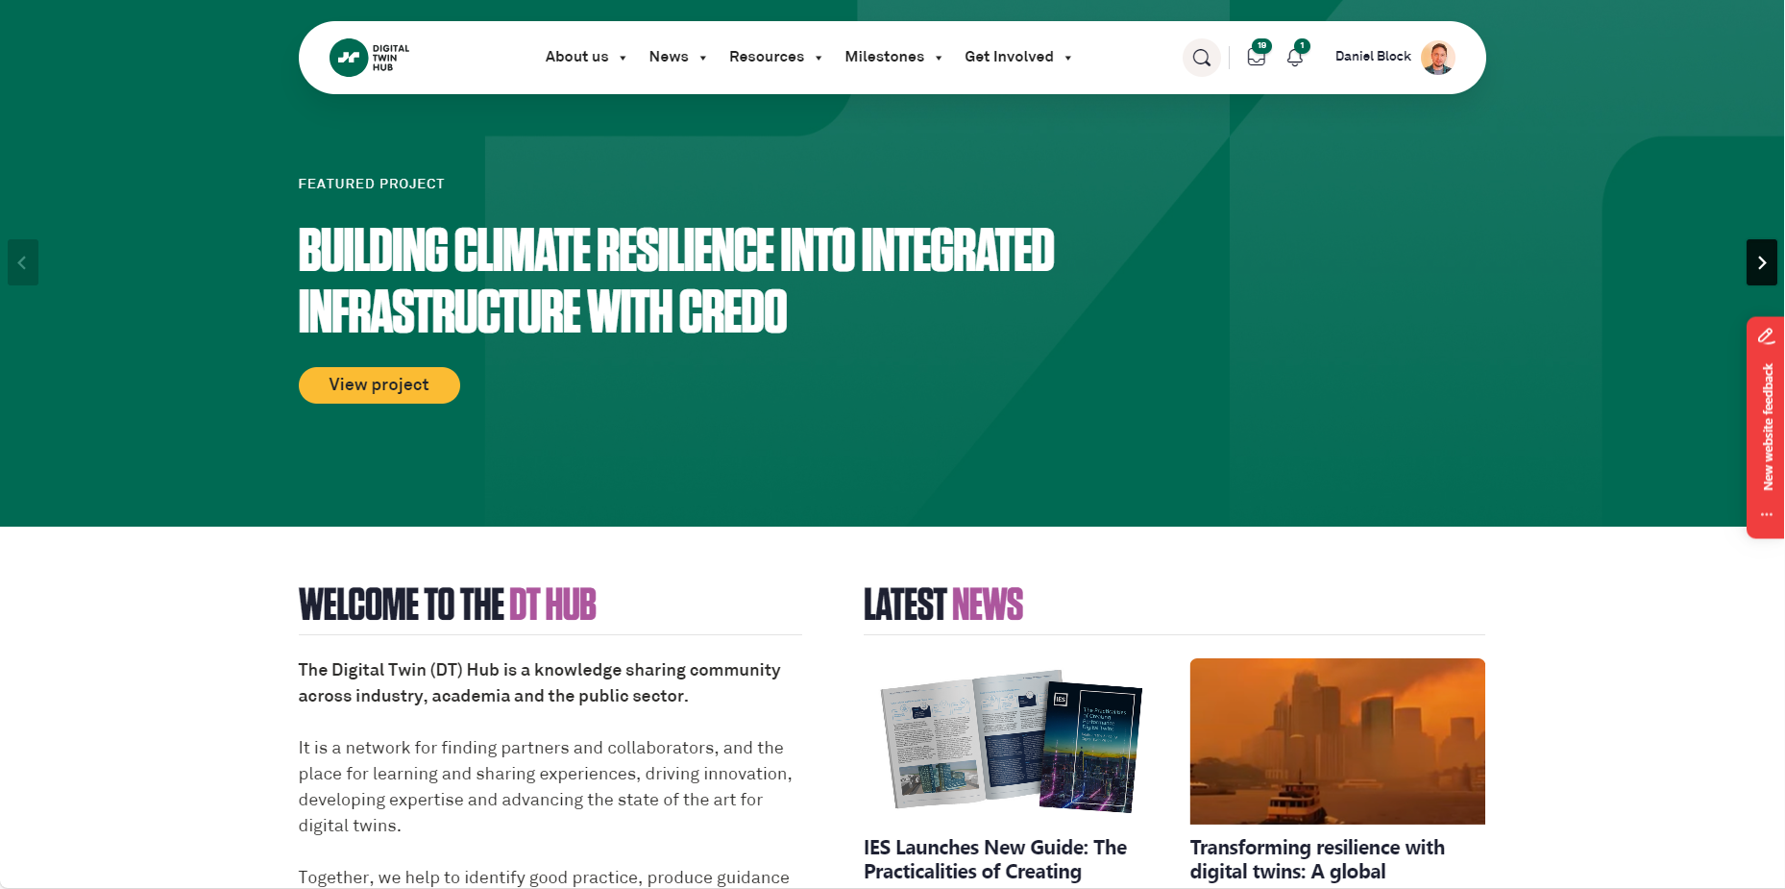
Community feedback
Please give us feedback on
the website
Your community website
daniel.block@cp.catapult.org.uk
Notes:
Finally, a call to action to the community.
The DT Hub is a vast website, with hundreds of discussions, articles, resources, case studies and more. We have worked very hard to ensure as smooth a transition between platforms as possible, but inevitably there will probably be some things which don’t look exactly right or don’t work how you’d expect. So we would like your input please. Our web design team have helpfully included an easy to use reporting tool on the website. You can see I’ve highlighted the little red tab on the right of this screenshot.
For the next few weeks, every page on the DT Hub has that tab. If you click on it it will open up a window with a screenshot of the page you’re looking at, with options to highlight with boxes or arrows any issues you’d like to report back to us. You can then give a brief description of the issue and submit it, and that goes directly to our web team who can fix issues for us. And please do use that reporting system to also give us general feedback on the website.
Alternatively, if you would like to contact me directly with any questions, suggestions or general thoughts about the website then I’ll be more than happy to discuss those offline. My email address is on the screen now, and I’ll also post it in the chat, and of course I’ll be happy to answer questions today submitted through Slido.

Slide 8

Thank you!
www.digitaltwinhub.co.uk
Notes:
Thank you very much. And with that I’ll hand back to Simon.

