Slide 1

Digital Twin Down Under
Gemini call – 30th January 2024
tempoinstitute.com.au

Slide 2
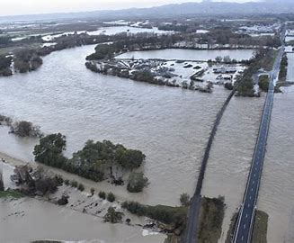
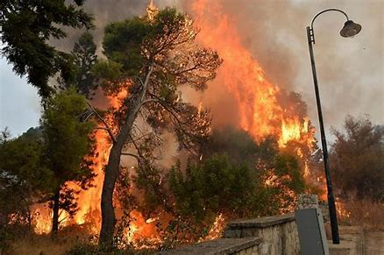



Slide 3
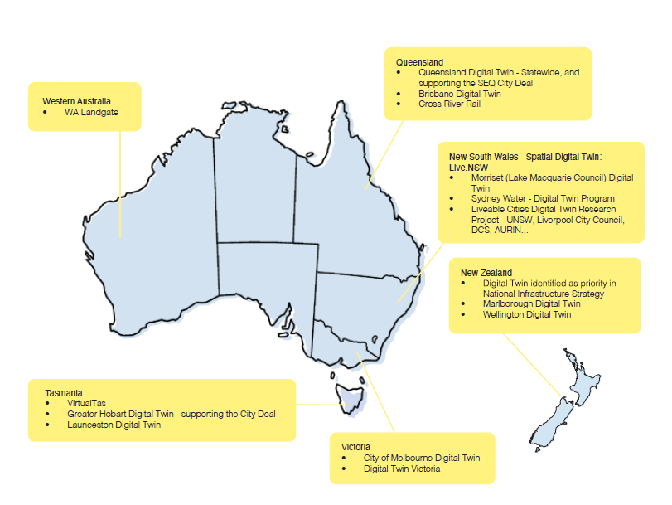
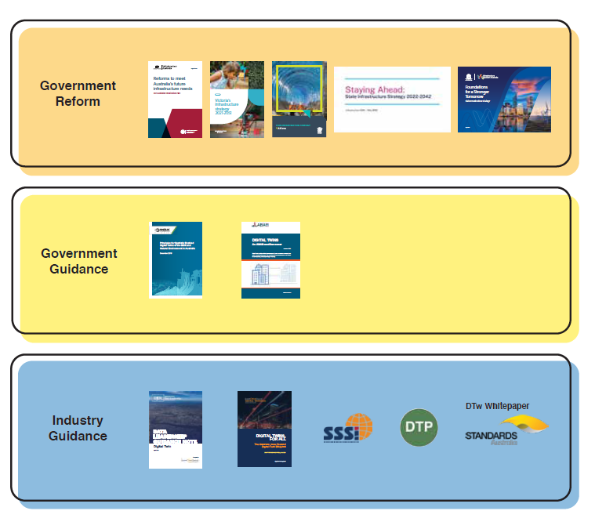

Australia’s Progress – it's happening now.

Slide 4
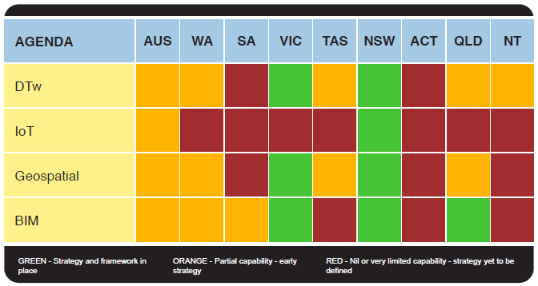

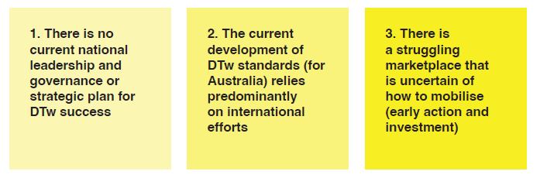
Australia’s – current state

Slide 5

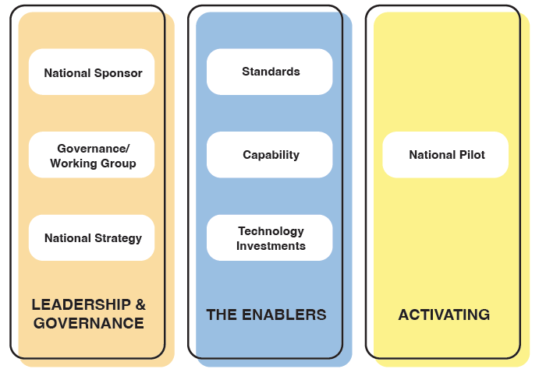
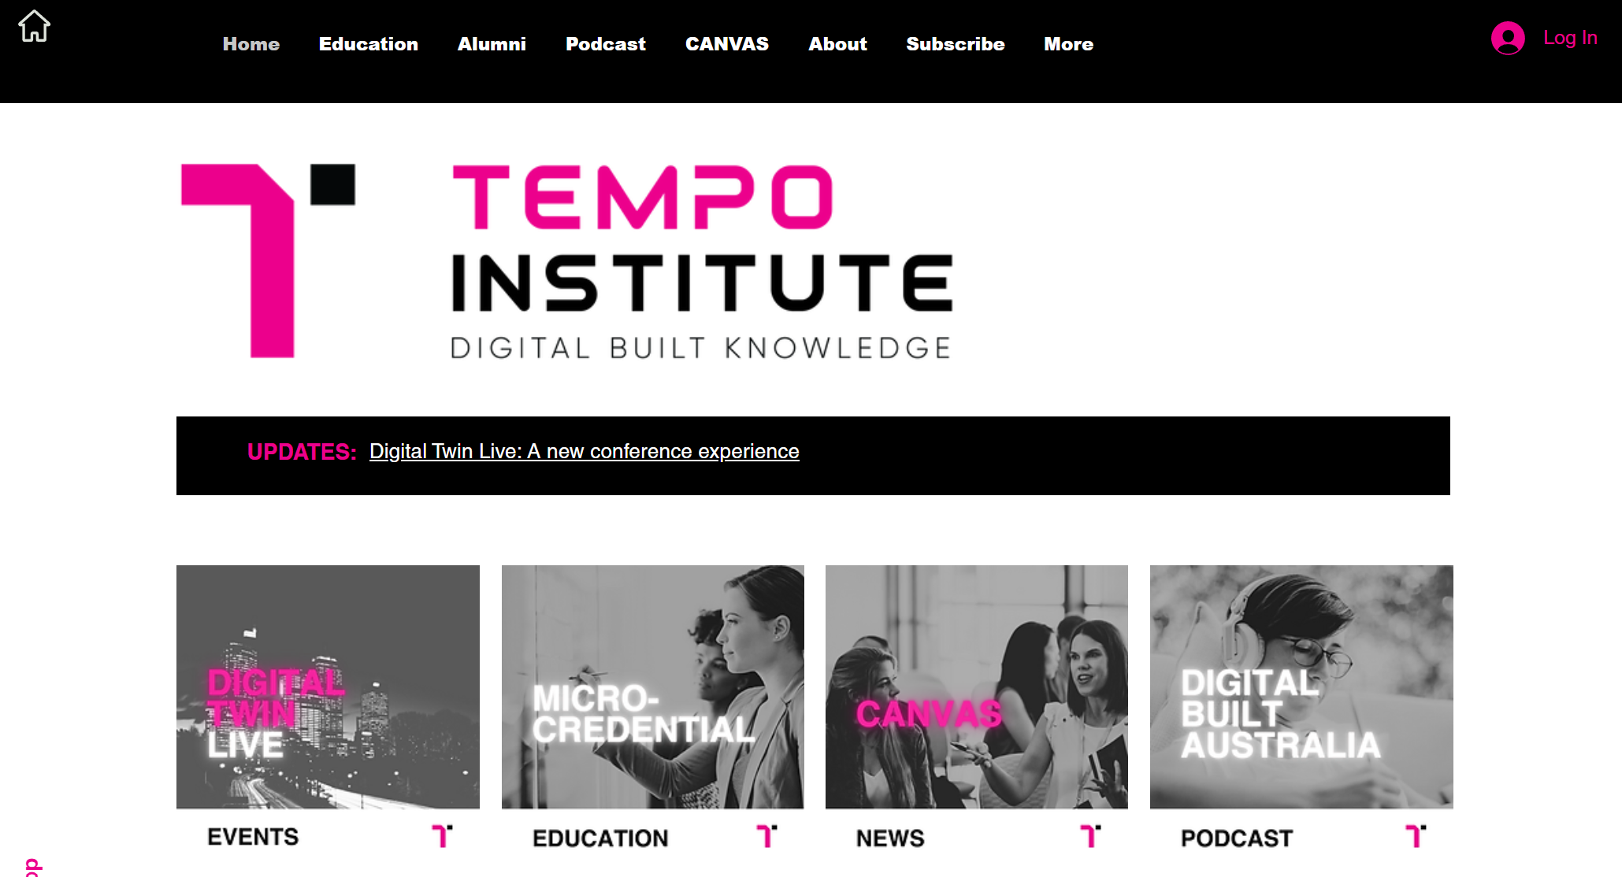
key recommendations

Slide 7

MICROCREDENTIAL
The goal of this Microcredential is to support the capability development of policy makers and practitioners in shaping high performing built and natural environments.

Slide 8
MICROCREDENTIAL - MODULES
Module 1: Fundamentals
Module 2: Developing your strategy
Module 3: Developing use case development
Module 4: Technology and Data Enablers

Slide 9
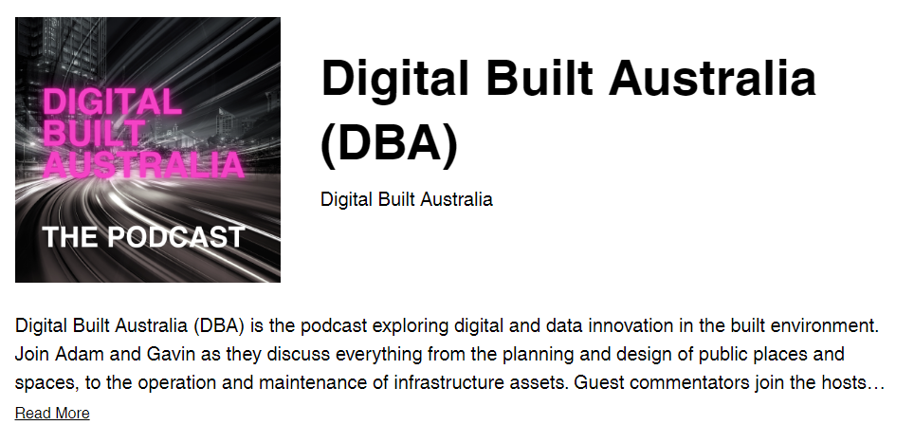

Podcasts – DIGITAL BUILT AUSTRALIA

Slide 11
Digital Twin Down Under
Gemini call – 30th January 2024
tempoinstitute.com.au

