Slide 1
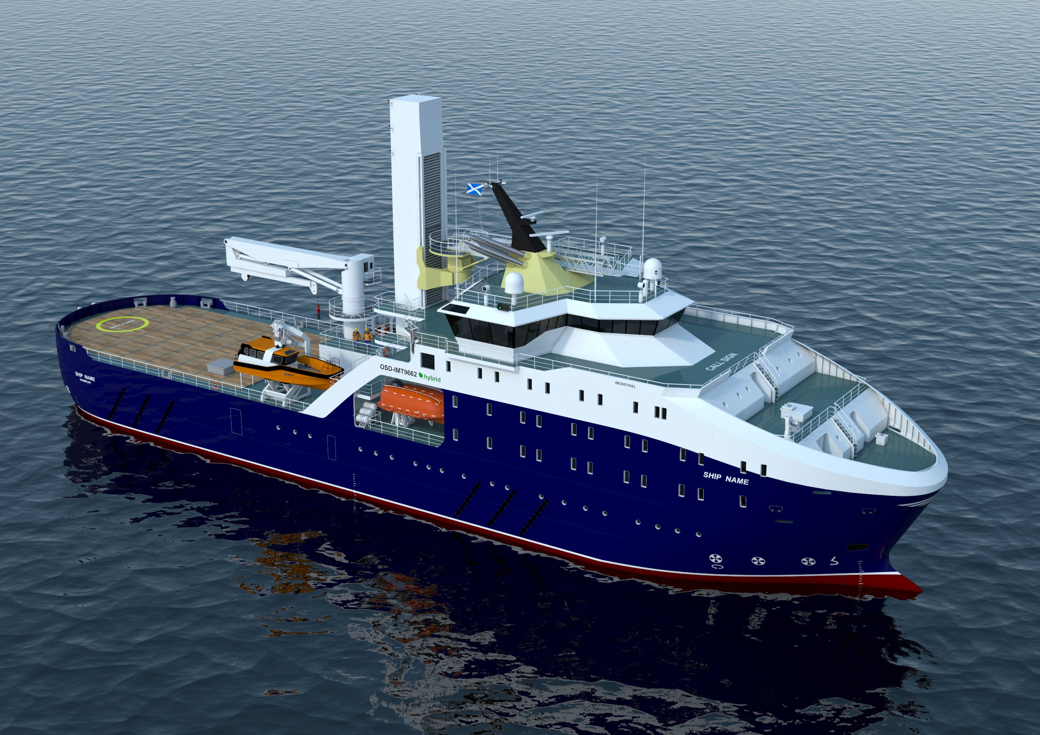
ZEVI eSOV
Bibby Marine
Tuesday, 12 December 2023

Slide 2
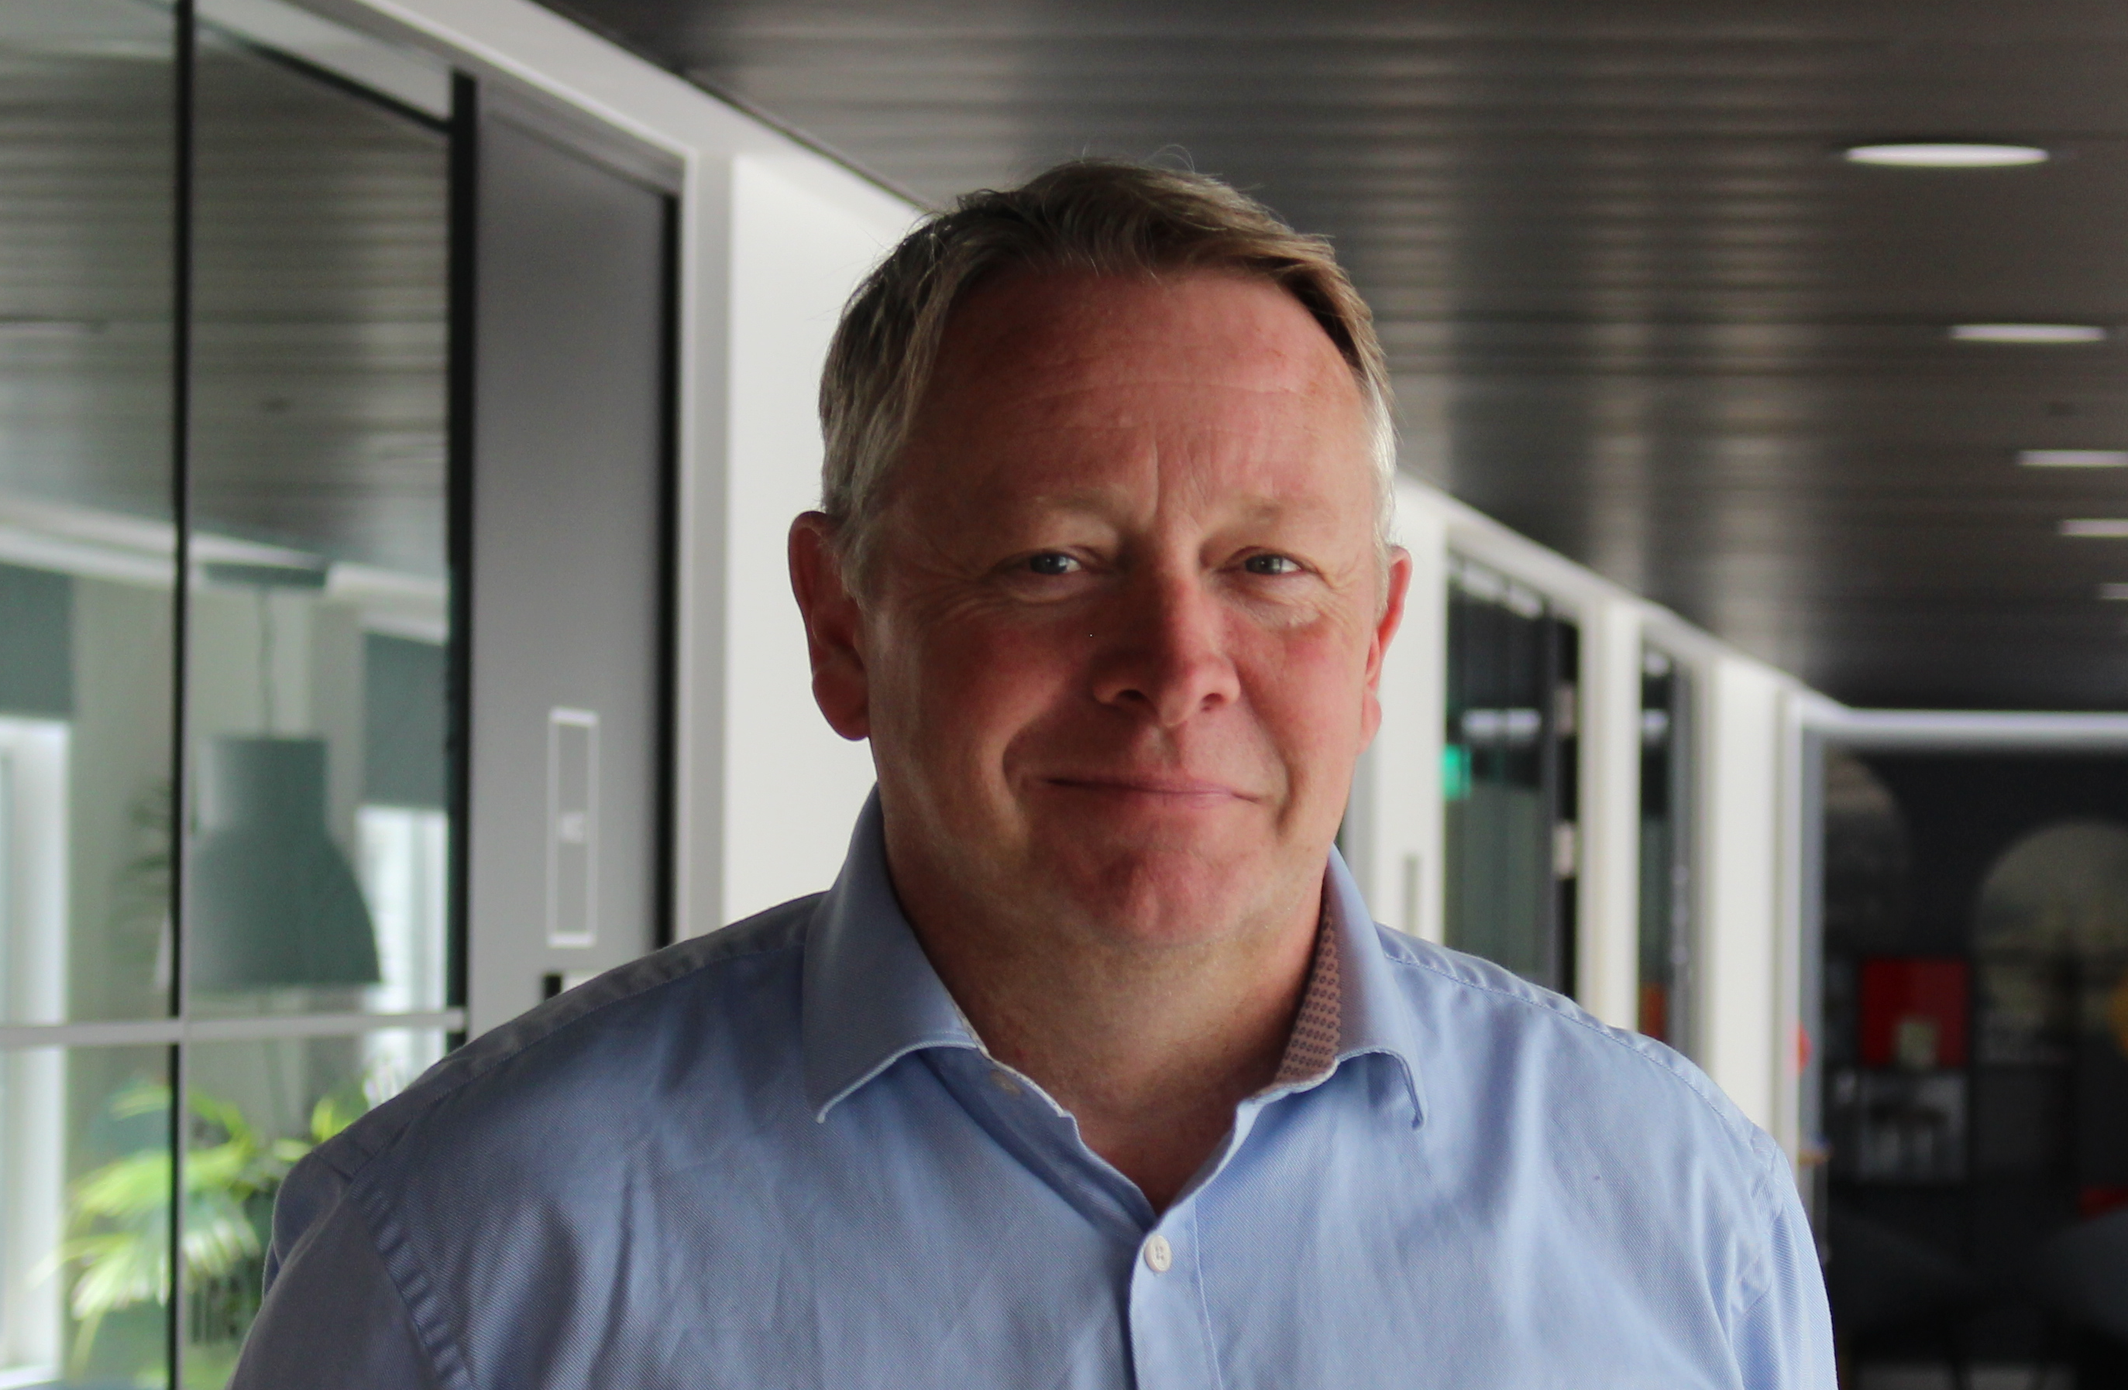
“A warm welcome” from Nigel Quinn, Bibby Marine CEO
Bibby Line Group is a 200 + year old family business with its history in shipping. We are the UK's oldest privately owned family shipping company. We are built on a set of core values: working together, trusting each other, being innovative, doing the right thing and being better.
Bibby is committed to sustainability, and looking to the future it is our ambition is to become the first Zero Carbon Vessel Operator in this sector. In collaboration with our Technical and Operations Teams our appointed Naval Architects are currently working on concept engineering designs using both existing and emerging technologies.
This activity is further underpinned by our projects with Maritime Research and Innovation UK (MarRI UK) and InnovateUK and our recent Zero Emission Vessel Infrastructure (ZEVI) bid win to build the world’s first electric SOV.

Slide 3
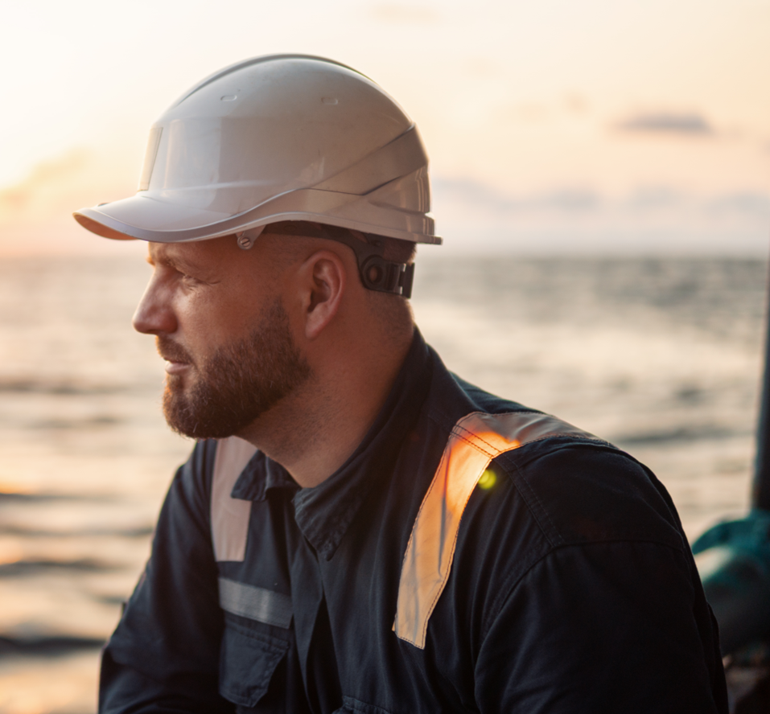
Building Tomorrow’s Green Future Today
Our vision
To be the UK’s clean and most committed SOV operator – to operate a zero-emission SOV before 2030
To be a positive influence in the energy transition and to drive innovation
Our commitment to innovation and sustainability drives us towards zero-emission solutions, which only helps us, but also our clients, in reaching their long-term sustainability goals – support Vattenfall’s goal of fossil freedom
Underpinning our compass environmental pledges to reduce our emissions in line with climate science with the SBTi framework

Slide 4
Our Roadmap to Green – long-term thinking
WaveMaster Zero C – commenced in 2020​
​Led by Bibby Marine in collaboration with a project team of marine industry leaders​
​Supported through funding by MarRi-UK​
Project aimed to determine which alt-fuel is best suited to the next generation of SOV’s and similar sized vessels​
​
SOV Offshore Charging System – launched in May 2022​
Funded via the Clean Maritime Demonstration Commission 2, Department for Transport in partnership with Innovate UK​
Funding will allow us, alongside our partners to continue our research into the use of electrical batteries to power vessels, and how they are charged both on and offshore​
ZEVI eSOV – launched in February 2023, awarded in Sept 2023
Funded through the Department for Transport, awards funding to projects for the design and development of clean maritime solution. Led by Bibby Marine, this project has been successful in accessing funding for their latest project. The project was announced as winners as part of London International Shipping Week in Sept 23

Slide 5
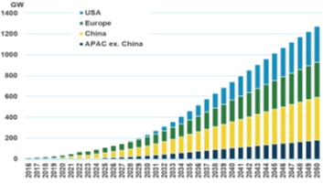
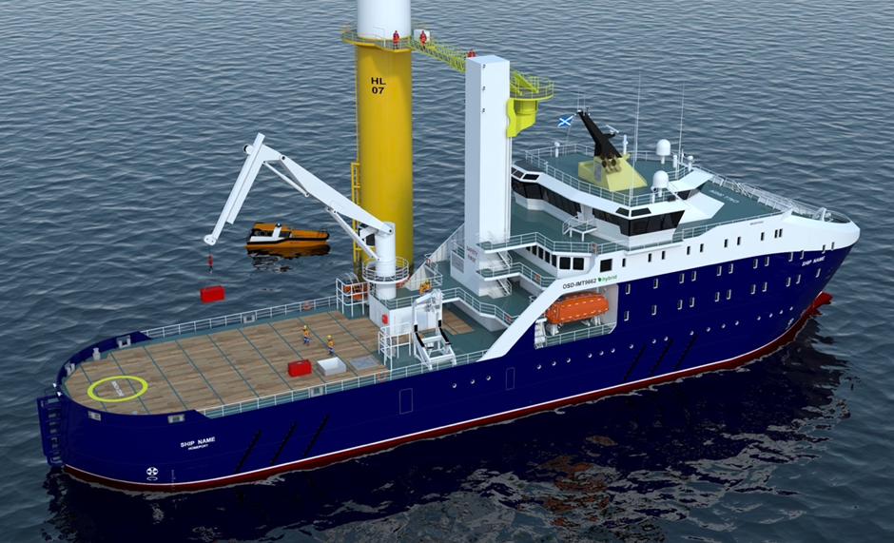
The Challenge of Net Zero
Electrification of the maritime industry potential to be a game changer
Forecasts suggest at least 600 SOVs needed for O&M support to this market by 2050, and 200+ by 2030
Installed global offshore wind capacity expected to exceed 200 GW by 2030 and 1,200 GW by 2050.
Each fossil-fuelled SOV emits more than 7,000 tonnes of CO2 each year. Potential for 100% battery operation equating to true net zero operation
This project has the potential to save more than £1 million a year in fuel costs for our clients
By delivering a sustainable and cost-effective solution, we can help our clients meet their climate change commitments while at the same time realising their commercial objectives
Notes:
Electrification of the maritime industry is only in its infancy, yet has the potential to be a global game-changer, and Bibby Marine is proud to play its part in driving the industry towards decarbonisation.
Each fossil-fuelled SOV emits more than 7,000 tonnes of CO2 each year - the equivalent carbon saving of 1.5 years of one wind turbine - equating to 175,000 tonnes over the 25-year design life of the vessel. Based on a carbon offset cost of $100/tonne, this would represent a substantial financial burden of over $0.7m annually, or $17.5M over the vessel's lifetime.
Our design principles present an opportunity to operate the vessel using battery power 100% of the time, which, with clean offshore charging would equate to true net zero operations. In the early stages, while offshore charging infrastructure develops, our technology will still facilitate a significant 50% reduction in MGO fuel consumption and associated emissions.
This project has the potential to save more than £1 million a year in fuel costs for our clients, even with only a 50% reduction in fuel consumption. Once operating on 100% battery power, the savings could reach up to £2 million per year.
By delivering a sustainable and cost-effective solution, we can help our customers meet their climate change commitments while at the same time realising their commercial objectives

Slide 6

The clean Solution
At Bibby Marine, we are taking the opportunity to lead from the front by developing our own electric eSOV with methanol range extender, dual fuel hybrid, the first of its kind in the world.
The vessel will offer customers a safe, sustainable and cost-effective solution
Initial design is OST-IMT 9662 (Longitude)
Minimum 96 beds required
25 Marine crew – (4 officer suites, 14 singles, 4 doubles )
70 Client staff – (60 singles 5 doubles)
Methanol/MGO Dual-Fuel Hybrid.
3D Crane 5 Tonnes (e.g. SMST KBC L)
30m W2W Integrated Gangway (Port & Stbd access)
Min 350m² deck space
Options on side loading cargo doors and helideck
Daughter Craft 1.5Hs
4 x battery packs of 5MWh (20MWh total with two operational modes: Offshore charging available/offshore charging not available

Slide 7

How can DT Community help?
We know the future of the marine industry depends on innovation, but do we have the expertise to follow through?
There are gaps in how Commercial Shipbuilders use DT in pre & post build vessel design
How can we access / transfer technology that is already readily available in other industries (automotive / aerospace) to marine industry?
We want our vessel to be more efficient and more sustainable - to provide real-time data, to exceed traditional methods. We believe through the use of digital twinning and AI; we can have a clearer picture of a ship's impact – both on its operations and the world in which we live.
Notes:
By harnessing the power of the latest innovation and digital technologies, companies in the maritime industry can…​
​
Increase the value chain​
Meet the requirements of clients​
Meet environmental targets. ​
​
The potential benefits of innovation and digitisation include…​
​
Cheaper operations​
Faster operations​
Safer Operations ​
Increased flexibility​
Real-time visibility on operations​
Better customer /user experience ​
Becoming and remaining competitive v rest of the world ​
By harnessing the power of the latest innovation and digital technologies, companies in the maritime industry can…​
​
Increase the value chain​
Meet the requirements of clients​
Meet environmental targets. ​
​
The potential benefits of innovation and digitisation include…​
​
Cheaper operations​
Faster operations​
Safer Operations ​
Increased flexibility​
Real-time visibility on operations​
Better customer /user experience ​
Becoming and remaining competitive v rest of the world ​

Slide 8
Questions / Ideas

