Slide 1
Semantic Partners
Dan Collier, Partner and Founder
13th June 2023
dan.collier@semanticpartners.com

Slide 2


Company Profile
Founded, 2021, staff in 7 countries,speak 10 languages
Semantic Graph/Ontology training for entry level and experienced
Neutral Vendor Systems Integrator, exclusive focus on RDF based KG’s and promotion of FAIR data principles
Expert distributed team of KG specialists, engineers and ontologists, combined experience of 100+ years hands on KG/engineering implementation.
Team currently engaged with Alex Luck’s group at BEIS working on IES4

Slide 3
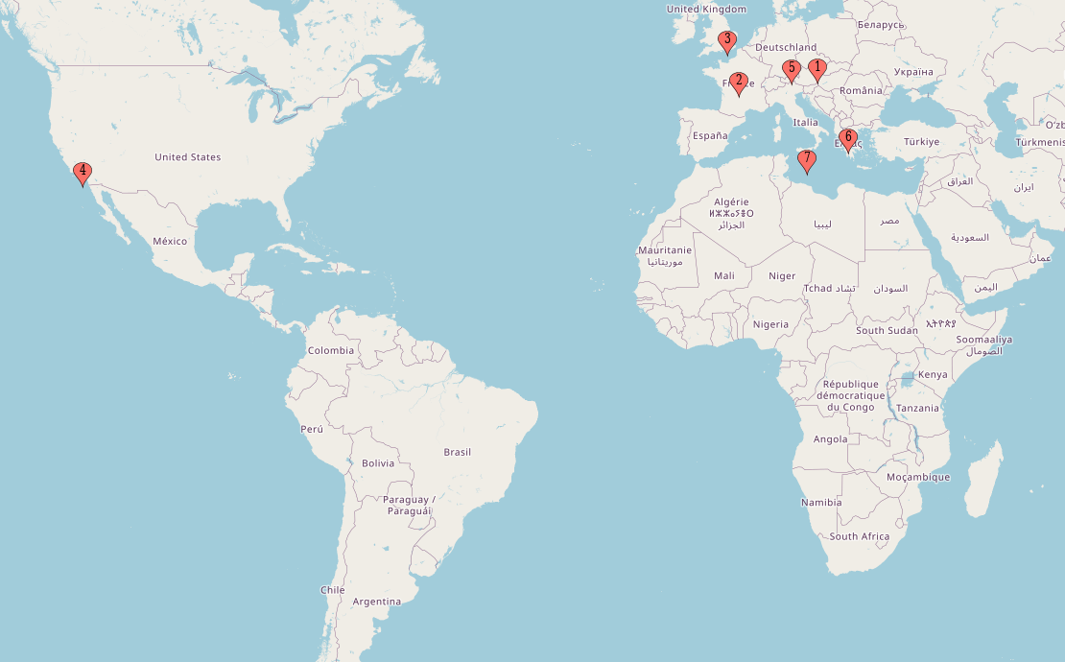
Global team - 7 countries - 10 languages

Slide 4
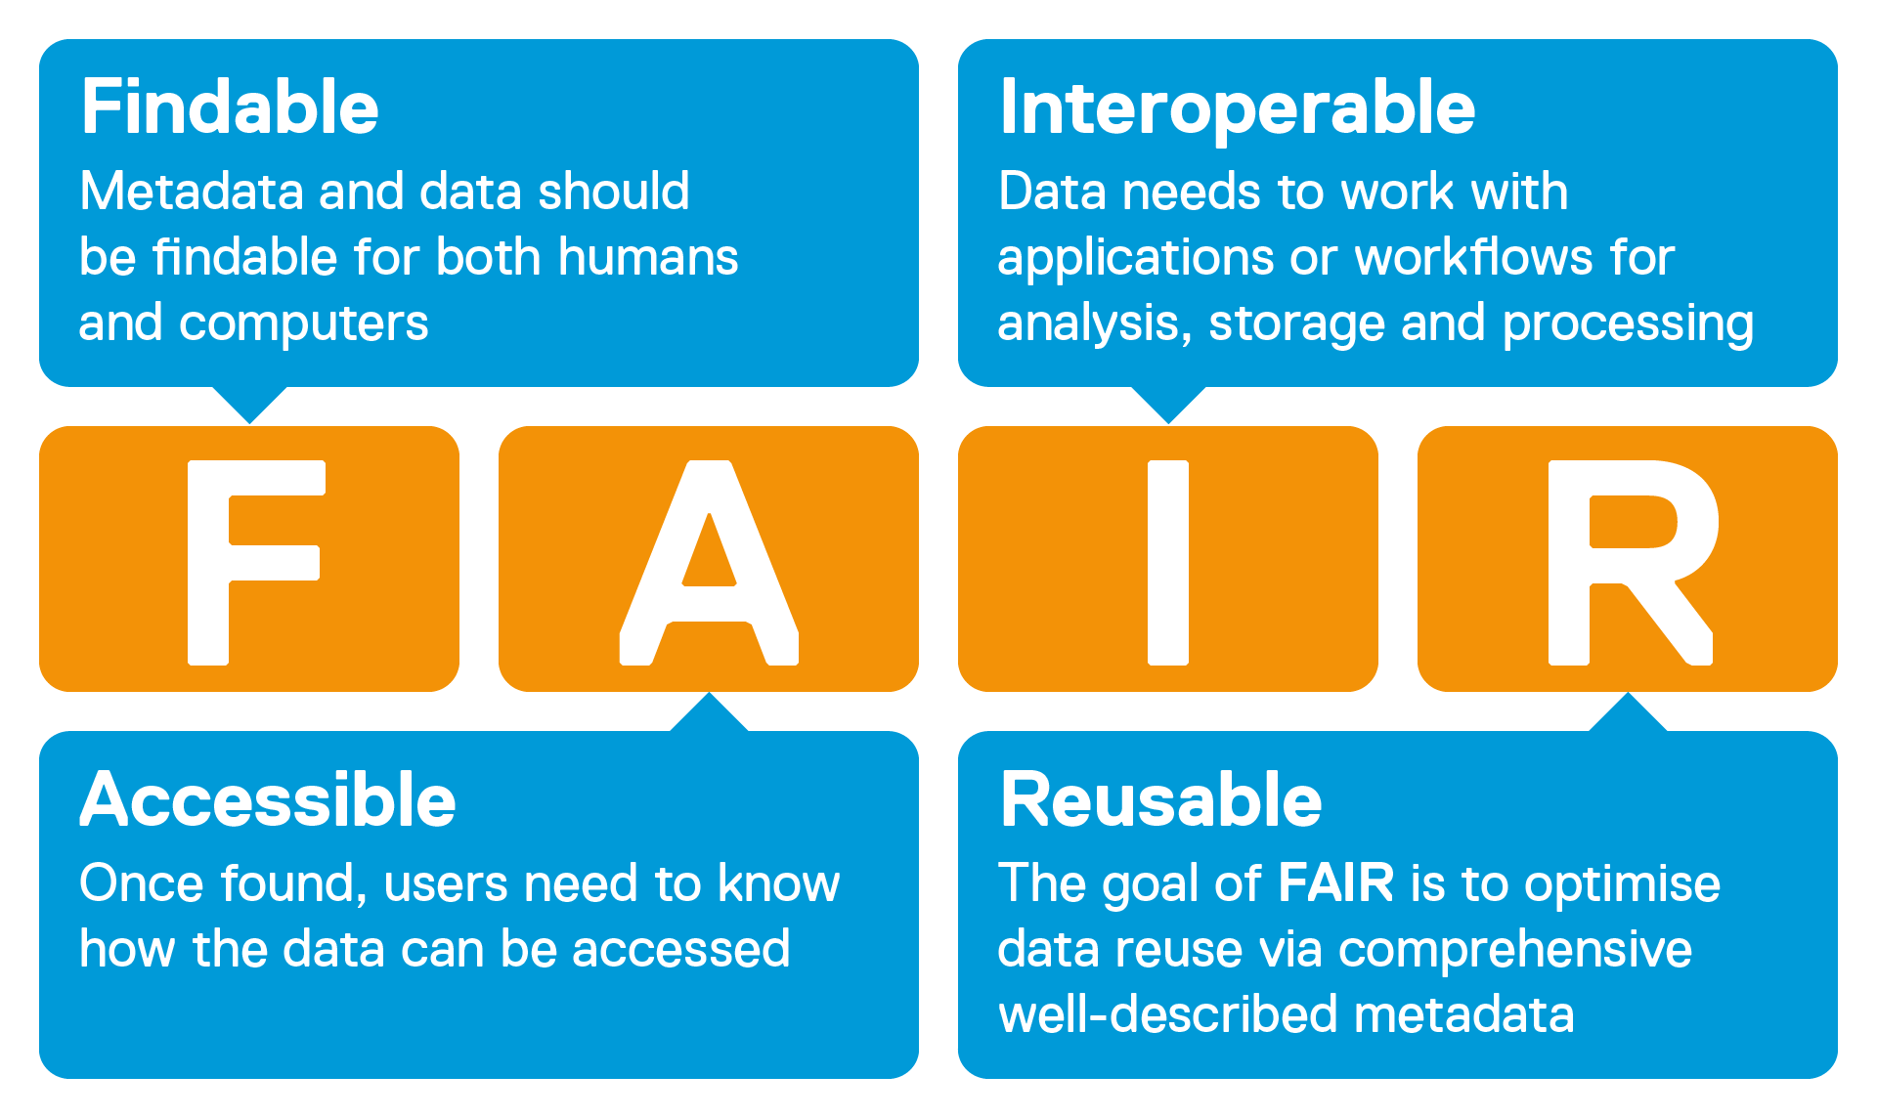
Definitions
Digital Twin – Our impressions of what this is.
FAIR Data - Findable, Accessible, Interoperable, Reusable.
Knowledge Graphs and Semantic Data

Slide 5



Observations from the Cyber Physical Forum
Data Sharing Infrastructure, something trusted and secure – Needed everywhere
Being able to show early benefit is key – identify Value early on if possible
Projects need to be set up for Scale – Isle of Wight, good example

Slide 6

Data is Facts - From Tables to Sentences
The data is stored in a format that both humans and machines can understand.
We move from rigid rows and columns in proprietary-format tables to sentence-like flexible nodes and edges in a KG.
Ability to be flexible - KGs can grow, extend and evolve easily - therefore can represent anything within a short time without having the need to tediously change table schema, and all the RDBMS hullabaloo.

Slide 7
The Case For Semantics
The earlier methods share the problem of lacking a precise meaning system. It is important that the meaning system is both human and computer oriented.
Clear and Precise | Semantic modeling can make the process of data collection and reporting more efficient. Being both human and computer readable, it reduces the need for manual data transformation and validation.
Interoperability | Semantic models facilitates data interoperability, making it easier to share and exchange data between different systems, organizations, and jurisdictions.
Flexibility | Semantic models are inherently flexible and can be easily extended or modified to accommodate new data requirements.
Standardization | Semantic modeling provides a standardized way to define and report data. Being machine and human readable,it simplifies the process of data collection and analysis, as data from different sources can be easily combined and compared.

Slide 8
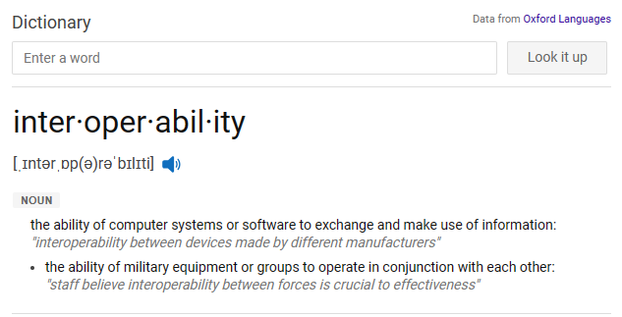
Interoperability
It’s not all about data, but it’s how systems interact with each other’s data.
Semantics - not just meaning, but a way how different systems understand each other talking a common language, removing complex barriers for seamless interoperability.

Slide 9

Data application to model Manufacturing plants
Business Goal: Desire is to model a manufacturing plant so remote working employees can monitor and view what is happening at the plant, without the need to physically visit the location.
How?
Ingestion of data sources, link this, write queries to use the data in the application
Continuing query development to allow for change tracking and search
Git integration, journal backup/restore, automatic mocks
Challenges: Internal wrangling over solution choices
See Bosch CEO talking about how important Semantics are to them here Start your product centric digital transformation with digital twins and Bosch Semantic Stack - YouTube

