Slide 1
The Potential of an Enterprise Digital Twin for Rail
5th December 2023

Slide 2









The HS1 Challenge
Cyclical
Scheduled
Timed
Slow
Risk-Averse
Operational
Cost
Maintenance and Renewal
Decision-Making
Impact

Slide 3


The HS1 Challenge
Cyclical
Scheduled
Timed
Slow
Risk-Averse
Operational
Cost
Maintenance and Renewal
Decision-Making
Impact
Available resources and their locations
Availability of inventory, parts and spares
The availability of plant and equipment
An ageing workforce
Rail Industry Skills Gap
DATA
DATA
DATA
DATA
DATA
Use of data
Planning
Factors

Slide 4
The HS1 Challenge
Cyclical
Scheduled
Timed
Slow
Risk-Averse
Operational
Cost
Maintenance and Renewal
Decision-Making
Impact
Available resources and their locations
Availability of inventory, parts and spares
The availability of plant and equipment
An ageing workforce
Rail Industry Skills Gap
DATA
DATA
DATA
DATA
DATA
Use of data
Planning
Factors
RADICAL CHANGE NEEDED!

Slide 5




How to Tackle this Challenge?
Highly Regulated
High emphasis on safety
High Maintenance Burden
High Equipment Availability Requirements
Data Complexity
Access for Maintenance Challenges
Conflicting inputs
Resource and Skills Constraints
Bottlenecks
THE SOLUTION
Deliver a technology-based solution that helps to push forward the HS1 Digital Vision

Slide 6



Enterprise Digital Twin
Target Service Levels
Target Revenue / Budgets
Strategic Objectives
Customers
Operating Model
Assets
Equipment
Resources
Maintenance Policy
Infrastructure
Spares
Supply Chain
Design
Management
Optimisation
6

Slide 7
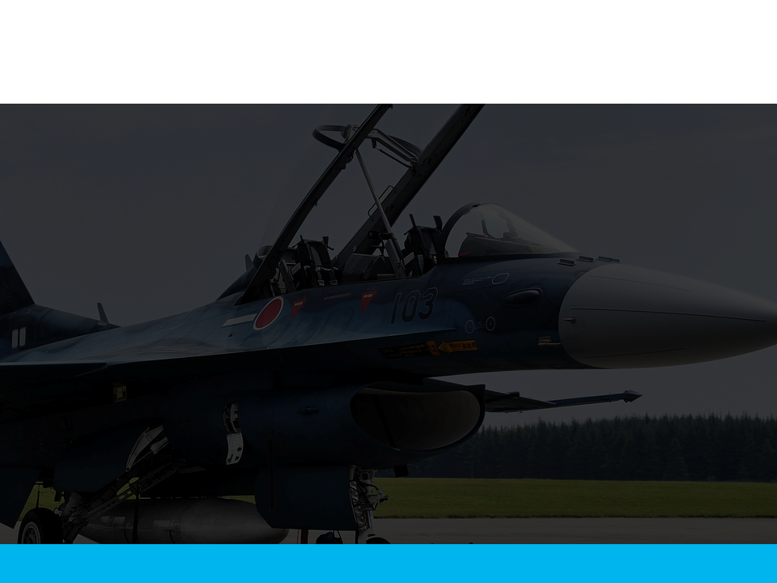
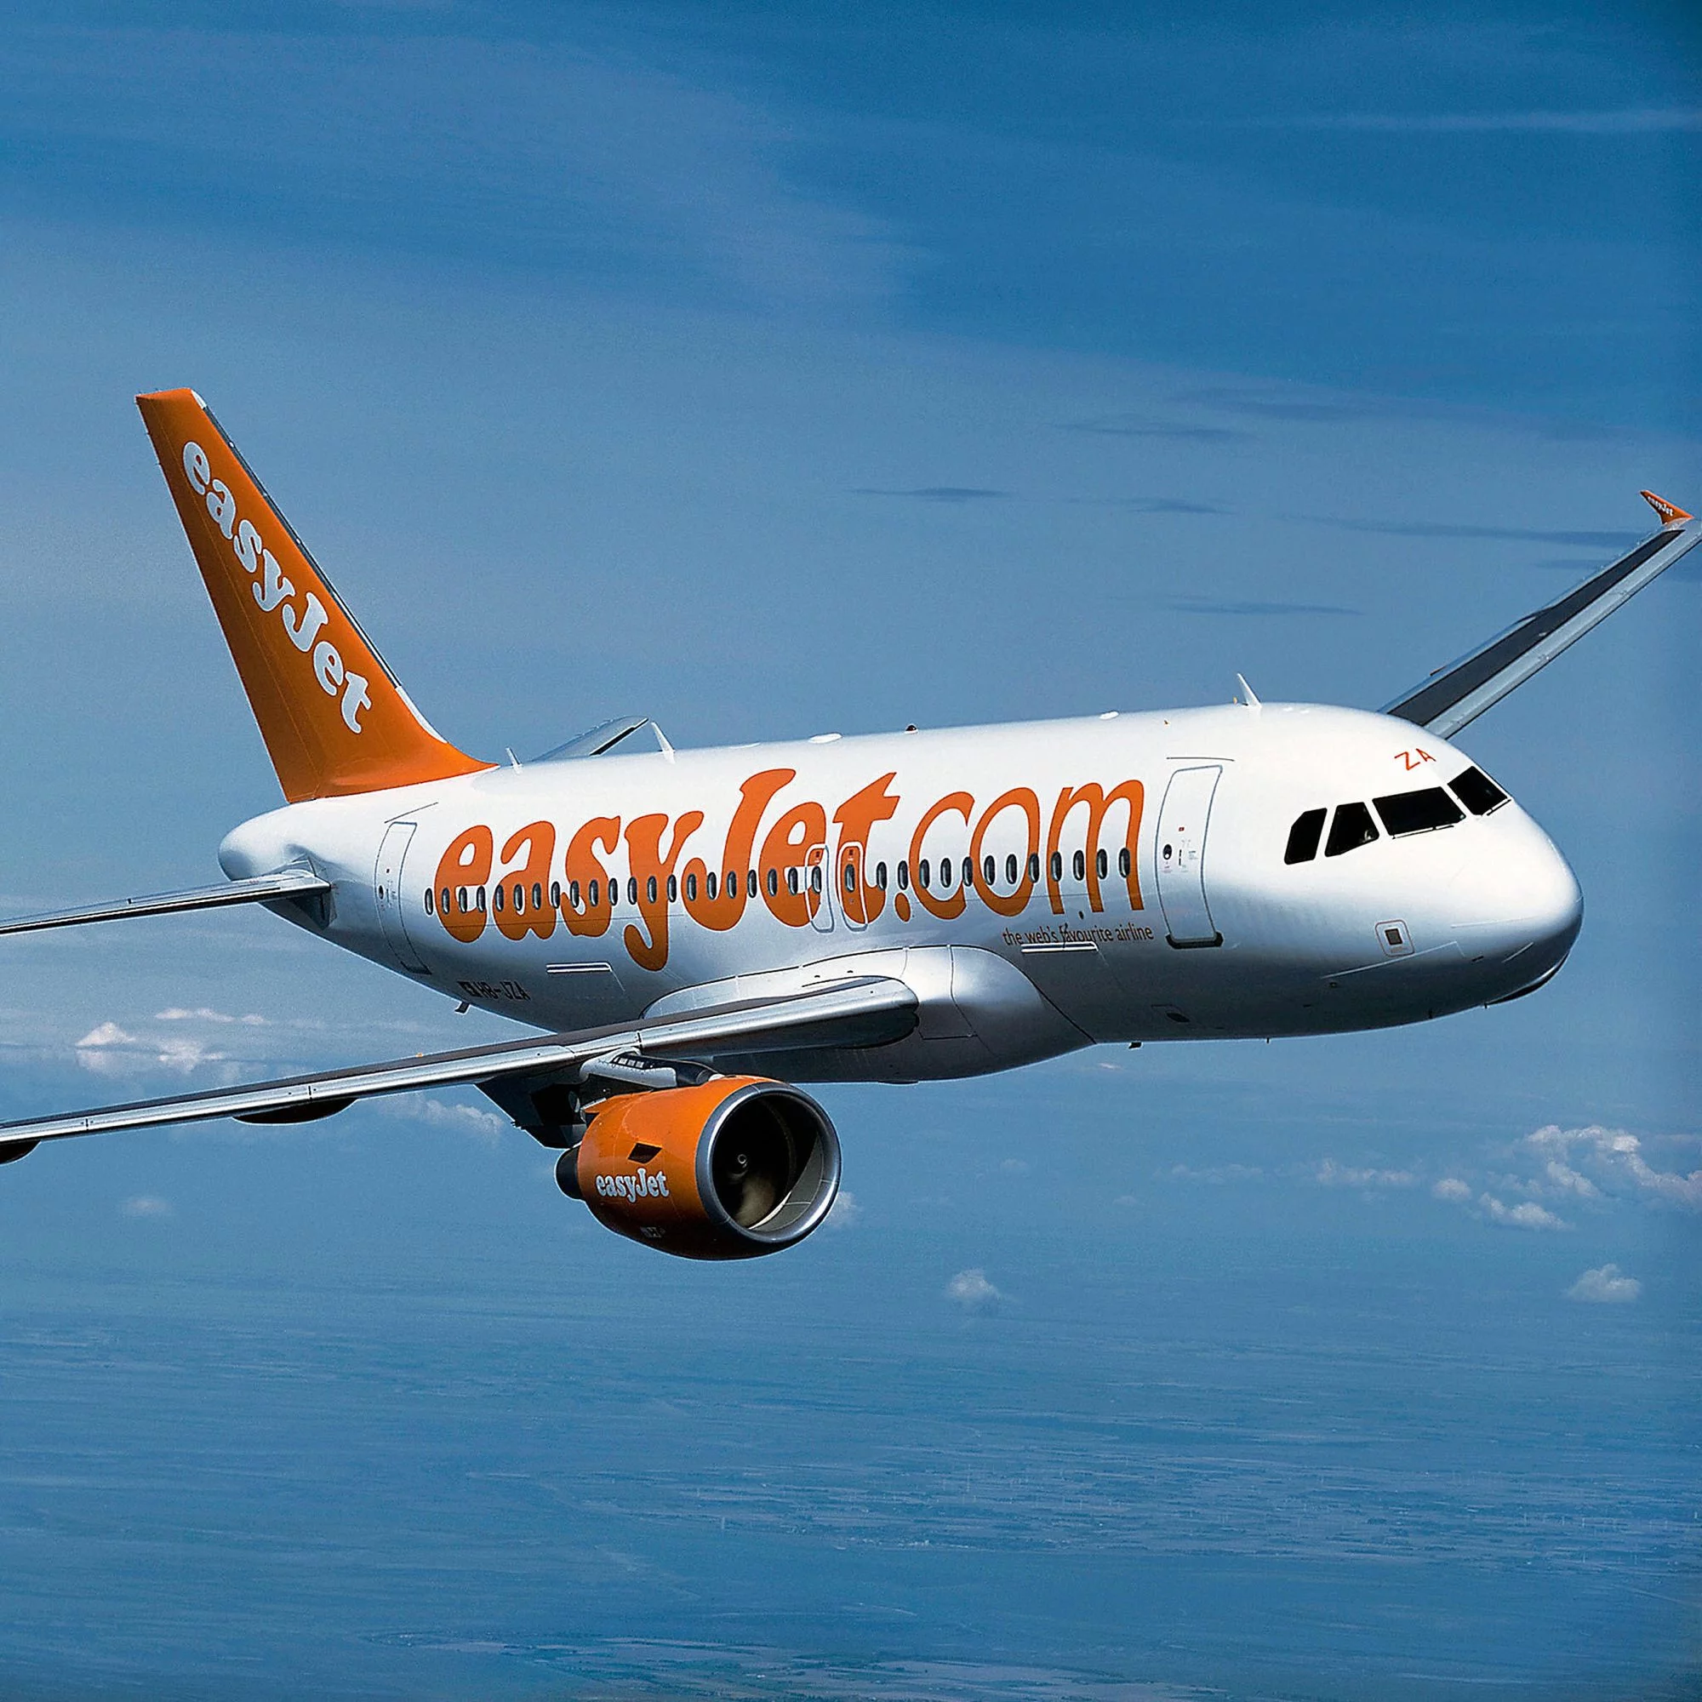
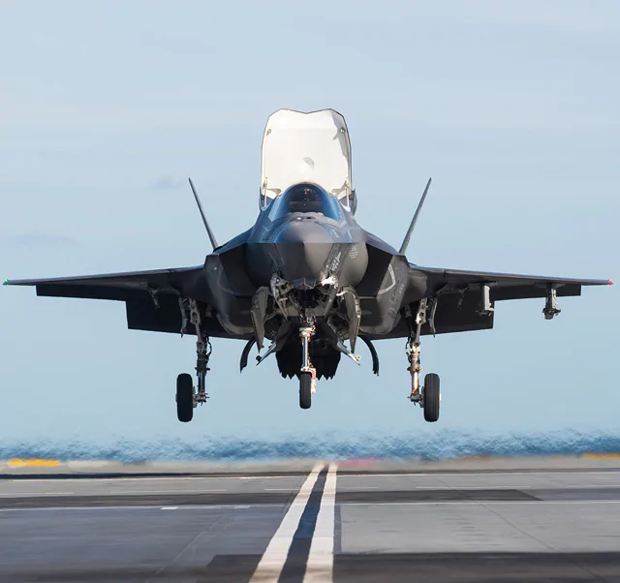




The What, How and Why of Aerogility
Working in partnership with leading aerospace & defence customers
Providing safe & trusted insights for forecasting, planning & decision-making
By deploying Enterprise Digital Twins founded on innovative and proven model-based AI technology
Delivering optimised asset[1] performance, operational efficiency, & strategic objectives
[1] Platform, Fleet, Systems, Facilities, Tooling etc

Slide 8
Forecasting, Planning & Decision Making across the Asset Lifecycle
OPERATE
REALISING BEST POSSIBLE BUSINESS OR MISSION OUTCOMES FROM THE ASSETS
PLAN
REFINING AND VALIDATING STRATEGIES AND BUSINESS CASES
ACQUIRE
PROCURING / SUPPLYING THE RIGHT ASSETS MEET BUSINESS / OPERATION NEED WITH OPTIMUM RISK - REWARD
DISPOSE
ENSURING ASSETS ARE RETIRED FROM SERVICE TO BEST MEET OPERATIONAL, FINANCIAL AND ENVIRONMENTAL DEMANDS
SUSTAIN
MAINTAINING & UPGRADING ASSETS TO BEST MEET CONTRACTUAL, COST, ENVIRONMENTAL, MISSION ETC TARGETS
PREDICT
OPTIMISE
PLAN
Understanding the likely outcomes of a range of operational scenarios
Finding the option that best meets the business objectives (KPI)
Automatically generating an implementation plan for the chosen option
Enhanced Decision Making

Slide 9
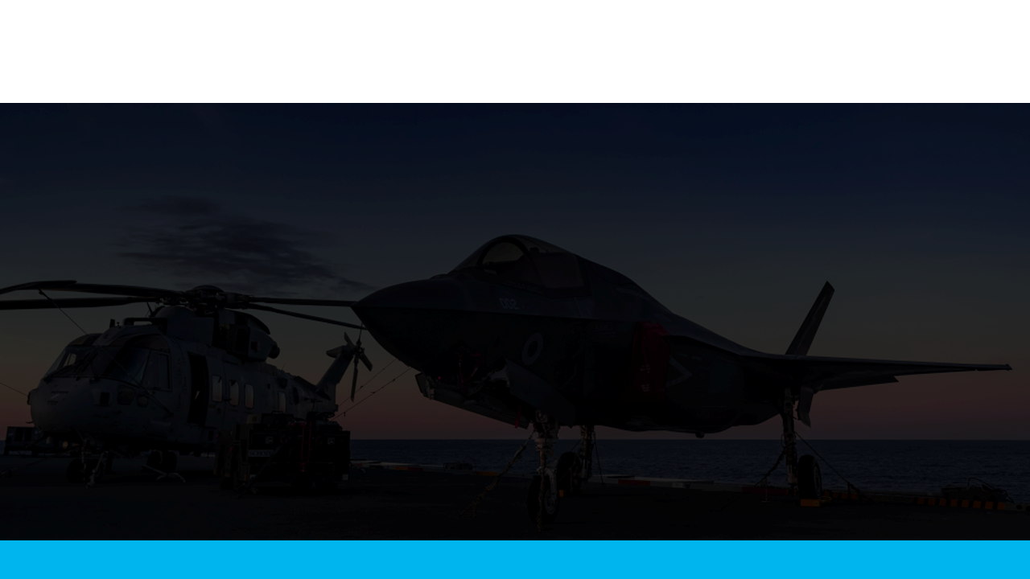
Why Aerogility?
    World leader in proven model-based AI
    Agile and responsive organisation, ranked #1 IT supplier by global organisation
    Library of Sector specific Agents, supported by sector expertise, enables rapid deployment
    One model – a “single version of the truth“supporting many use cases
    Ideally suited to resolving complex, new, or unforeseen situations
    Highly scalable – number of users, scenarios, and multiple assets
    Safe & Trusted AI - model and results are understandable, explainable, and trustworthy to business users
“Model-based AI is essential for safe and trusted decision-making and planning in the enterprise – Aerogility’s work in the global defence and aerospace sector is a leading example of software innovation for next generation AI and how large organisations can understand, evaluate, and resolve complex decision-making and plans that affect the whole of their operation.”
Professor Nick Jennings – Chief Scientific Advisor
In Strict Confidence

Slide 10
Proof of Concept Scope
Key Objectives
Take a current approach and create a Proof of Concept (POC) enterprise system model, demonstrating the value-add and improve current planning processes, resulting in improved cost and performance.
Assess the current operating model, processes, people and tools to determine what a future state would need to look like to successfully implement both the digital twin technology and the benefits identified through the modelling.
Draft Scope of Work
NR(HS) to identify a team within their operation. This team has a workbank that needs to be planned and delivered. It is recognised that the current approach is very risk averse and manual. The team planning activity is likely to include the following:
Resource Availability/Optimisation | Skills/Capabilities related to Tasks/Activities | Infrastructure | Planned Maintenance Tasks
Scheduled Maintenance Tasks | Unplanned Maintenance/Repair Tasks | Line Possession/Access Rules and Timing Windows
Spares/Materials | Equipment to enact maintenance | Master Scheduling | Cost and Performance Targets | Efficiency | Effectiveness

Slide 11
Next Steps
Proof of Concept is now starting
Initial results expected end of Q1 2024
We’ll come back and report on the outcomes

