Slide 1


Gemini Skills development update
digital twins for senior leaders' course

Slide 2
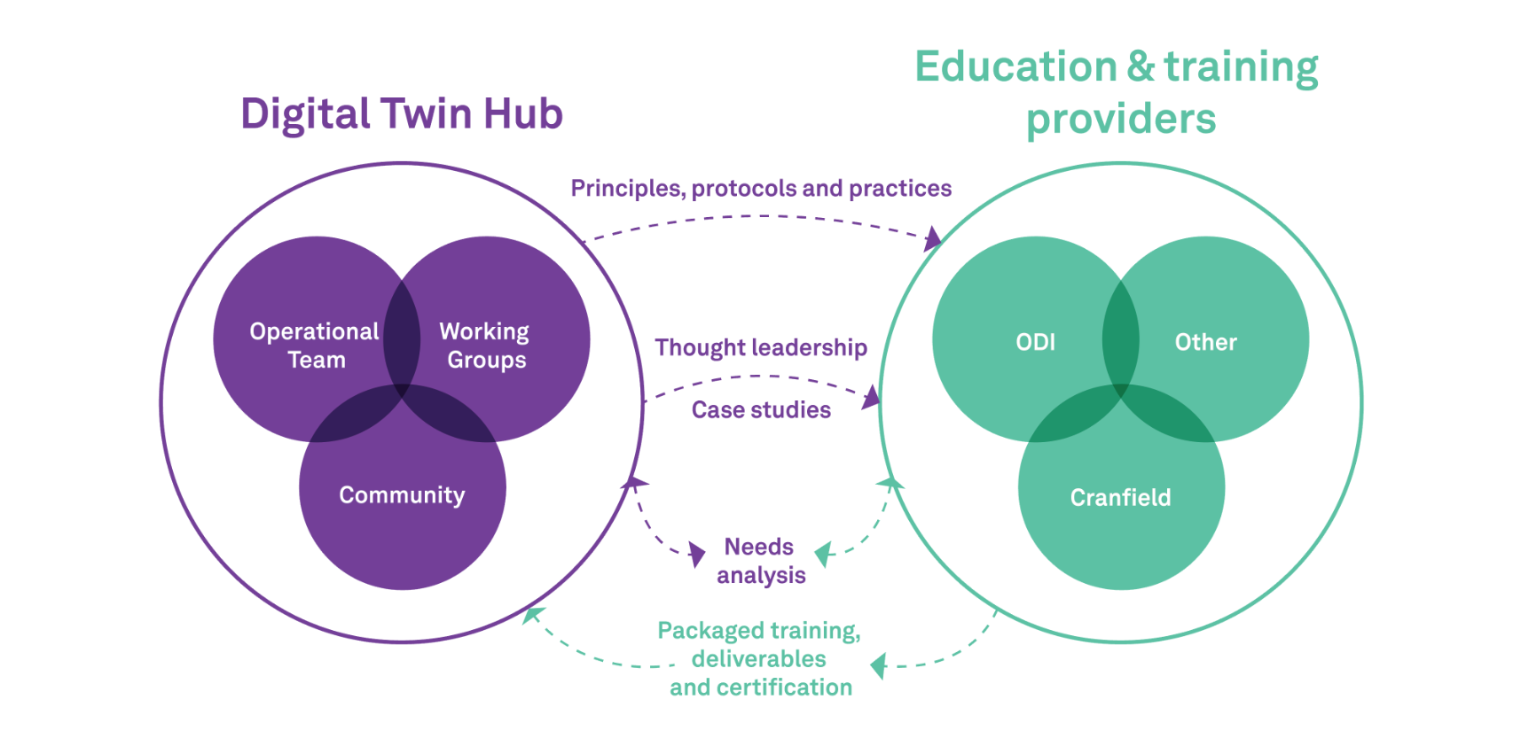
GEMINI ALLIANCE
BRIDGING THE GAP BETWEEN THE DT HUB AND EDUCATION / TRAINING PROVIDERS.

Slide 3
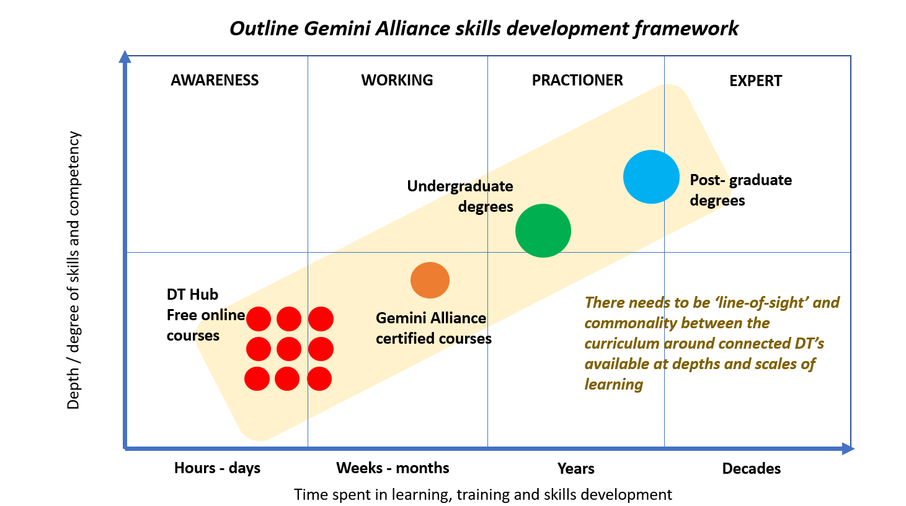
GEMINI skills programme
Gemini skills development framework.

Slide 4

Gemini skills programme
Digital twins for senior leaders’ course, led by Prof. John Erkoyuncu.

Slide 5
DIGITAL TWINS for senior leaders
baseline for competency in digital twin skills.
For leaders and future leaders in roles that will influence decision making to realise digital transformation and organisational change. The enablers and subsequent end-users of digital twin systems or the translators of digital twin technologies and capabilities, rather than those creating the digital twins.
Timetable
Week 1 - What is a digital twin and why is it significant to you?
Week 2 - What is value, and could the organisational value creation and purpose change with digital twins?
Week 3 - How do organisations enable sustainable change in the context of digital transformation?
Week 4 - What does the digital twin ecosystem look like?
Week 5 - How do we sustain human-machine interaction in a digital twin environment in tasks/divisions/enterprises.
Week 6 - How do organisations position data as a core value creating asset through digital twins?
Week 7 - What new decisions and analytics can organisations make through a digital twin?
Week 8 - What is my organisational strategy with a continuous digital twin over time?

Slide 6
Register interest
digitaltwinhub.co.uk/gemini-leadership-training/

