Slide 1
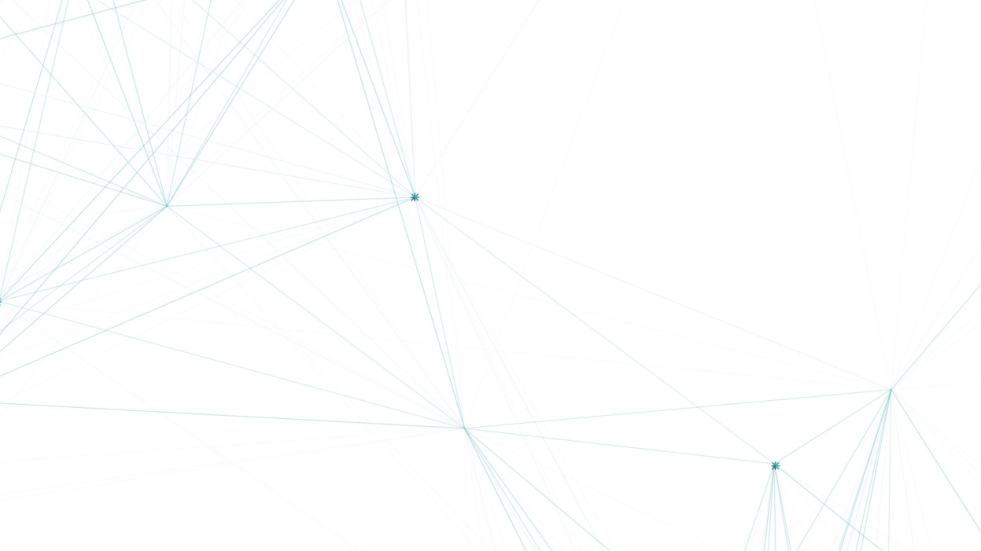


Digital Twin Hub
Gemini Call
“Creating a data collaboration ecosystem in offshore energy to unlock the full potential for digital twins– a lesson learned”

Slide 2














Digital Twin Hub
OEDA - Consortium

Slide 3
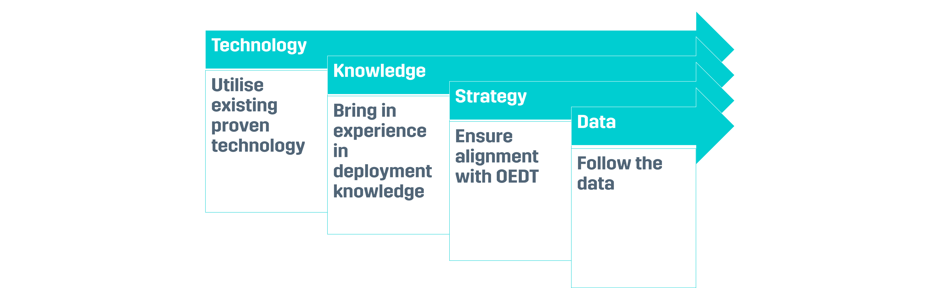


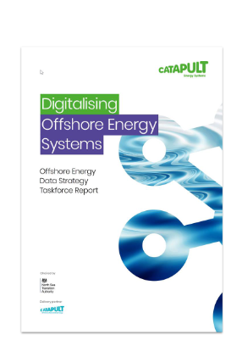

Digital Twin Hub
OEDA - Overview
Project Approach
Work Scopes
Data Landscape Report
A report to establish the technical requirements for OEDA.
1.
Technical Feasibility Report
A report to demonstrate that the requirements to deliver OEDA are technically feasible.
2.
Architecture & Ontology Design Report
A report to summarise how the pilot can be adapted to meet the technical requirements.
3.
Business Model Report
A report to highlight what the OEDA service could look like with various options and comparisons in other sectors.
4.
Independent Review Report
A review by the Energy Systems Catapult to assess how OEDA meets the requirements of the OEDS report.
5.
MVP Pilot
A live demonstration of a pilot MVP using the Foundry platform.
6.
Benefits Report
A report to summarise the lessons learned.
7.
Approach & Work Scopes – Overall project approach with the key work scopes.

Slide 4
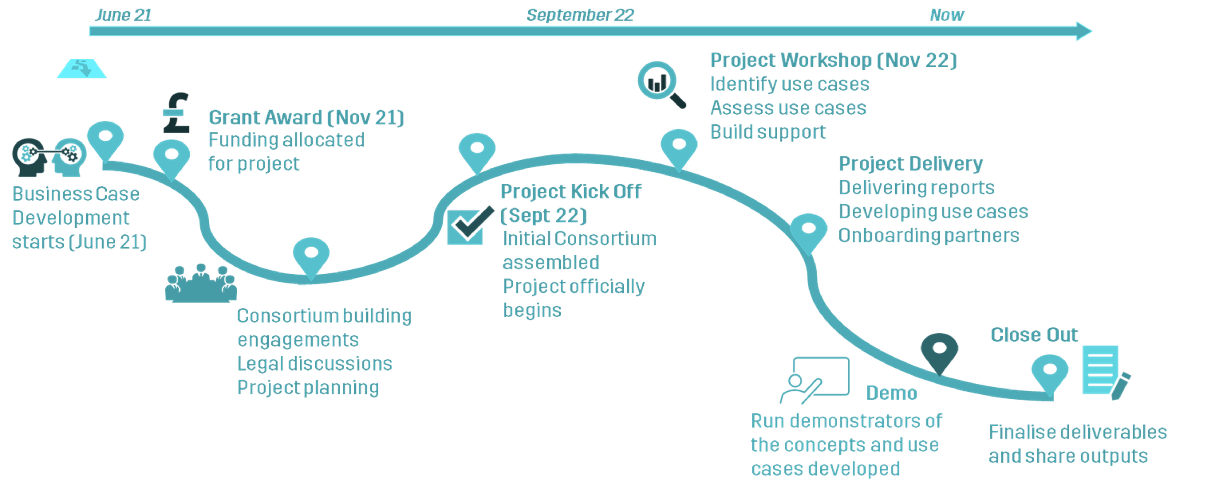
Digital Twin Hub
OEDA - Journey
Journey– Overall timeline for the project development.

Slide 5
Digital Twin Hub
OEDA - Lessons Learned
Cross the divide
Common Challenges
Critical Challenge
Buy In
Winning hearts and minds to join the endeavour.
Participation/ Engagement
Having the right level of participation for a collaboration
1.
7.
Technology
Deciding on which technology to implement and deciding on the make or buy approach.
2.
Use Cases
Identifying appropriate use cases that are impactful and feasible
3.
Data
Discovering data and where its located
4.
Legal
Navigating through legal discussions to obtain sponsorship/participation and data.
5.
Project Timeline
Deliver according to the agreed schedule with the funding that is available.
6.
Lessons Learned – Common challenges that could be overcome in the project setting and the critical challenge when attempting to develop a data collaboration ecosystem.

Slide 6
Digital Twin Hub
OEDA - Going Forward
1. Innovation Funding Only Model
2. Co funded by industry
Award
Project
Lessons
Award
Project
Lessons
Industry Funding + Resources
1. Repeat the process taking the same approach with innovation funding alone. Likely encounter same issues regarding participation.
2. To develop the concept further, industry funding is needed to ensure the right level of participation and not encounter the same challenge.

Slide 7

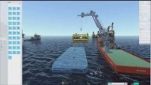
Digital Twin Hub
Enabling other projects– D4NZ
Smart energy basin
FieldTwin – FutureOn
Digital Twin
  Open API
  Design multiple assets
  Visualise assets
  Export reports to other tools
Simulator – National Decommissioning Centre
Digital Twin
  Real world physics applied
  Test multiple scenarios
Source: FutureOn Website.
https://www.futureon.com/fieldtwin/
Source: National Decommissioning Centre
https://www.futureon.com/fieldtwin/
Notes:
Example visualisations using FutureOn FieldTwin and National Decom Centre Simulator

Slide 8


Get involved.

