Slide 1
Developing decision-support use cases of CReDo
A presentation prepared for the Gemini Call
10 October 2023

Slide 2
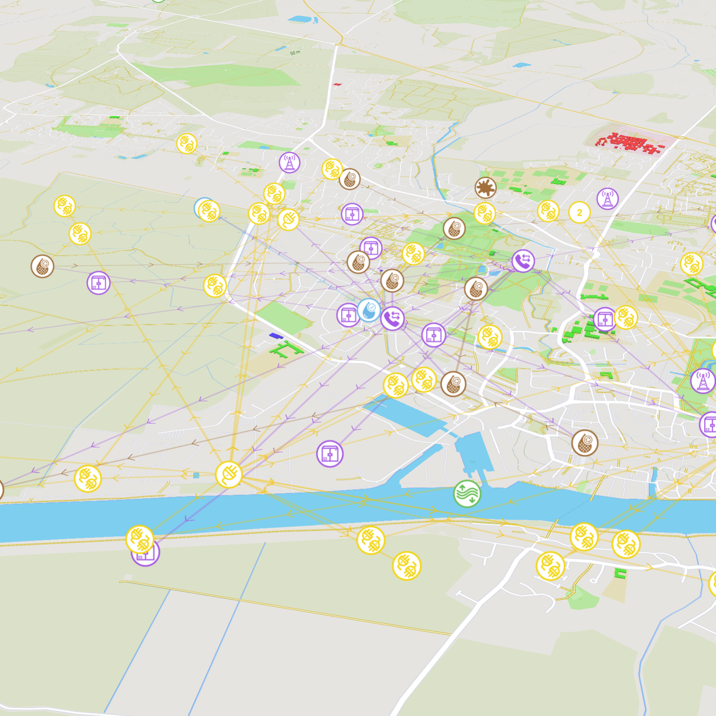
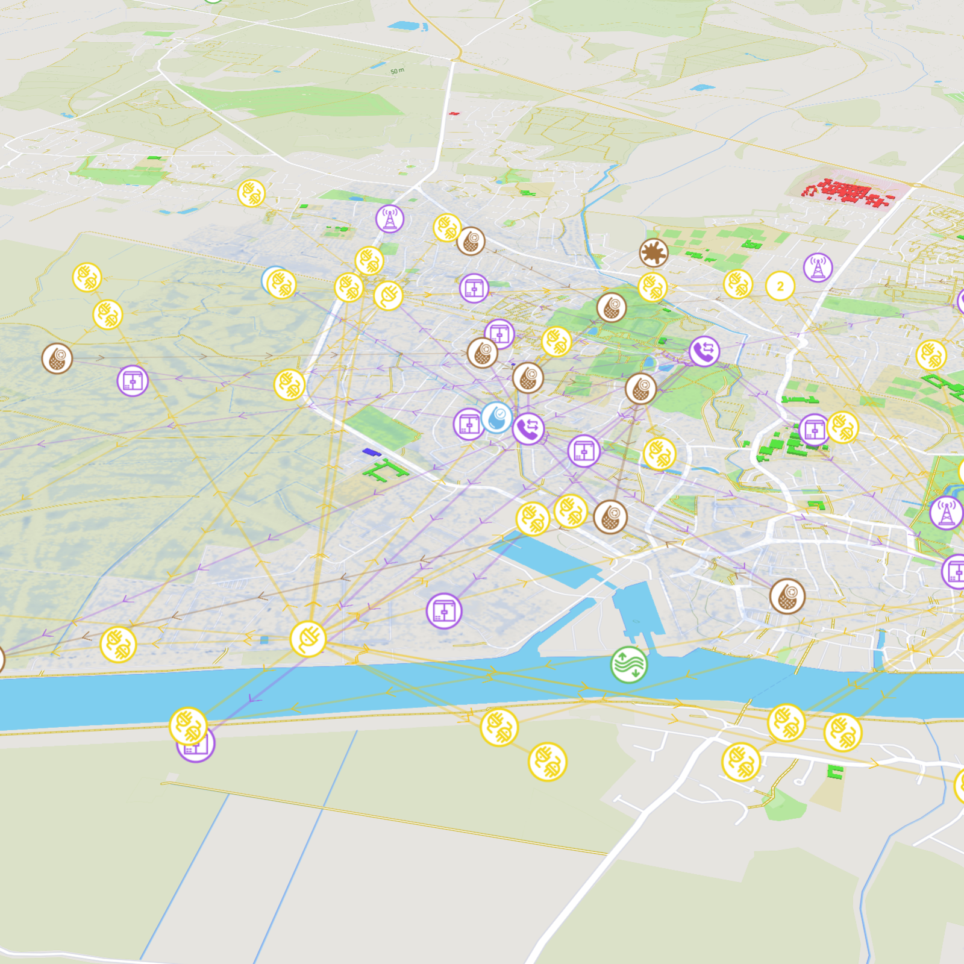
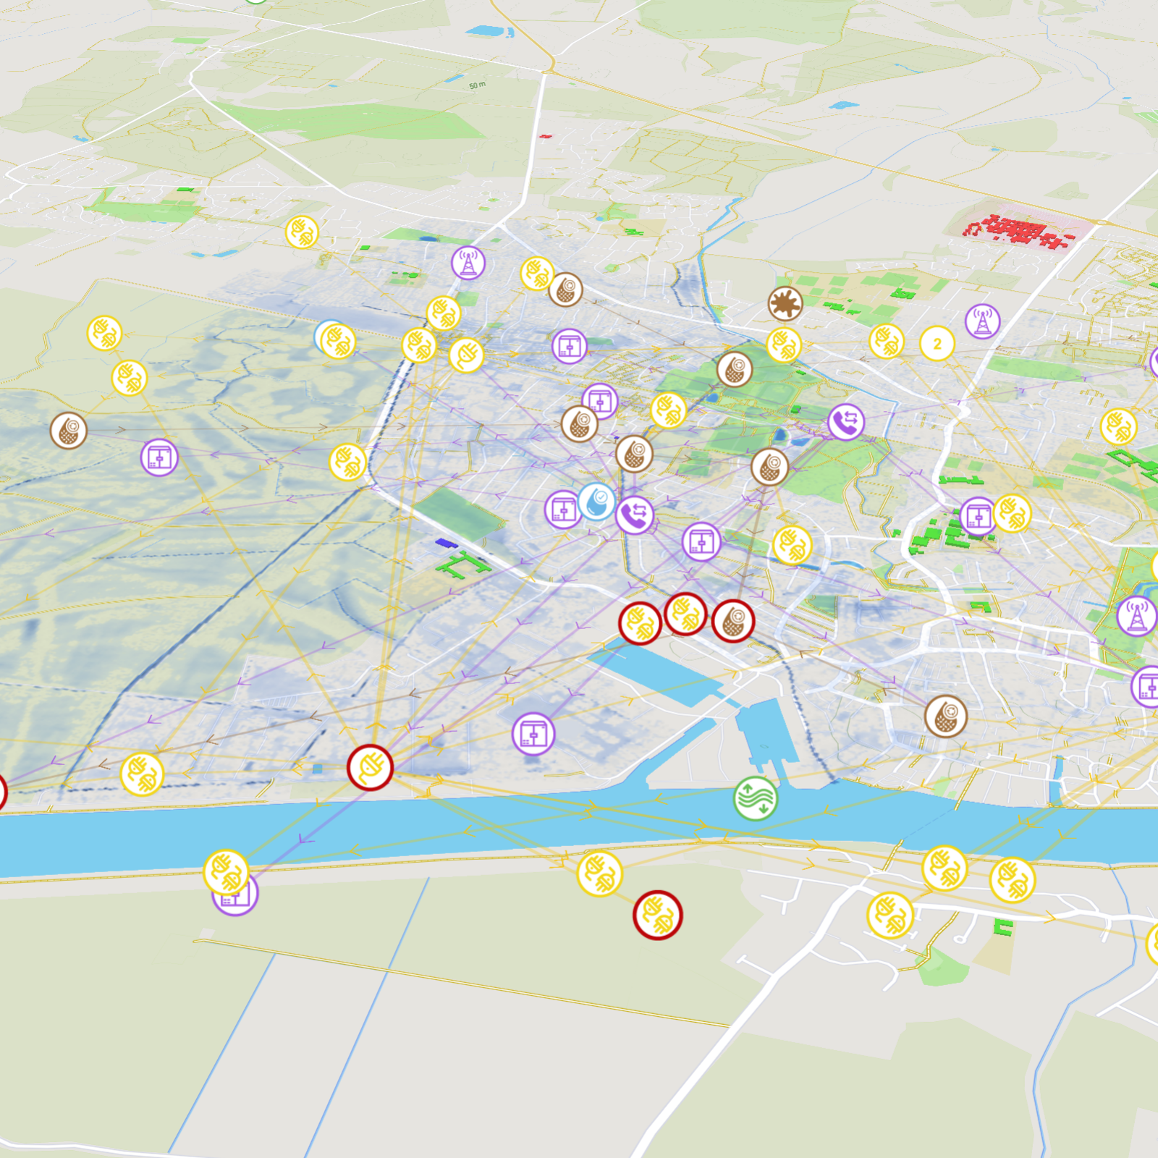
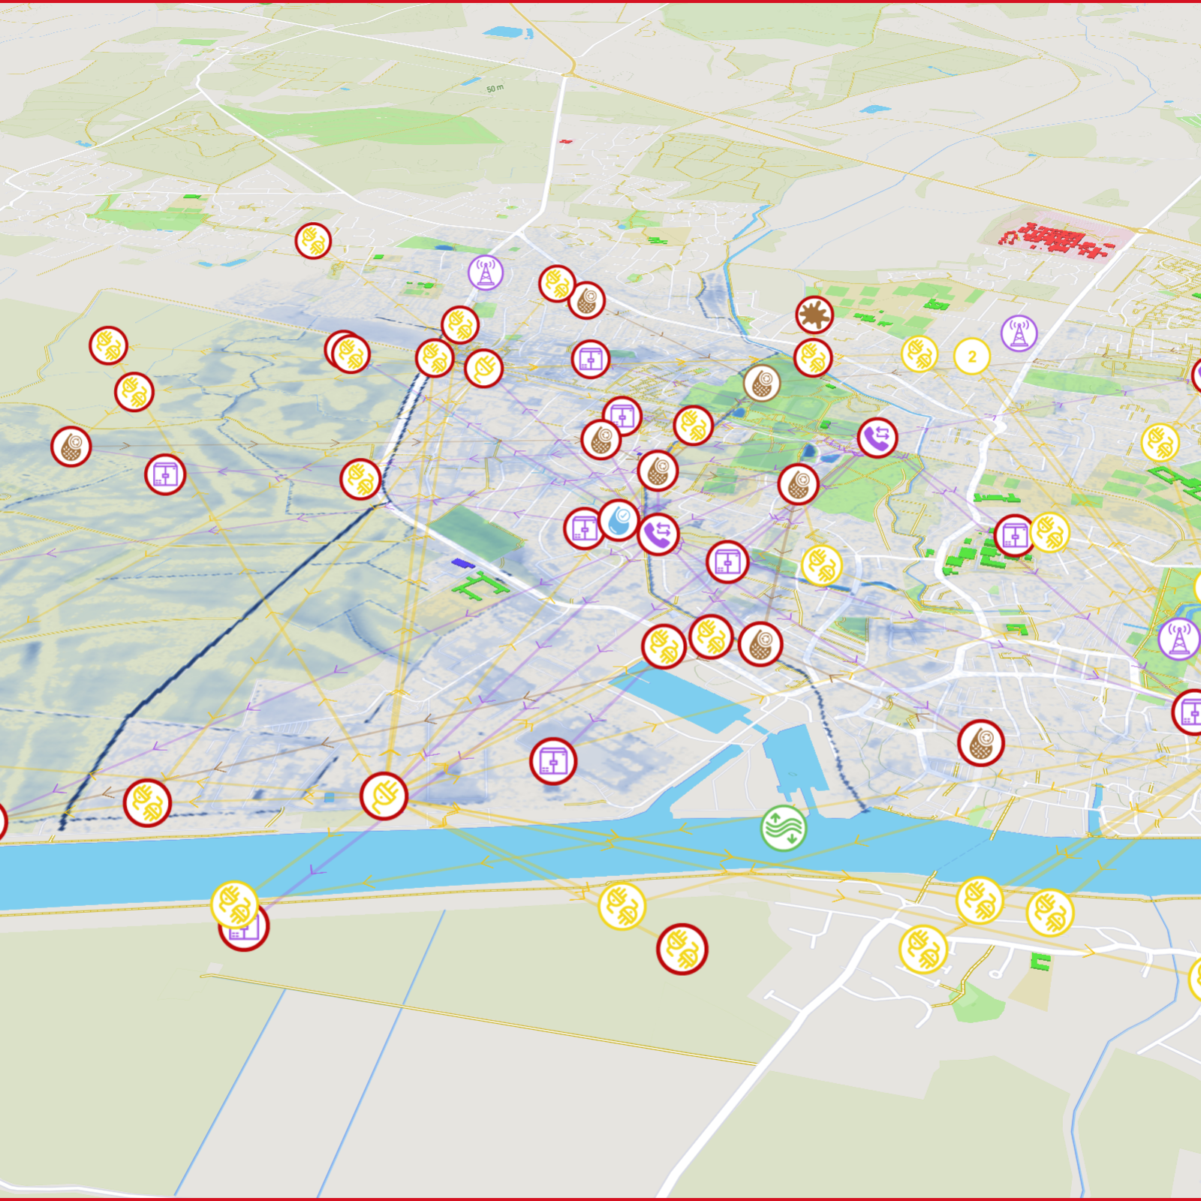
CReDo is a climate change adaptation digital twin
Bringing together data across energy, water and telecoms networks​
  Anglian Water’s water and sewerage assets,
  BT and Openreach’s communication assets and
  UKPN’s power network assets.
  with flood data to understand…
  Infrastructure interdependencies
  Asset failure and system impact
  What can we do to prepare or respond?
How do we increase system resilience and adapt?

Slide 3
Future-proofing our critical infrastructure requires a whole-system approach
Resilience planning from organisational silos creates inefficiency
Pressures on our infrastructure are increasing

Slide 4
Future-proofing our critical infrastructure requires a whole-system approach
Resilience planning from organisational silos creates inefficiency
Pressures on our infrastructure are increasing
CReDo can help
CReDo reveals network vulnerabilities from a system perspective
CReDo provides additional inputs for decision-maker’s resilience investment planning

Slide 5
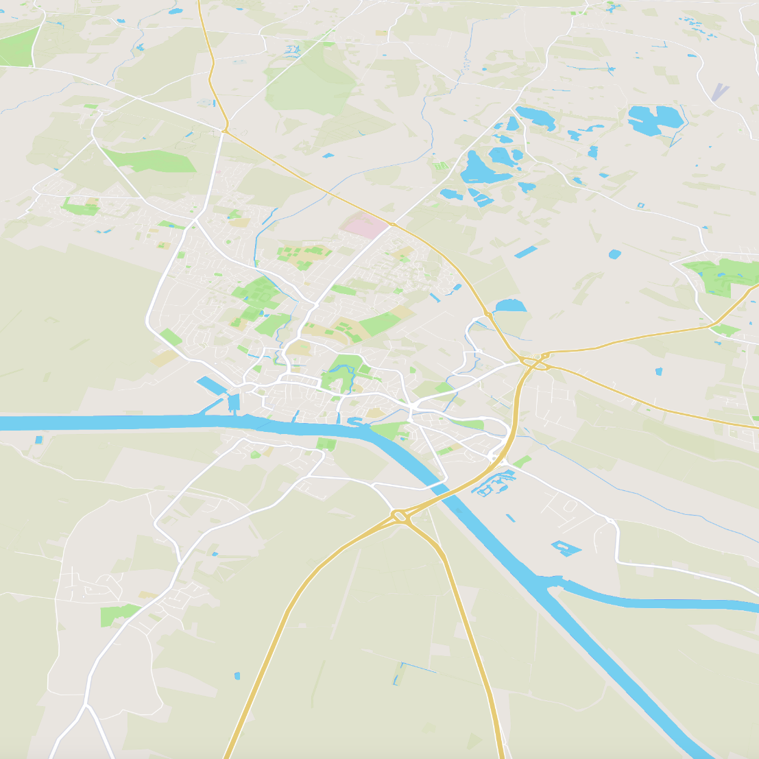
Phase 2 has brought some material improvements to CReDo
Real data on assets and resilience measures
A broader geographic area
Increase number and type of floods

Slide 6

We helped unlock the decision-support use case by combining CReDo with a Cost Benefit Analysis
Real data on assets and resilience measures
Improved understanding of interconnectedness
A broader geographic area
Cost Benefit Analysis
Improved planning
for flood resilience
Increase number and type of floods

Slide 7
The CBA allows us to quantify impact that outages caused by floods have
The CBA unlocks two key decision-support tools
Under two key scenarios
Which assets are most critical
Siloed view of resilience, each network is isolated
Cost Benefit Analysis
Which interventions are most cost-beneficial
System view of resilience, enabled by CReDo

Slide 8
To implement the CBA, we considered a broad range of costs and benefits
Total costs
Costs to asset operators
Costs to customers
Negative externalities
  Containment and preventative measures
  Repairing assets
  Due to inability to use essential services
  Cost of pollution incidents due to outages

Slide 9
We used the CBA to estimate the criticality of each asset under the siloed and system view
Electricity system
£
Low criticality for the siloed-view
Electricity asset

Slide 10
We used the CBA to estimate the criticality of each asset under the siloed and system view
Infrastructure system
£
Low criticality for the siloed-view
Electricity asset
Water asset
Telecom asset
££
Medium criticality for the system

Slide 11






We then compared the costs of a number of interventions, which depend on criticality
Event | Preventative measures | Asset output state | Containment measures | Outcomes
‘Siloed’ scenario
‘Intervention #1’ - CReDo

Slide 12
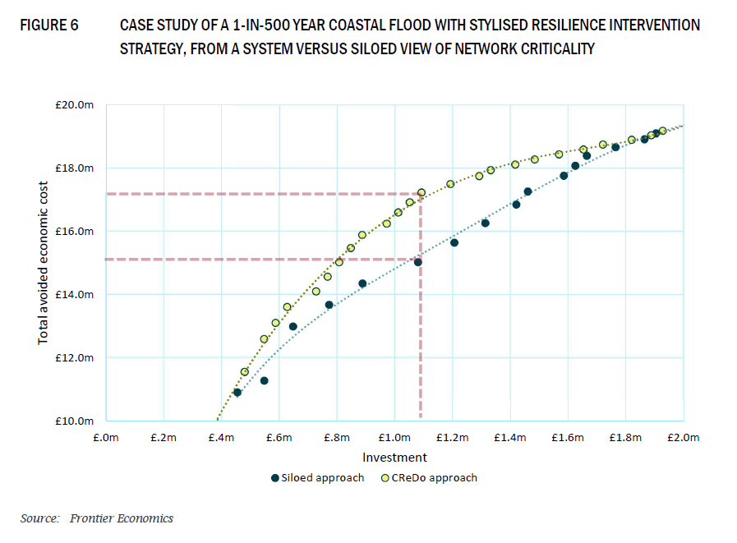
CReDo can identify interventions that have higher benefits for the system
We use a case study to illustrate potential benefits of CReDo
Two key outputs can support asset operators’ decisions
Which assets are most critical
Which interventions are most cost-beneficial

Slide 13
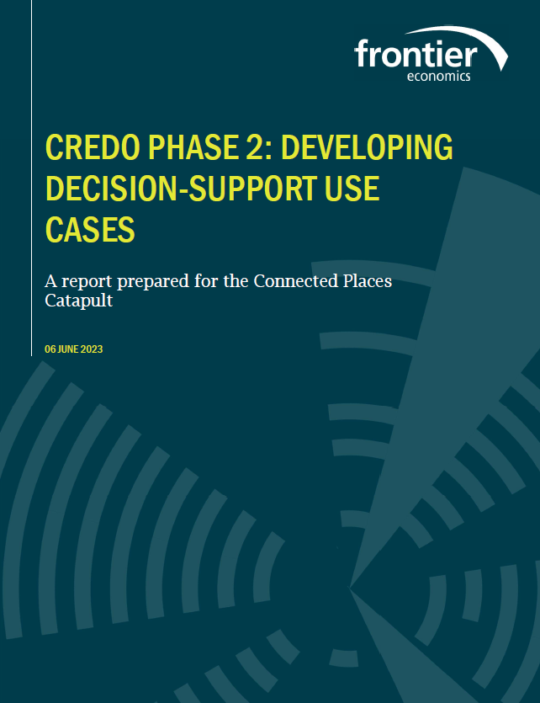
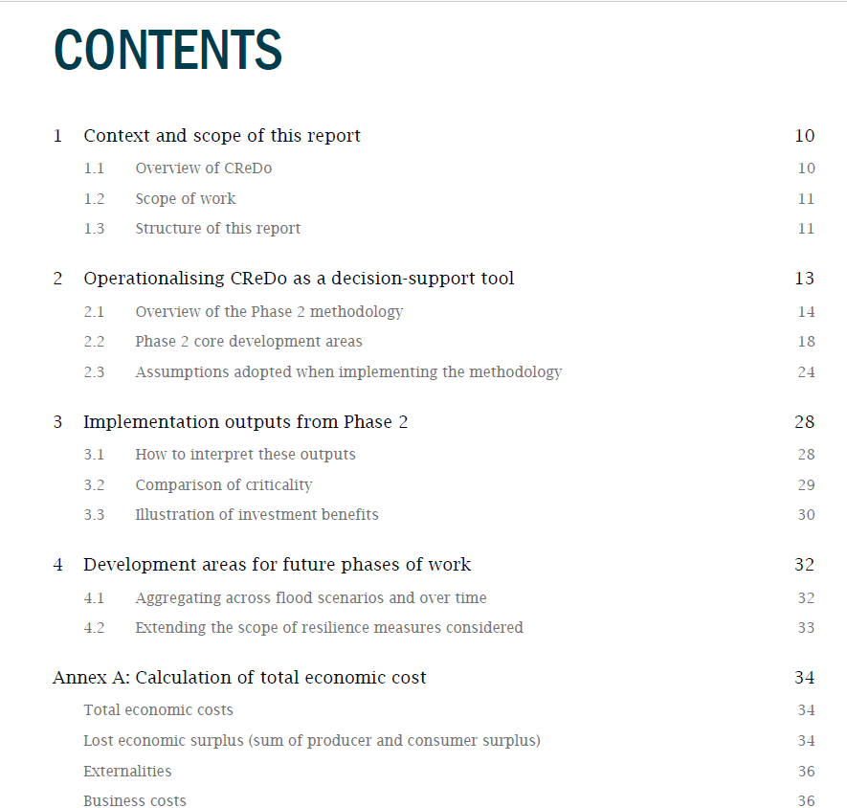
Our Phase 2 report will be published today
Includes details around our methodology and case study

Slide 14



The expected benefits of CReDo are broad
Improved understanding of interconnectedness
Improved planning
for flood resilience
Asset operators
CReDo
[add illustration of CReDo]
Improved response
to flood events
Residential and
commercial customers
More efficient/effective ways to share information between organisations
Spillover effects
Wider society

