Slide 1


Innovate UK
We are the UK’s innovation agency
We support business-led innovation in all sectors, technologies and UK regions
A key delivery body of the Government’s Innovation Strategy
Our Mission
To help UK businesses grow through the development and commercialisation of new products, processes, and services, supported by an outstanding innovation ecosystem that is agile, inclusive, and easy to navigate.
Notes:
Innovate UK is the UK’s innovation agency. We drive productivity and economic growth by supporting businesses to develop and realise the potential of new ideas, including those from the UK’s world-class research base.
Our mission:
We will help UK businesses to grow through the development and commercialisation of new products, processes, and services, supported by an outstanding innovation ecosystem that is agile, inclusive, and easy to navigate.
When talking through our mission, its important to define what we mean by UK Business:
When we say UK business, we mean any company that has an operating footprint in the UK and contributes to our economy.
For example, in this context, Nissan can be considered as a UK business, it’s a legal entity in the UK, operates in the UK, contributes to the UK economy – so it is in scope of our programmes, despite being headquartered in Yokohama, Japan.
Whilst we will support companies to de-risk innovation – we aren’t here to do the innovation for you.
We are here to help you realise your ideas – but they need to be fully formed – with a plan to develop and diffuse.
If we are going to inspire, involve and invest, where are we going to choose to work?
UK has 1.4 million businesses with employees
We also have165 higher education institutes, including 4 of the top 10 universities in the world, the majority of which are research intensive - producing over 200,000 publications a year.
It is simply impossible for us to invest in 1.4M businesses and 200,000 ideas.
As such, we need to prioritise.
We recently released our Plan for Action for UK Business Innovation, to guide our actions and investments over the next four years.
The plan for action highlights the 4 criteria we have established to prioritise our resources, taking account of:
the size of the opportunity – the size of the accessible global market
the relative strength of UK capabilities, in both industry and academia – compared to other territories
whether it is the right time for business to act
added-value – whether the case for public sector intervention is strong, including consideration of the wider environmental and societal impacts.
We will set out a clear framework to measure our progress, and commission independent rigorous evaluation of our impact.
More Information: page 59
Data Sources:
Research Publications: https://assets.publishing.service.gov.uk/government/uploads/system/uploads/attachment_data/file/815400/International_comparison_of_the_UK_research_base__2019._Accompanying_note.pdf
Number of Businesses:
https://www.fsb.org.uk/uk-small-business-statistics.html#:~:text=In%202020%2C%20there%20were%20estimated,4.6%20million%20had%20no%20employees
Number of HEIs:
https://www.universitiesuk.ac.uk/latest/insights-and-analysis/higher-education-numbers#:~:text=In%202018%E2%80%9319%2C%20there%20were,education%20institutions%20visit%20HESA%27s%20website.
When describing what we do, I like to use three important words: inspire, involve and invest.
Inspire: Creatng a shared a vision of what the world might be like in the future and making the opportunity visible and compelling.
what the trajectory of technologies might mean for Global markets and for companies and their offerings. We will produce strategies and roadmaps for priority sectors.
Involve: bringing the appropriate people and organisations together.
Helping the right companies to forge the appropriate partnerships, within the public sector, the research base or the supply chain. Working with our partners, to bring in the right expertise – NPL for metrology or BSI for standards. And we will work with government departments, so we can align with the wider UK priorities. For example: to decarbonise road transport we will need to bring in designers, academics, road engineers, car manufacturers & their supply chains, companies involved in battery manufacturing and the charging infrastructure, people involved in insurance and pricing… all need to be aligned. On one hand it’s the private sector, who will make the products and services, and the other it’s the private sector, that can de-risk innovation, build networks (like KTN), define the policies and standards, and clear the obstacles to help companies move faster.
Invest: Convening the right resources, including – but not limited to - our own. This could be financial– convening grants, loans and equality investments, not just our own - we will align with the British Business bank to increase the availability of working capital. But it is also about assets – helping you access the right labs and technologies through the agri-tech centres, IKCs or the Catapult network.

Slide 2





Guide our actions
Strategic Themes
Areas where our work can have a significant impact on the returns for the UK economy
The themes allow us to draw upon the UK’s established sector and technology expertise
Future economy
Growth at scale
Global opportunities
Innovation ecosystem
Government levers
Deliver purpose-driven programmes across net zero, health & wellbeing, priority technologies, and horizon scanning
Support businesses to develop their leadership, skills and commercial capabilities to scale up and attract investment
Enable businesses to build the global supply chains of the future, access markets and attract inward investment
Increase responsiveness, agility, and co-ordination to support innovating businesses from idea to commercialisation
Help stimulate innovation, through regulation, standards, intellectual property regimes, and public procurement
Notes:
We are taking a theme-based rather than a sector-based approach – and have identified 5 strategic themes, to stimulate, guide and prioritise our future work.
The strategic themes are areas where we believe our efforts can have a significant impact on the returns the UK gains from business innovation.
The components of any theme may apply across all themes.
They are described as distinct elements for simplicity and clarity, and the outcomes and priority themes in each one will stimulate and guide our actions.
Theme 1: Future economy
Improving the quality of life for all, protecting the environment and conserving Earth’s resources mean the future economy will look different from today’s.
We will focus on the major opportunities we see for UK businesses in the following areas:
net zero (zero carbon emissions and tackling wider adverse environmental impacts)
health and wellbeing (sustaining healthy human life, including nutrition and healthcare)
technologies (creating and benefiting from advances in technology)
horizon scanning and foresight (continually looking ahead).
Success in these areas will make the UK more attractive for global innovation, deliver better products and services and economic growth, and improve health and wellbeing.
Theme 2: Growth at scale
Growing, innovating businesses are key to a strong, sustainable, and competitive UK economy.
We will increase our efforts to support businesses that are scaling and help companies of all sizes to grow rather than focus our efforts solely on their projects or novel products.
We want to see more businesses accessing markets and the global supply chains of the future, and more businesses with the leadership, skills and commercial capabilities to scale up and to attract investment.
We will support more business-led collaborations that give smaller businesses access to global opportunities and offer more guidance on growing and scaling, and we will build on our programmes to increase the availability of private finance to innovative, high-growth-potential businesses.
Theme 3: Global opportunities
We see large opportunities for UK companies to build on our research and innovation strengths by collaborating with overseas partners, helping build the global supply chains of the future, accessing markets and attracting inward investment.
We should be an innovation partner of choice for the many overseas businesses and organisations that are also aiming to meet global challenges.
Our work will help businesses to access international innovation opportunities, to play a role in tackling global challenges and to take advantage of government support for international innovation, trade and investment.
We will also help to build deep and enduring partnerships with key countries and play an active role in global innovation groupings, including EUREKA and TAFTIE.
Theme 4: Innovation ecosystem
The innovation ecosystem is made up of many actors, from public agencies to businesses, academia, infrastructure, charities, and the regulatory environment.
We want to see increased responsiveness, agility, and co-ordination to support innovating businesses from idea through to commercialisation, adoption, and diffusion.
We will look at how partners in the ecosystem can work better, design better programmes and better help businesses to access more easily and seamlessly the knowledge, facilities and equipment they need to succeed.
We will also work to inspire a national culture of innovation and make the UK a more attractive place for global partners to innovate
Theme 5: Government levers
Government can use many levers to stimulate innovation, including legislation, regulation, standards, intellectual property regimes, and public procurement.
We will help government to use standards and regulations to accelerate innovation and help businesses to influence their development at home and abroad.
We will continue to help the public sector procure innovative solutions to their challenges from businesses and run managed programmes for government departments and agencies.
Our support will include helping UK businesses to be better at protecting their intellectual property and gain the advice they need
More information: pages 21-45
Future economy: pages 21-29
Growth at scale: pages 30-33
Global opportunities: pages 34-37
Innovation ecosystem: pages 38-41
Government levers: pages 42-45

Slide 3











Working in Partnership
Making it easier for businesses to go faster
Business innovation is difficult
Help and expertise are available from multiple places
We are working with partners to deliver the Plan for Action

Slide 4





Our Impact
Confidence in the Plan for Action
Growing Companies
Through our programmes, we have invested £4.6bn in 12,000 companies, helping to create over 100,000 jobs and contribute £32.2bn in added value to the UK economy (a 7:1 return).
Building Sectors
We have helped the UK lead the way in new industries that are fundamental to our future prosperity.
We helped make the UK a world leader in offshore wind – now generating more than 10% of UK electricity.
We helped build the third largest cluster of cell and gene therapy companies in the world.
We helped attract more than £1.8 billion private investment for synthetic biology start-ups between 2014 and 2019.
We helped London grow into a world centre for the visual effects industry and open new studios across the UK.
We helped a semiconductor cluster in Wales contribute £172 million to the Welsh economy in 2020 and is supporting 2,100 jobs.
Notes:
We strongly believe that the IUK 4-year action plan is the right one for the UK – as it builds upon our successful approach of drawing in significant business investment in innovation.
Through our core-programmes and ISCF alone we have invested £4.5bn in 15,000 R&D projects at 11,800 organisations, helping to create 100,000 new jobs whilst adding £21 billion to the UK economy. If you factor in managed programmes we run for government departments and agencies (like ATI, CCAV, Network Rail, the advanced propulsion centre etc) – the numbers would be an order of magnitude bigger.
#1 Investment in research and development, including through Innovate UK and the Offshore Renewable Energy Catapult, helped to make the UK a world leader in offshore wind. Wind powers the equivalent of 4.5 million homes a year, is generating more than 10% of UK electricity, and became cheaper than coal, gas or nuclear 10 years ahead of expectations.
#2 Our early recognition of the potential of regenerative medicine has helped to build the third largest cluster of cell and gene therapy companies in the world in the heart of the UK.
#3 Similar support helped the top 70 UK synthetic biology start-ups attract more than £1.8 billion private investment between 2014 and 2019.
#4 Our vision for the creative industries has seen London grow into a world centre for the visual effects industry and effects studios opening across the UK.
#5 A business and research cluster in South Wales built around innovative new compound semiconductors contributed around £172 million to the Welsh economy in 2020 and is supporting 2,100 jobs.
These are all examples of what innovation can do, especially when support is coordinated and targeted at the best opportunities available to the UK.
Across Innovate UK’s core programmes, validated programme evaluations demonstrate a return to the economy of approximately of up to £7 for every £1, as well as spillover impacts estimated to be 2-3x larger;
Since 2011, companies supported by Innovate UK have raised over £7.7bn in venture capital funding, representing £13 of VC investment per £1 of IUK support. On average 11% of all UK investment goes to companies previously supported by IUK;

Slide 5

The KTN

Slide 6

Catapults

Slide 7
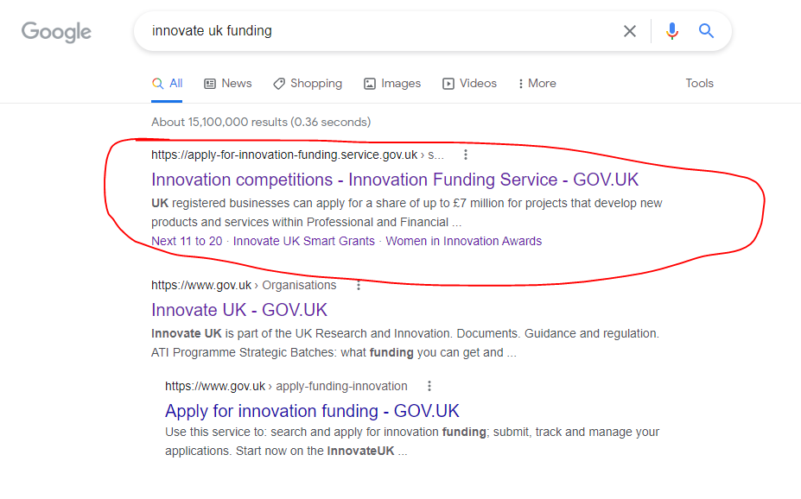
Funding!
https://apply-for-innovation-funding.service.gov.uk/competition/search

Slide 8
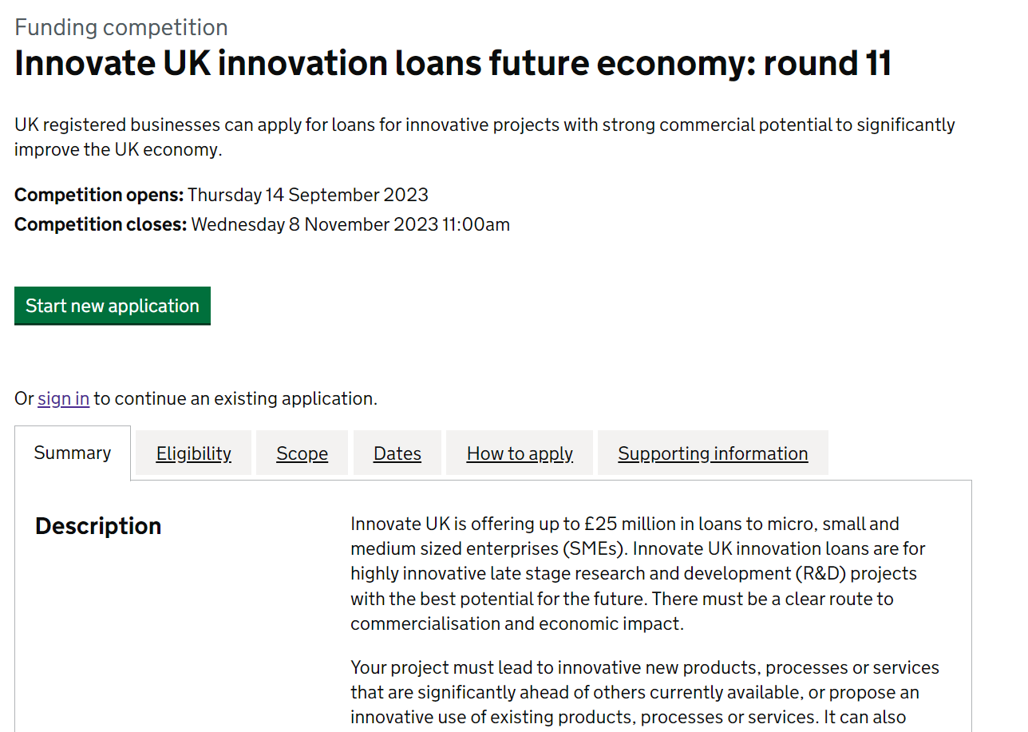
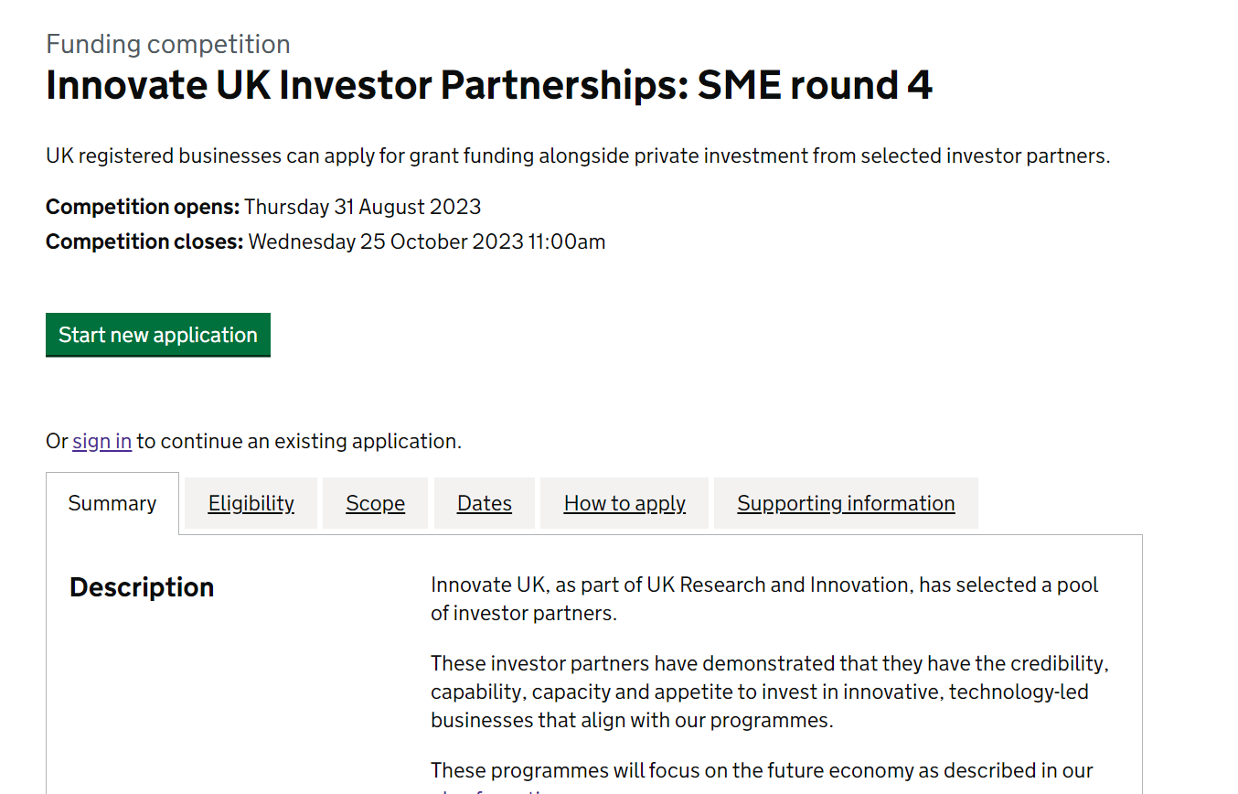
Funding….
https://apply-for-innovation-funding.service.gov.uk/competition/search

Slide 9

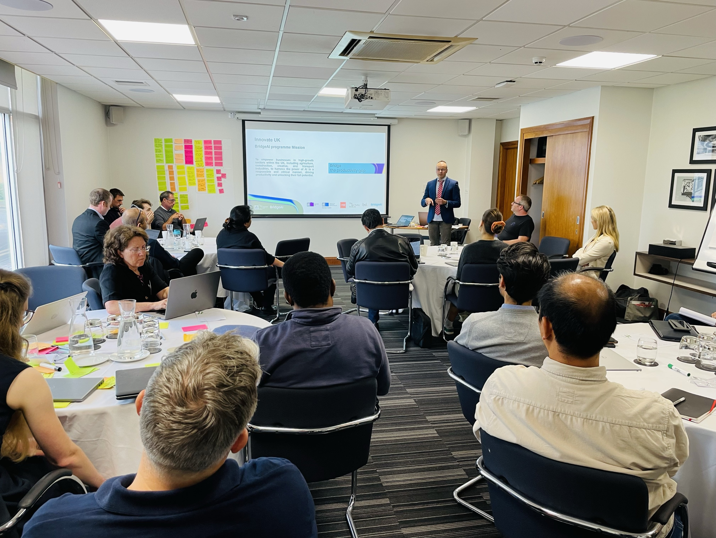
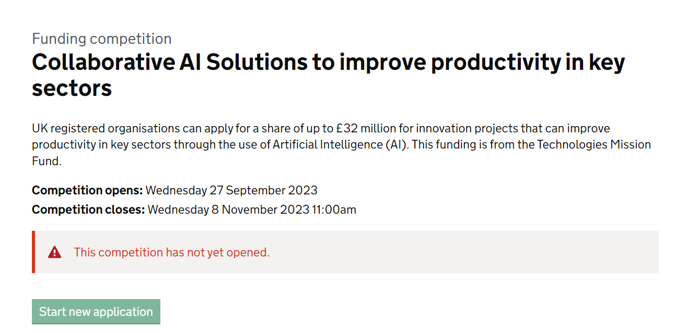
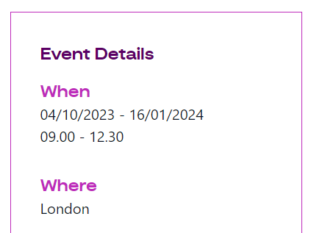
Bridge AI
bridgeai.net

Slide 10

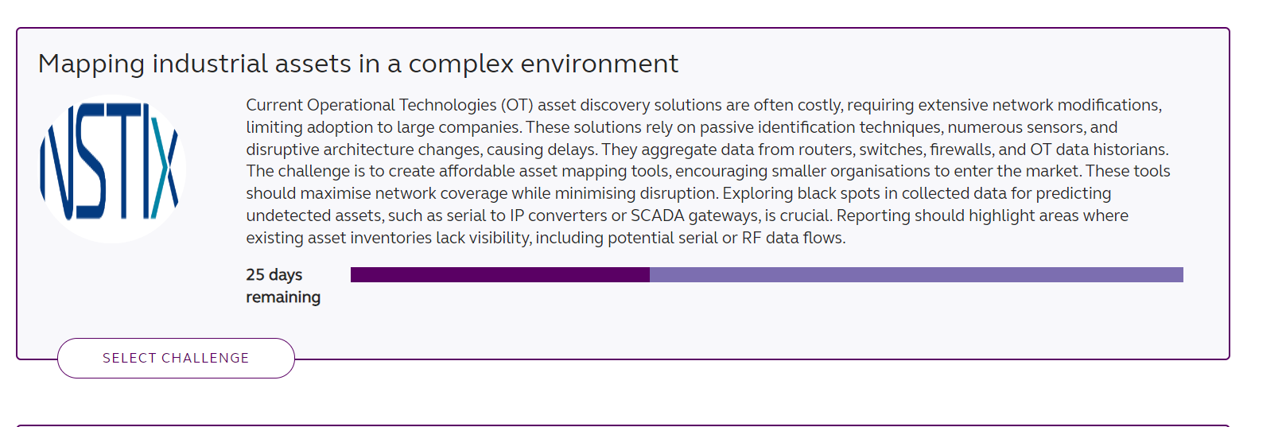
Collaboration Opportunities
https://www.ktninnovationexchange.co.uk/

Slide 11
Now the important bit…

Slide 12

International Opportunities
International Collaboration on Digital Twins
“ Innovate UK, the UK government’s innovation agency, is embarking on an exciting new initiative to accelerate the development of digital twins around the world. ”
Have a Voice in Shaping the Future
Your input is crucial in helping Innovate UK identify the countries and areas where collaboration is most needed for digital twin innovation.
By completing the survey, you will provide valuable insights that will guide Innovate UK in deciding the focus areas and countries for collaboration.
https://iuk.ktn-uk.org/news/join-the-digital-revolution-innovate-uk-seeks-public-input-for-international-collaboration-on-digital-twins/

Slide 13
We need YOU!

Slide 14
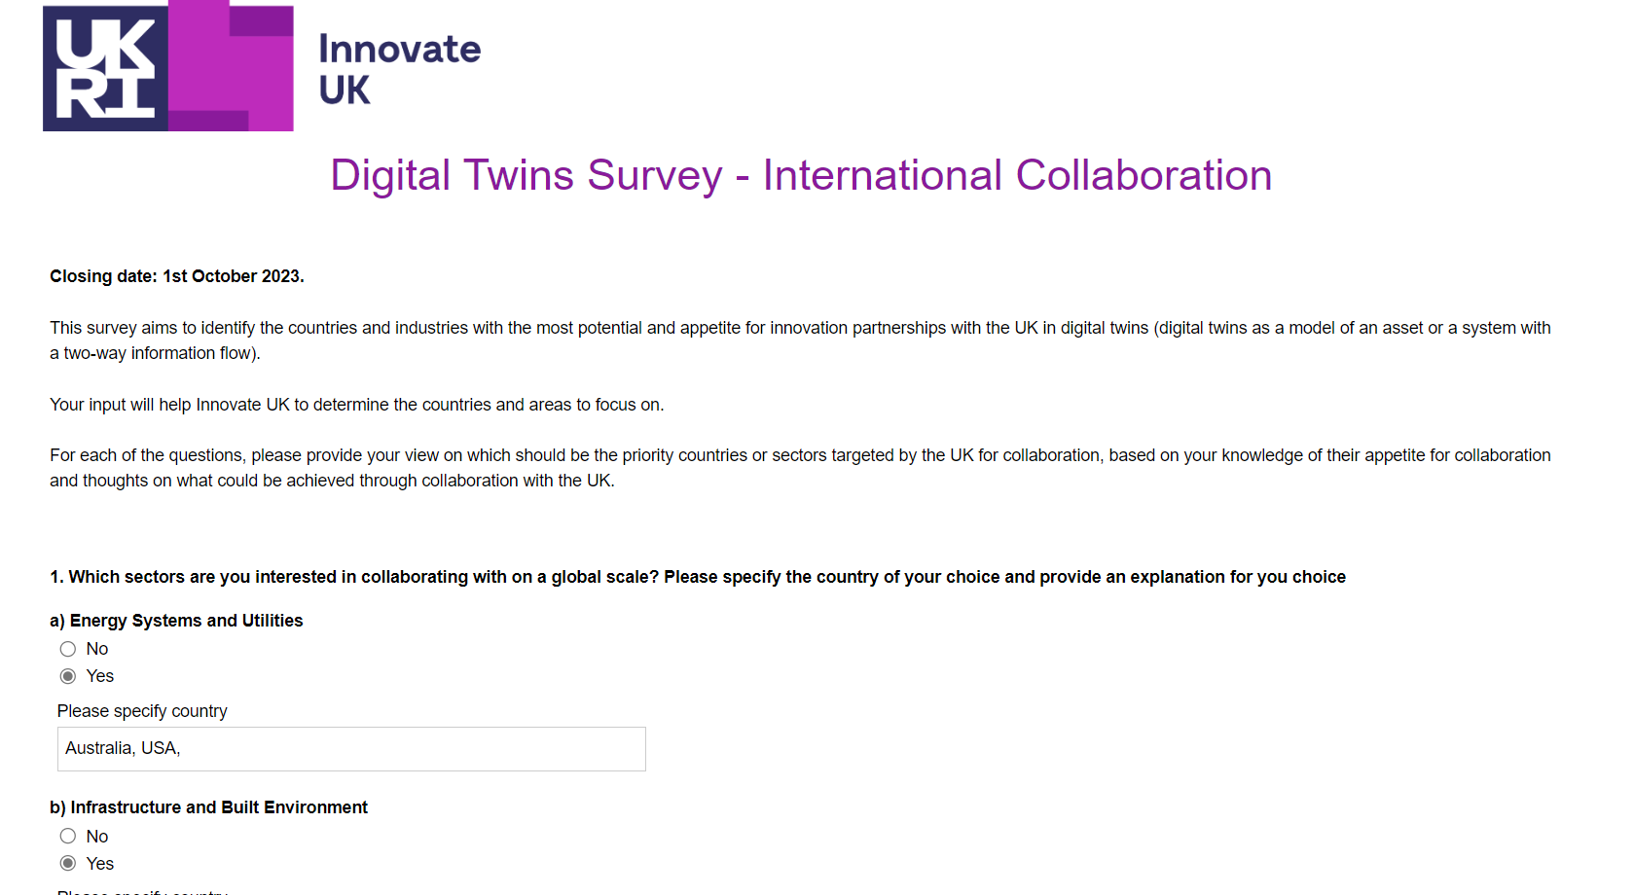
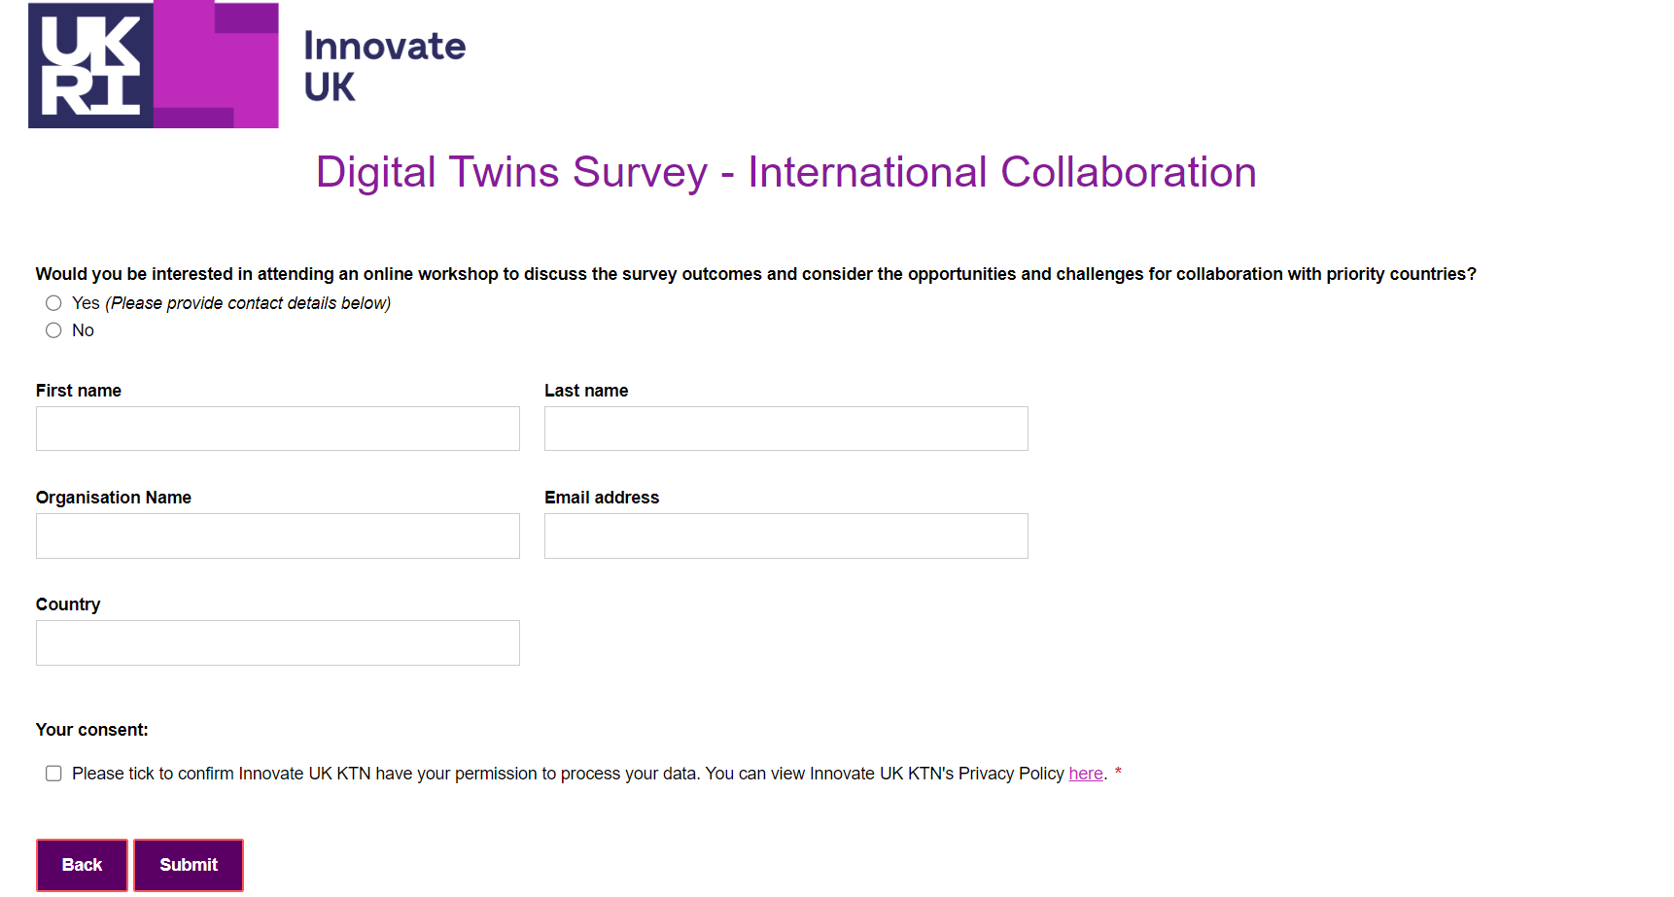
Survey - its easy!
https://iuk.ktn-uk.org/news/join-the-digital-revolution-innovate-uk-seeks-public-input-for-international-collaboration-on-digital-twins/

Slide 15
Thank you simon.hart@innovateuk.gov.uk simon.hart@iuk.ukri.org
@SimonBIM

