Slide 1





Digital Innovation Transformative Change (DIATOMIC) project
Gemini Call 19th September 2023

Slide 2
DIATOMIC project is 24 months to April 2025
The project is led by the Connected Places Catapult and is an interdisciplinary cross-cutting framework to that targets innovation capability to drive growth and prosperity locally, and enhance the reputation of the West Midlands globally
One work package in the wider DIATOMIC project is for a targeted digital twin demonstrator across three geographical areas and distinct focus themes across Birmingham City.
An overview of each of these will be presented today, with a more in-depth presentation at future Gemini calls
Targeted areas for Digital twin are:
Energy
Air Quality
Fuel cell operation

Slide 3
Digital twin work package
Currently in the procurement phase to deliver a platform with:
A focus on cloud based systems built on commodity rather than proprietary systems, e.g., Microsoft Azure platform / AWS / GCP
The use of existing rather than new sensors to provide data
The use of research driven insights from University partners to help drive innovation

Slide 4
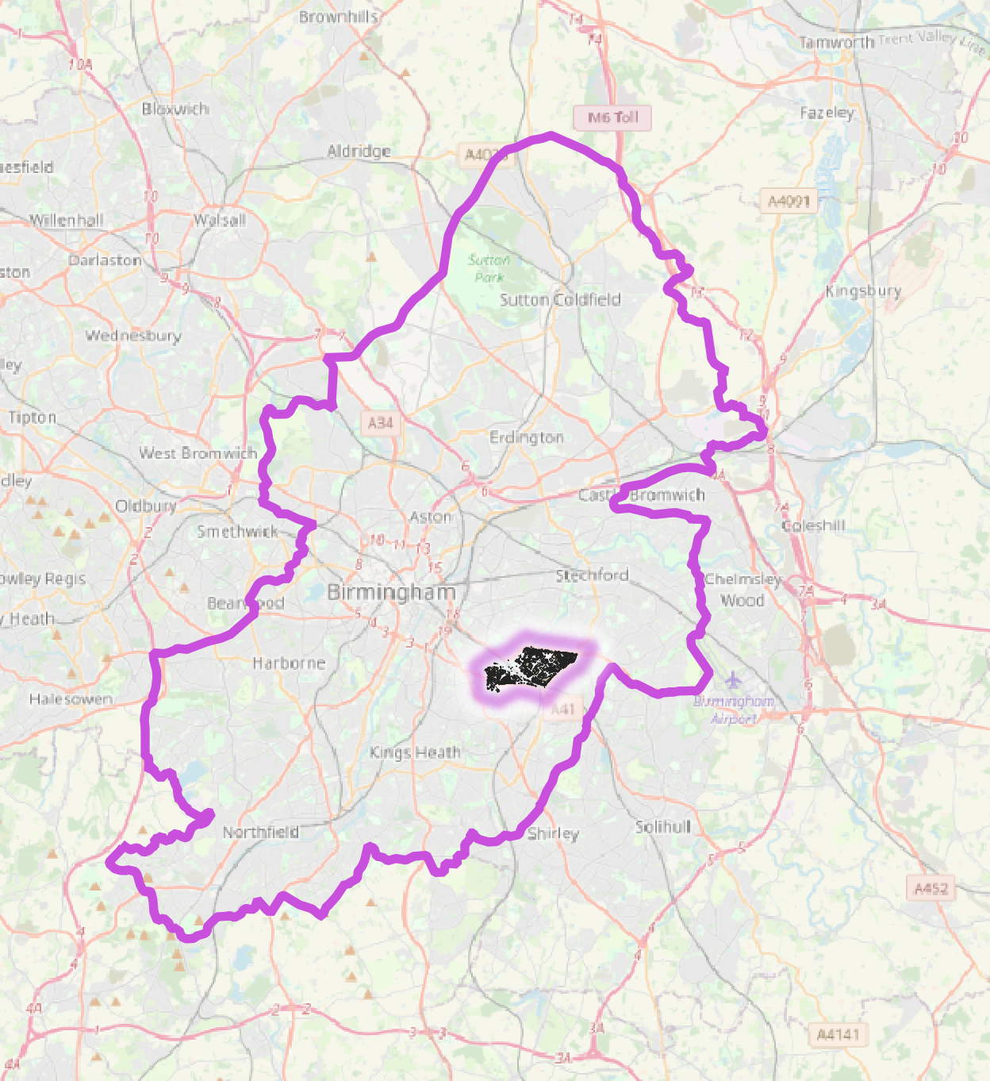
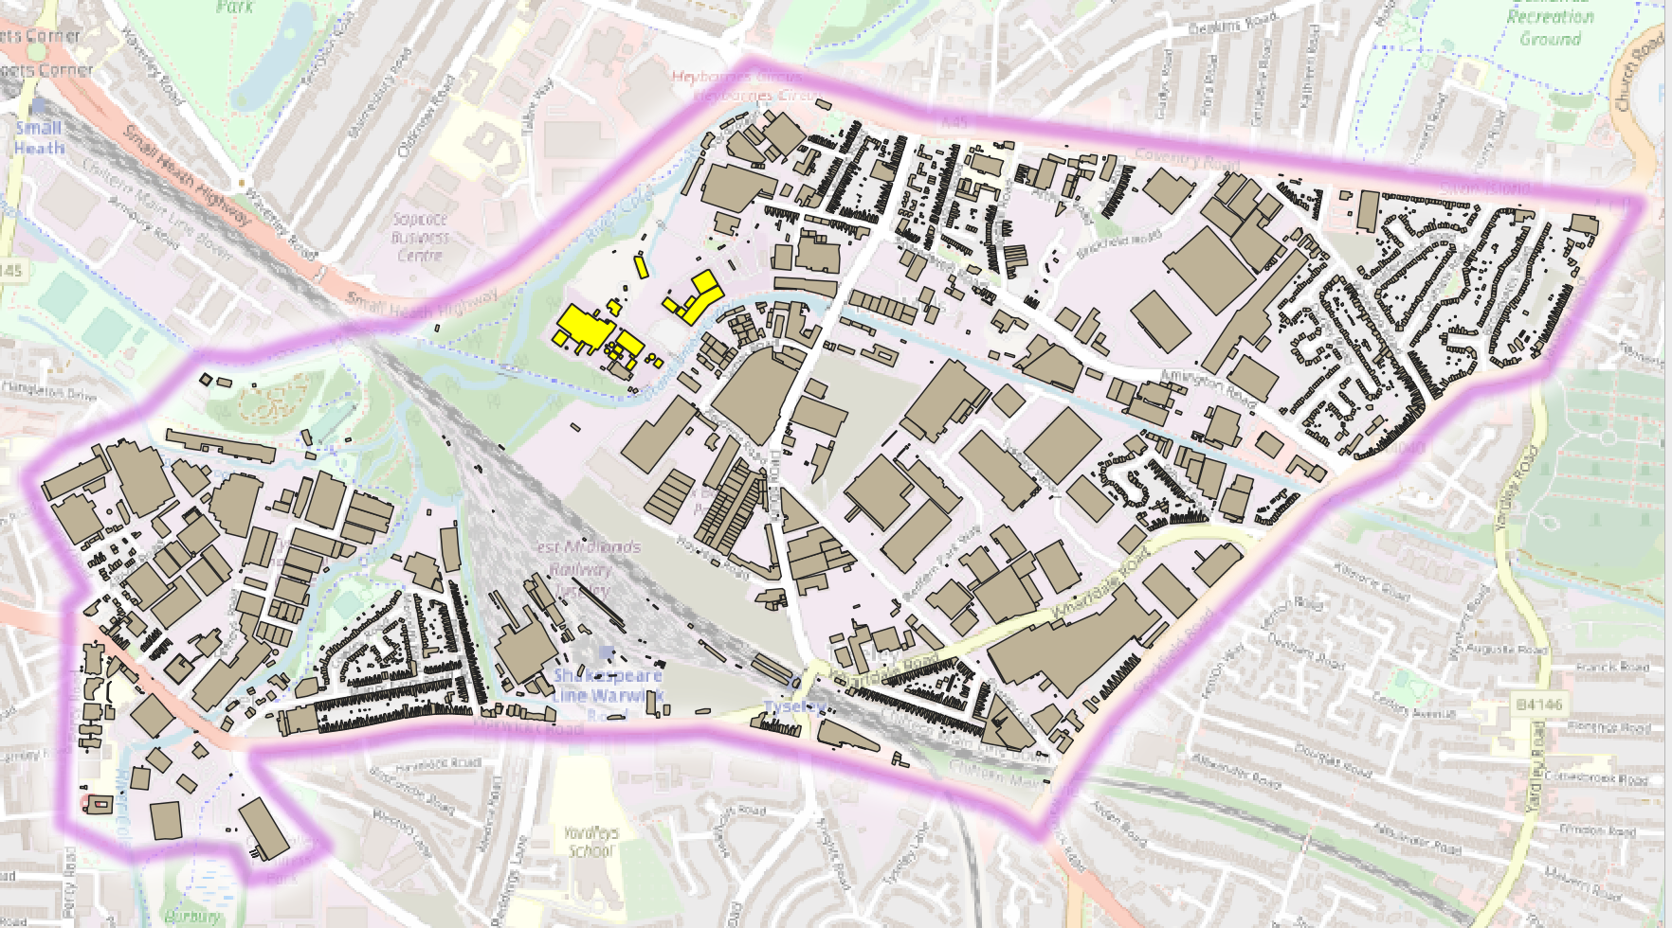
University of Birmingham focus on energy systems for Tyseley
The Tyseley Environmental Enterprise District is an area of East Birmingham that contains Birmingham’s existing energy from waste plant, and a biomass plant.

Slide 5
University of Birmingham focus is on energy systems analysis
Energy focussed digital twin has a number of objectives including:
Develop tooling and techniques to help with workflow management and ingestion from different data sources, of geography, scale, timeframes, data types
Research techniques for predictive analytics in the energy and built environment space at a hyper local level
Create visualisation tools to help drive public engagement of the energy transition
Vision is to test a multi-vector, interactive visualisation, that can be scaled out across a wider geographical area

Slide 6
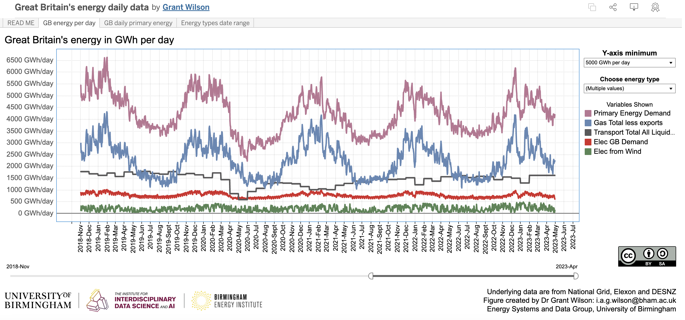
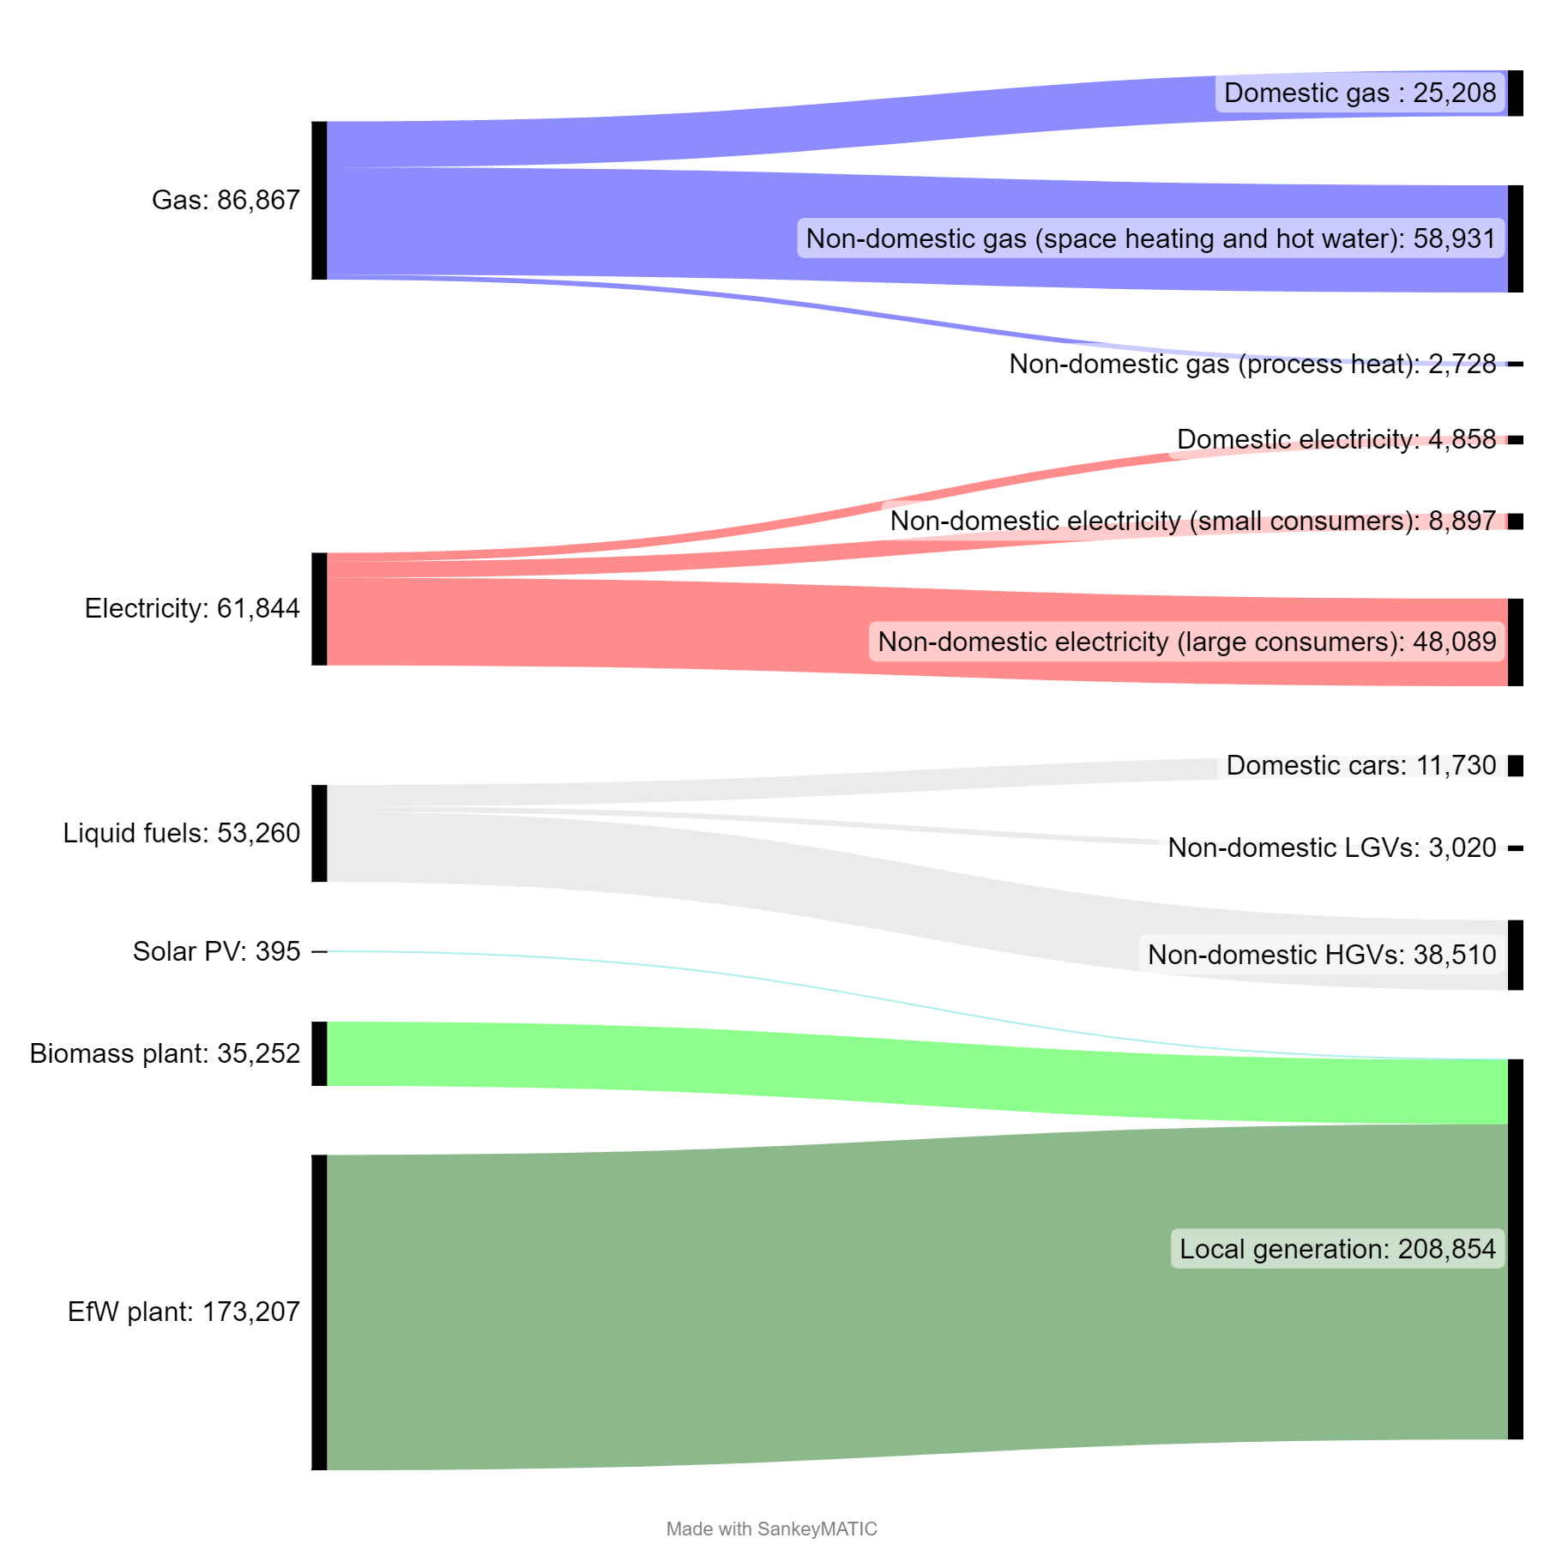
Local Sankey diagrams and multi-vector interactive charts

Slide 7
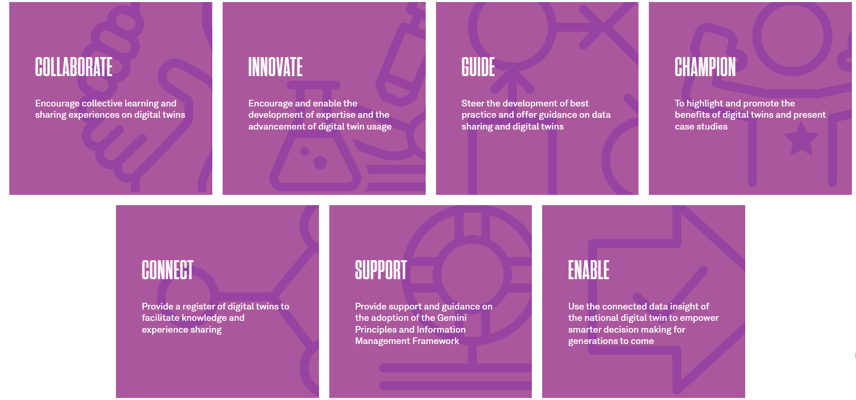
Birmingham City University - area of focus

Slide 8
Traffic & Air Quality Digital Twin Objectives
Collaborate with SMEs and public sector to gain a comprehensive
understanding of current infrastructures.
Innovate insights from traffic and air quality data through data ingestion, visualization, analytics, and modeling.
Champion promoting of digital twins to citizens and small and medium-sized enterprises (SMEs) initially in the West Midlands and eventually nationwide.
Connect with SMEs and public sector to create impact case studies of TAQ-DT.
Enable smart-decision making across different scenarios, particularly within the clean tech, med-tech, and health tech sectors

Slide 9
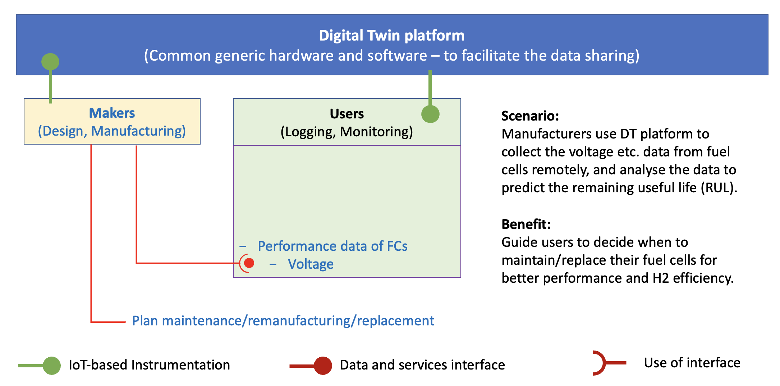
Aston University’s Case Study: Step 1 – Predicting RUL remotely

Slide 10
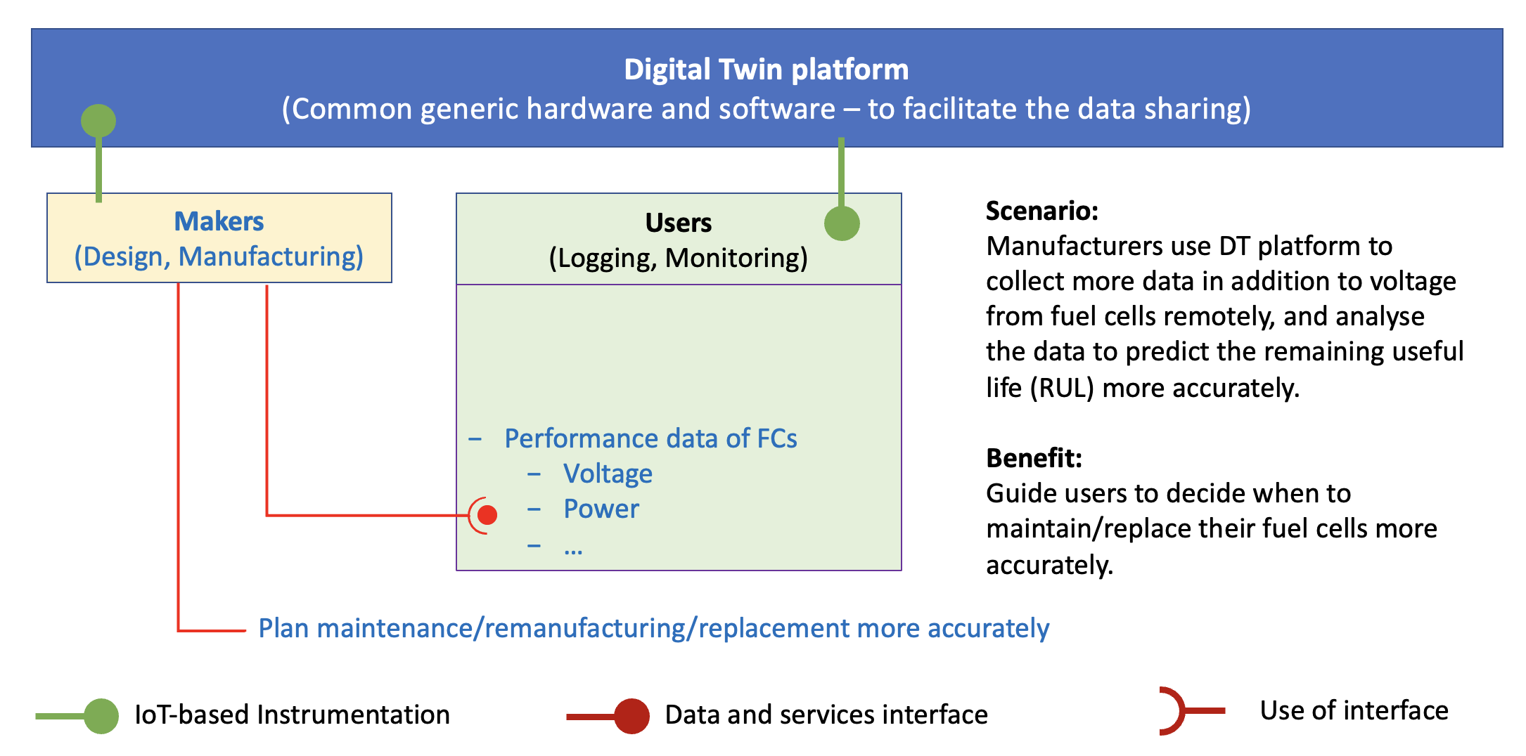
Aston University: Step 2 – Predicting RUL more accurately

Slide 11
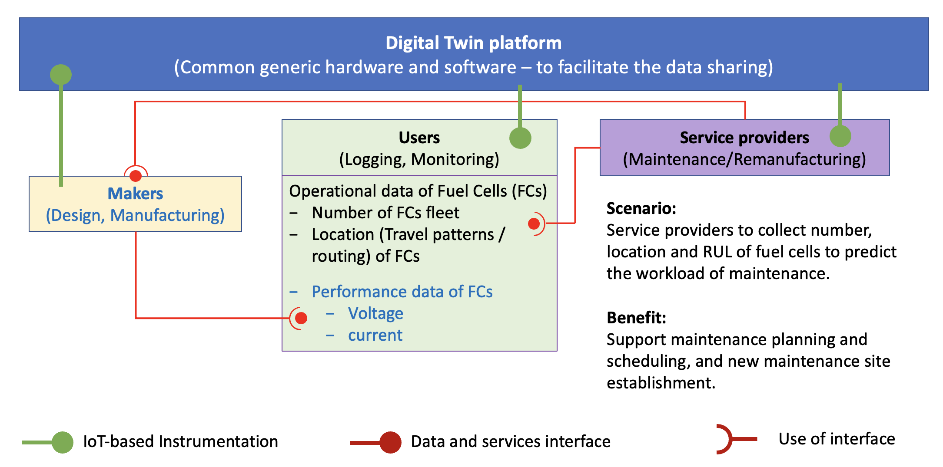
Aston University: Step 3 – Predicting workload for maintenance

Slide 12
Further Gemini call presentations planned once the initial implementation of the platform has been tested, and data flows, visualisations and data insights are developed
University contact details are:
University of Birmingham: Dr Grant Wilson (i.a.g.wilson@bham.ac.uk), Dr Zoya Pourmirza (z.pourmirza@bham.ac.uk)
Birmingham City University: Dr Sara Hassan (Sara.Hassan@bcu.ac.uk), Dr Abdel-Rahman Tawil (Abdel-Rahman.Tawil@bcu.ac.uk)
Aston University: Dr Yuchun Xu (y.xu16@aston.ac.uk), Dr Lucy Bastin (l.bastin@aston.ac.uk)

