Slide 1
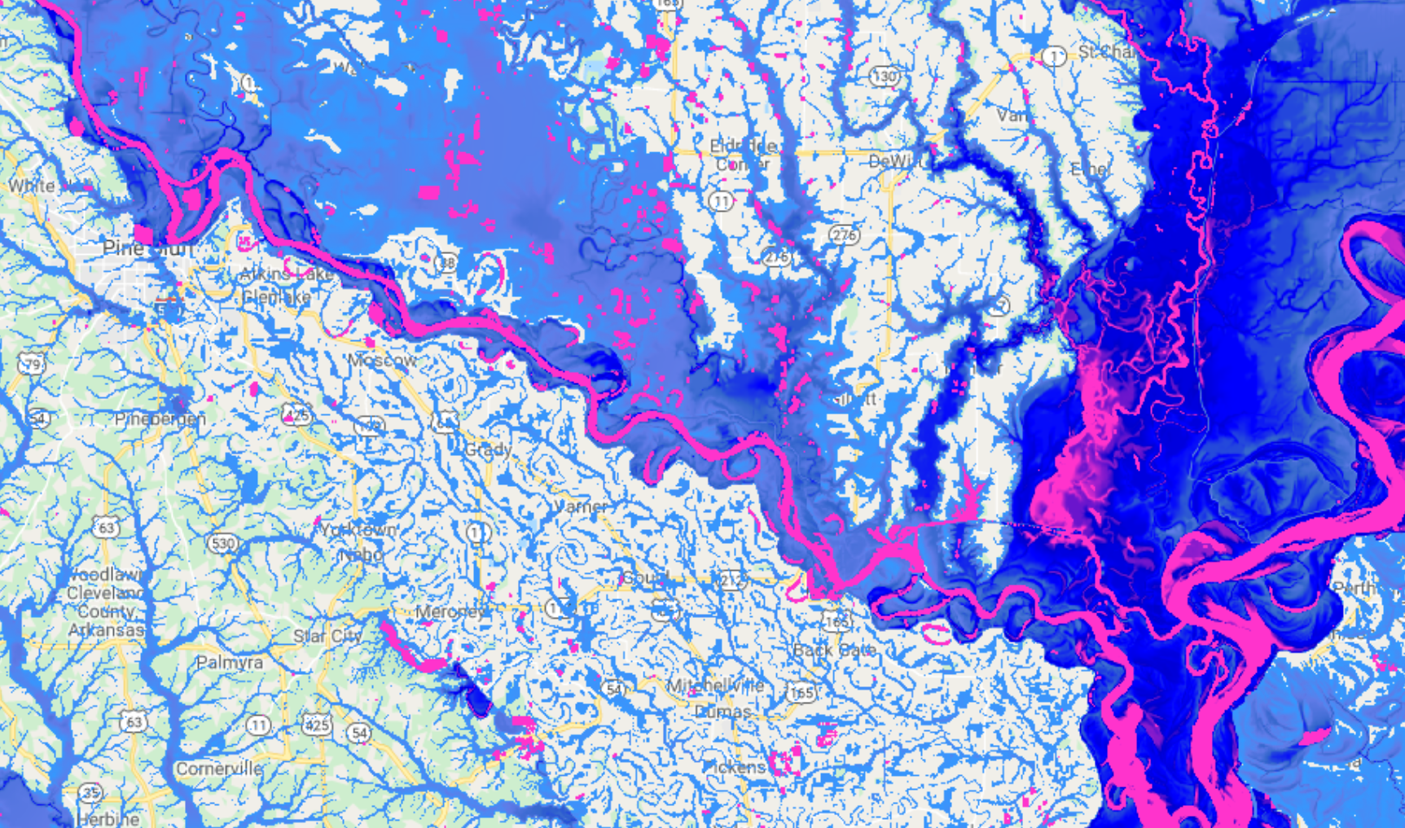

Fathom
Gemini Call

Slide 2
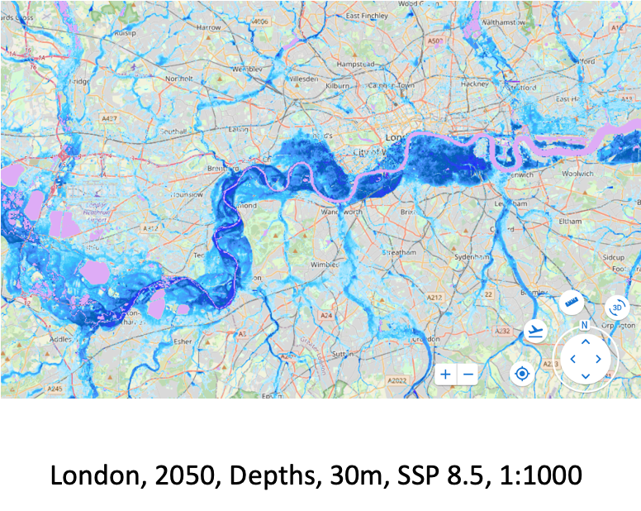
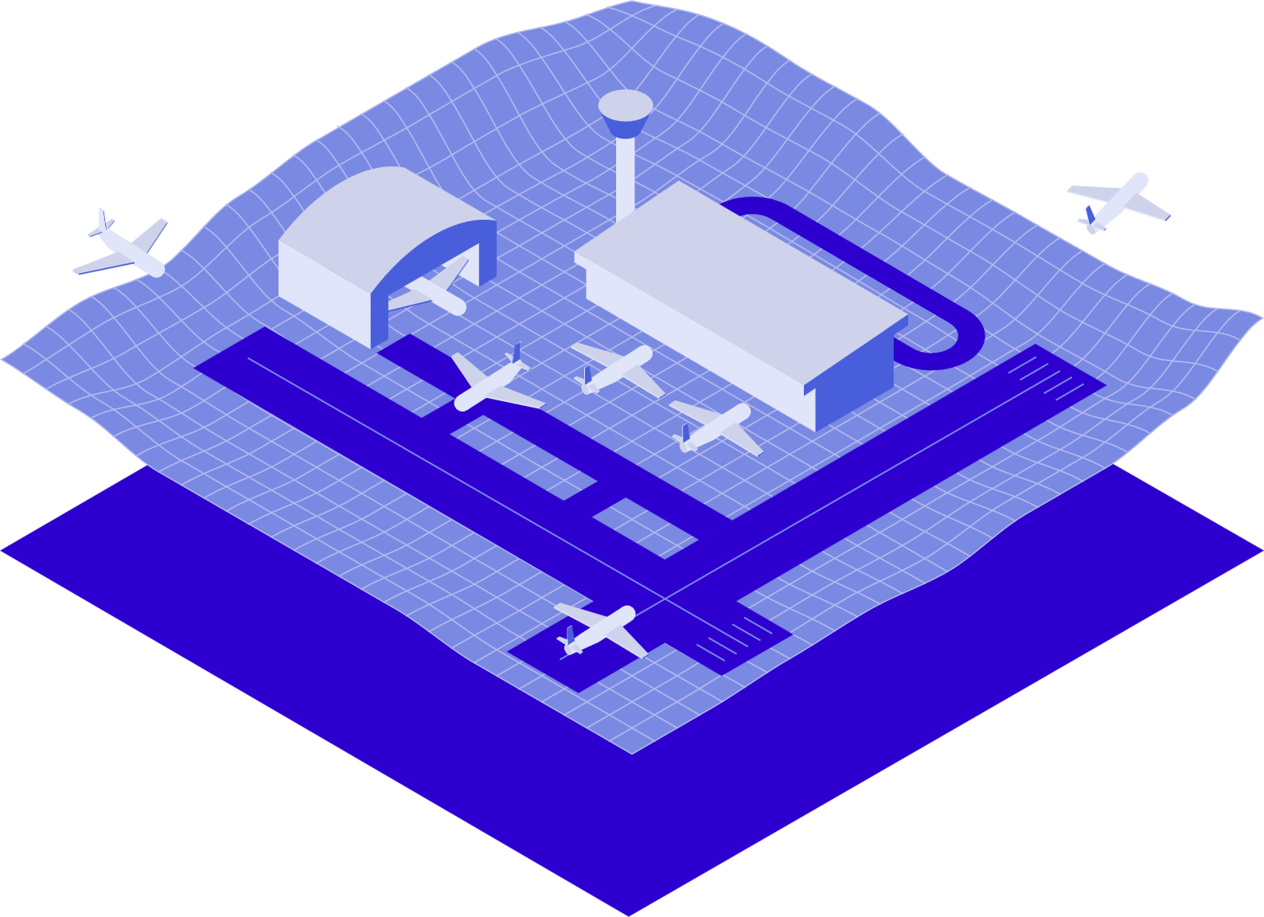
From expansion to adaption
“It is not the most intellectual of the species that survives; it is not the strongest that survives; but the species that survives is the one that is able best to adapt and adjust to the changing environment in which it finds itself.”
Slow, linear, predictable
Sudden, heterogeneous, unpredictable

Slide 3
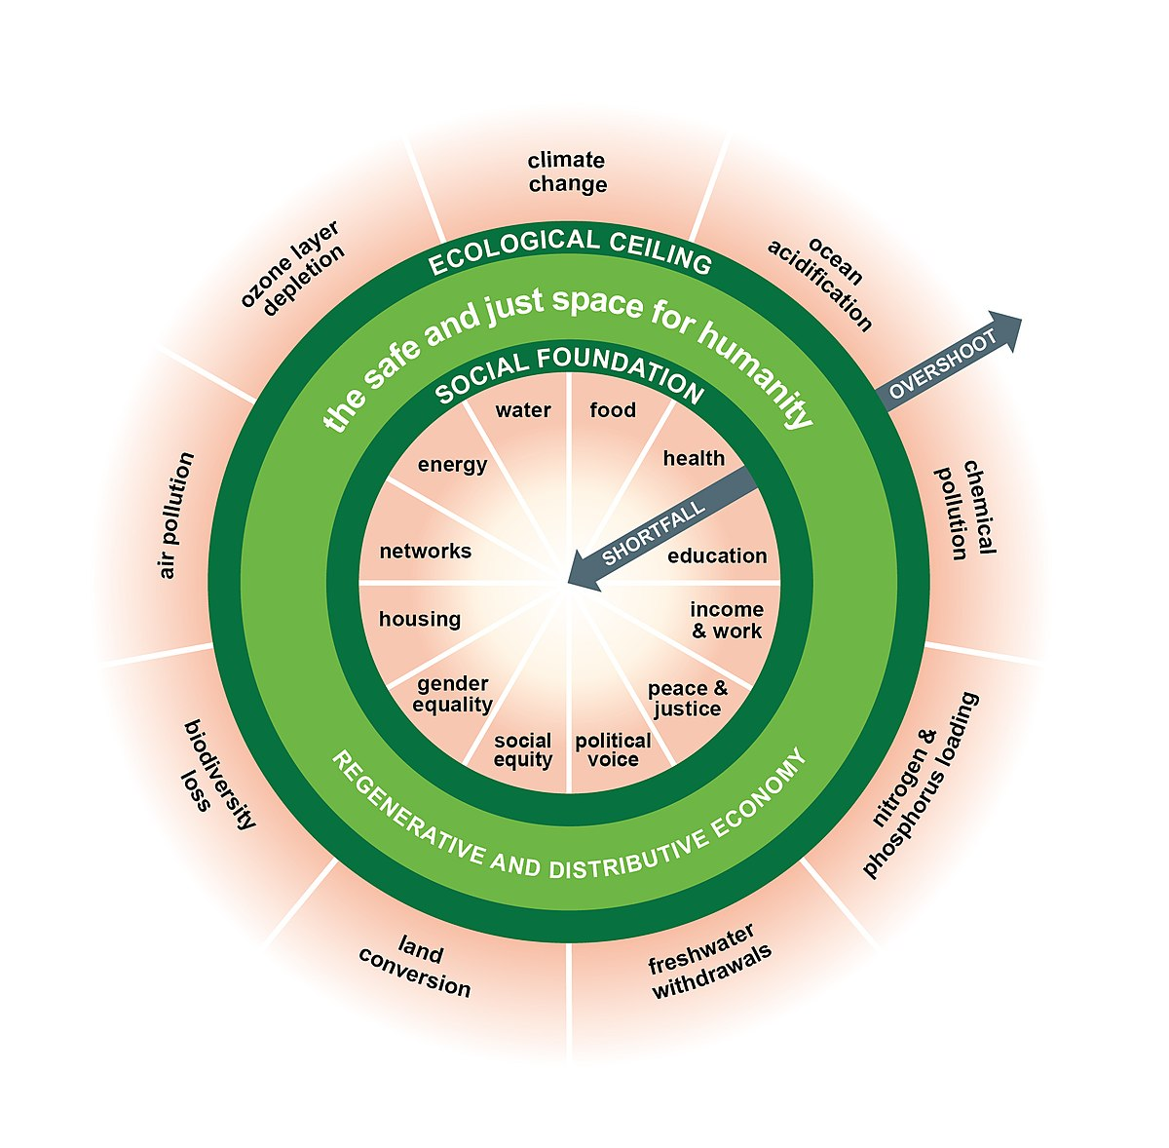
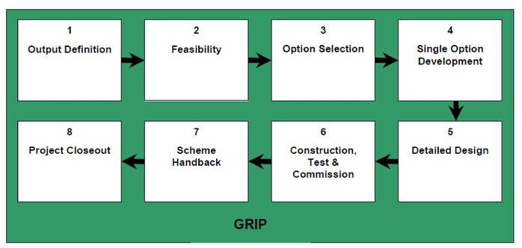
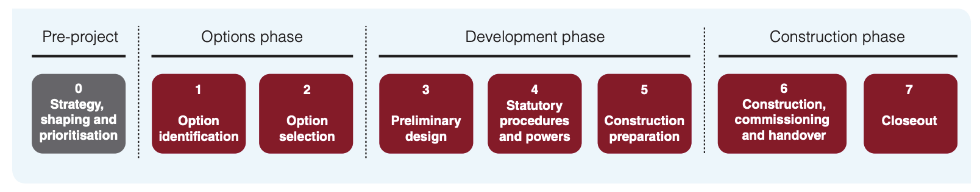
Infrastructure delivery machine
Network rail GRIP
National Highways PCF

Slide 4
Infrastructure delivery machine
Experience and evidence-based framework to mitigate uncertainty and deliver socioeconomic ROI
Built environment expansion
The predictable linear progression of urbanization, gradually improving the provision of basic needs
Infrastructure delivery machine
(easy to invest in)
Built environment adaptation
Unpredictable disruption of urbanization, suddenly removing basic needs
Infrastructure protection machine
(not easy to invest in)
Experience and evidence-based framework to mitigate uncertainty and deliver socioeconomic ROI
Notes:
Reduce birth rate, natural resources, climate change etc

Slide 5

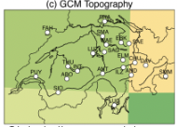
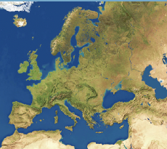
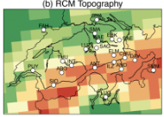
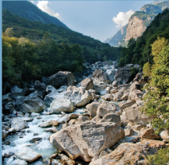
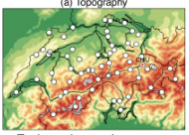
Experience and evidence-based climate data
There is a fundamental mismatch between climate models and local peril models
Climate models are highly complex, but aren't perfect
Generally run at relatively low spatial and temporal resolutions
Processes such as convection that produce flood-driving rainfall are often missing or parameterised
Topography and its influence on flood processes is poorly resolved
We adopt a change factor approach that links climate model output from multiple models to our high-resolution flood maps
GCMs
~150 km
HighResMIP
~25 km
Fathom hazard maps
~30 m

Slide 6
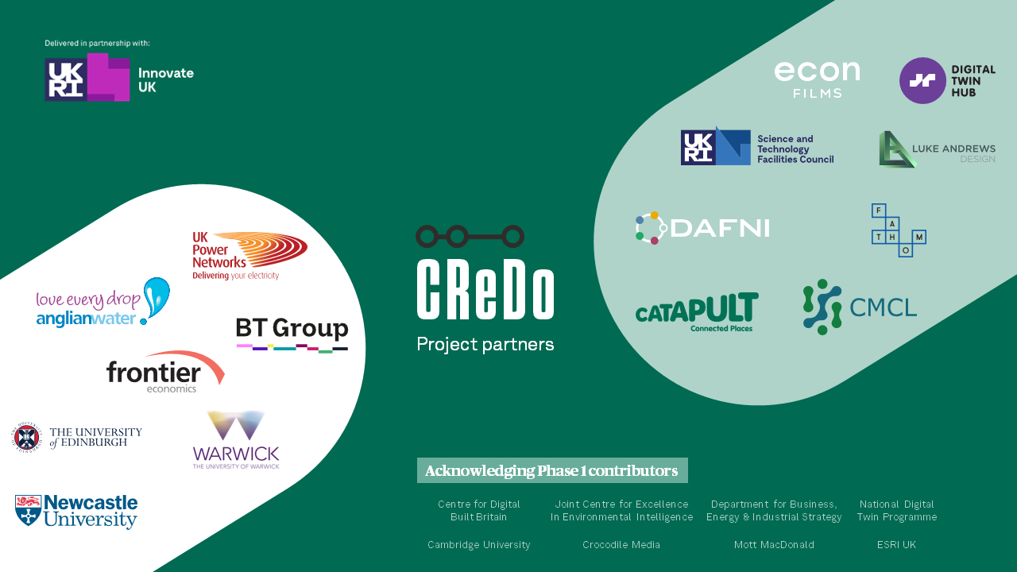
CREDO
What happens to our built environment when disaster strikes?
The Climate Resilience Demonstrator (CReDo) is a pioneering climate change adaptation digital twin project that provides a practical example of how connected data can improve climate adaptation and resilience across a system of systems.

Slide 7
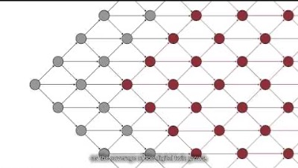

Slide 8
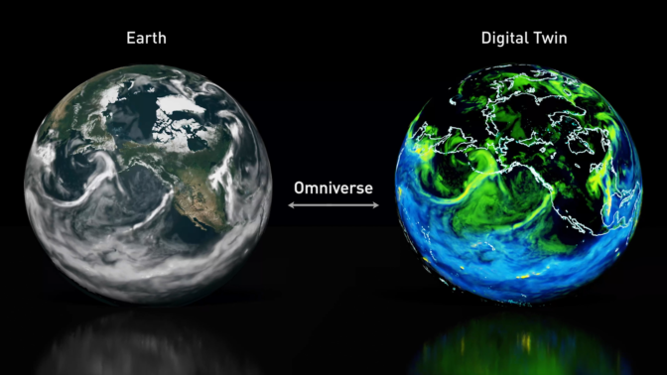



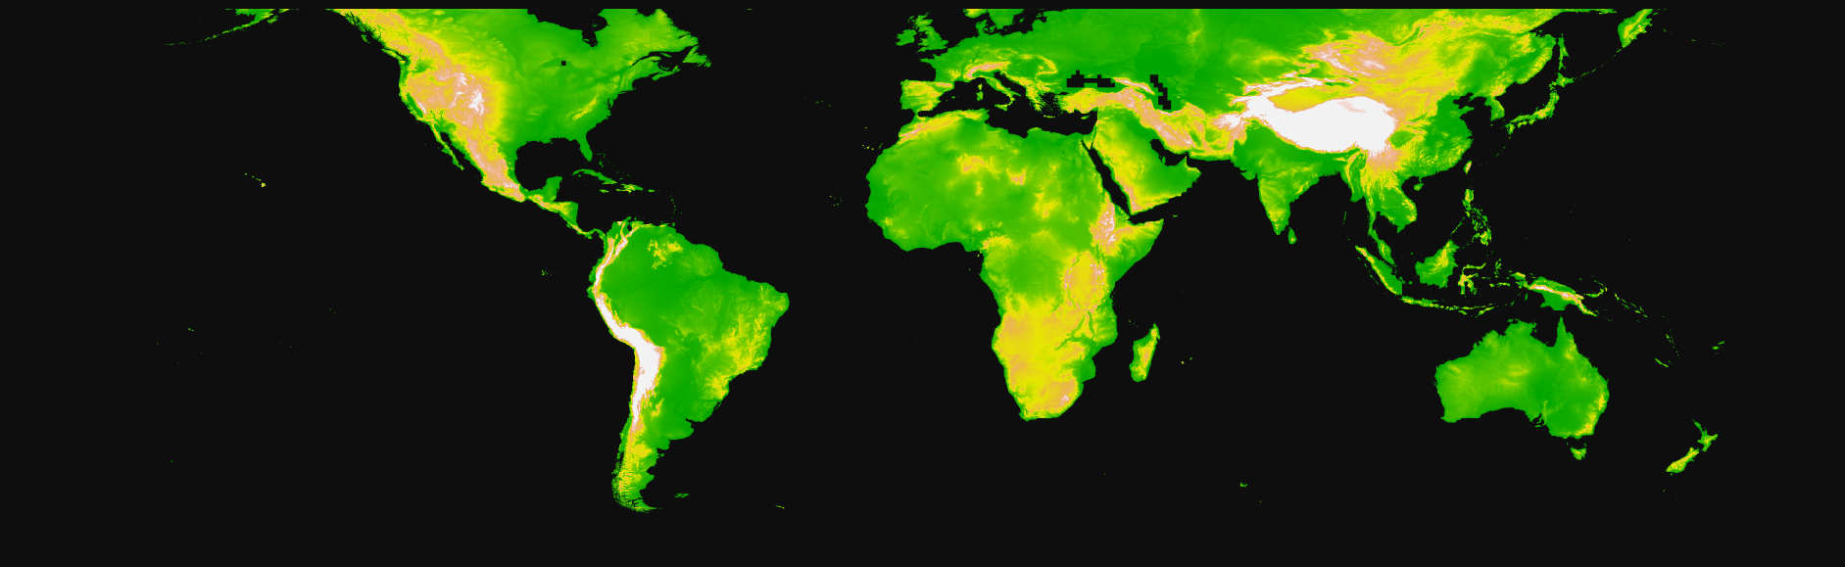
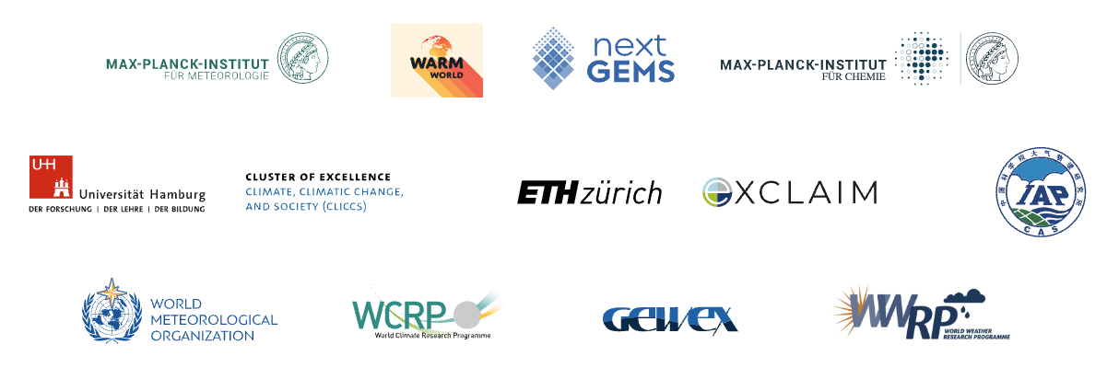
What else is happening?
Experience and evidence-based framework to mitigate uncertainty and deliver socioeconomic ROI
Infrastructure protection machine
(easy to invest in)
Earth Visualisation Engine consortium

