Slide 1
DT Hub Gemini Call
Building the Foundations for Digital Twins
Matt Webb – Head of Enterprise Data Management

Slide 2
The pig picture perspective
When it comes to digital twins, there are some key questions that UK Power Networks are grappling with and trying to contribute to answering:
What is the line between a digital model and a digital twin – does it really matter?
What do we need to do internally to develop our ‘digital twinning’ capabilities?
How do we ensure we are aligned and compatible with the rest of the energy industry?
How do we ensure we and the energy industry are aligned and compatible with other sectors in the context of whole system and the national digital twin?

Slide 3
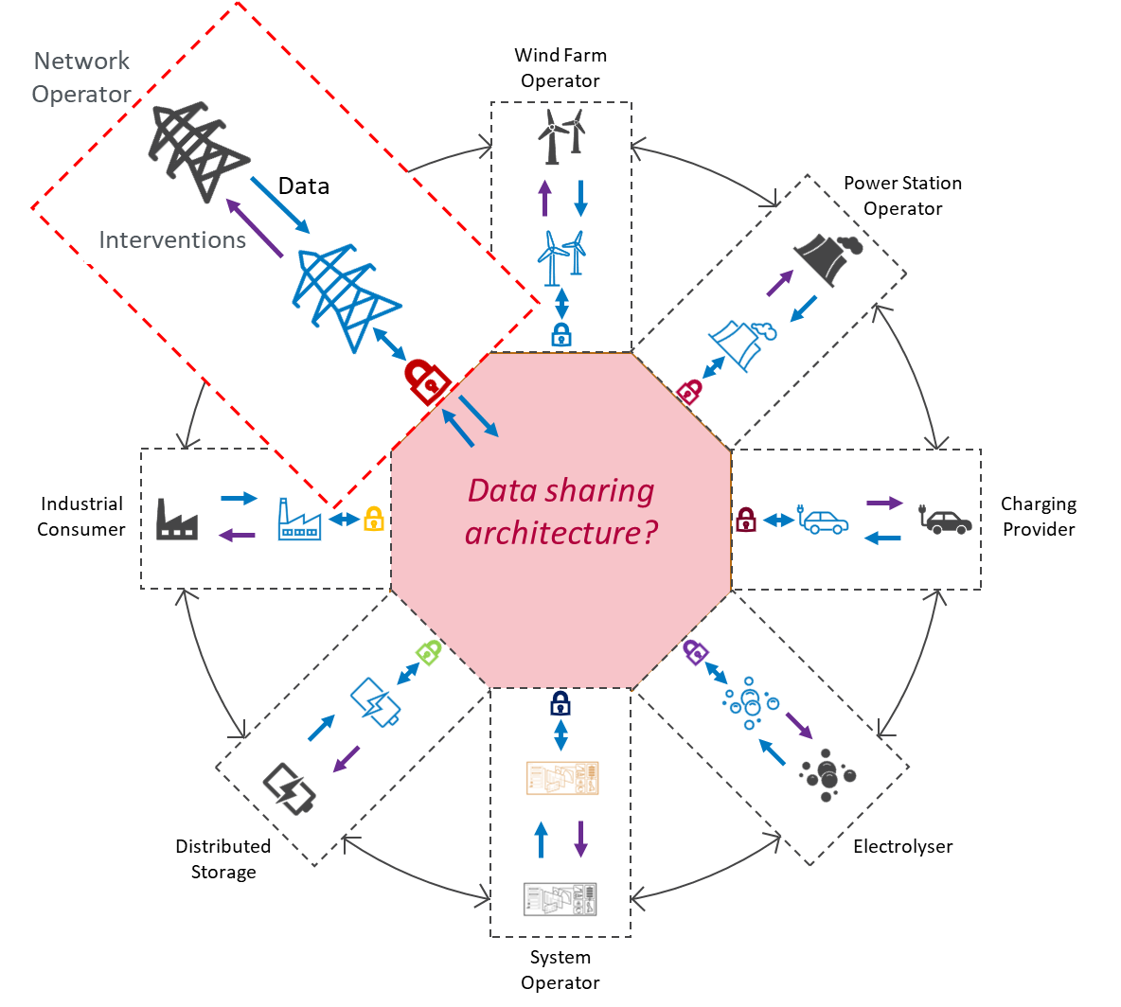




Understanding the role we play
Digital Spine?
Telco
Transport
Other built infrastructure…
Water
Energy
Virtual Energy System?

Slide 4
Building the foundations…
Digital maturity across the energy sector is varied, as it the data landscape. We therefore have a lot to do with respect to consistency, quality and reliability to ensure the full potential of an industry and national digital twin is realised.
Data Governance
Data Remediation
Master Data Management
BI / Analytics / Sharing / Twinning
Asset / use Case
Association & Alignment
Target Data Model
Quality Assessment
Master Data Definition
Data Engineering
Standardisation

Slide 5
Thank You

