Slide 1
Digital Twins for local roads: Building blocks
Digital Controller Interface Specification (DCIS)
Andy Graham and Jon Wade

Slide 2
About TTF
DfT and Innovate UK funded
Focus on local roads
  97% by length
Helping local authorities with technology
Get ready for digital future

Slide 3

About signal controllers
Grey boxes at side of the road ( “on the edge”)
Stop traffic signals doing dangerous things
  Which stages and phases run when, what are the gaps…
  The Italian Job cannot happen in the UK
Manage capacity and safety
  How detectors in the road / pedestrian buttons change signals
Can have complicated logic
  Trams, signalised roundabouts etc
The way they work is output as a paper form, or spreadsheet copy
Fundamental to CAVs, future mobility etc. We know what signals are doing - a “digital twin” of a controller others can access

Slide 4
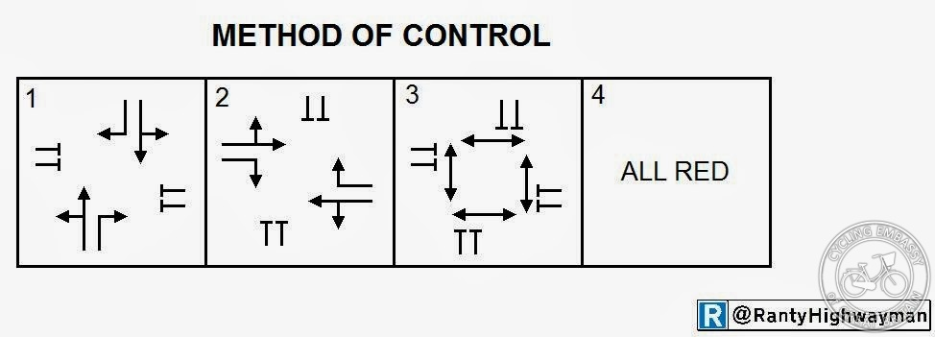
About signal controllers
Typical Controller Stage/Phase Diagram

Slide 5
The role of DCIS
Digital Controller Interface Specification (DCIS)
  Many potential use cases, but all improving data connectivity in traffic management
Digital twins offer improvements, but there are key requirements
  A digital base model of the controller
  A coherent, standardised means of identifying relevant elements (cf NaPTAN for public transport) – i.e. a numbering scheme for traffic signals
  Linking to other digital twins..
    Of the roads that feed traffic into junctions
    Of the utilities below
    Of the power and comms networks we connect to
    Of the rules of the road (Digital Traffic Regulation Orders)

Slide 6
Proposed 4 Step Approach
1. Intersection Summary Document
2. Intersection Diagrams
3. Intersection Definition Documents
4. Controller Configuration Documents

Slide 7
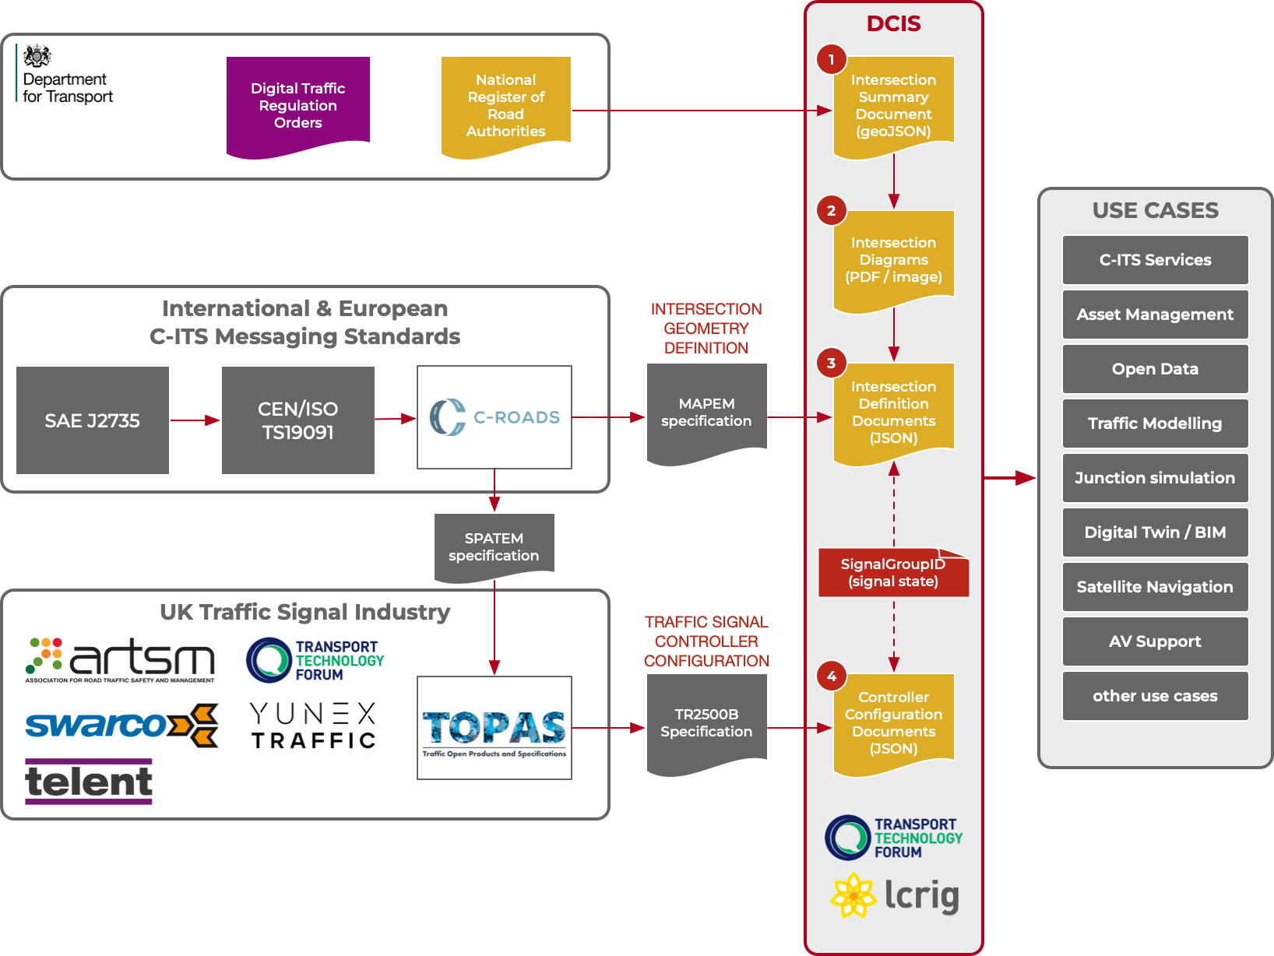
The aim of the DCIS project is to create a specification for how signalised intersections are:
Identified – numbered with a nationally unique “IntersectionID”
Defined - in terms of their lane geometry and turning logic
Controlled - by traffic signals
Ensuring that other international, national and automotive standards are also being upheld.

Slide 8
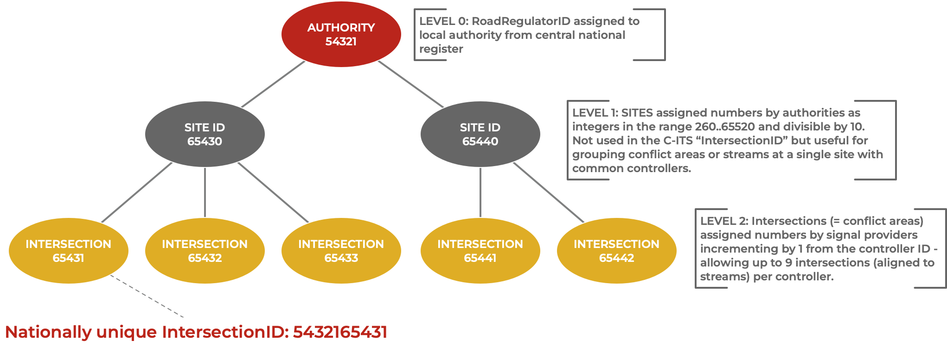
Intersection Identification

Slide 9
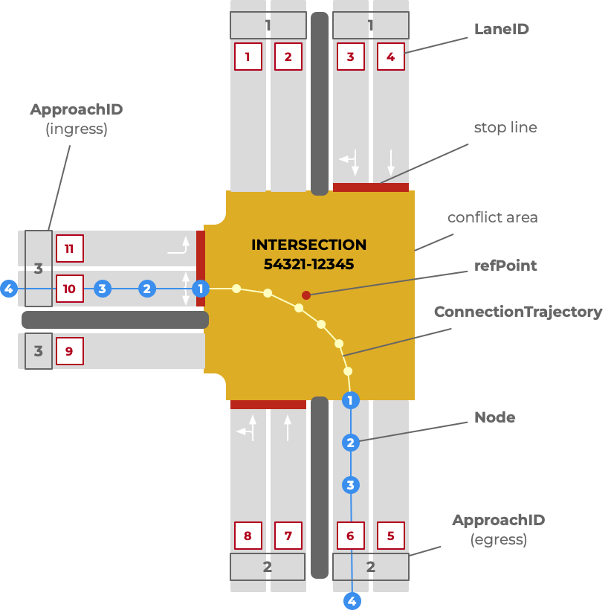
Intersection Geometry
The CEN/ISO TS19091 defines the MAPEM message standard defines how an intersection should be defined in terms of its lane geometry, and the permitted connections between lanes.
The way that lanes are defined (as nodes offset from a refPoint in MAPEM is relatively complex requiring specialised software.
We can see a potential need for a MAPEM “lite” which would allow the definition of the intersection lane elements but without the need for accurate lane geometry.

Slide 10
So what ?
The benefits from DCIS are:
• Integrating with other digital twins to produce a full model of the road network and what is below it
• Making it easier and cheaper to model junctions, both in real time and for planning/ development control/ new schemes
• Allowing sat nav suppliers, connected and later AVs to access digital data on how signals work rather than a PDF
• Enabling new services by providing basic data to enable data feeds
• Making it easier to plan utility works using a digital twin of the junction (ie not dig up our sensors)
• Improving asset management of signals, and reducing costs for signal development and refresh
• Allow cheaper and easier record keeping of junctions and portable signals
And many other benefits of starting the digitalisation of signals

Slide 11
Contacts
Andy@whitewillow.biz
jon.wade@interoperate.co.uk

