Slide 1
Credo update and thank you
Yalena Coleman

Slide 2
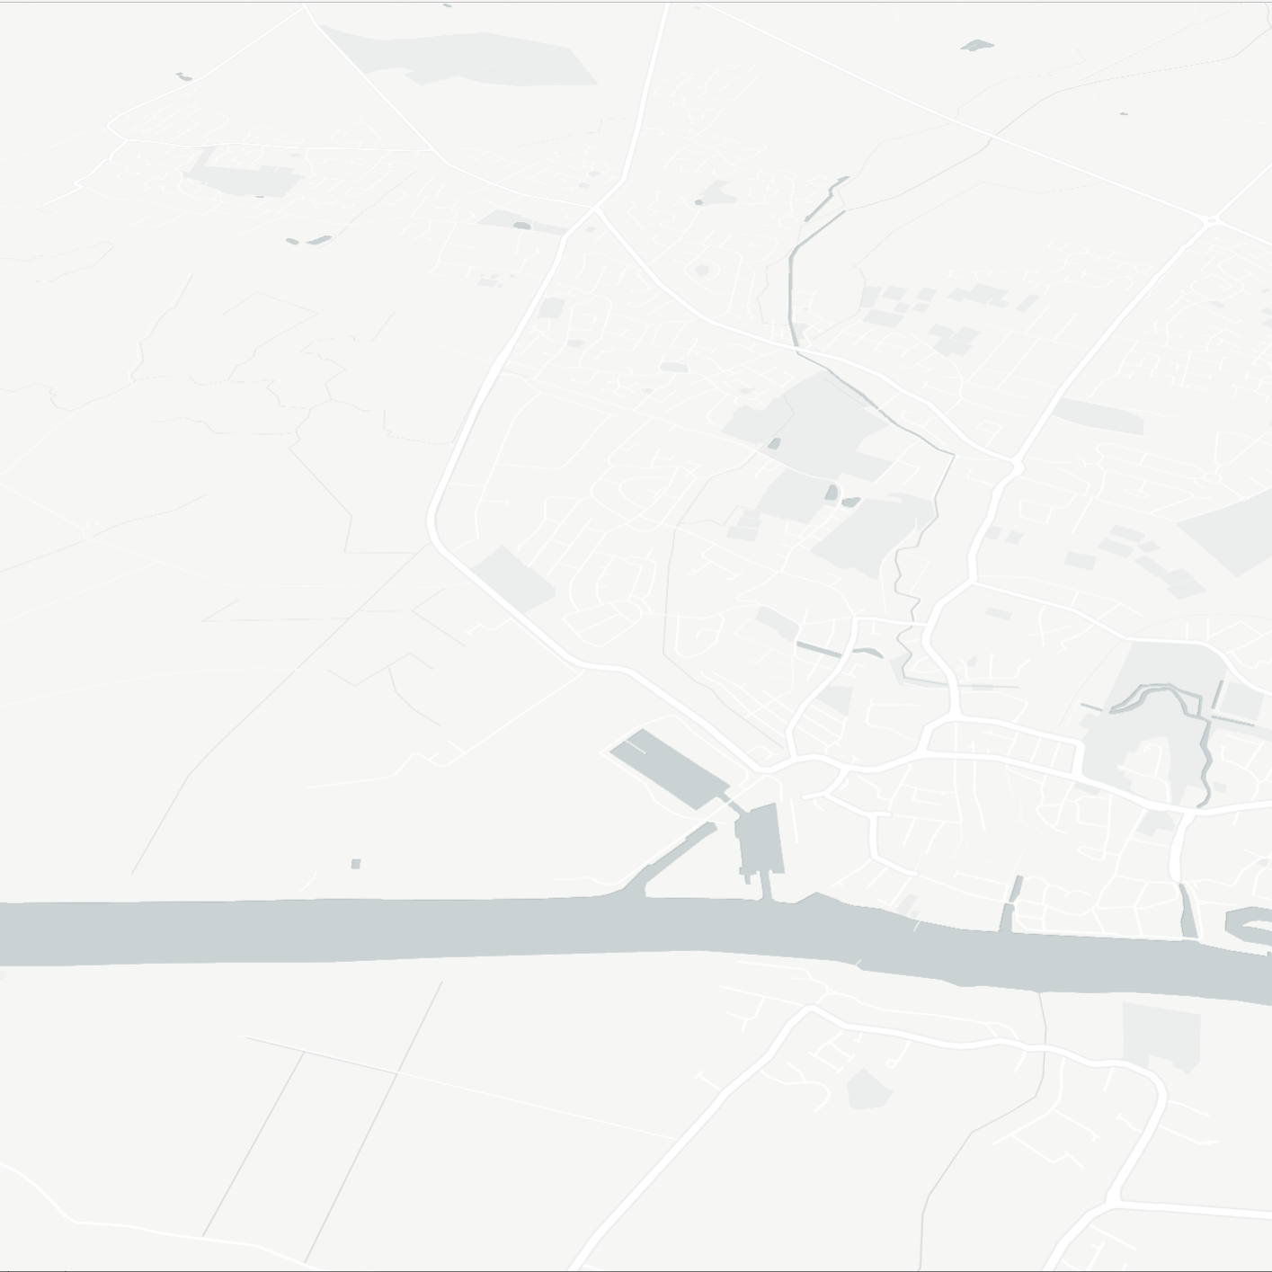
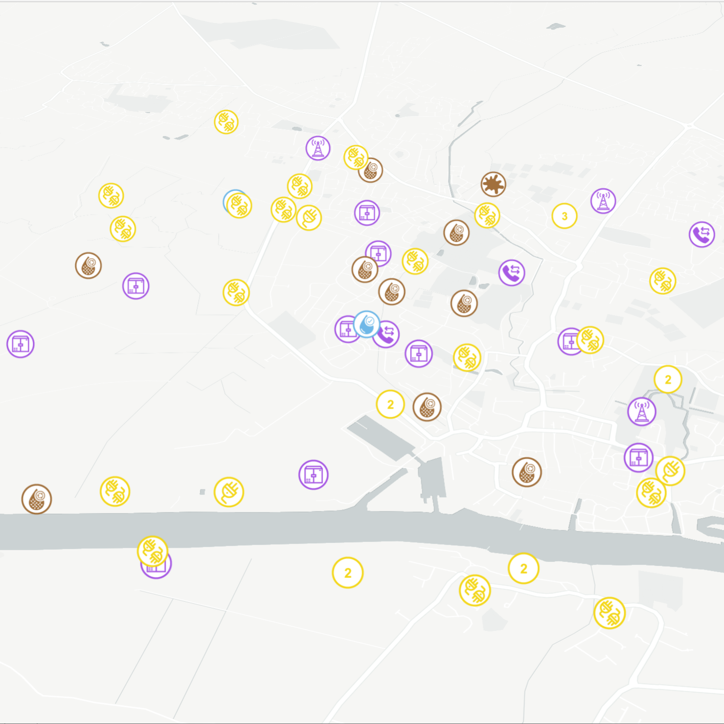
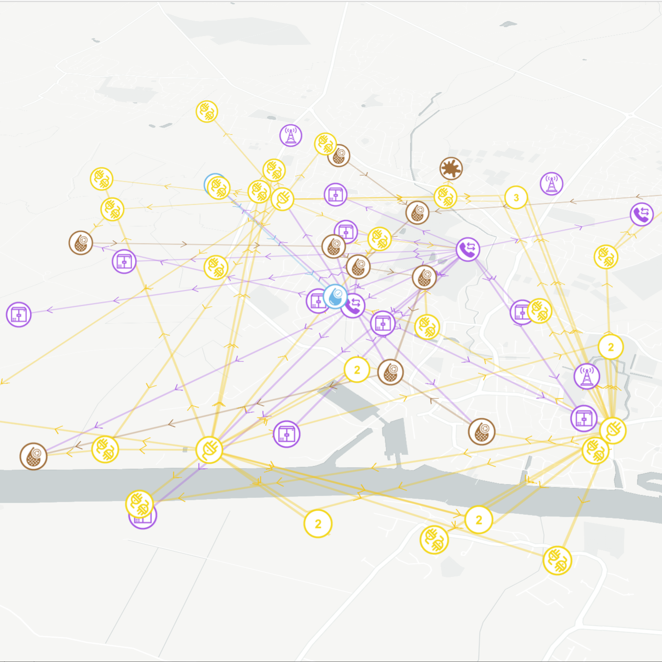





Phase 2
Objectives
Build in flexibility for future system functionality expansions and extensibility to new asset owners and data types.
Move existing CReDo functionality to a new distributed architecture where Asset Owners have the capability to control their data in their own secure environments.
Continue to explore and
develop methods of promoting interoperability.
Enable asset owners to see the
system level view and insights from the digital twin according to the conditions of the data license.
Unlock the strategic resilience planning use-case so Asset Owners can access and interact with real data for both their own and interconnected assets.

Slide 3
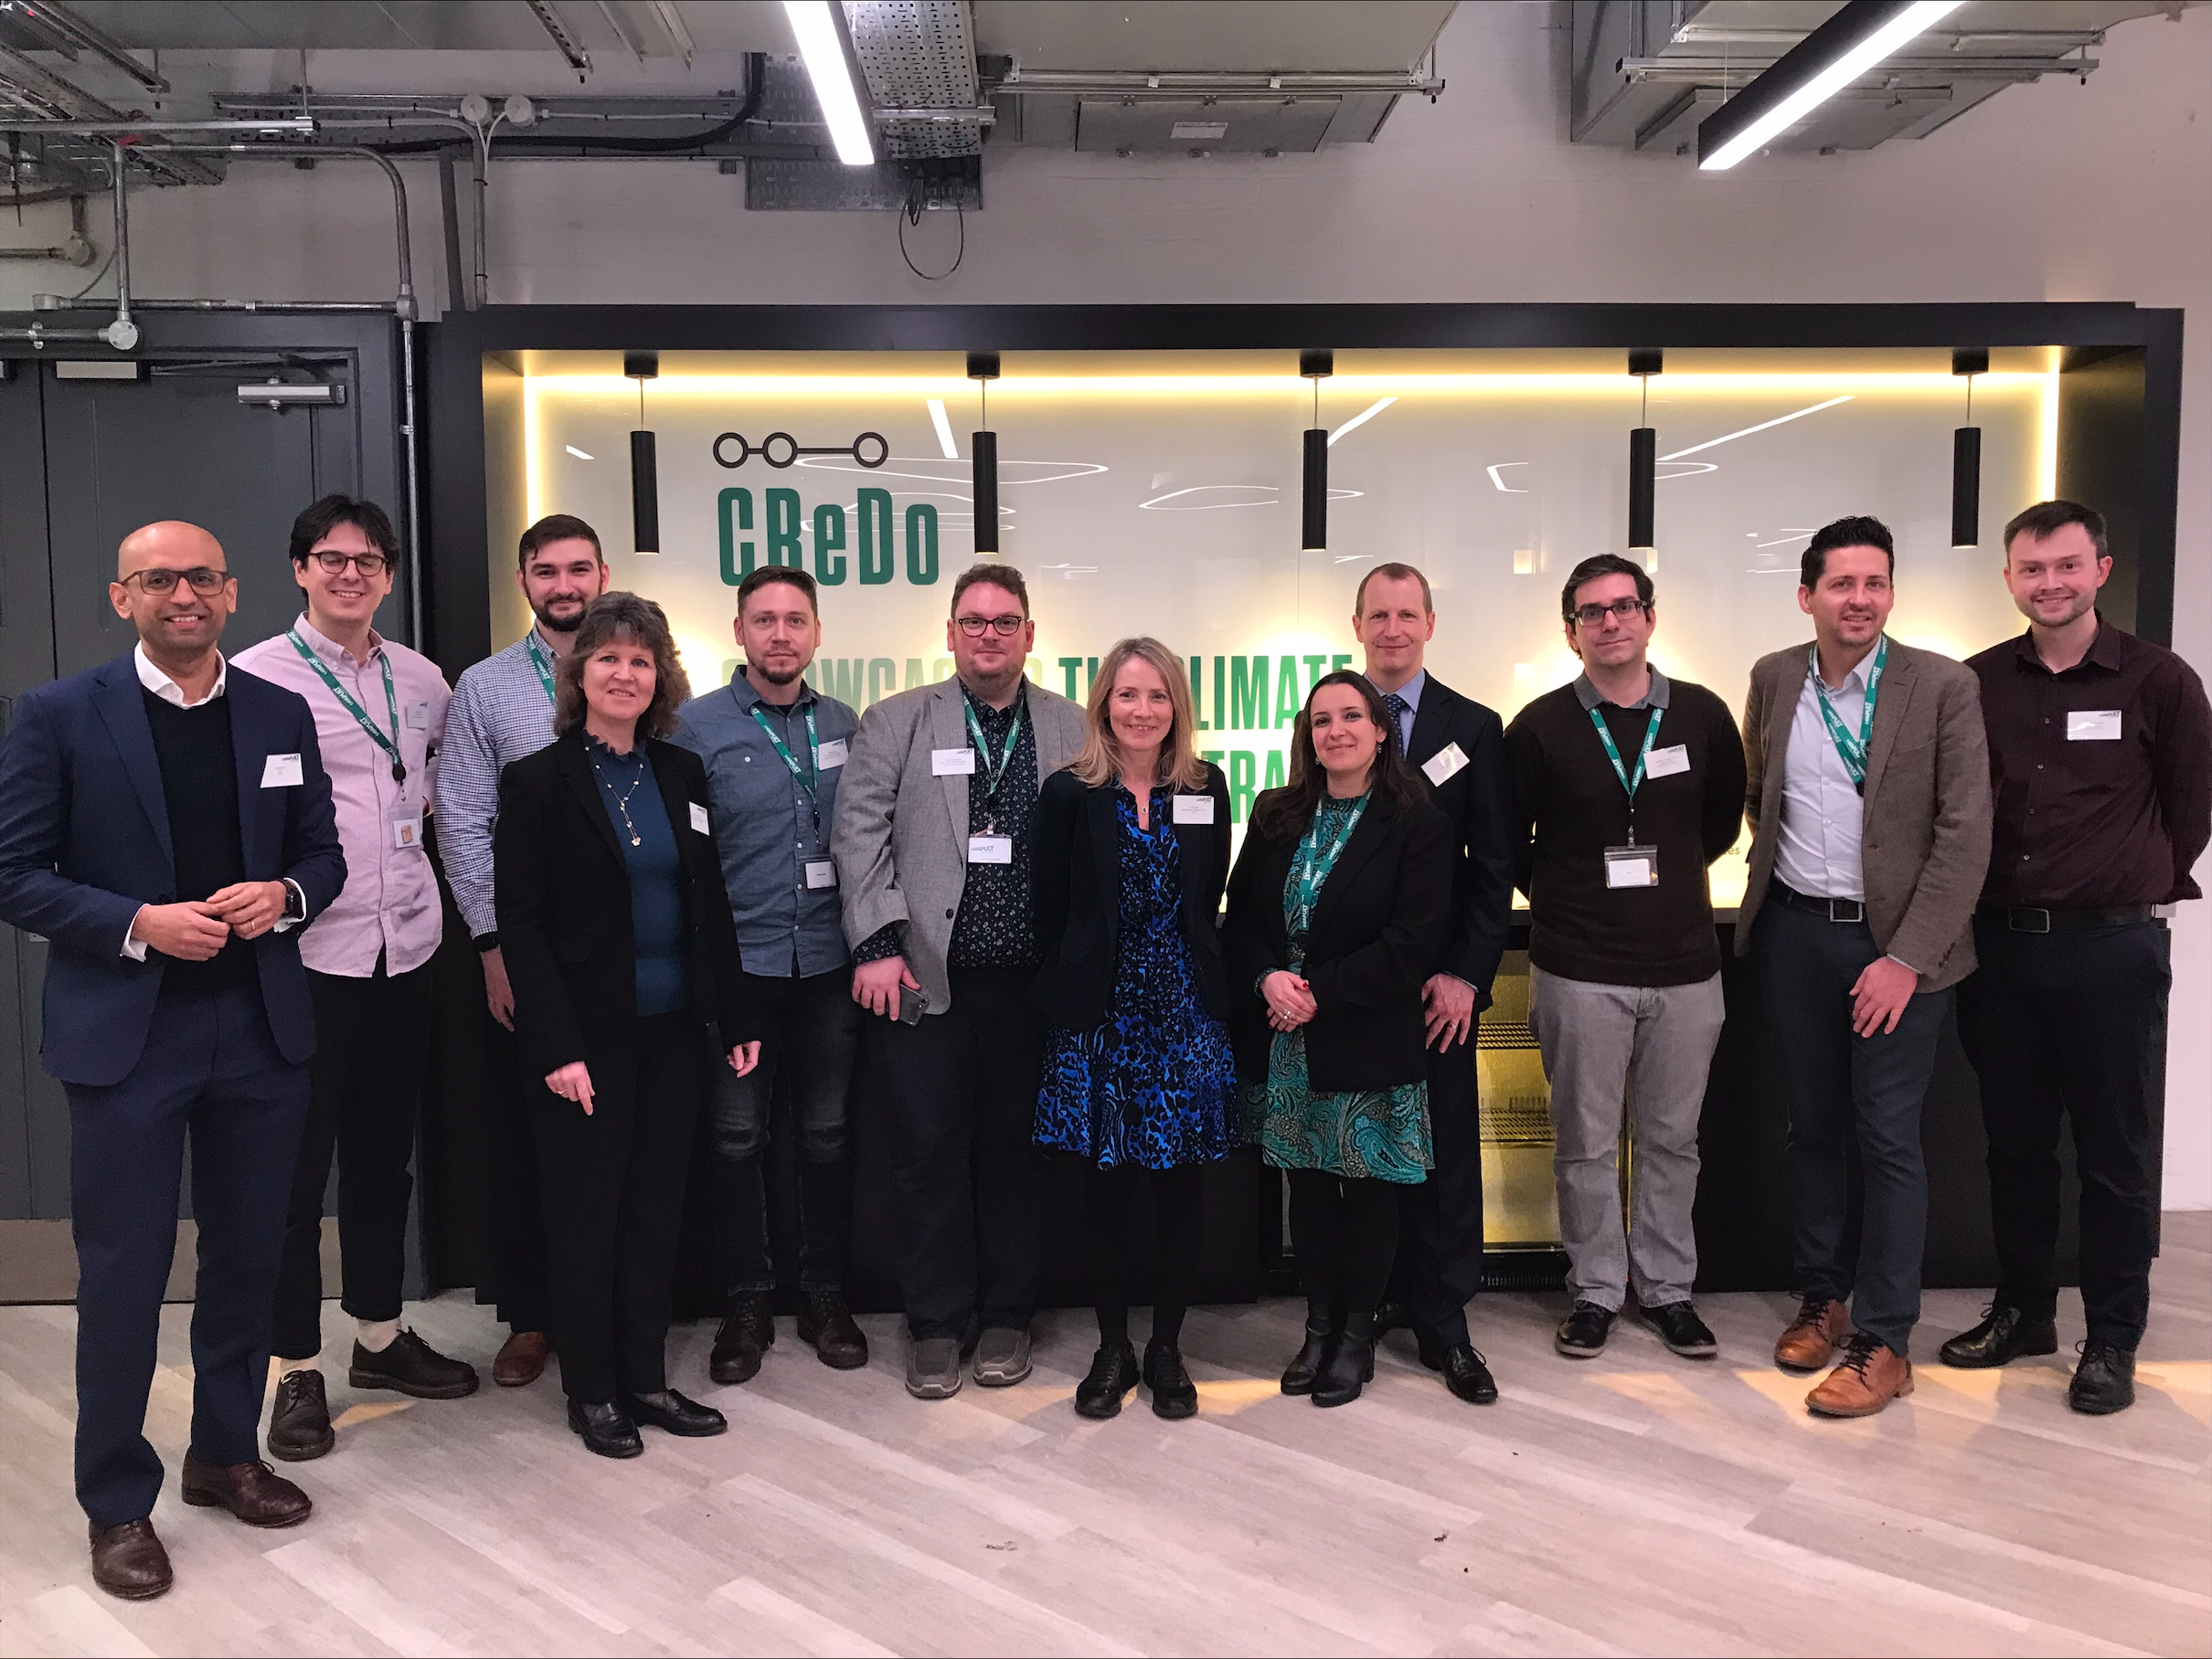
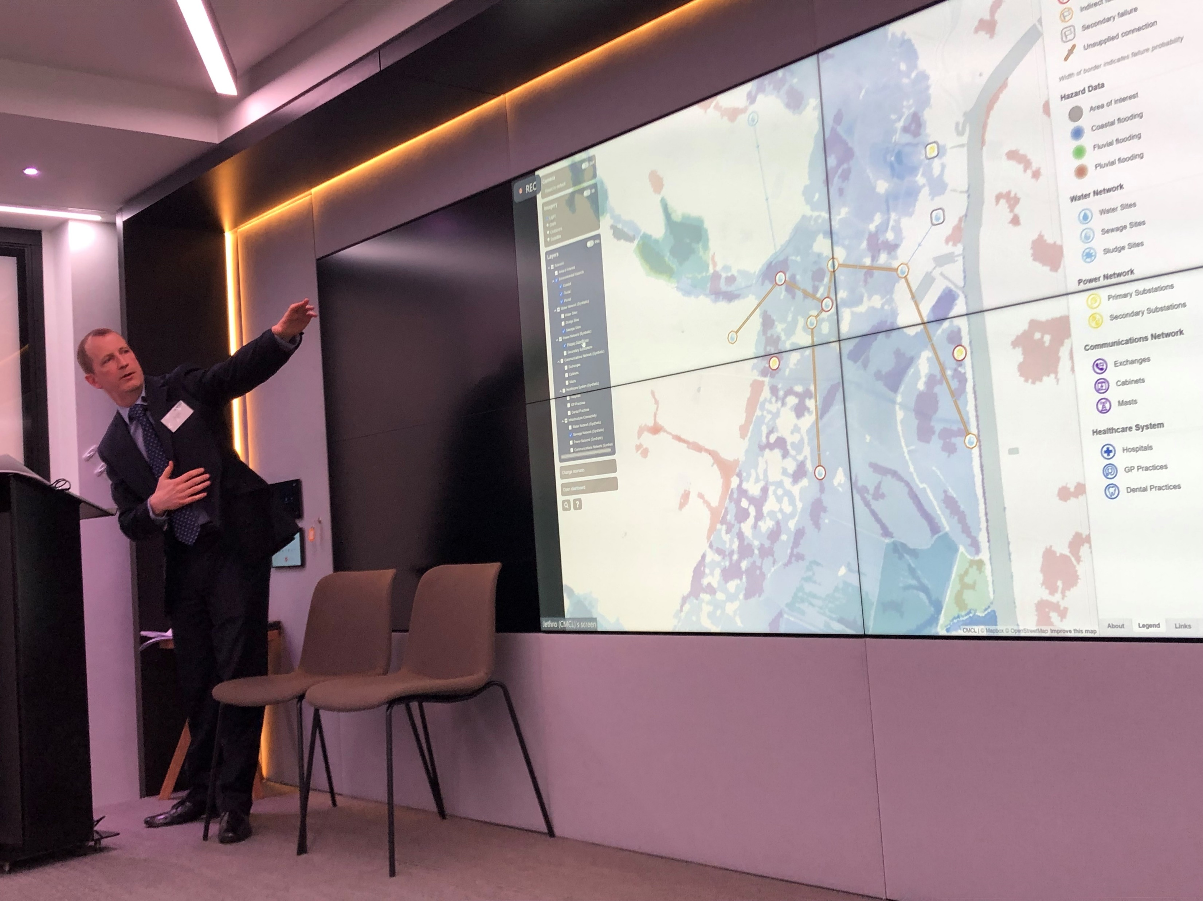
Showcasing CReDo

Slide 4

Phase 2 films
4 minute film played at CReDo conference
Longer film to be released this week

Slide 5















Project partners
Acknowledging Phase 1 contributors
Centre for Digital Built Britain | Joint Centre for Excellence In Environmental Intelligence | Department for Business, Energy & Industrial Strategy | National Digital Twin Programme
Cambridge University | Crocodile Media | Mott MacDonald | ESRI UK

Slide 6
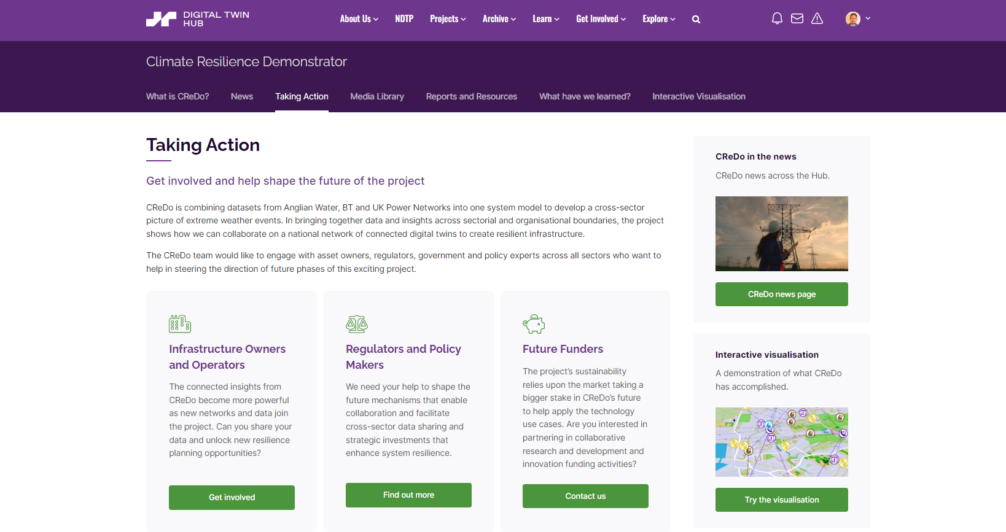
Together we want to take action
Notes:
How can you help - we want you, together with ourselves to take action.
The CReDo team would like to hear from Infrastructure Owners, Operators, Regulators & Policy makers, Future Funders, collaborators or investors.
For infrastructure owners - We are keen to explore bringing in more infrastructure data to drive richer insights
For regulators and Policy makers - we are keen to engage around facilitating cross-sector data sharing to enhance system resilience.
Funders/investors – CReDO as a solution is showing great promise as we have seen today – we want it to fulfil its potential and are keen to discuss with the market input in to our future roadmap and gain co-support for a sustainable funding pathway.
The Taking action pages for CReDO on the Digital Twin Hub provide all the details – perhaps someone can put the link in the chat please.
We look forward to working with you to make the next phase of CReDo a success.

