Slide 1
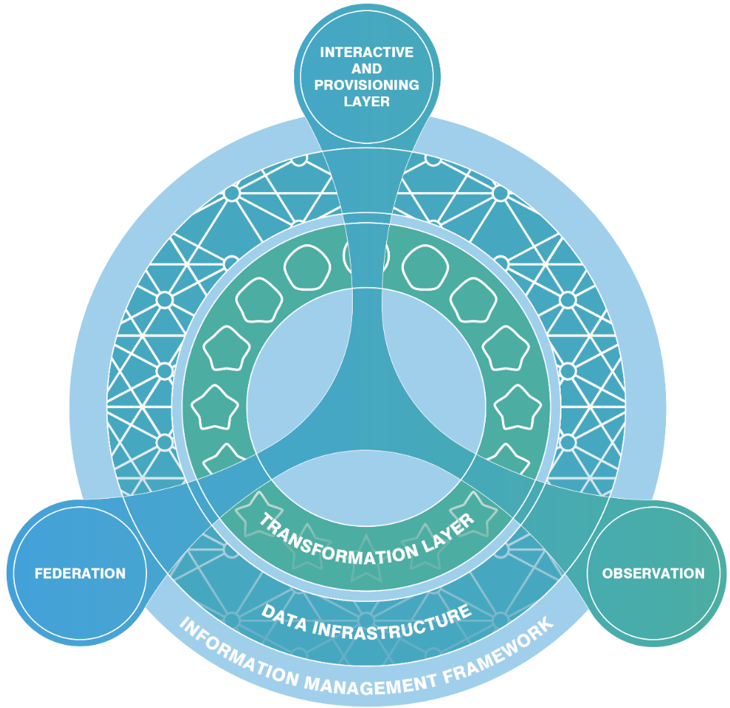
An Information Management Framework for Environmental (IMFe) Digital Twins
DT Hub Gemini call
25th April 2023
J. Buck¹, J. Siddorn¹, G. Blair², D. Boot¹, J. Byrne⁵, A. Kingdon³, A. Kloker¹, A. Kokkinaki¹, G. Moncoiffe¹, E. Blyth², M. Fry², R. Heaven³, E. Lewis⁴, B. Marchant⁴, B. Napier⁴, J. Passmore₄, S. Pepler⁴, P. Townsend⁴, J. Watkins³ and K. Winfield⁴
¹ NOC, ² UKCEH, ³ BGS, ⁴ STFC, ⁵BAS

Slide 2
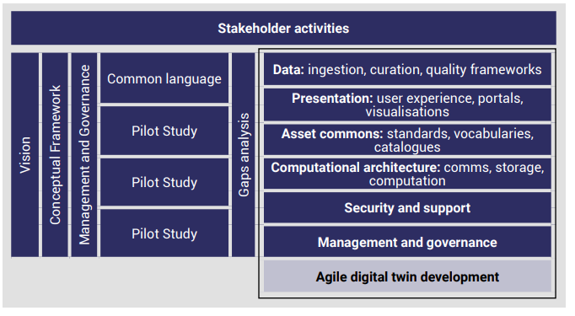
What is a digital twin? …..
A tool to improve decisions.
A digital twin is a virtual representation of a physical asset enabled through data and simulators for real-time prediction, optimization, monitoring, controlling, and improved decision making.
Information Management Framework (IMF):
Establishing a shared vision
Developing the conceptual framework
Agreeing, and implementing, digital commons
Delivering demonstrators (pilot DTs)
Developing DT components
…with use cases
Siddorn, J. et al. (2022). An Information Management Framework for Environmental Digital Twins (IMFe). https://doi.org/10.5281/ZENODO.7004351

Slide 3
Developing a roadmap for an IMF for Environmental Digital Twins (IMFe)
- Results of the IMFe roadmap project (October 2021 – March 2022)

Slide 4

Methodology – Combining Top-Down and Bottom-Up approaches
CDBB
ENVIRONMENTAL DT THEORETICAL LANDSCAPE
THEORY
THEORY & EXISTING LANDSCAPE COMBINED
Brought together based on the 3 project use cases to develop the IMFe model
DRAFT IMFe
IMFe model
and roadmap
BAS
LAND INSIGHT
3DT
FDM
RDL
IA
GOVERNANCE
OTHER
EXISTING LANDSCAPE

Slide 5
Piloting the IMFe
- New project running from October 2022 to November 2023

Slide 6
Piloting the IMFe
IMFe Development Framework
(WP2)
Conceptual framework to support IMFe development
IMFe Framework
'An IMFe management and governance approach built upon the concept of the commons, consistent with the CDBB and future National Digital Twin programme approaches, should be produced and made widely and freely available’ (Recommendation 4)
Theoretical meets realisation
A generalisable
IMFe
(WP3)
Working with WP4 and other DTs, to create a reusable IMFe
IMFe Services
‘Following the review of ontologies in the IMFe project, ensure that recommendations are made for ontologies as part of the IMFe governance’ (Recommendation 14)
‘Future digital twin development projects should include appropriate effort in the development of vocabularies and ontologies, including cross-disciplinary top-level ontologies as well as the bridging mid-level ontologies and domain ontologies’ (Recommendation 15)
Stakeholder engagement
(WP1, WP4.1)
‘Building on the current momentum of stakeholder engagement and establishing fora for engagement that ensure cohesive community engagement on digital twin governance, coordination and development approaches’ (Recommendation 2)
Common software, designs and standards
IMFe in the Haig Fras
Pilot Study
(WP4)
Agile design and build of Haig Fras Digital Twin
Haig Fras Digital Twin
‘A number of diverse environmental digital twin pilots, with explicit reference to the IMFe building blocks as detailed in this project, need developing to challenge and test the IMFe and our readiness to implement it’ (Recommendation 8)

Slide 7
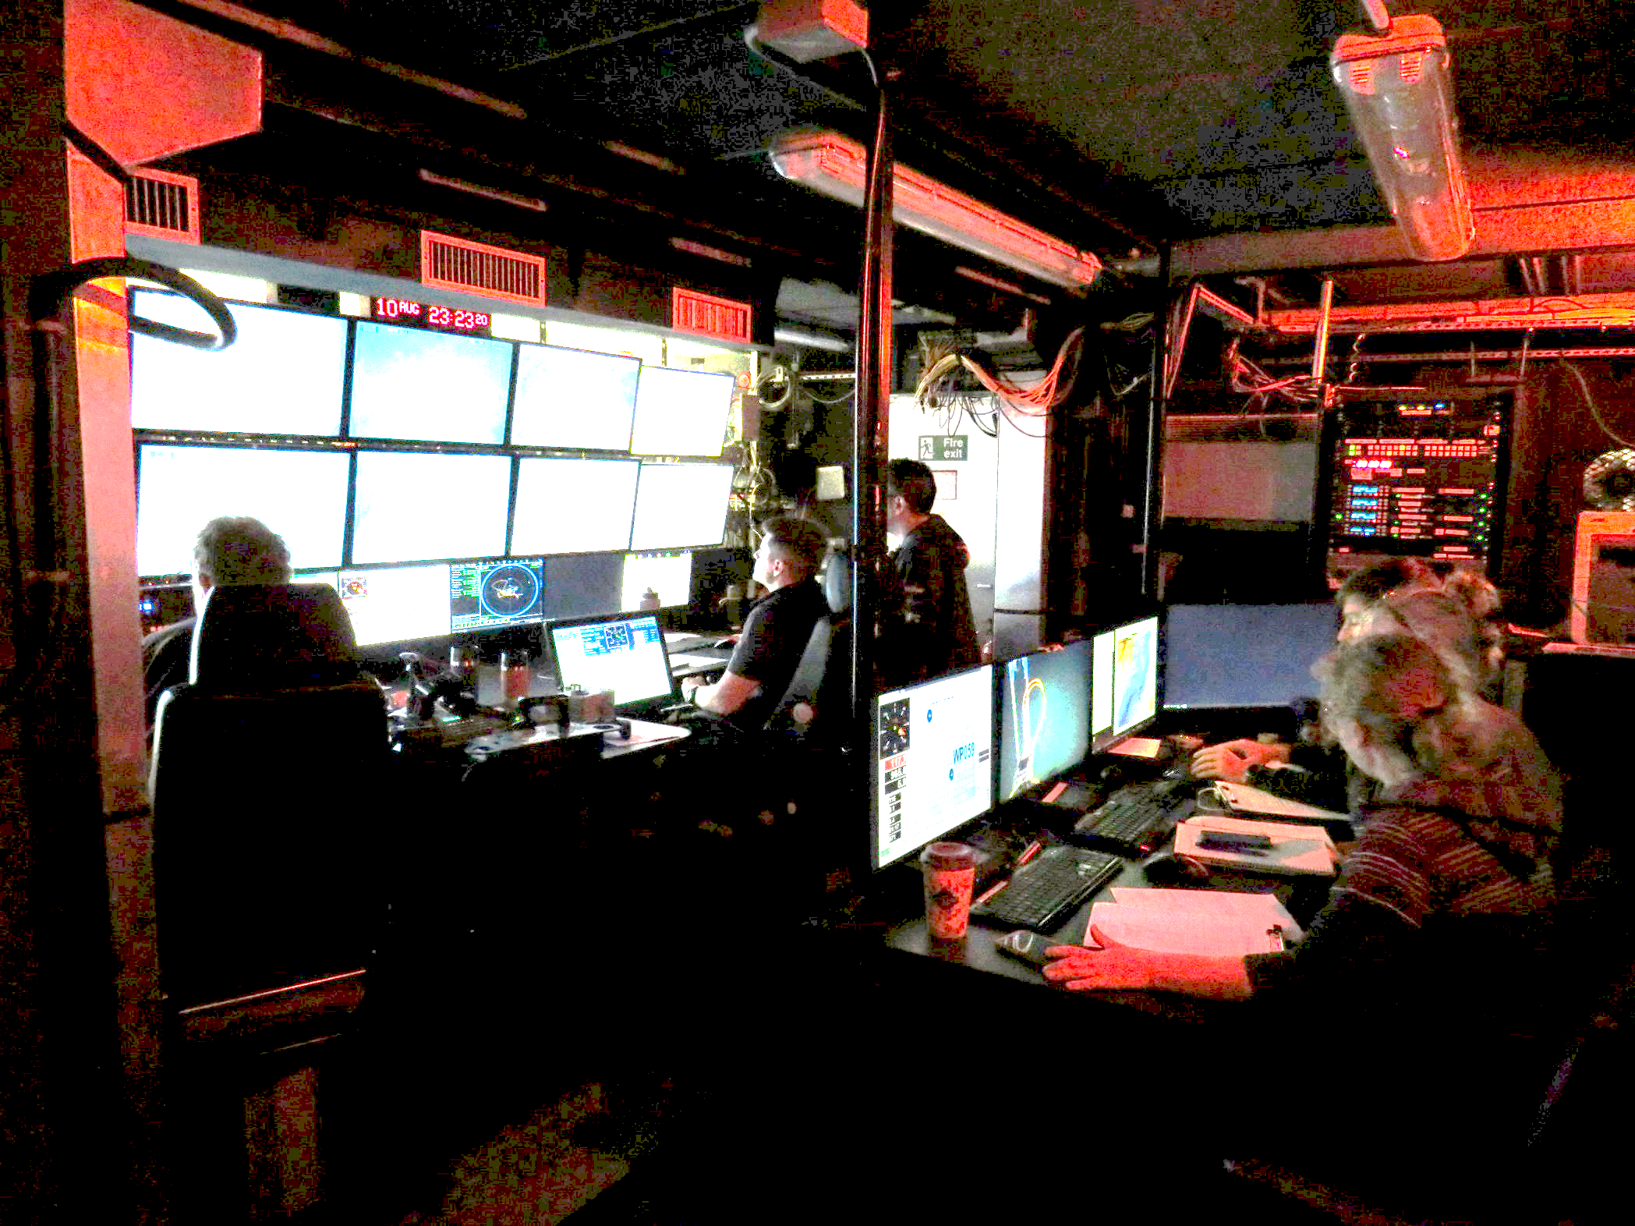
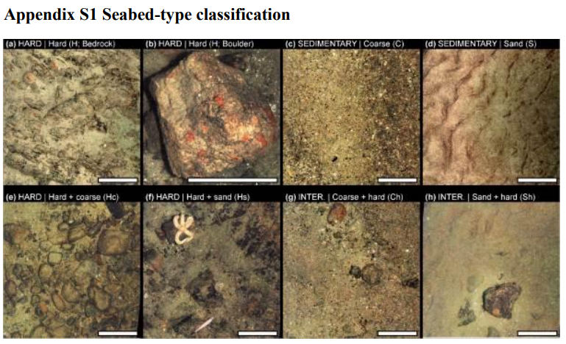



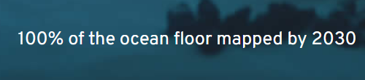


An Impactful Digital Twin case study on Marine Biodiversity
Ocean protection is a policy priority and protection of 30% of the ocean by 2030 a commitment of the UK G7 Presidency.
Monitoring is critical to assessing the success of Marine Protected Areas.
Imagery is increasingly used as a non-destructive method.
Infrastructure will be built from other funded projects
The end-to-end workflow from mission planning, data processing to decision-ready information all require AI developments.
  Build on and develop SciVision and other Turing open tools
  Bring together Cefas, NOC, PML etc to consolidate and improve the AI used in image collection
Move towards continuous, timely assessment of our protected seabeds.
Haig Fras Marine Protected Area
The Autonomy control room on board RRS James Cook
Seabed 2030 Global Data Centre
From Benoist et al., (2019). Monitoring mosaic biotopes in a marine conservation zone by autonomous underwater vehicle. Conservation Biology, 33(5), 1174–1186. https://doi.org/10.1111/COBI.13312
Durden et al. (2021). Automated classification of fauna in seabed photographs…. Progress in Oceanography, 196, 102612.
Durden et al. (2016). Perspectives in visual imaging for marine biology and ecology: from acquisition to understanding. In Oceanography and Marine Biology, pp. 9-80

Slide 8
Asset register
Developing an asset register is a key outcome of Piltoing IMFe project
Asset register will enable digital twin to be:
  Documented
  Discoverable components
  Machine actionable component descriptions
First version of asset register will be at:
  https://catalogue-imfe.ceh.ac.uk/pimfe/documents
Analytical Utilities
Sensor Network Outputs
Process Model
Components
Semantic Tools &
Ontologies
Spatial
Baseline Datasets
Potential Asset Register Contents
Standards & Best Practise
Documents
Temporal
Baseline Datasets
Linked Data
Archived
Code Components
Visualisation Utilities

Slide 9
Engaging with the broad digital twins development community

Slide 10

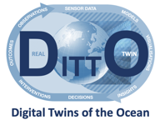

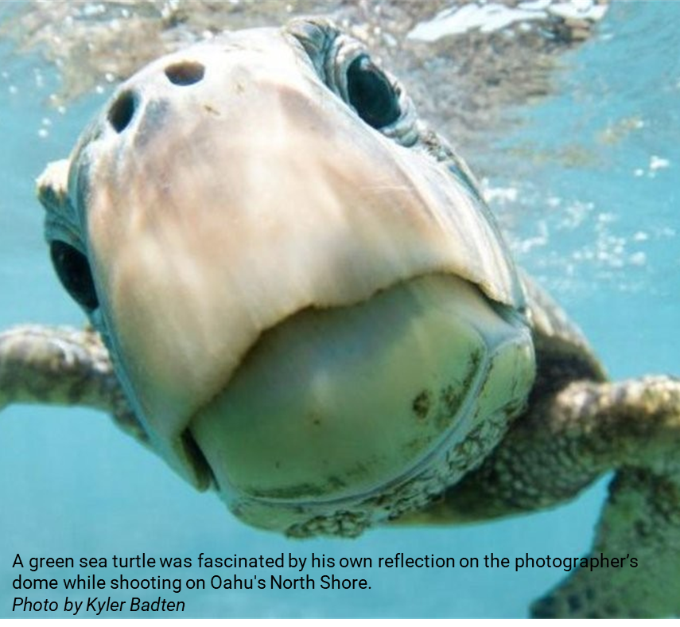
Digital Twins of the Ocean - DITTO
An accessible ocean with open and equitable access to data, information, and technology and innovation.
    The Haig Fras digital twin has been submitted as a DITTO project.
    Interoperbility architecture for a dgital ocean DITTO action (TURTLE)
    Collaboration within TURTLE enables the IMFe to be shared with and to learn from the marine domain.
Develop a comprehensive digital representation of the ocean.

Slide 11





Turing Research and Innovation Cluster (TRIC)
produce open and reproducible computational tools and provide these tools as an international resource
Digital Twin research in the areas of environment, infrastructure and health
Multi-disciplinary, sharing tools and techniques to create DTs with impact
Address important societal challenges, including around climate and climate impacts
Environment
Impact
Hub
Use demonstrators to democratise access to DT technology
Infrastructure
Health
Notes:
£6M initial fundinInfrastructure
g

Slide 12
Acknowledgements
This work has been commissioned by the Natural Environment Research Council (UKRI) under the project: Towards An Information Management Framework for Environmental Digital Twins (Grant Ref: 2021DTIMF1Siddorn. and the Piloting IMFe project (Grant Ref. NE/X016765/1).
We would like to thank the many contributors to this work. The case studies would not have been possible without the engagement of Aaron Hopkinson and Kirstine Dale from the Met Office, Scott Hosking, James Byrne and Maria Fox from the British Antarctic Survey and Ian Bailey and Steve Kochli from Telicent.
We would also like to thank Alex Luck of the Department for Business, Energy & Industrial Strategy (BEIS), Matthew West and Peter el Hajj from the Centre for Digital Built Britain (CDBB) and representatives of the European Commission’s Destination Earth programme (Peter Bauer, Nils Wedi and Irina Sandu of ECMWF) who helped set the wider context.
Additional thanks go to Aaron Hopkinson for his particularly active and helpful engagement and his contribution reviewing the report.
Thank you

