Slide 1
Improvements to the Energy System Digital Twin Visual Demonstrator
Eloise Thatcher (Energy Systems Catapult)
Andy Moore (Frazer-Nash Consultancy)

Slide 2

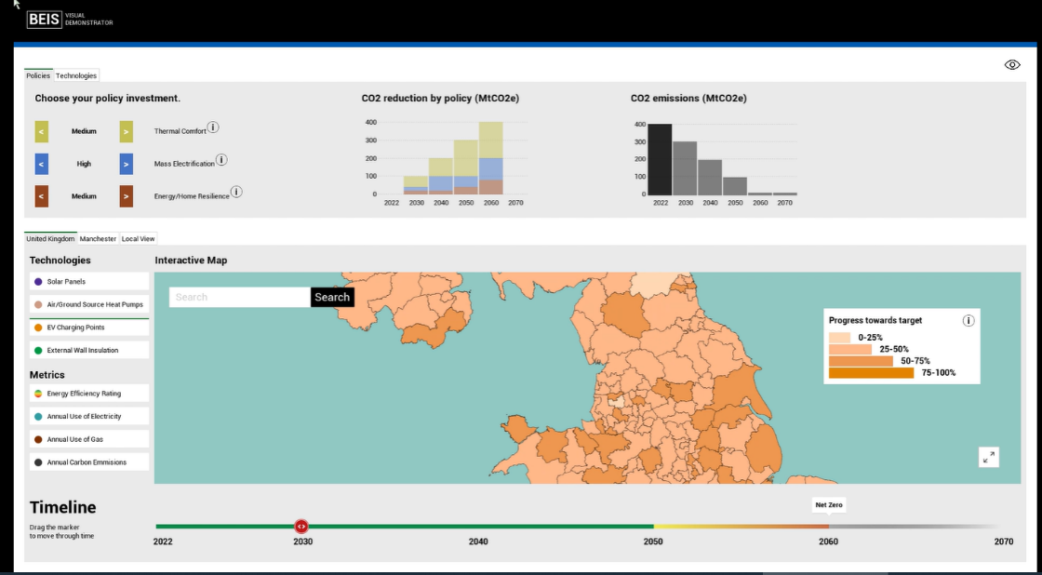
Energy System Digital Twin Visual Demonstrator
Use Case:
Decarbonise homes
For:
Policy professionals, minister and their staff
To:
Visualise the impact of decisions in a meaningful and accessible way

Slide 3








Our Motivation
how can we make digital twins more useful for policy makers?
reality
digital twin
policy makers

Slide 4




Our Motivation
What’s the problem?
reality
digital twin
policy makers
Our Challenge
Success
Can we expose some of the messy real world complexity in the home decarbonisation visual demonstrator?
These techniques inspire developments in other policy digital twins

Slide 5
How will we do it?
Understand
Design
Manage
Predict
reality
digital twin
policy makers

Slide 6
















How will we do it?
Understand
Design
Manage
Predict
reality
digital twin
policy makers
?
?
?

Slide 7





Using Uncertainty
Understand
Design
Manage
Predict
reality
digital twin
policy makers

Slide 8
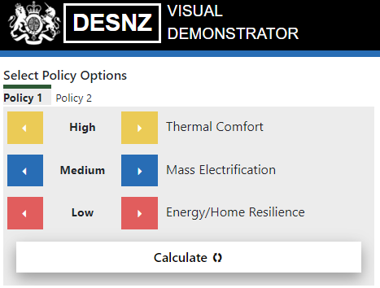
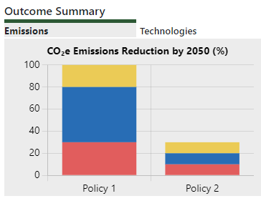
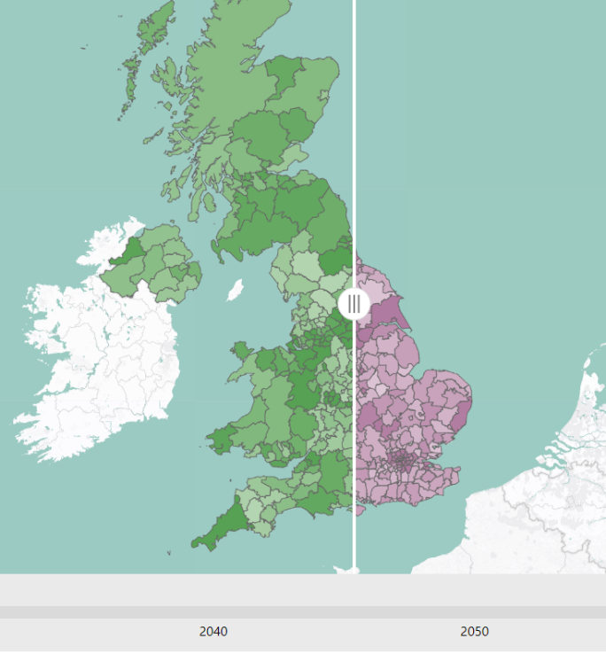
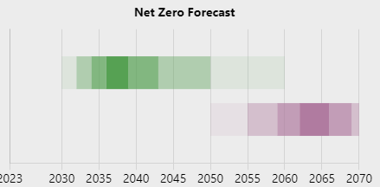
New Visualisation Features
1
The ability to easily compare policy options and outcomes

Slide 9
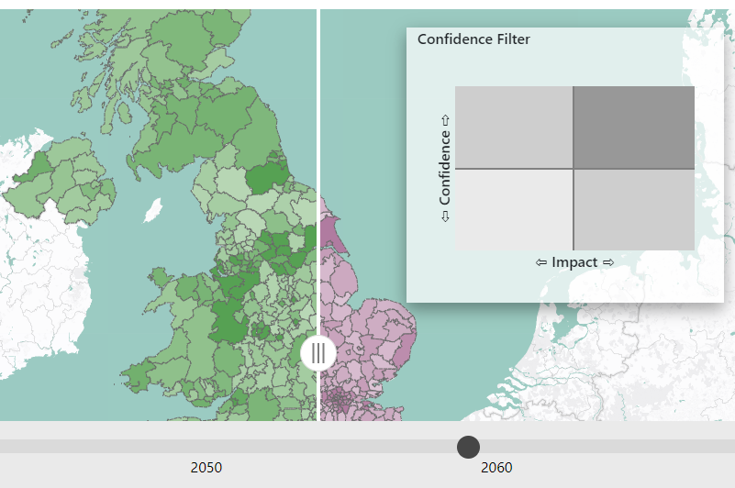
New Visualisation Features
2
Exploring how outcome confidence can be used to answer different questions
Where do we have high confidence that the policy will make a big difference?
Where do we have high confidence it won’t make a difference?
Which regions are we not sure about the outcome?
✓

Slide 10

New Visualisation Features
3
Explaining the logic behind the outcomes

Slide 11
New Visualisation Features
3
Explaining the logic behind the outcomes

Slide 12
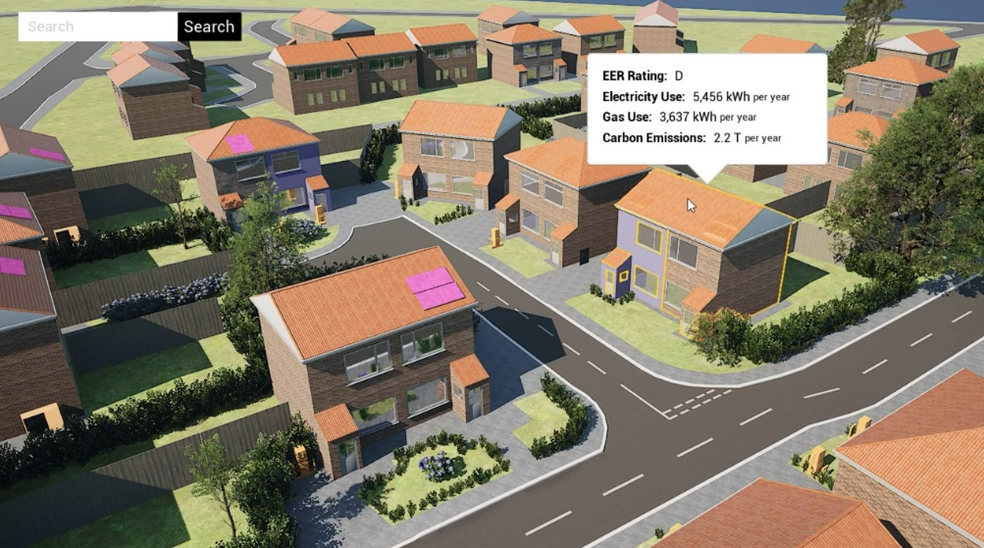

Local Context Feature Update

Slide 13


Summary and call to action
Digital Twins have the potential to help policy makers make confident decisions in a complex and uncertain scenario, by:
Quantifying that uncertainty,
Visualising multiple options,
Allowing them to trace back the output to the input data.

