Slide 1

01
Introducing the World Economic Forum and Urban Transformation Platform
The World Economic Forum

Slide 2

Our role
INTRODUCING THE WORLD ECONOMIC FORUM
The World Economic Forum is the International
Organization for Public-Private Cooperation.
Our purpose is to bring together stakeholders from all sectors of society to shape a better future and generate great impact through purpose-driven communities and platforms.
Reinforced by a track record of success over five decades, we are proud to serve as your trusted platform for high-level, multistakeholder cooperation.
Our mission is to improve the state of the world.

Slide 3





HOW WE CREATE IMPACT
Engage with our Centres and Platforms
Centre for the New Economy and Society
Centre for Industry Transformation
Centre for the Fourth Industrial Revolution
New Economy and Society
Advanced Manufacturing and Value Chains
Cybersecurity
Artificial Intelligence and Machine Learning
Consumption
Digital Economy and
New Value Creation
Blockchain and Digital Assets
Centre for Nature
and Climate
Nature and Climate
Energy, Materials and Infrastructure
Financial and
Monetary Systems
Data Policy
Health and Healthcare
Media, Entertainment
and Sport
Centre for Regional and Global Cooperation
Trade and Investment
Mobility
Urban Transformation

Slide 4

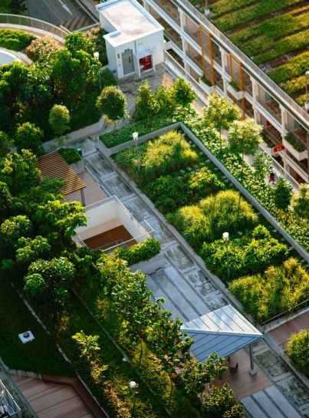



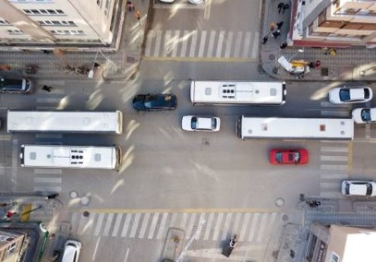
Shaping the future of urban transformation
OUR MISSION
Cities are home to a growing majority of the world’s population and generate more than 80% of global GDP.
As global challenges increase, cities are both on the frontline and essential to hopes for a more sustainable and resilient future.
Our platform advances public-private collaboration in cities, enabling more resilient and future-ready communities and local economies.

Slide 5





More than 60 cities & 30 countries
OUR GLOBAL FOOTPRINT
G20 Smart Cities Alliance
Regional Offices & Centers
Urban Innovation Testbeds
2022/2023 City Strategy Dialogues
Notes:
Check global lighthouse from advanced manufacturing

Slide 6

02
How we create impact by
Global Digital Twin City Initiative

Slide 7


















About global digital twin city initiative
DIGITAL TWIN CITY INITIATIVE
The digital twin city is a new concept and model of urban planning and construction for future sustainable development, an effective combination of digital technology innovation and urban operation mechanism innovation, and a feasible pathway for urban upgrading.
Currently, the digital twin city is still in the early exploration stage, facing many challenges such as inconsistent understanding, immature technology, and unclear business models.
At the beginning of 2021, the World Economic Forum and the China Academy of Information and Communication Technology (CAICT), together with key global stakeholders, launched a three-year initiative that seeks to make digital twin technology accessible to the public, promote social equity and inclusiveness, help cities achieve digital and low-carbon transformation, and jointly shape the future of digital twin city development.

Slide 8
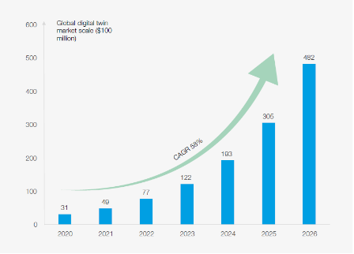
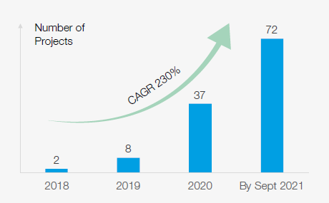
Concept and market
DIGITAL TWIN CITY INITIATIVE
A digital twin is a digital copy of a real-world place or object. Artificial intelligence and machine learning technologies enable the creation of digital twins, which are dimensionally accurate 3D digital models that can be updated quickly to reflect changes with its physical counterpart. Its goal is to:
Solve the complexity and uncertainty of urban planning, design, construction, management and services through simulation, monitoring, diagnosis, prediction and control;
Establish the simultaneous operation of and interaction between the physical and digital dimensions of the city.
Booming and disordered Market
It is predicted that by 2030, the application of digital twin technology will save $280 billion for urban planning, construction and operation, the digital twin market is expected to reach $48.2 billion by 2026 and grow at a 58% CAGR (compound annual growth rate)*.
The total investment scale of China’s new smart cities in 2020 was about RMB 2.4 trillion ($0.38 trillion). In particular, China’s City Information Modelling (CIM) construction projects have shown a trend of rapid growth year on year, with the number of projects growing from 2 in 2018 to 72 in 2021, the average investment of the projects reached RMB 28 million ($ 4 million).
* Source: Marketsandmarkets, collated by CAICT
* Source: Project research

Slide 9
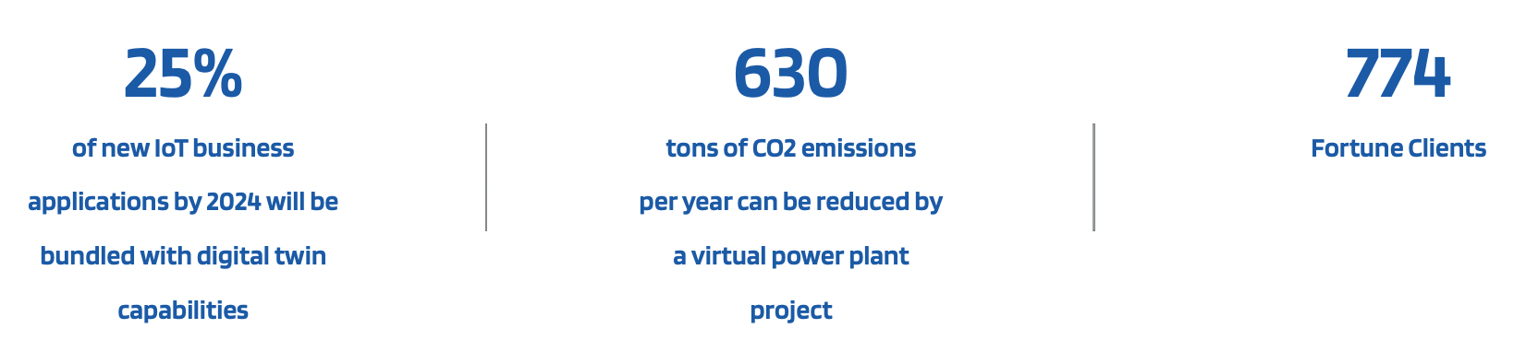
Global challenges
DIGITAL TWIN CITY INITIATIVE
Cities are an important achievement in human civilization, and the main catalyst for modern economic development and social activities. While cities are growing rapidly, they also face a series of challenges, such as economic stagnation and weakness caused by the COVID-19 pandemic, increasing carbon emissions and environmental pollution, urban traffic congestion due to population concentration, and urban vulnerability, exposed by natural disasters such as floods and storms.
Under these circumstances, “digital twin city” offers a potential solution for policymakers around the world to improve city governance and create a conducive urban ecosystem for industries and people.

Slide 10
Impact house to shape the future
DIGITAL TWIN CITY INITIATIVE
GLOBAL VISION AND HIGHER PURPOSE
INSIGHT
COMMUNITY
EVENTS
GLOBAL MULTI-STAKEHODERS

Slide 11
3 Year strategy and plan
DIGITAL TWIN CITY INITIATIVE
Methodology and
key outcome
Roadmap to Construction
Roadmap to development
Roadmap to
Sustainable business
Framework
Guideline
Evaluation
Operation
WHAT:
Concept, Value and key drivers
HOW:
Guideline of Design and Construction
WHAT:
Maturity evaluation model
HOW:
Sustainable business model
Show cases and
business
Select:
Use cases
Incubate：
Pioneers
Benchmark:
Industry
Toolbox:
Policy, Tech, Finance, training
Phase I
2021-2022
Phase II
2022-2023
Phase III
2023-2024

Slide 12
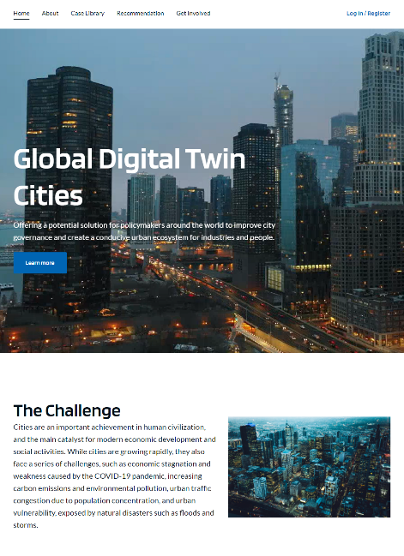



Summary of Phase I achievements
DIGITAL TWIN CITY INITIATIVE
2 Sets Recommendations
3 key Visions
4 Technical Characteristics
7 Global Cases
9 Key drivers
  Project Website
  Insight Report

Slide 13
Phase II – Key Action Plan and major deliverable
DIGITAL TWIN CITY INITIATIVE
Design and Construction Guideline
Global Community and Advisory Committee
Select and foster Best Practice
GLOBAL IMPACT
Know-how
Annual Insight report
Rewards and exchange
Global Digital Twin Pioneer Projects
Project site visit
Event
Summer Davos
Project workshop

Slide 14



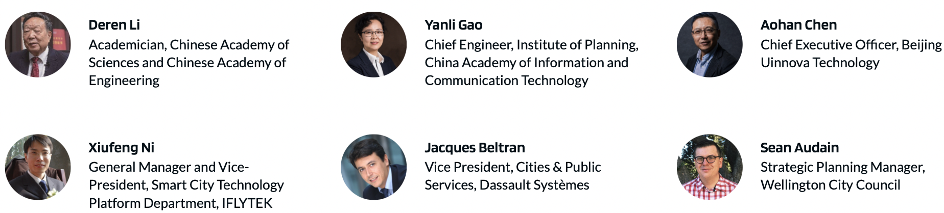
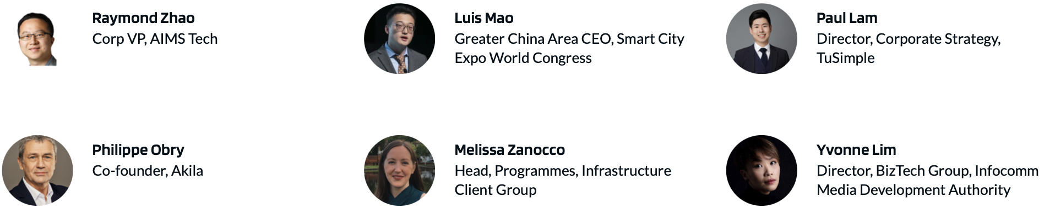
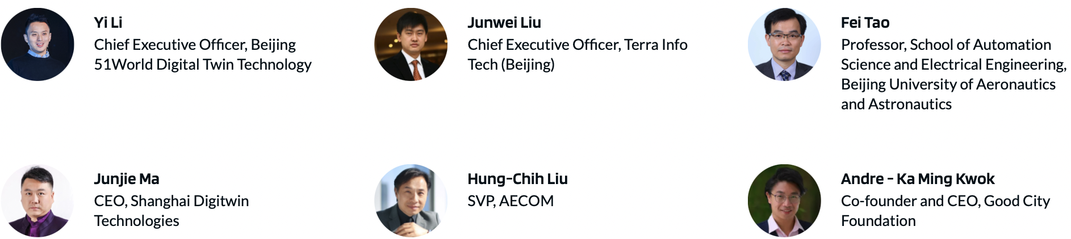

Phase II – Global Advisory Committee (GAC)
DIGITAL TWIN CITY INITIATIVE
Co-chair
Committee Member
Digital Twin Cities Project Global Advisory Committee
The Digital Twin Cities Advisory Committee is a group of global industry leaders from government, industry, entrepreneurship, and academia.
The membership of the Committee is nominated and decided by the World Economic Forum and the China Academy of Information and Communications Technology (CAICT). The Committee will hold 1-2 all hands meetings in the year to discuss and decide on the strategic direction, share progress, and solve key issues of the project, while the project team will form specialized working groups to complete the working plan under the leadership of the Committee.

Slide 15
Phase II – Design and Construction Guideline
DIGITAL TWIN CITY INITIATIVE
TECHLONOGY
TADOS Model
Digital twin tech core capability (IoT, Visualization, Modelling and Simulation etc.) and consolidated digital platform to serve future construction and operation purpose.
OPERATION
Key stakeholders and business model during different phases (design, construction and operation).
APPLICATION
The key application scenarios, relevant public benefits and business value.
STRATEGY
Strategy and plan of digital twin tech empower parks’ business, the relevant policy, organization and talent foster & promotion plan.
DATA
Critical ICT infrastructure, data consolidation, usage and governance.

Slide 16
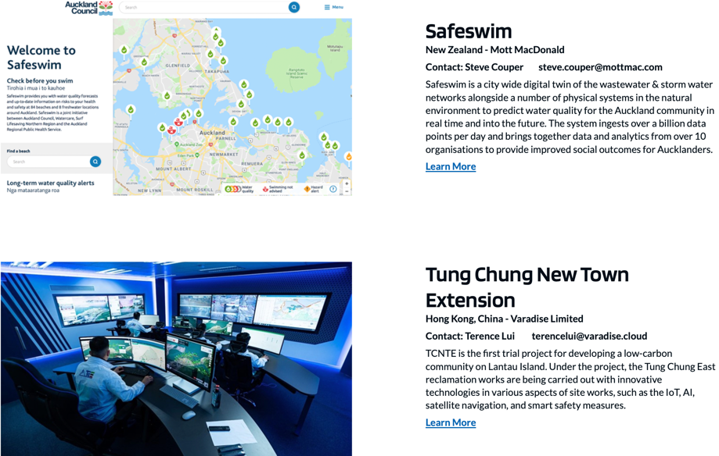
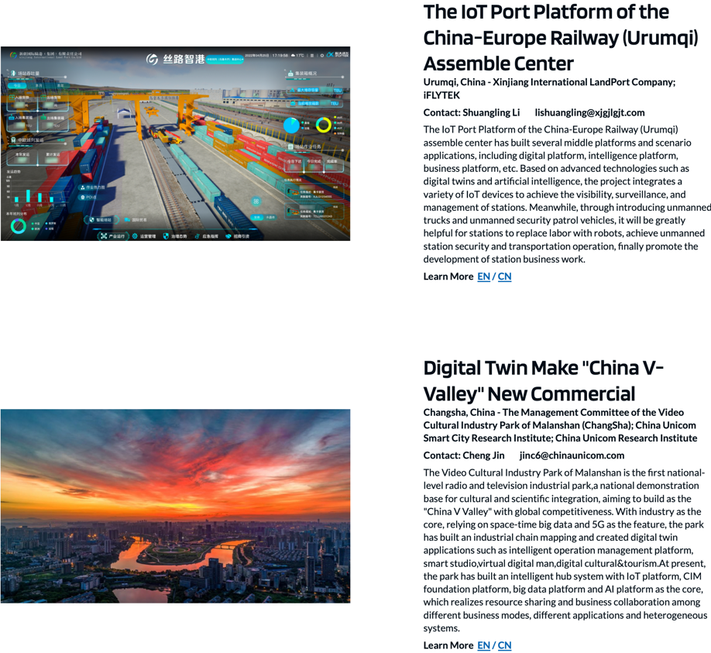
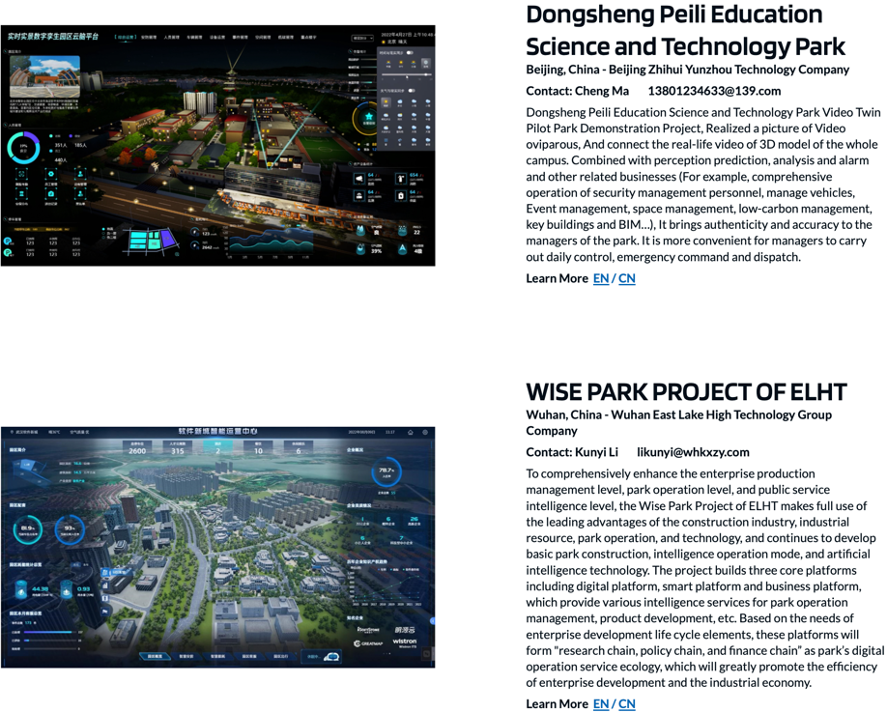
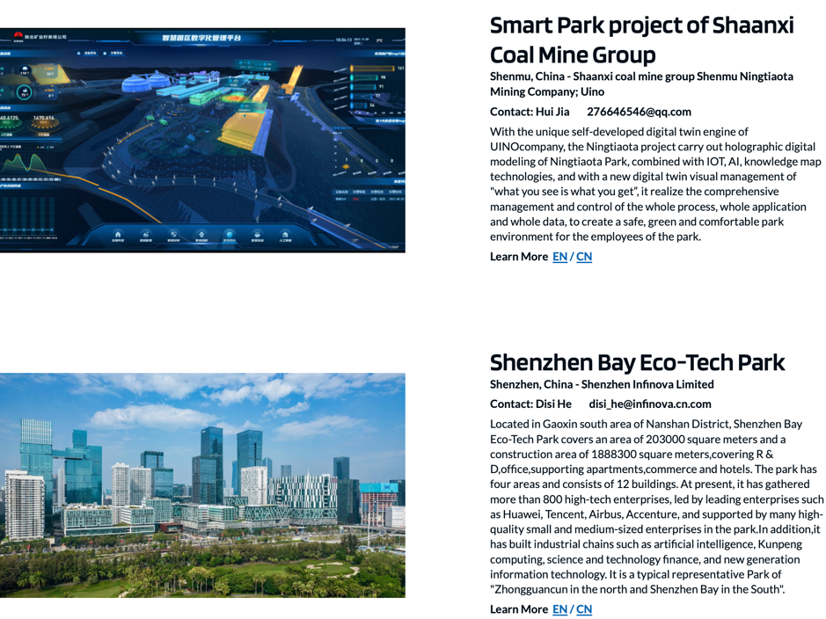
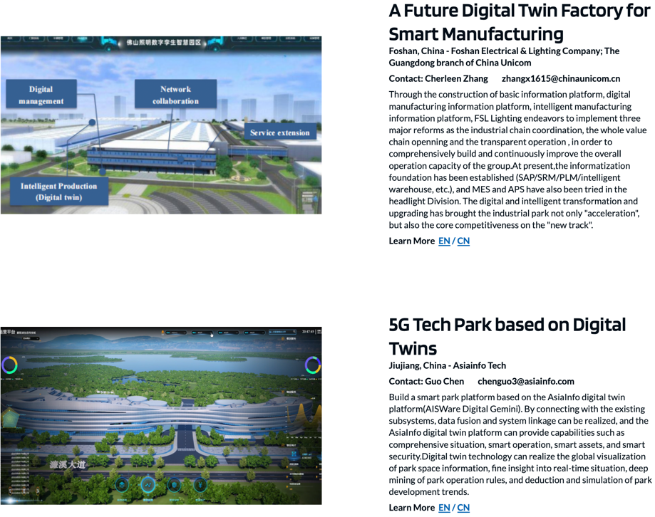
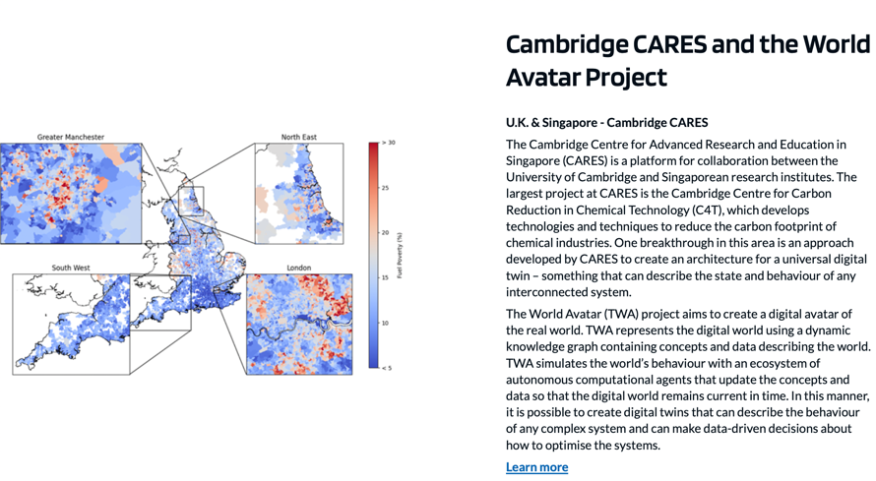
Phase II – Best Practice and Pioneer Projects
DIGITAL TWIN CITY INITIATIVE
The project team has launched a worldwide competition to select the best practices in digital twin urban projects.
The selection criteria are based on the TAODS methodology, and the Global Advisory Council (GAC) will serve as the jury to evaluate and vote on the results.
The project and cities will exchange their experiences and insights in the community.
The top three projects will be nominated as the "Global Digital Twin Pioneer Projects" during the upcoming Summer Davos forum.
The leaders and experts of the projects will be involved in drafting annual insights report and sharing their knowledge with key stakeholders around the world.

Slide 17
2023 events calendar
DIGITAL TWIN CITY INITIATIVE
2-3
Apr: International City Sustainable development Summit - Chengdu
11-12
6-8
Sep: Digital Twin City Workshop HK
May: Digital Twin City workshop –Beijing Office
Oct: Urban Transformation Summit
24th Feb: China Digital Twin City Summit -Suzhou
Jun: AMNC -Tianjin
Dec: Digital Twin City Stereo Meeting – TBD
Mar: Digital Twin City online exchange
Jul: Global Digital Economic Conference –Beijing
9-10
4-5

Slide 18
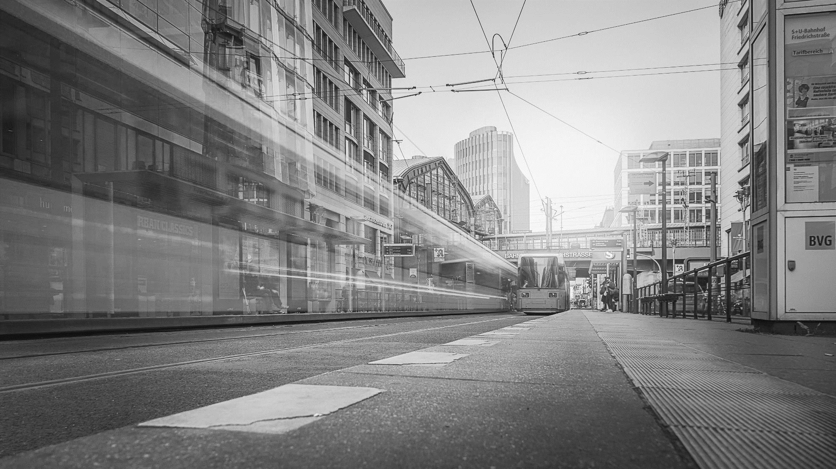


Contact Details
Yamin XU
Lead of Greater China and ASEAN Region,
Urban Transformation Platform,
World Economic Forum
yamin.xu@weforum.org

Slide 19

Phase I Achievement: Vision and challenges
3 Visions:
3 Challenges:
Resources and Business
There is a lack of composite human resources.
Intra-city algorithm model resources is inadequate.
Too much dependence on government funding.
1
Urban production and operation are highly efficient and intensive
Value Cognition
2
There is a lack of rational, objective awareness on digital twin cities.
Too much dependence on visual modeling techniques hampers the realization of the ultimate value of simulation extrapolation and the optimization of reality.
Urban space is liveable and convenient
3
Urban environment is sustainable
Data Governance
Limited IOT sensing data collection hinders the depth of application.
There is a lack of standardized governance on multi-source heterogeneous data.
Centralized processing of massive amount of data increases the risk of data breach.

Slide 20
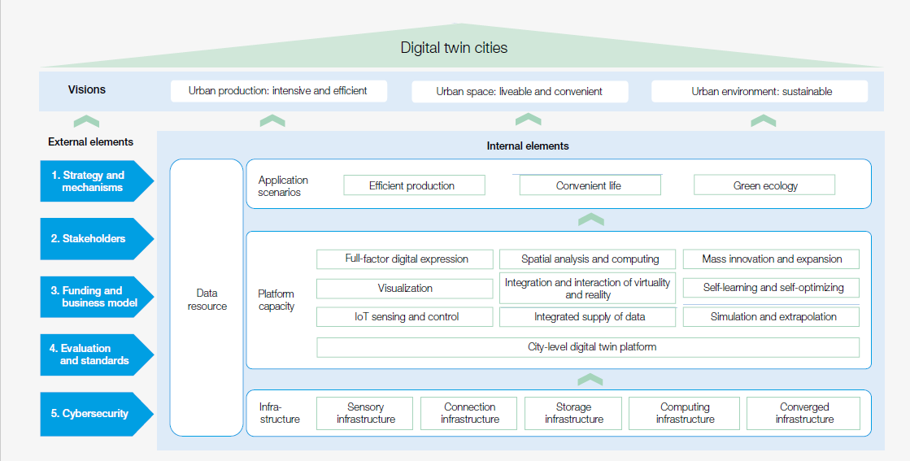
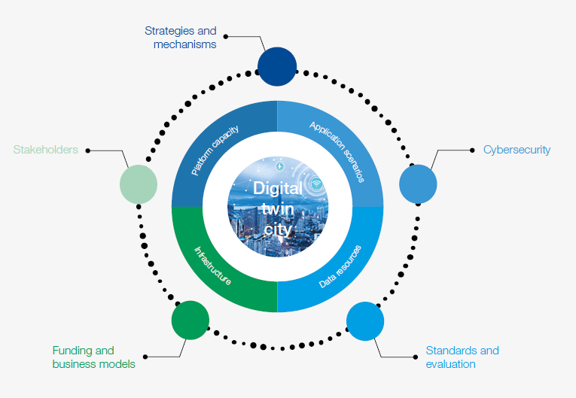
Phase I Achievement: 4*5 Key elements as internal and external drivers

Slide 21
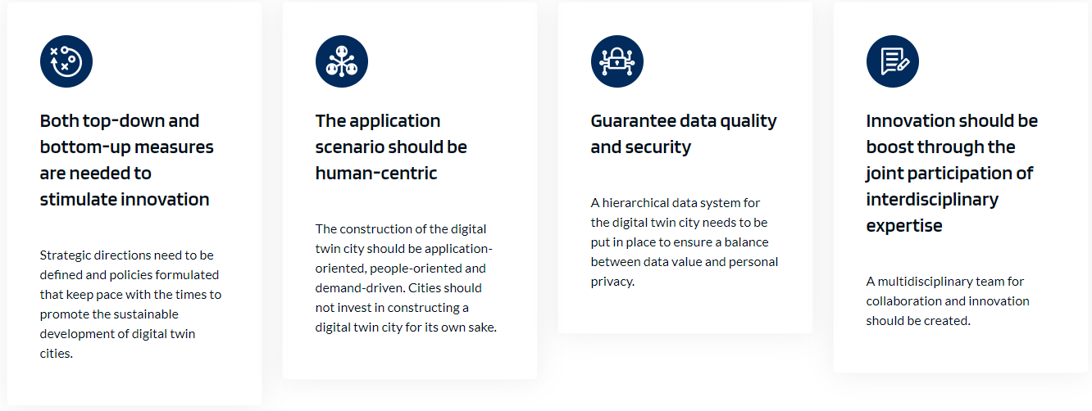
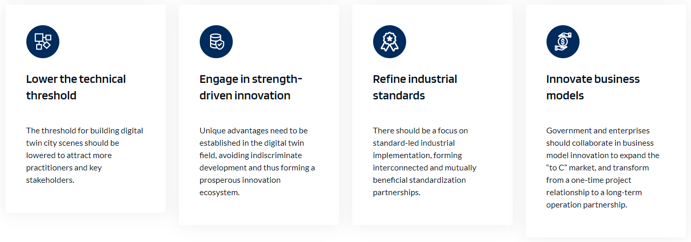
Phase I Achievement: Recommendations to Key stakeholders
Recommendations for Government
Recommendations for Industries

Slide 22
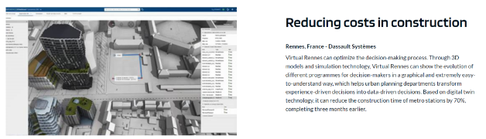
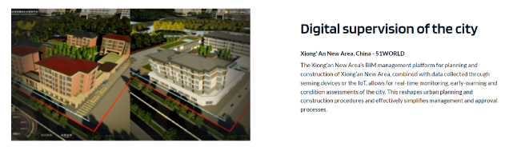
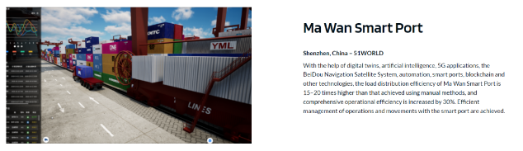
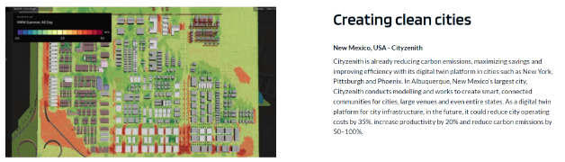
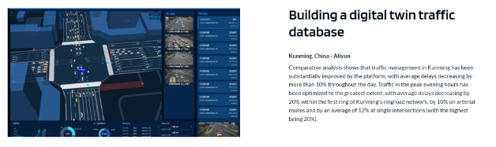
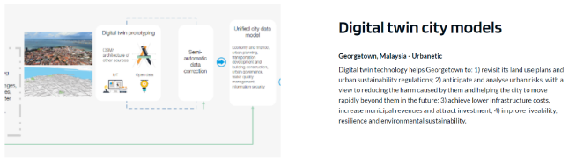
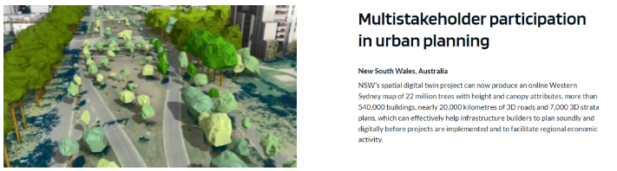
Phase I Achievement: Recommendations to Key stakeholders

