Slide 1
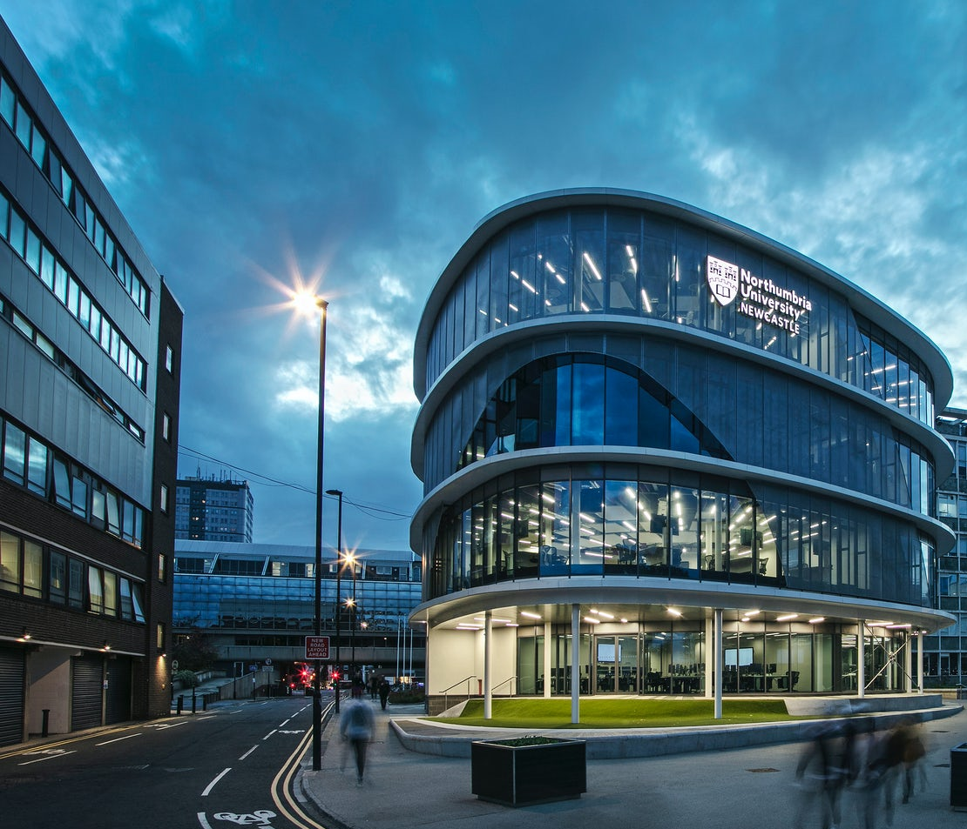

Developing a Digital Twin for Northumbria University

Slide 2
Exploratory aim & motives
Value
How can a DT help us overcome existing problems?
How can it unlock new value?
Challenges
What challenges we might encounter while developing a DT including technical, legal, political, ethical, security related…etc.?
Notes:
1) How can a DT of the CIS bldg. can help us / understand what challenges we might encounter while developing a DT

Slide 3









Workflow: data – knowledge gap
BIM Model
Data
Knowledge
Schedule of events
User friendly
Easy accessibility from any where to real-time sensors data
Providing visual insights and supports decision making
BMS/ Sensors’ data

Slide 4



Use case
High energy consumption
Rising concerns of Indoor Air Quality especially with the pandemic
Difficulty to achieve better carbon performance

Slide 5
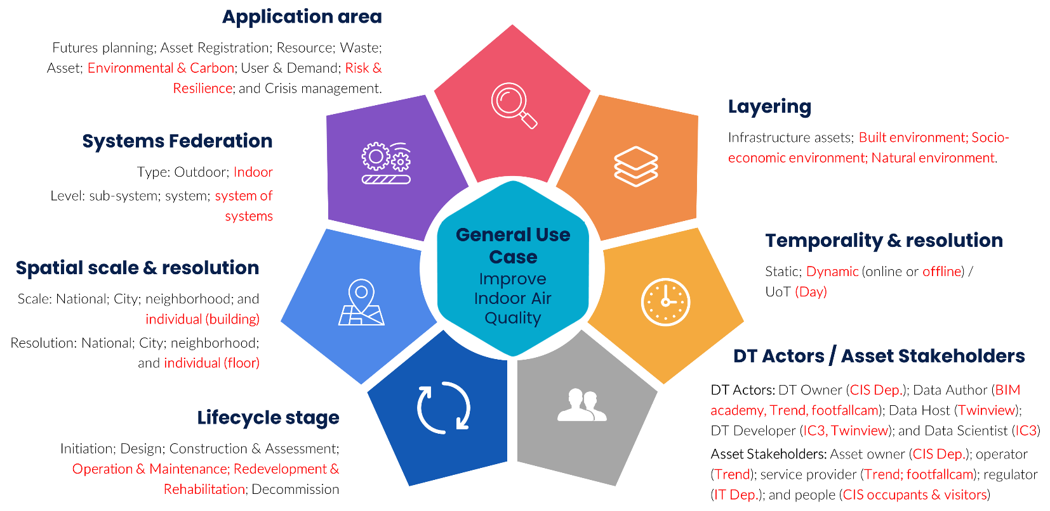
DT functional requirements
Reference: Al-Sehrawy R, Kumar B, Watson R (2021). A digital twin uses classification system for urban planning & city infrastructure management, ITcon Vol. 26, 832-862, https://doi.org/10.36680/j.itcon.2021.045
Notes:
Framework as part of PhD: published

Slide 6
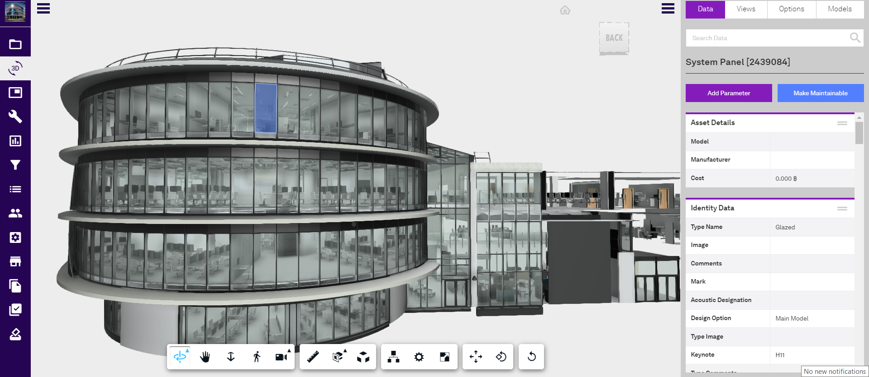
Notes:
Access to design models and uploaded to TwinView (imported really-well – anomalies adjusted manually + challenge: some BIM models had to be repaired)
Support from twinview team

Slide 7
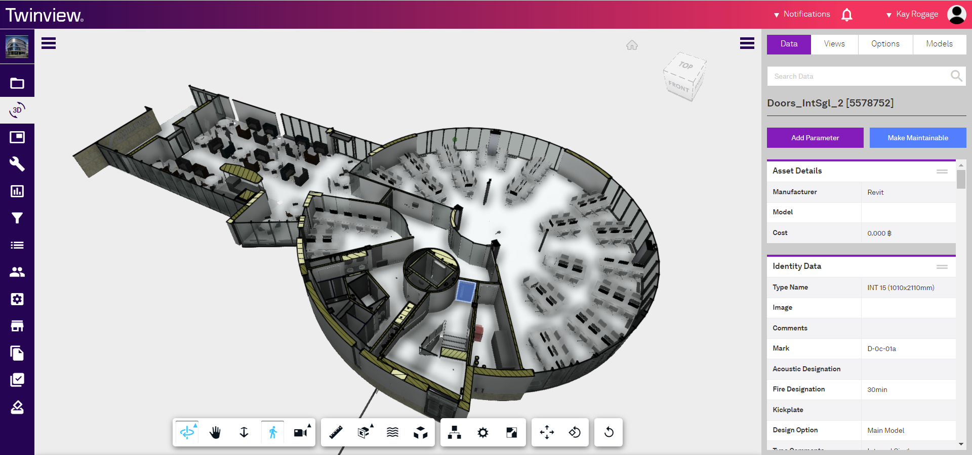
Notes:
Able to navigate around the building, create views, access detailed information about specific assets within the building e.g. internal fire door selected.

Slide 8
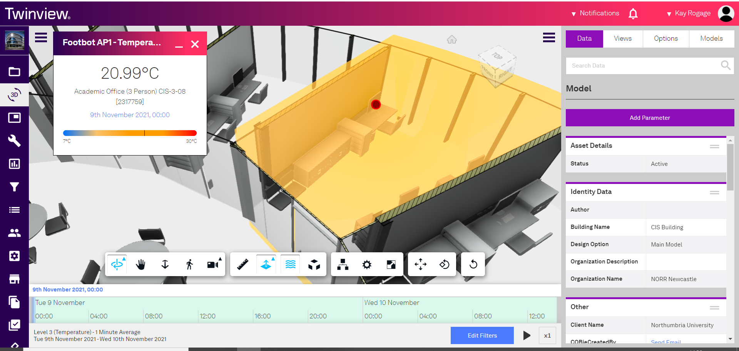
Notes:
Realtime sensor data linked to building

Slide 9
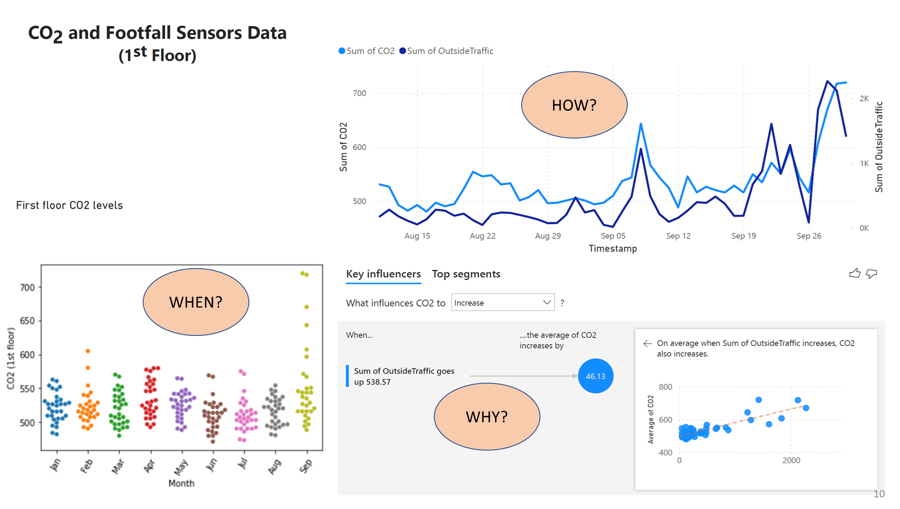
Notes:
Linking datasets to Power BI, creating dashboards to gain further insights
Gives a better understanding on how many people or how much traffic would increase the CO2 levels closer the limits or the threshold we would not want to pass (HSE & ASHRAE recommend maintaining CO2 levels indoors below 800 ppm – just over 700ppm in September)
Footfall and CO2 data from Jan 2021-Sep 2021 … I was abroad not even in the UK when I was working on analysing this data remotely … Noticed a considerable increase in activity in September – it was a hot week combined with induction – can see we do need additional ventilation or to consider reduced capacity during periods of increased footfall.

Slide 10
Key outcomes
Changing mindset and perception
Criteria | BMS-based | DT-based
Vision | Systematic (if-then) | Systemic (big picture & root causes)
Approach / mindset | Reactive | Proactive
Risk strategy | Mitigate | Avoid
Sustainability | Low | High

Slide 11
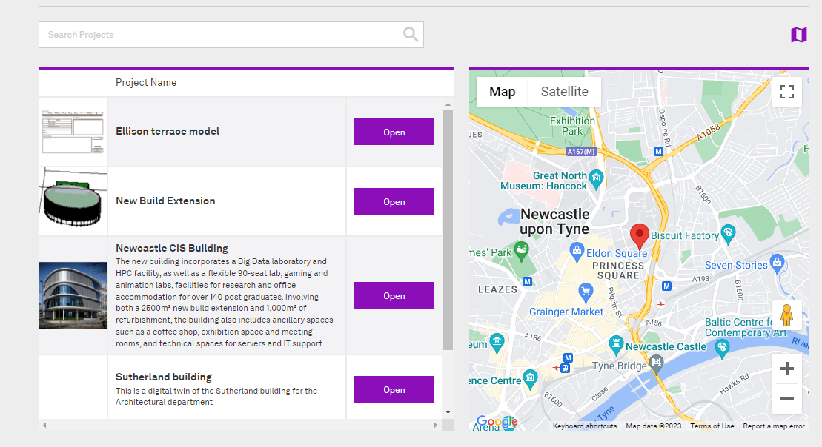
Campus Digital Twin
Notes:
Including further buildings to develop campus DT – ABE (Sutherland building) was brought in next.
We are using these models now for teaching and research
Connecting DTs of different buildings

Slide 12
CIS Digital Twin – Challenges
Interoperability: Manual adjustments to BIM model and linking of sensors data to python and Power BI
Legal / political: linking campus data to the DT as this is a legal and political issues since datasets are owned and stored by different organisations (BMS, footfall, BIM model…etc.)
Security concerns: which have evolved as a result of current IT security policies
Ethical concerns: Who would provide/have access if the DT is published or becomes open access

Slide 13


THANK YOU!
Ramy Alsehrawy
BSc, MSc, PhD.
BRE BIM Informed Professional
BREEAM Associate
ramy.alsehrawy@northumbria.ac.uk

