Slide 1
Rail Data Marketplace
DT Hub
Hayden Sutherland
Carl Selby
Clare Morrissey
Notes:
Welcome
Cameras and microphones off
We will be recording the session
Talk about the concept which is currently in development
Look at some of our challenges around licensing & data quality and how we are approaching it
Q&A and time for debate at the end

Slide 2

What is the problem?
Rail is a fragmented ecosystem of providers from both the public & private sectors.
No clear cross-sector view about what data is collected or available.
Sector specific language & acronyms hinder new entrants.
Gaining access to data is rarely straightforward.
Data quality is likely to be unknown until the data can be accessed.
Data formats and standards are inconsistent.
Not all data is ‘open’.
?
Notes:
Challenges not unique to rail

Slide 3

Solution: Rail Data Marketplace?
The Rail Data Marketplace aims to simplify access to rail related data and open it up to a wider user base via a single access point with the aim of bringing together data sources and related services from across the industry and beyond.
Notes:
Make rail data FAIR
Reduce friction in the sharing of data
Open data and commercial data, with and without conditions of use
NOT a data lake
Business to business

Slide 4









RDM features
Data catalogue
A catalogue of available rail data, searchable using a consistent taxonomy
Data publication
Make data publicly available and minimise the effort with system generated content
Content Management
Manage documentation and content to provide the best user experience
Data License Management
Ability to generate and hold licensing agreements, incl. e-signature.
Rail Data Marketplace
Community Forum
Exchange of ideas and innovation between publishers and consumers.
APIs management
Control access, throttle traffic, manage keys
Analysis and insight
Usage statistics and user feedback on your data as well as what users search for.
Billing and Invoicing
Ability to monetise data; set pricing, centrally managed billing and invoicing.
Notes:
Consistent taxonomy & metadata
Describe the known quality of data
Commenting, rating and feedback
Licensing framework that works across multiple different conditions gives publishers control
Control, measure & throttle access
Billing & invoicing

Slide 5




The Rail Data Marketplace – Benefits
Provide access to data and real time rail information which ultimately leads to a better customer experience.
Improve data sharing across operational bodies which leads to efficiency gains across the industry.
Improve access to high-quality rail data, which supports growth in rail and cross-modal public transport.
Stimulate innovation and enable agile development of customer-focused products and services.
Provide a learning platform where the next generation of data professionals can access a rich source of data.

Slide 6
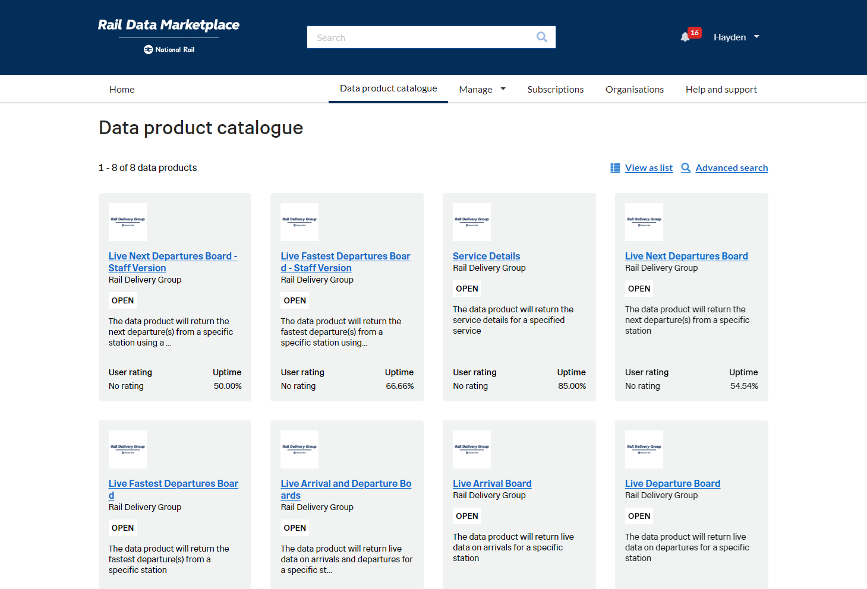
Public Beta in April 2023 - raildata.org.uk

Slide 7
RDM Pilot Phases - How can you get involved?
RDG now inviting organisations into Beta
Data Publishers
  Do you have a rail related data source?
  Do you want to monetise your data assets?
Data Consumers
  Do you want to find and use new data?
  Do you need different data products for your project?

Slide 8
The Data Standards Landscape
DRAFT
Wider industry & UK Government data standards
UK Rail data standards
RSSB Standards https://www.rssb.co.uk/standards-catalogue
RDG
e.g. RSPxxxx in ASSIST
Transport & Mobility data standards
TransXChange
NeTEx
SIRI VM
GTFS
Network Rail
e.g. CIF Open Data files
NaPTAN
MDS
INSPIRE (EU)
Data Privacy
(e.g GDPR)
Technology standards & TCoP alignment
(e.g. JSON, XML, CSV, etc.)
UK Gov Data Sharing / Intermediaries Platform Principles (in progress)
UK Gov API technical and data standards
(E.g. REST, OAS, ISO8601
UK Gov Geospatial Standards
(GeoJSON, UK GEMINI, etc.)
TOMP
Wider Rail Digital standards
Rail
data model
CSN EN 12896
Rail Sales &
Distribution
osdm.io

Slide 9
For more information google ‘Rail Data Marketplace’
Or email at
raildatamarketplace@raildeliverygroup.com

