Slide 1
Architectures for data sharing
Industry collaboration
Gemini Call 17 January 2023
Sarah Hayes
Jethro Akroyd
Jonathan Barcroft
Contributors
Elliot Christou, Connected Places Catapult
Gavin Starks, Icebreaker One
Greg Johnston, Energy Systems Catapult
Jethro Akroyd, CMCL Innovations
Jonathan Barcroft, National Grid ESO
Mark Enzer, Mott MacDonald
Matt Webb, UK Power Networks
Miranda Sharp, Metis Digital
Peter El Hajj, KPMG
Polly Hudson, Alan Turing Institute
Ryan Goodman, Connected Places Catapult
Sarah Hayes (chair), Connected Places Catapult
Simon Evans, Arup
Steven Steer, Zuhlke
Projects Represented
Climate Resilience Demonstrator (CReDo)
Virtual Energy System
National Energy System Map

Slide 2
Background
Observation:
  There is complexity and disparity in how industry develops connected digital twins and in how industry communicates this
  Much of the language used is hard to access for wider / non-technical audiences
  This results in confusion, inefficiency and friction
Question:
  Can we create a simple diagram structure that can represent any configuration of connected digital twins, at a high level
  So differences between configurations can be understood and compared
  => To help us better understand what to share and what to develop
Outcome:
  The following slides present our current thinking

Slide 3



Data sharing scenarios
From one-to-one data sharing
To many-to-many data sharing
Scenario A
I give you a copy of some of my data (for example, e-mailing a spreadsheet)
Scenario B
We allow access to a database containing a copy of our open data
People
Open data
Access, security and quality controls
Data
Scenario C
We share access with you to a database containing a copy of some of our data based on agreed security, access and quality controls
Organisational
boundary
Copy of data
Scenario D
We give you controlled access to some of our data (pre or post processing)

Slide 4
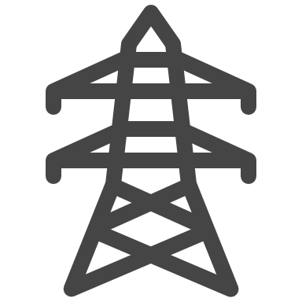












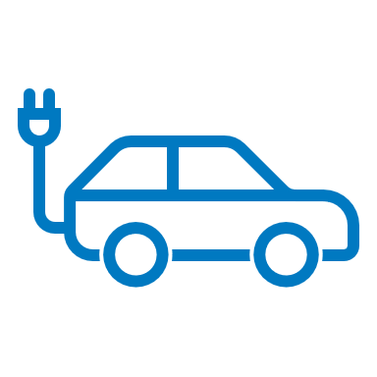
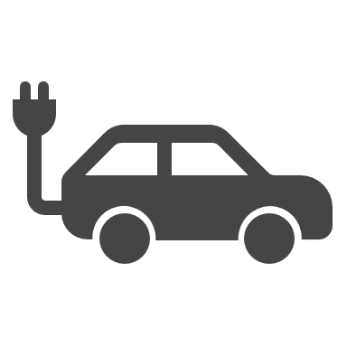






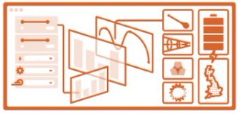

Data sharing
between
digital twins
Network Operator
Wind Farm Operator
Data
Power Station Operator
Interventions
Physical asset
Digital twin
Control over data sharing
Data sharing architecture
(can be centralised or distributed)
Industrial Consumer
Charging Provider
Distributed Storage
Electrolyser
System Operator

Slide 5
Data sharing
between
digital twins:
Point to point
Network Operator
Wind Farm Operator
Data
Power Station Operator
Interventions
Industrial Consumer
Charging Provider
Distributed Storage
Electrolyser
System Operator

Slide 6
Data sharing
between
digital twins:
Central database
open/closed
Network Operator
Wind Farm Operator
Data
Power Station Operator
Interventions
Industrial Consumer
Charging Provider
Distributed Storage
Electrolyser
System Operator

Slide 7
Data sharing
between
digital twins:
Distributed
architecture
Network Operator
Wind Farm Operator
Data
Power Station Operator
Interventions
Access, security and quality protocols
DATA
(distributed architecture)
Industrial Consumer
Charging Provider
Distributed Storage
Electrolyser
System Operator

Slide 8
Data sharing
between
digital twins:
Reality:
point to point,
Centralised and
distributed
Network Operator
Wind Farm Operator
Data
Power Station Operator
Interventions
DATA
(distributed architecture)
Industrial Consumer
Charging Provider
central
Distributed Storage
Electrolyser
System Operator

Slide 9
Examples
Using industry projects

Slide 10














CReDo: phase 1
Centralised data sharing architecture
Energy
Network
Energy
Network
Telecoms
Central database
Models
CReDo
Water
Other user of CReDo with restricted access?
Water
Telecoms
Climate projection and flood data
CReDo uses a common data structure to create interoperability between the data from the different asset owners

Slide 11





CReDo: phase 2
Distributed data sharing architecture
Energy
Network
Access, security and quality protocols for CReDo
Distributed architecture
can connect to
Models
Other user of CReDo with restricted access?
Water
Distributed architecture
can connect to
Telecoms
Climate projection and flood data
CReDo uses a common data structure to create interoperability between the data from the different asset owners

Slide 12



Virtual Energy System
Wind Farm Operator
Network Operator
Power Station Operator
Industrial Consumer
distributed architecture
Charging Provider
Distributed Storage
Electrolyser
System Operator

Slide 13
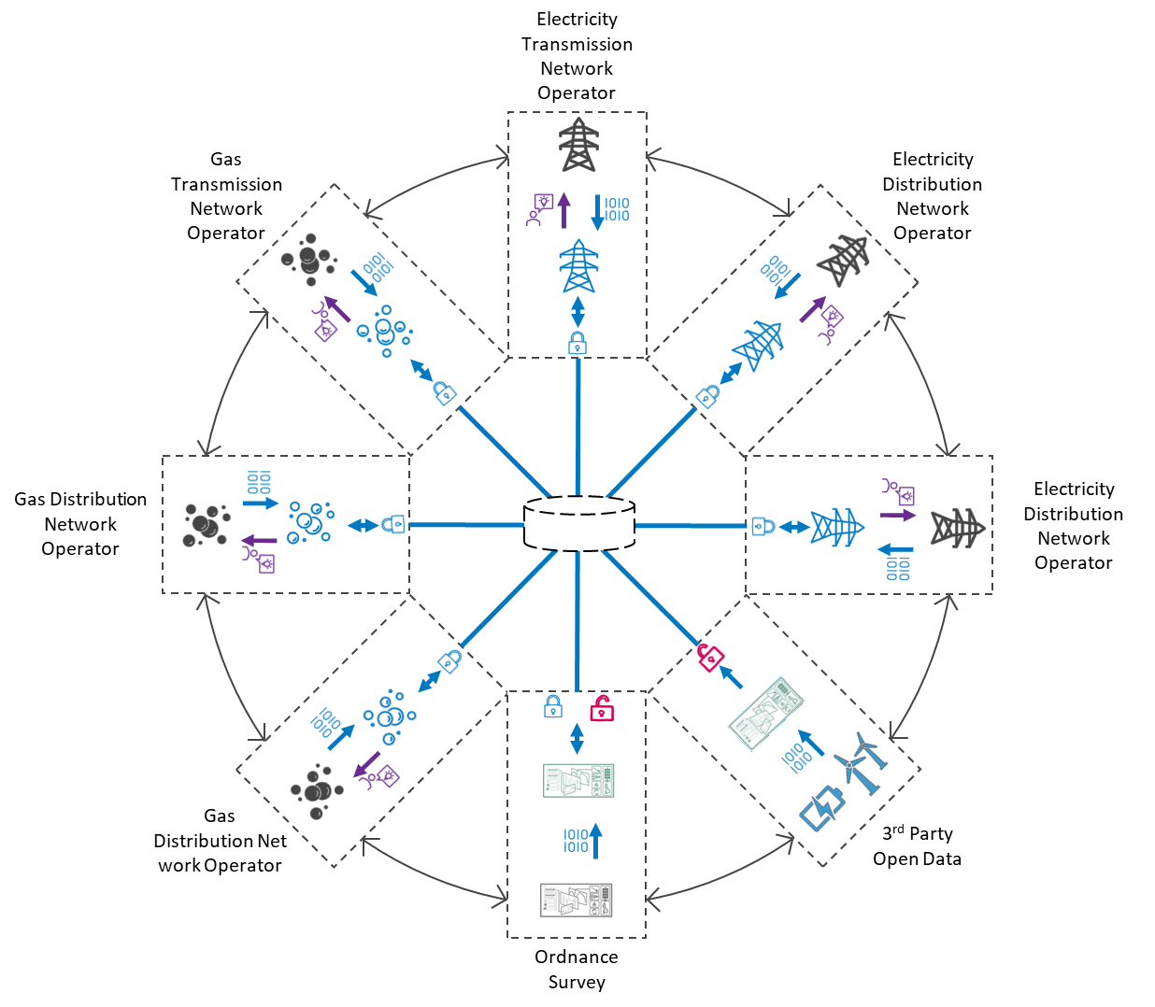
National Energy System Map

Slide 14
Can you create your version for your connected DT project?
Can we develop the shared rules that will enable distributed architectures to work across industries?
Join the network: Data sharing architectures - DT Hub Community (digitaltwinhub.co.uk)

