Slide 1

Retail Planner
A Collaborative Partnership; A user led journey into Data Centric Planning, Enabling IM & BIM Adoption

Slide 2
Overview
Desktop & Cloud in Partnership
A Cooperative Partnership between Data and Users
Data Centric - Not Drawing Object Centric
Live Scheduling & Change Visibility
User First - A socio technical focused project
Data & Drawing Information Interoperability
Data Visualisation
3D Rendered Visuals

Slide 3
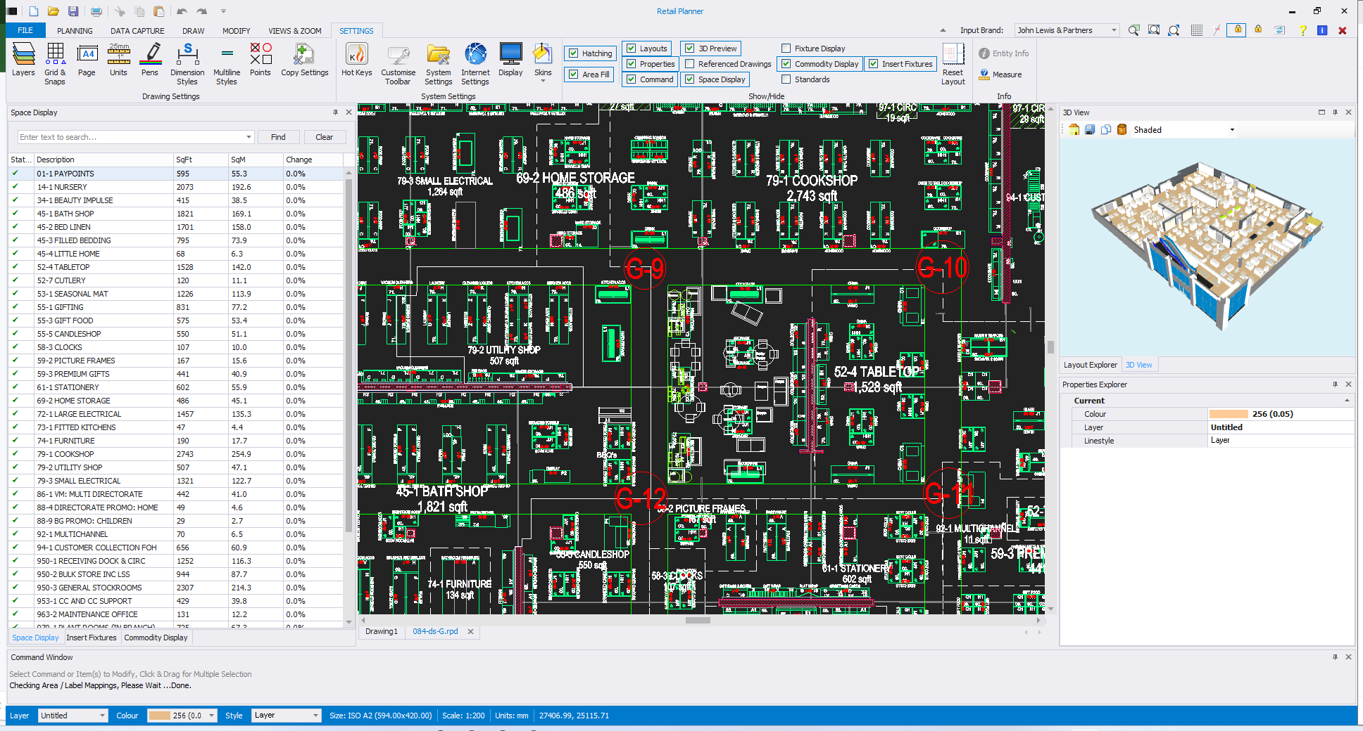
Desktop & Cloud in Partnership
Retail Planner Desktop Software
  Store Design - Planning Tool
  Space Data Capture
  Visualisation
  Change Logging
  Accountability
  Legislation Compliance
Retail Planner Cloud Portal
  Controlled Data for Planning
  Reporting
  Data Sharing
  Controller for Data Transfer between systems
  REST API’s

Slide 4
A Cooperative Partnership between Data and Users
Like the John Lewis Partnership, Retail Planner has a been designed with both data and users in mind.
Designed to remove the unnecessary and provide functionality to support the users in their roles, not Just another CAD System with addons.
Built in Partnership with John Lewis & Waitrose Design Teams.
Supports Business Critical Processes.
Agile ongoing development partnership, growing and developing with the ever changing needs of a complex and challenging client and the environment they work in, supporting constantly evolving processes and WoW.
Facilitating Change, Supporting Better outcomes.
Data Portal used for sharing information across organisational & sectoral boundaries.

Slide 5
Data Centric - NOT Drawing Object Centric
Retail Planner is Data Object Based.
Objects can only be edited inline with Best Practices & Compliance Checks.
Planning Tools & Data Visualisation to aid the user.
Built in Accountability with Change Logging.
Space & Asset Management.
Controlled and Managed Planning to Support the User and the Company without conflict or need to understand each other. Making complex tasks simple, removing the jargon.
Built in Compliance Controls.

Slide 6
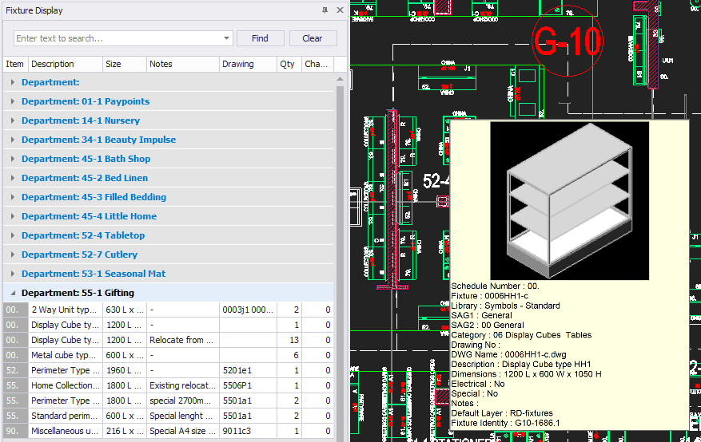
Live Scheduling & Change Visibility

Slide 7
User First - A socio technical focused project
Built with a Retail Designer in mind, not just an addon to an already complex CAD System with many unnecessary functions.
Visualisation to help speed up the design process
Easy to learn - Reduces the onboarding overhead.
Easy to use - Lets the user focus on their job more, improving Performance and effectiveness.
Does the complex CAD planning at a professional level while being accessible to all levels of experience.
Supports & Guides a Clients Processes & Standards with the flexibility to cater for Non Standard Requirements.

Slide 8
Data & Drawing Information Interoperability
Imports Data from CAD plans for 3D Architecture.
Exports Planned Objects to IFC for inclusion in external models.
Asset Information Management designed to Support and Work With Building Information Management.
Portal data transfer via REST API’s.
Portal acts as a CDE, controlling and enabling the bi-directional flow of data across an interconnected network of systems.
Enabling the ability to drive the drawings from data sources via the already enabled foundation of "live" reading of data from the model.

Slide 9
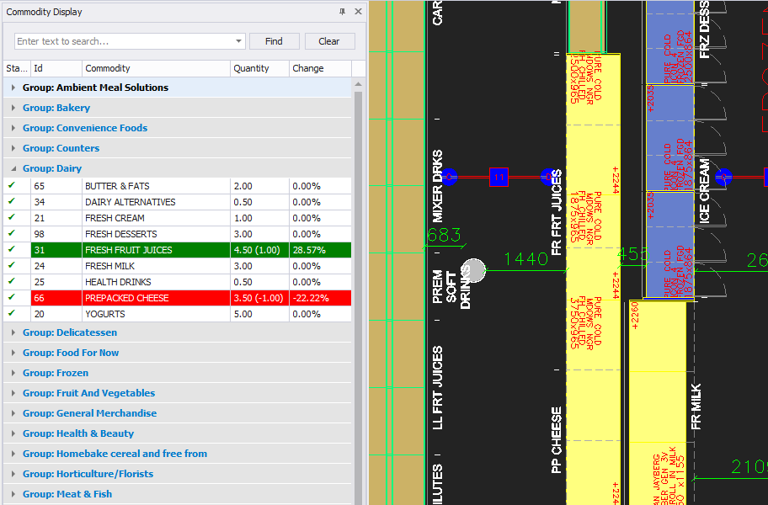
Data Visualisation
Compliance Checking.
Change Tracking and Implementation Phasing.
Live Planning Schedules.
Centralised Portal Data Query, i.e. where are sausages next to bacon?
Heat Mapping using varied numeric data types such as Sales Data to visualise stores based on profitability.
Space Planning aided by Data Visualisation.

Slide 10
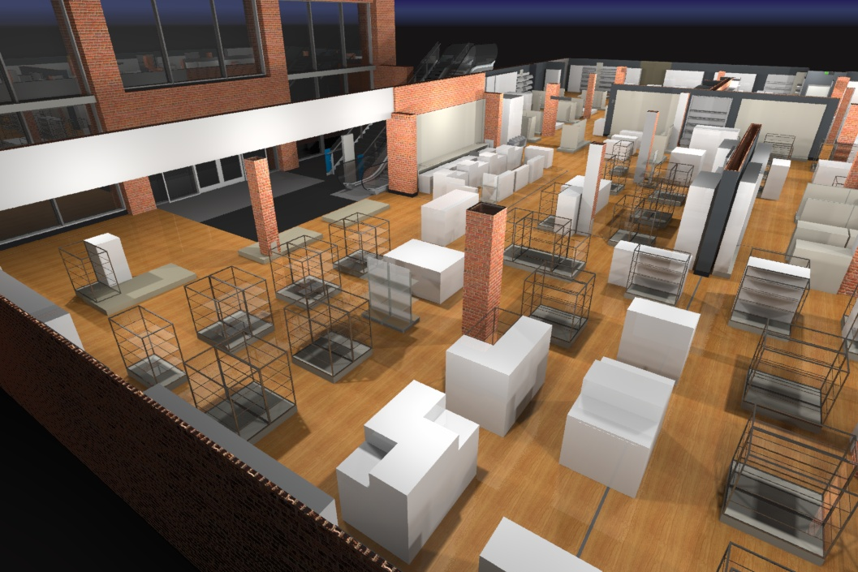
3D Rendered Visuals
3D Visualisation - generated directly from the Internal Layout.
Ability to go further into conceptual and version planning stages without the need for additional Complex Rendering "Slow" tools.
Live 3D Walkthroughs enabling accessible Design Dialog for all Stakeholders, producing quick and informed decision making.

Slide 11
Next Steps & Future Goals
4D Planning - Phasing with projects over time.
Revit Referencing - Model Interrogation and Dialog Between Roles and Disciplines
Online Plan Visualisation, Amendments, Snagging and Comments.
Drawing > Portal > Drawing - Data Driven Plan Changes
Concurrent and Overlapping projects managed in the same "space".
Asset Management - Full Lifecycle.
Routes through a store - Stock room to shelf
Customer Floor Guide
Export to dialog with Mixed Reality
Shoppable Fixtures
Home Planning

Slide 12
Cadlogic Limited
www.cadlogic.com
+44 (0) 1543 419886
3 Greenhill
Lichfield
Staffordshire
WS13 6DY

