Slide 1

DT hub's chair update
Strategic Board Chair
Dr Alison Vincent
Tuesday 13 December 2022

Slide 2
Relevant updates for the community
Overview of the DT Hub Governance Structure
Introduction to the Advisory Group
Update on the Working Groups

Slide 3
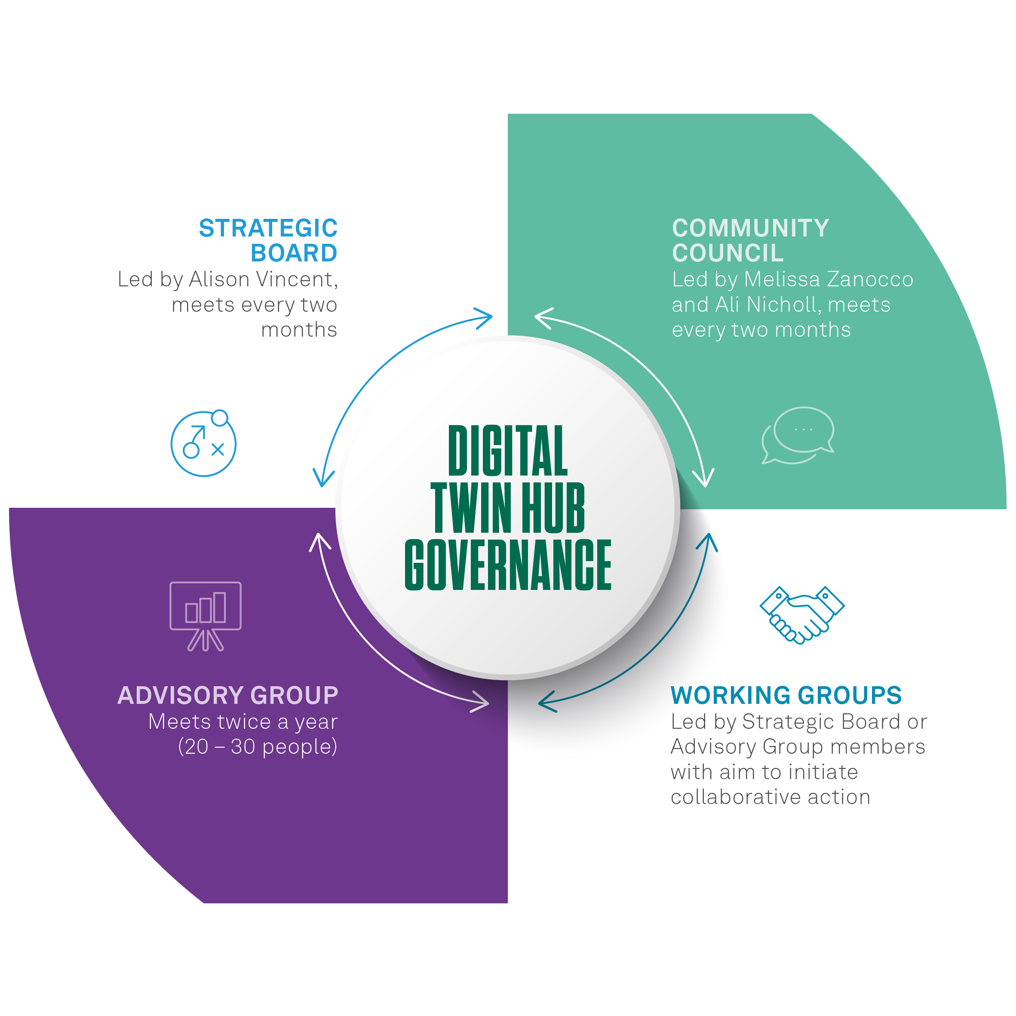
Notes:
The Hub is a community focused initiative, and we wish the community to drive it forwards. In addition to the strategic board the groups below will work to create impact in collaboration.
Advisory Group
The Advisory Group will be a larger group, including wider policy interests and government representatives along with academia and industry. The Advisory Group can be called upon to bring external expertise into all aspects of the DT Hub. This will allow the DT Hub to benefit from longer term, ongoing, systematic relationships that provide access to expertise when needed. The Advisory Group will include representatives such as BEIS / CPNI / DCMS / IPA / the wider Catapult network / community reps as well as industry.
Working Groups
Working groups will be set up to focus on specific areas of interest, for example sector specific demonstrator projects, standards development or the creation of best practise guides and playbooks to support the community in advancing digital and data maturity and adopting digital twin solutions. Led by members of either External Advisory or Strategy Board to explore specific topics in more detail and initiate collaborative action. If you wish to connect an existing initiatives into the DT hub as a working group please get in contact.
Community Council
The newly formed community council has an advisory role in the future direction of the DT Hub, giving a voice to the community in the journey towards an ecosystem of connected digital twins. You can contact members via their DT Hub profile pages.

Slide 4
DT Hub advisory group

Slide 5
The role of DT Hub Advisory Group members
Members of the Advisory Group represent government and policy interests, academic and industry stakeholders to drive growth and adoption of Digital Twin technologies.
The Advisory Group has been called upon to bring external expertise into all aspects of the DT Hub. Allowing the DT Hub to benefit from longer term, ongoing, systematic relationships that provide access to expertise when needed.

Slide 6
Advisory Group MEMBERS
Anasol Pena-Rios – BT Research Labs
Dino Nola – East West Railway
Daniel Tides – NSW Government
Teodora Kaneva –Tech UK
Peter El Hajj - KPMG
Bola Abisogun OBE – DiverseCity Surveyors
Emilia Cardamone – Turner & Townsend
Keith Dear - Fujitsu
John Adams – Glider
Alex Luck - BEIS
Jon Kerbey - Cohesive
Ali Nicholl - Iotics
Jonathan Eyre – AMRC
Simon Reeve – Lloyds Register Foundation
Maria Pregnolato – University of Bristol
Kevin Vincent –Coventry University
Andrew Levers – Digital Engineering and Autonomous Systems
Sam Rose – DFT
Simon Hart – Innovate UK
Richard Moore - Ofcom
Jacob Coker - BEIS
Mark Birkin – Alan Turing Institute
Matthew Hewitt - DCMS
Phillip Young – Digital Catapult
Hema Ramamoorthy – Digital Catapult
Mark Gaskarth – UKRI
Anne-Marie Friel – Pinsent Masons
Notes:
Process was as follows:
We engaged with many members of the community we felt would add value to the Advisory Group. Members of the DT Hub approached these individuals to gauge their level of interest in joining/supporting the Hub on its mission.
In addition to this approach, we ran an open application process to ensure we created opportunities for other stakeholders within the eco-system to apply if interested. Following this process, we have now selected the vast majority of our Advisory Group (1 or 2 still to confirm). Based on the people selected, we feel the Group comprises a board range of experience and offers coverage across different industries and stakeholder groups, including Industry, Academia and Government.

Slide 7
DT Hub Working groups

Slide 8
Goals of Working groups
Goals of the Working Groups
Supporting the advancement of connectivity between digital twins both nationally and internationally
Building on the Gemini Papers, specifically focusing on 'How' the community and industry can work towards a connected Digital Twin future.
Helping to grow the Hubs membership into new and emerging sectors, beyond the Built Environment
Each working group will define what they can deliver for the June 22nd showcase and how they can collect feedback from the community to shape outcomes and outputs

Slide 9
The Working Group themes and who is leading them
Following consultation with the DT Hub's community and its Strategic Board members, we can now confirm four themes have been selected. The four agreed Working Groups will focus on:
Business case and demonstrating value
  Led by Davin Crowley Sweet and supported by Liz St.Louis and Paul Lam
Open Standards and Interoperability
  Co-led by Charles Kennelly, Mark Enzer and Ben Ford
Digital Skills and Capacity Building
  Led by Matt Edwards and supported by Mark Coates
Governance Models and Trust: Legal Agreement, Contract, Commercial and Procurement clauses
  Co-led by Anne-Marie Friel and Sarah Cameron from Pinsent Mason's

Slide 10





Where you can find us
The Apollo Protocol: The Circularity Hack
Birmingham, 19 Jan.
Engineering Digital Twins Practice
Sheffield, Date TBD
World Water- Tech Innovation Summit
London, 21-22 Feb.
Futurebuild 2023
London, 7-9 Mar.
Digital Construction Week
London, 17-18 May.

Slide 11

Digital Twin Hub Strategic Board Chair
Dr Alison Vincent

