Slide 1

Digital Twin Fan Club Presentation
Lifecycle Asset Management in the Intersection Between
Digital Twins and Smart Buildings
Dr. Ahmed Alnaggar
Senior Consultant, Digital Twin and Smart Buildings
Building Research Establishment (BRE)
06 December 2022

Slide 2
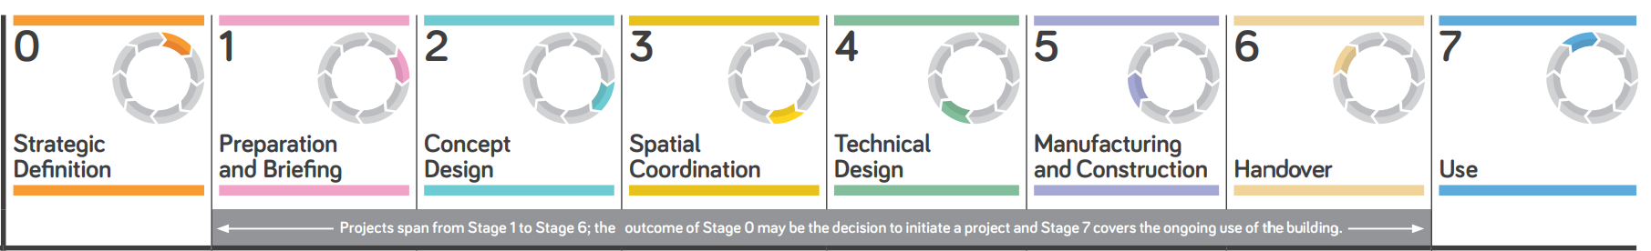
Building Lifecycle CapEx and OpEx
  Capital Expenditure (CapEx) about 15-20% of total Building Lifecycle Cost
  Operational Expenditure (OpEx) about 80-85% of total Building Lifecycle Cost
Are we giving the right focus to Digital Twin applications and use cases in the “Operation/In-Use Phase” of the building lifecycle?

Slide 3
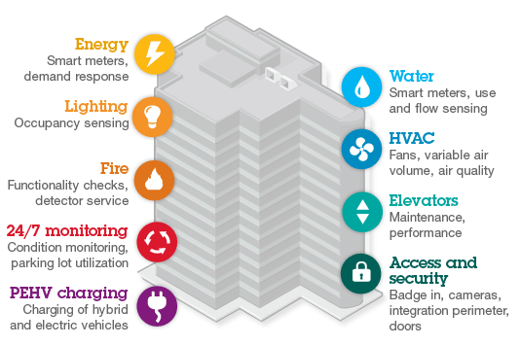
Smart Building (SB) Definition
“ Smart Buildings are digitally connected structures that combine optimized building and operational automation with intelligent space management to enhance the user experience, increase productivity, reduce costs and mitigate physical and cybersecurity risks.” Deloitte
Source: MappedIn

Slide 4
The Intersection between Digital Twin and Smart Building
Lifecycle Digital Twin includes the link between:
Digital/BIM model
Asset Management System
Smart Building and IoT Ecosystem
Lifecycle
Digital Twin
BIM asset Data
Flow to operation
BIM in operation in
CAFM system
Connected Systems
CAFM/BMS/IoT

Slide 5
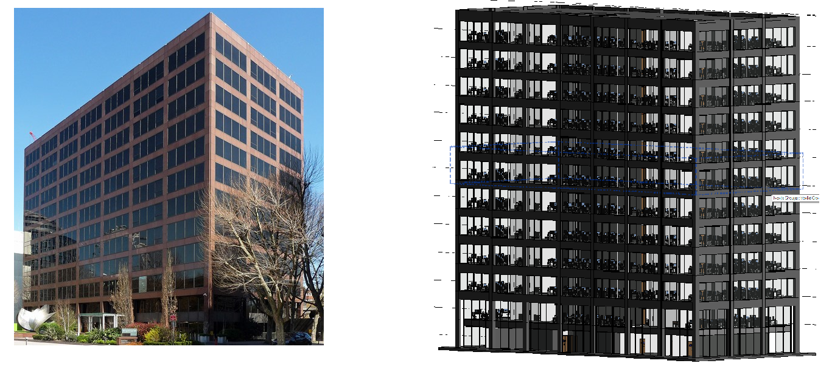
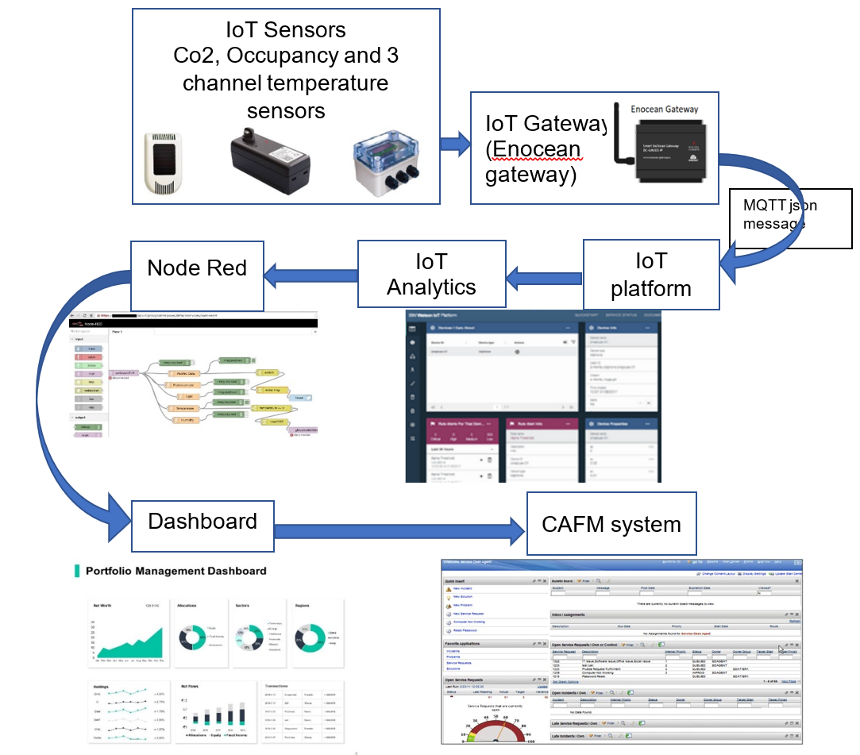
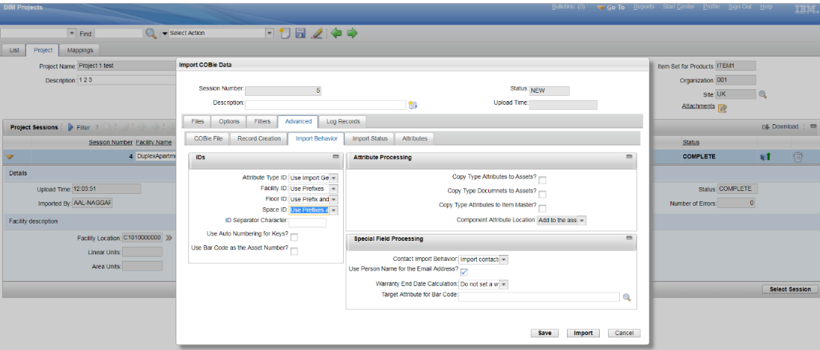
A lifecycle Digital Twin – Case Study
BIM model for the building as the first phase of creating a digital twin
The automated import for COBie data into the CAFM system

Slide 6
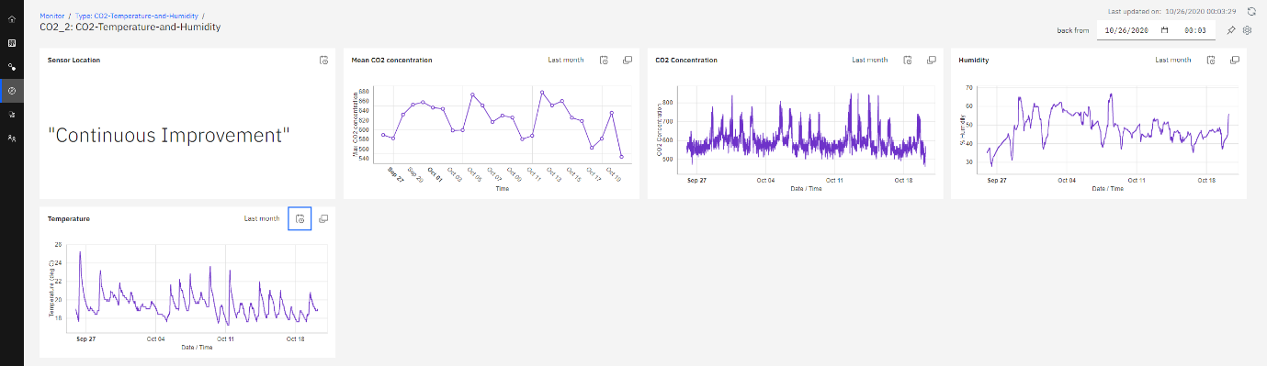
IoT Enabled Lifecycle Digital Twin
It is important to give more focus to retrospective digital twin of existing building because new built is a frication of existing buildings stock in the UK
CO2, temperature, and humidity data in meeting room 1
1-Create BIM model – Using
2-Export Model Data from the model
3-Import Model data to CAFM system
7-Connect IoT data to the CAFM system
Result Connected Digital Twin
4-Develop the IoT use cases
5-Install IoT sensor Network
6-Harvest IoT data in IoT Platform
A road map for retrospective Digital Twin

Slide 7
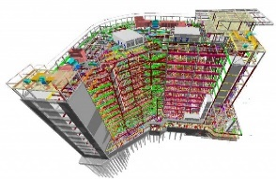
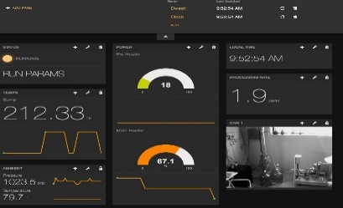
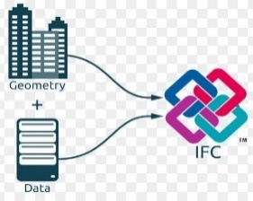
Lifecycle Connected Digital Twin
1- BIM Authoring software (Revit, Archicad, Teckla …etc)
6- Data visualisation Dashboard
End-to-End Connected
Lifecycle asset management system
2- Extract Model data via IFC
3-BIM application
Imports IFC’s data and geometry
4- CAFM and IWMS Platform
5- IoT and Data analytics Platform
BMS connectivity using IoT protocols

Slide 8
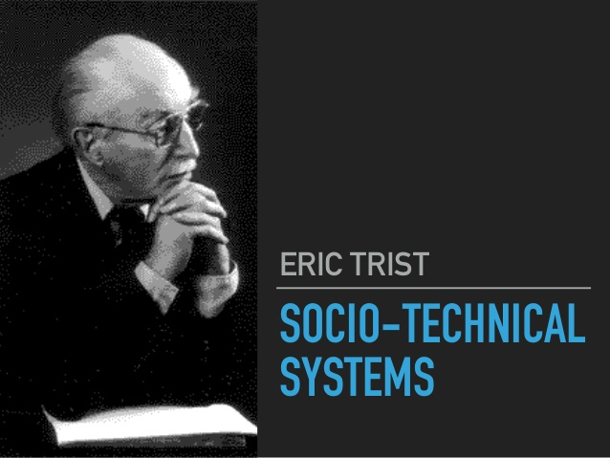
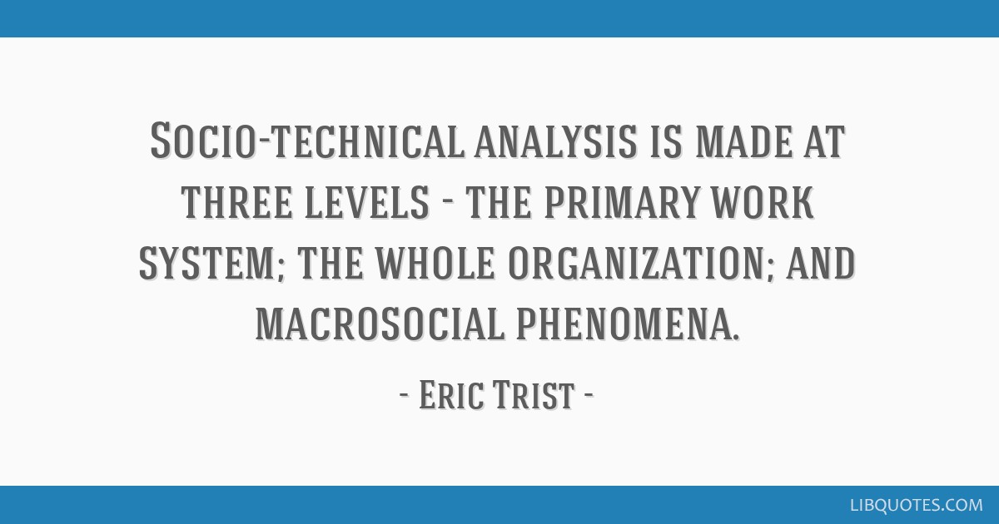
Socio-Technical Systems and STS Transition
Analysing and Managing the social change associated with the Digital Twin technological change is equally important!

Slide 9
Digital Twin as a Socio-Technical Change
Environment (Policy, regulations, legislations, frameworks, economy, social aspects)
Work System
Social Subsystem
Technical Subsystem
People (Employees)
Roles & responsibilities
Skills & expertise
Culture and Behaviours
Technology BIM/GIS/CAFM/IoT/5G
Hardware, software
Network connectivity
Sensors and BMS
Organisation
Leadership & Strategy
Structure
Policy, procedures & training
Work Process
Coordinates people tasks, technology use and organisational context

Slide 10
Key Points
More focus needs to be given to develop use cases, business case, and applications of smart technology in the operation phase of building lifecycle as it accounts for 80-85% of the life cost of the building.
An integrated lifecycle digital twin should be connected to the asset management system i.e. intersect with the Smart Building concept.
More work needs to be done about technology development for Facility and Asset management system to understand IFC for a complete the digital lifecycle of the asset.
It is important to give more focus to retrospective digital twin of existing building because new built is a frication of existing buildings stock in the UK
Digital Twin is not only about technology, but also it is a social change, so more work is needed in analysing the sociotechnical transition associated with Digital Twin implementation.

Slide 11
Thank you!

