Slide 1



Using Digital Twins to Support Net Zero Interventions
Tim O’Callaghan
tim@electriccorby.co.uk
www.nn2nz.co.uk

Slide 2
Agenda
Introduction to Electric Places
North Northamptonshire: Developing a Roadmap to Net Zero (NN2NZ)
Why a Digital Twin?
Progress to Date
Summary
Q&A
www.nn2nz.co.uk

Slide 3



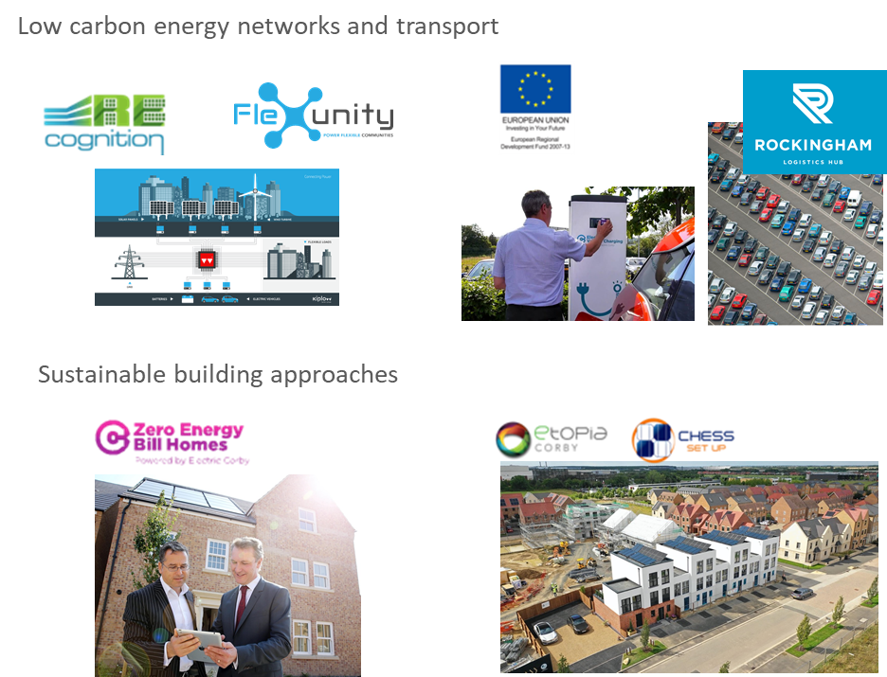
Electric Places
We produce strategies and deliver projects that support the transition to Net Zero.
We develop and promote projects for the private and public sector that actively enhance the economic and environmental strength of places, people and businesses.
A not-for-profit community interest company
Supporting organisations with their net zero carbon agenda
  Local Authorities
  Housing developers
  Renewables consortia
Delivering clean tech R&D projects
  Pilot tests for next gen renewables, energy flexibility
  Design of 47 ecohomes (zero energy bill)
Community Renewal Fund for NN2NZ project

Slide 4
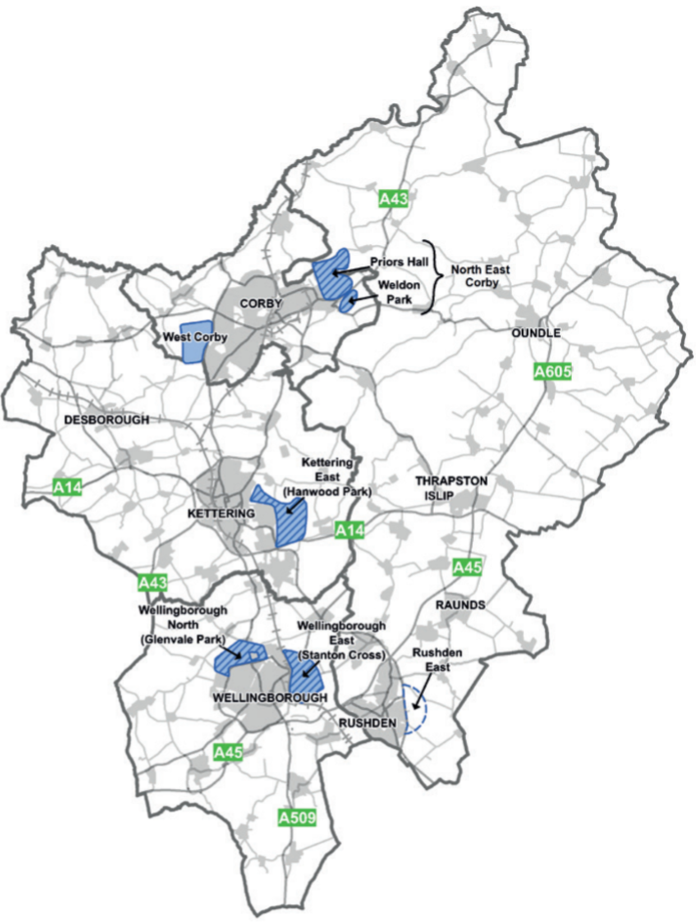
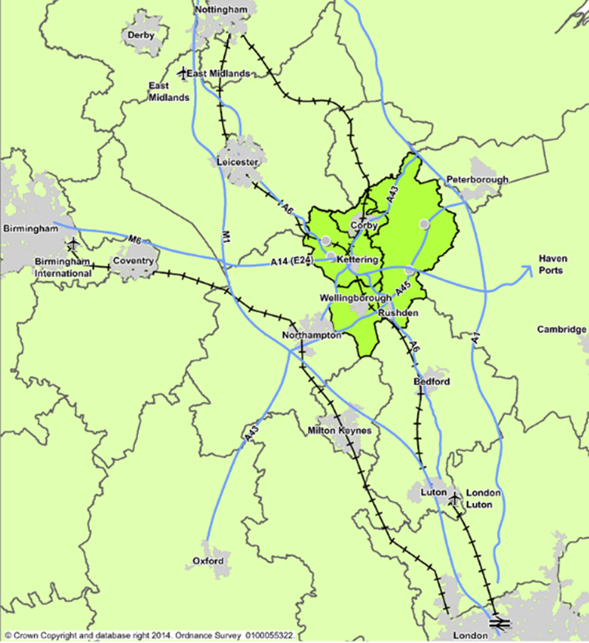
North Northamptonshire to Net Zero
NNC a Unitary Authority since April 2021
Population of c.350,000
Mix of large (“growth”) market towns and over 100 villages
Part of the Ox-Cam Arc significant economic potential
Planned strategic growth to 2031 and beyond…
  31,100 new jobs
  35,000 new homes
“…a showpiece for modern green living and well managed sustainable development: a resilient area where local choices have increased the ability to adapt to the impact of climate change and to global economic changes”
North Northamptonshire Joint Core Strategy 2011-2031

Slide 5
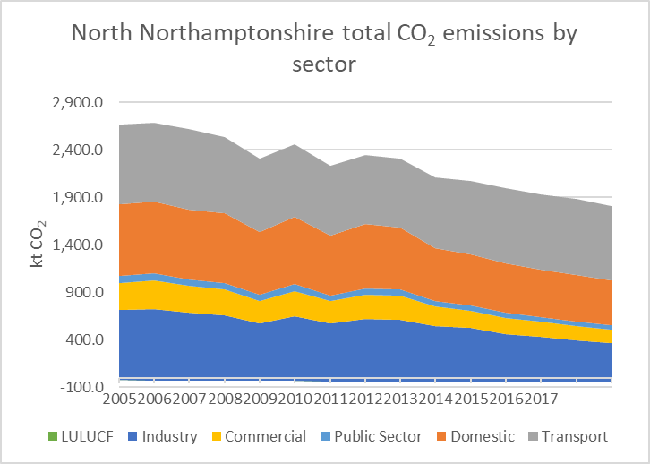
NN2NZ – a roadmap to net zero
UK Parliament declared a climate emergency in 2019, along with goal of being net zero by 2050. Many are trying to beat this. Emissions are coming down, but significantly more needs to be done to reach net zero.
NN2NZ aims to develop and recommend a programme of initiatives that would enable NN to reach Net Zero ahead of 2050, along with a robust framework for assessing new ideas as they emerge
Follow-on funding for trialling and roll-out of the key initiatives will be sought to enable success for NN
www.nn2nz.co.uk

Slide 6
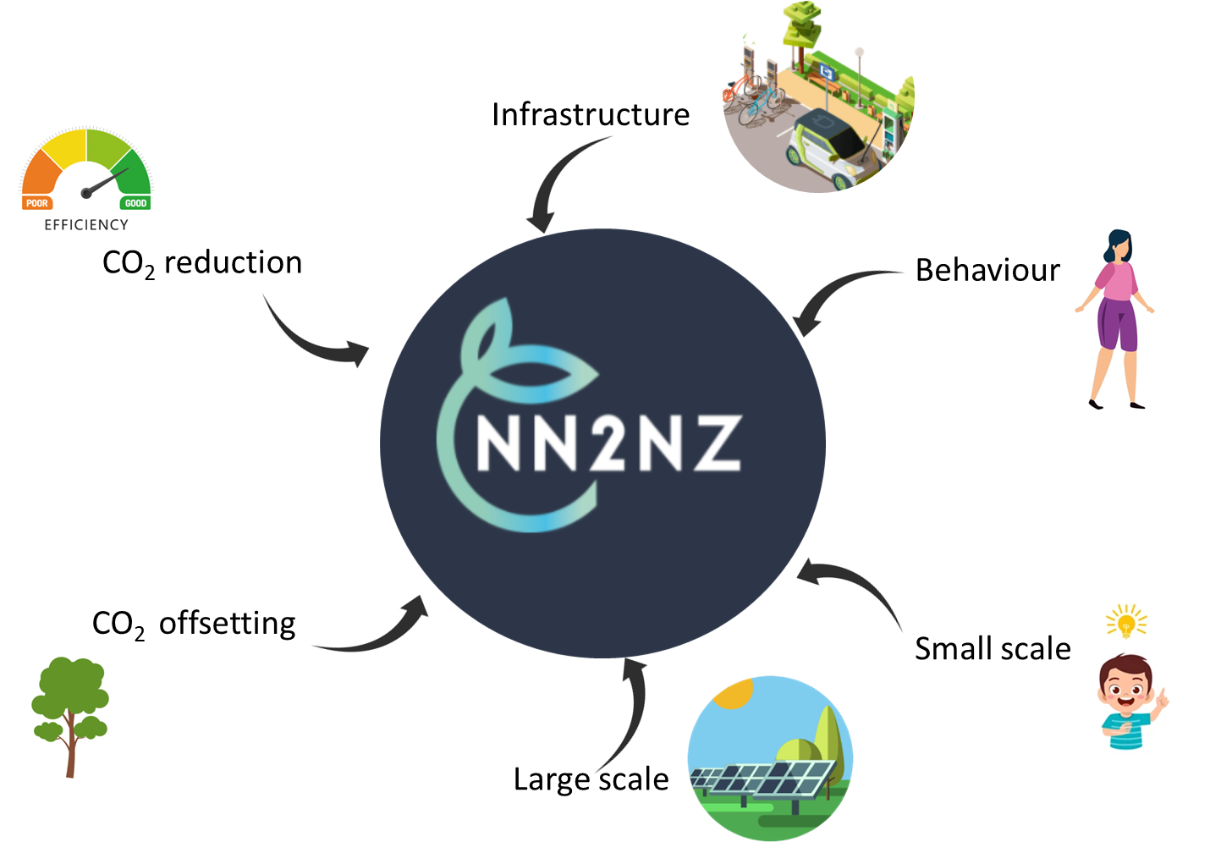

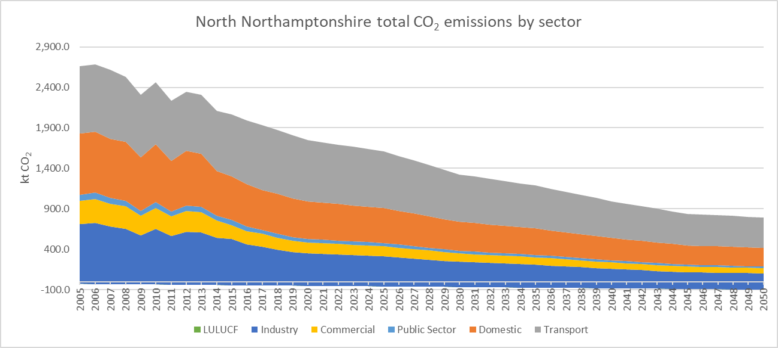
Which interventions? What’s the impact?
>8000 projects analysed – no stone left unturned. What if…..
  every south-facing roof had solar
  every car park had solar and wind
  people gave up their second cars
  no-one drove to work…
Determined relationships linking intervention impact and adoption to CO₂ savings
Forecasted scale and impact of all viable projects assessed against the NN CO₂ gap
Cranfield University validating emission calculations and relationships
Today
2030
2040
2050
Forcasted BAU emissions are based on National Grid Future Energy Scenario (FES) “Steady Progression”, 2021). This represents a base case decarbonisation profile for North Northamptonshire

Slide 7
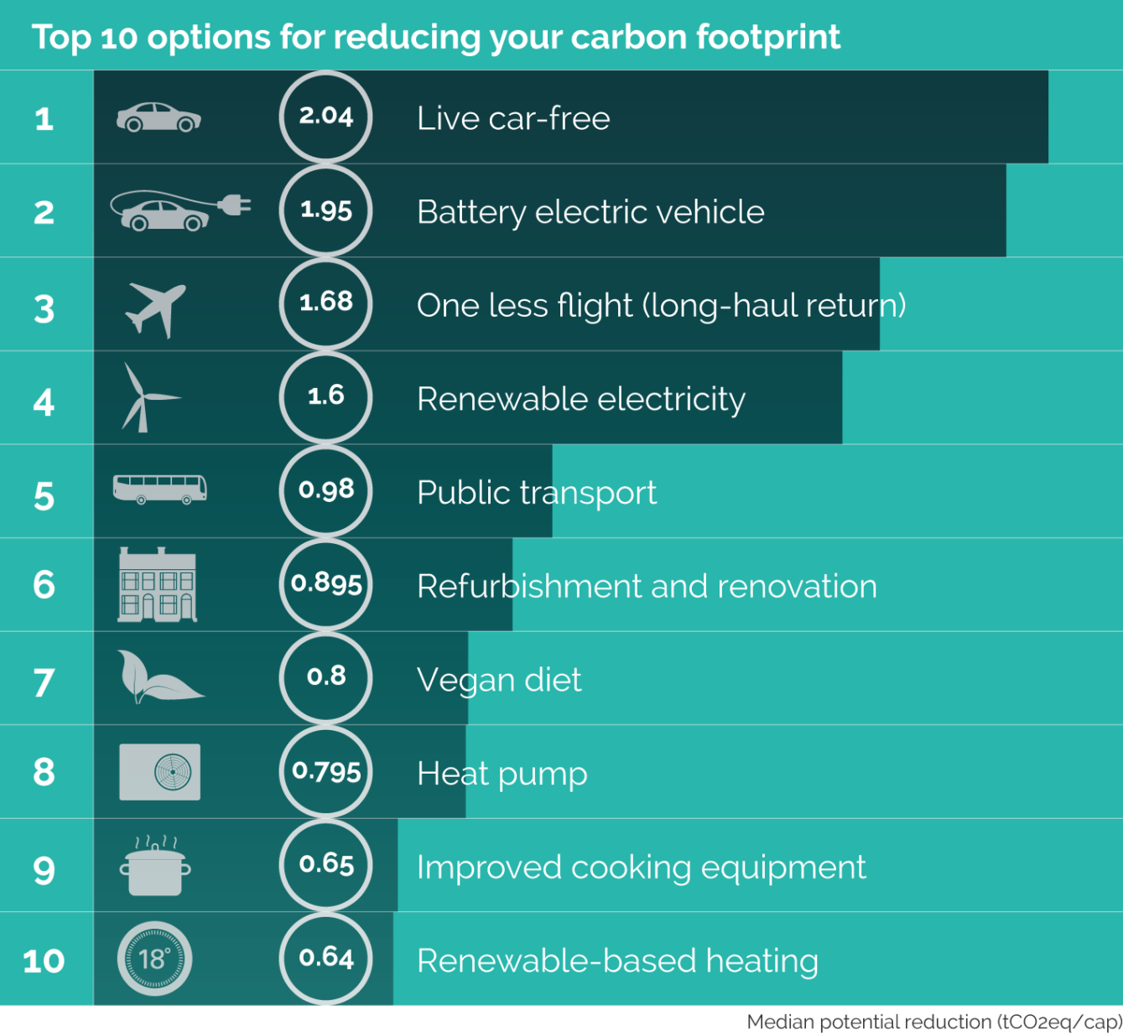

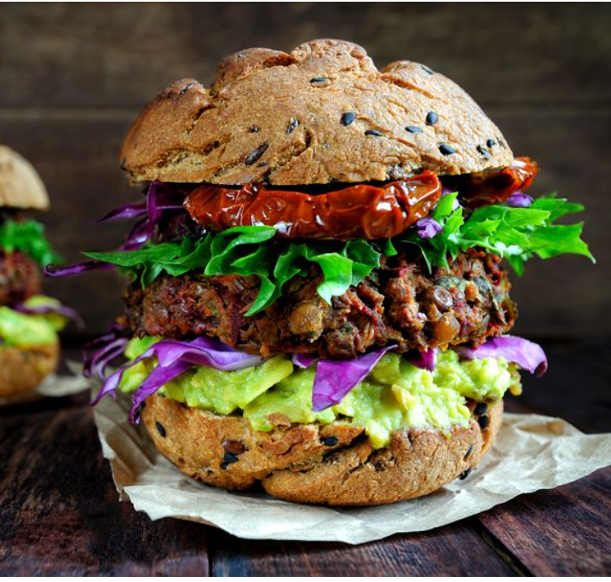
Top 10 for individuals
Diana Ivanova et al 2020 Environ. Res. Lett. 15 093001

Slide 8
Summary draft gap closed for NN

Slide 9
Why a digital twin?
The Challenge of Data
The Challenge of Prediction
The Challenge of Engagement
What and where are the data I need to support my net zero strategy?
Large growth in available data from a myriad sources by 2030
Most of data is siloed, disconnected and not used to create value
Much of analyst time spent on low value, data pre-processing tasks
How do I use data to provide quantified evidence-based predictions of impact in my Local Plan?
What is the relationship between intervention, impact and those impacted?
How do I predict the changes that will happen over time?
How do I quantify and optimise the value add of competing intervention options?
How do I engage and secure buy in from a diverse set of stakeholders across the region?
How do I transform my strategy into a data-based story?
What compelling visualisations can I create to broaden engagement?
How do I measure engagement across a diverse constituents?
www.nn2nz.co.uk

Slide 10


Where, how many, when?
To assess the feasibility of promising interventions we need to model and map initiative impacts on existing infrastructure and understand populations that may disproportionately benefit from or pay for interventions.
Aggregate
A single platform which acts as an NN evidence base for decision making
Collating data from diverse sources (e.g. Land use mapping, DNO, Traffic, EVCP, housing, carbon conversion factors, social indicators, census data)
Analyse,
Calcs can be performed in Excel but challenging to simulate time-related:
  Geospatial impacts (e.g. impact of EVs on regional NO₂ and congestion)
  Location specific quick wins or barriers (e.g. impact of PV in areas with export headroom but not affected by curtailment issues)
Interpret
Visualise heat maps and RAG rated infrastructure/metrics to help decision making
Communicate
Maps with overlaid metrics, dashboards ,3D renders, intractability enable evidence based engagement with planners, councillors, developers and the public.
www.nn2nz.co.uk

Slide 11
NN Digital Twin in action
Video showing Compass Engine Simulation
Video showing 3D rendering
www.nn2nz.co.uk

Slide 12

Digital Twin challenges
Identifying available data
  What’s public?
  Where can we find it?
  Is it accurate?
Determining the best input data
  Recent vs. granular (e.g. vehicle registration data)
Updating/changing data inputs
  New data formats/reporting standards (e.g. CO₂ to CO₂e)
  Different geospatial references (e.g. postcode vs. LSOA)
Defining the most important questions to ask of the digital twin
  Specific outputs/metrics required (CO₂e/kWh/energy self sufficiency)
  Impacts on development time
Input data
Digital tools & Workflows
Outputs
Compass Engine
Simulations
www.nn2nz.co.uk

Slide 13
Summary
Digital twin will enable the feasibility of promising CO₂ saving interventions to be determined for NN
  Model and map their impacts on existing infrastructure
  Understand impact on populations and geographies
Enable the aggregation, analysis and interpretation of data and communication of outcomes
Coherent, robust evidence base to justify interventions and future funding for projects to reach net zero
Potential to evolve the Digital Twin to support Spatial Strategies, Local Planning, environmental impacts
  Guide development policy – meet both growth and NZ targets
  Test CO₂ impacts of different ‘built environment’ strategies (urban extensions vs. dispersed development)
  Visualise regional impacts of climate change and assess mitigation factors
  Determine GHG/climate impact evaluation and monitoring criteria for new sites brought forward for development.
  Help determine costs of CO₂ saving interventions and where the public sector can intervene
Developing a versatile Digital Twin tool with embedded UK LA data and carbon impact factors
  Could potentially be leveraged by other local authorities
www.nn2nz.co.uk

Slide 14
Thank you
Questions?
Tim O’Callaghan
tim@electriccorby.co.uk
www.nn2nz.co.uk

