Slide 1
Revolutionising decision-making for individuals and organisations
Dr Keith Dear
DT Hub Gemini Call
18th October 2022

Slide 2
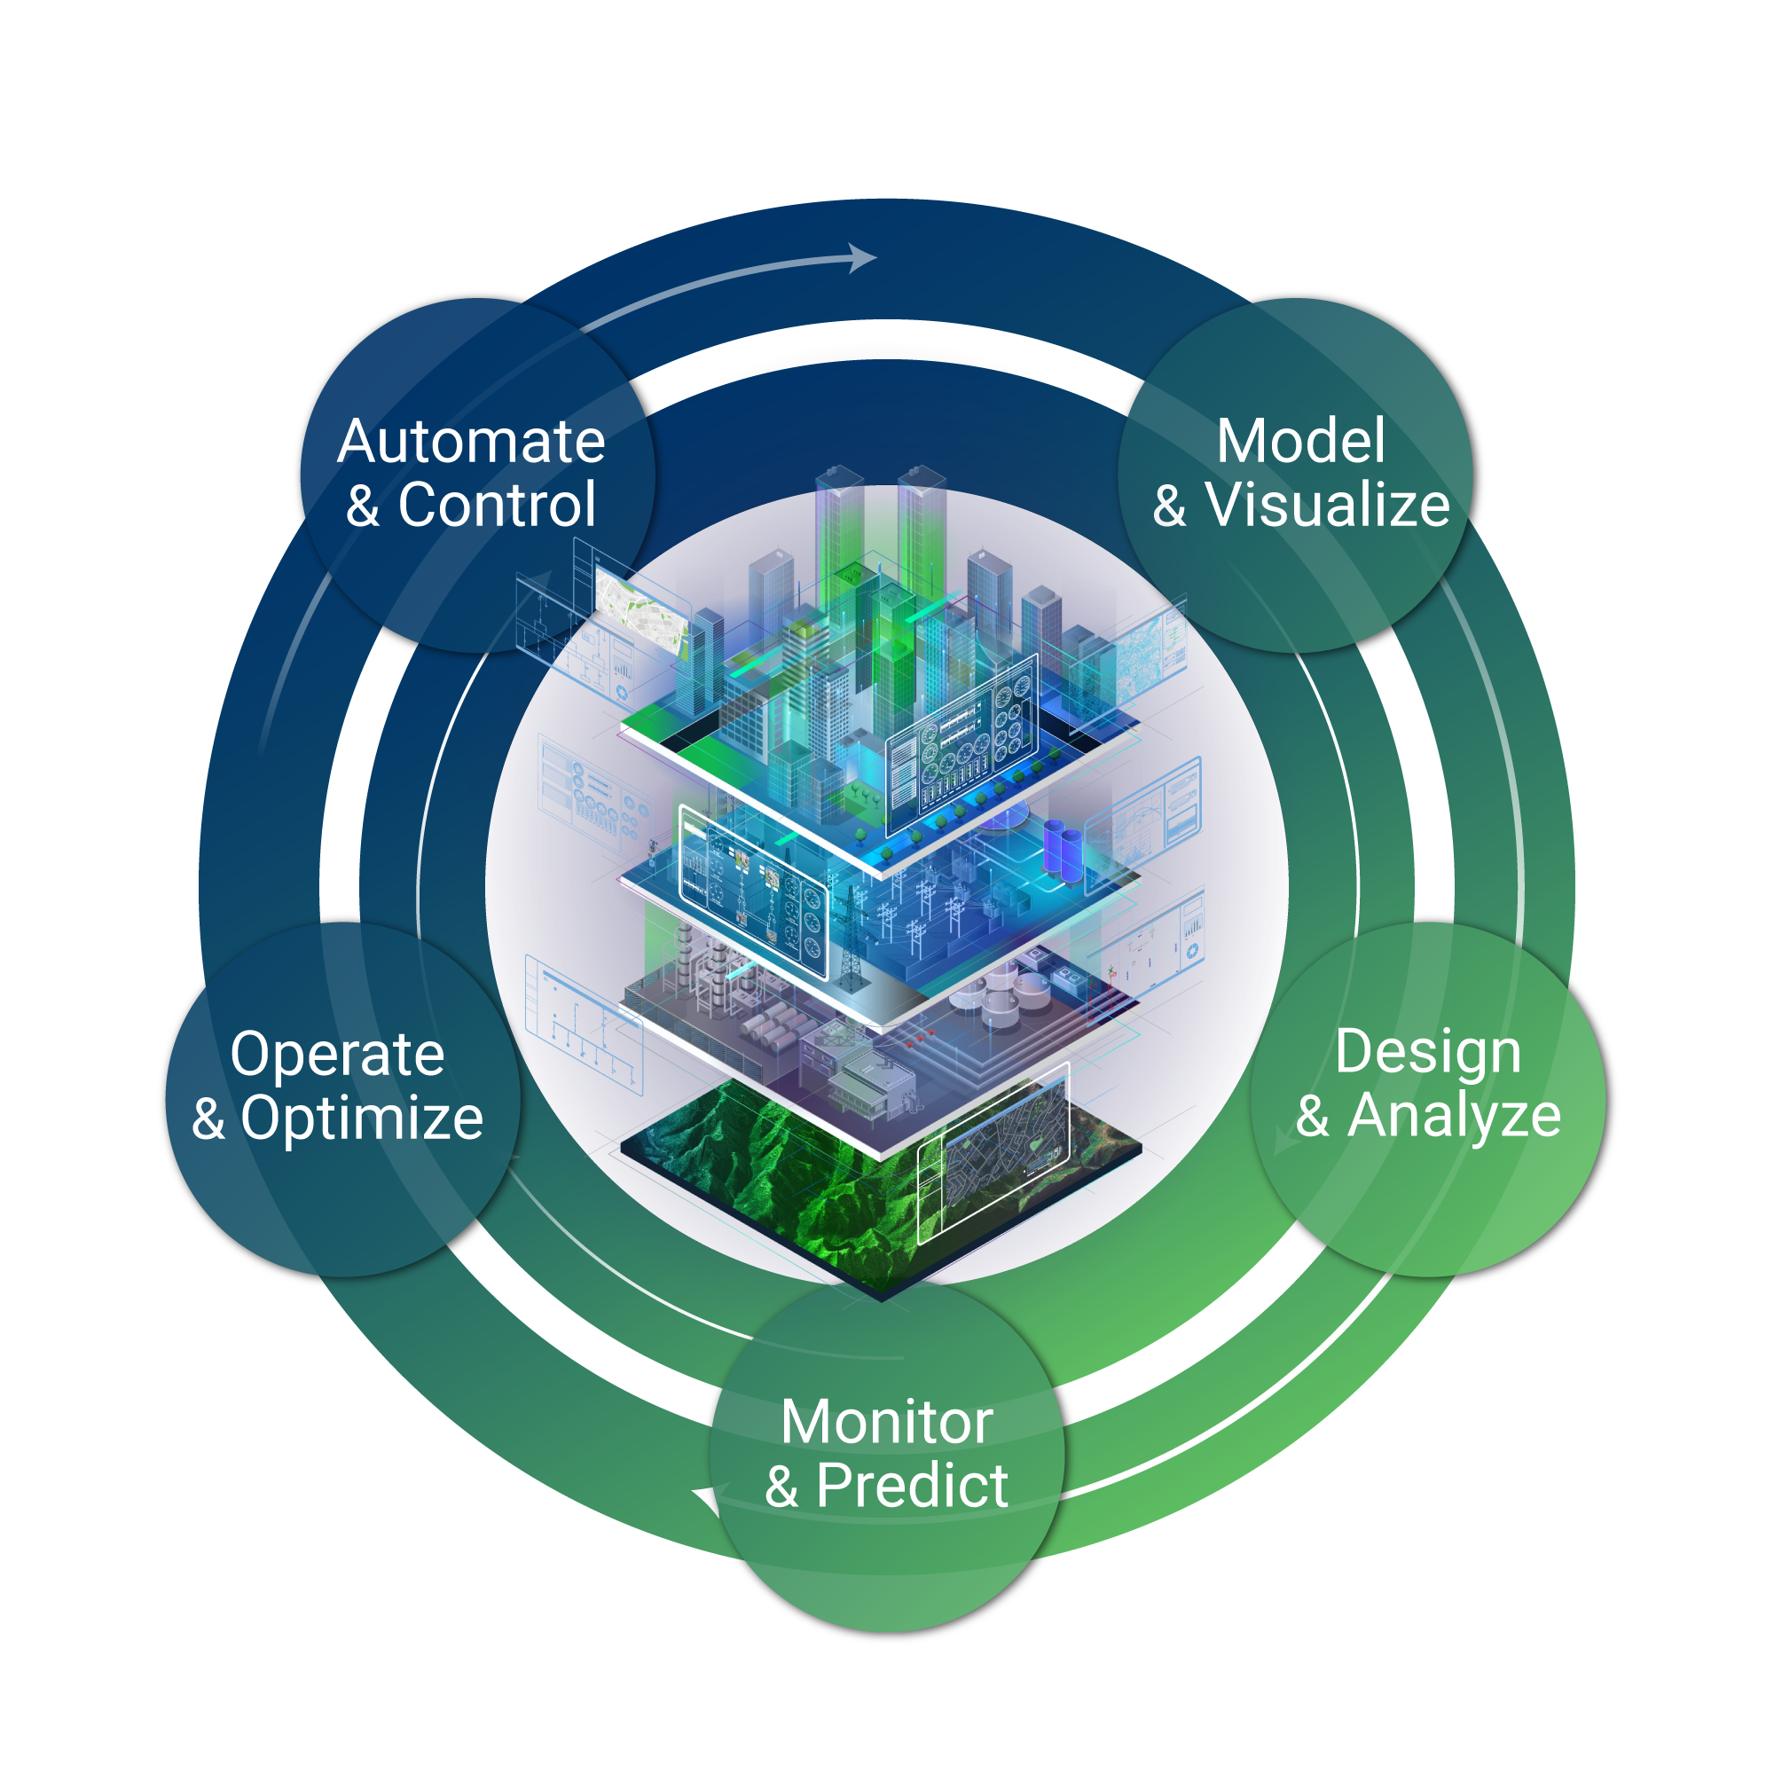

Background
A rapid evolution of Digital Twin and cognitive technologies in the last year
  ‘A revolution as profound as the introduction of the internet’
  Japan’s 6th Basic Plan for Innovation
  UK International Strategy’s integrated review
  Digital Democracy at scale in a Brave New World
Barriers to practical deployment remain strong
  Sharing relevant information in an inclusive yet effective manner
  Taking into account differences of users and varying levels of digital literacy
  Enabling faster and effective decision-making for individuals and organisations
To change the world, Digital Twins can’t work alone
  AI, High Performance Compute, strong visualisation, communications tools and more can form a perfect package if used appropriately

Slide 3
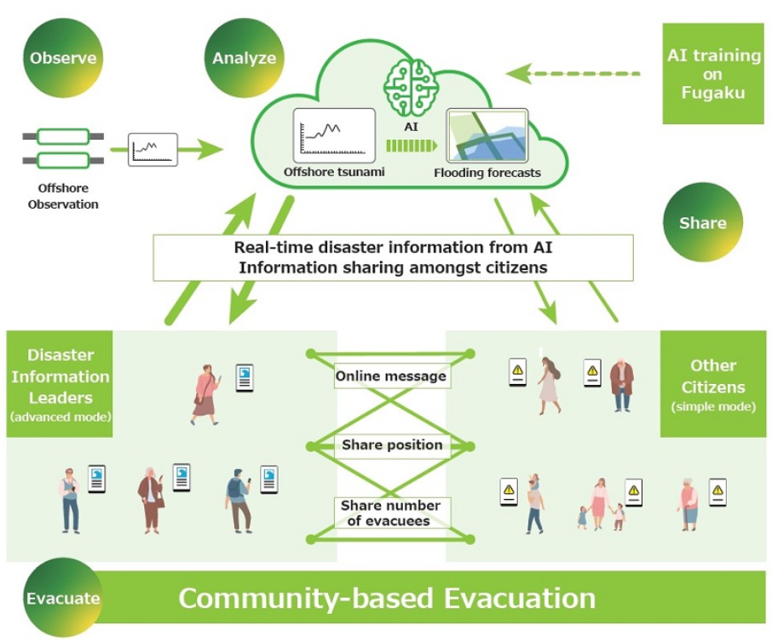
Kawasaki Tsunami Forecast
Fujitsu real-time tsunami flooding forecast app, including evacuation drill on March 12th in Kawasaki, Japan
Technologies
  Using AI training with the power of Fukagu to collect and analyse tsunami flooding forecast data
  Data delivered to a dedicated Fujitsu app
  App used by residents in real time, showing arrival time, flooding height and locator map of other community members
Evacuation drill aims
  Maximise the effectiveness of community-based evacuation
  Identify most effective ways to use the technology
  Support local communities in sharing information amongst residents

Slide 4
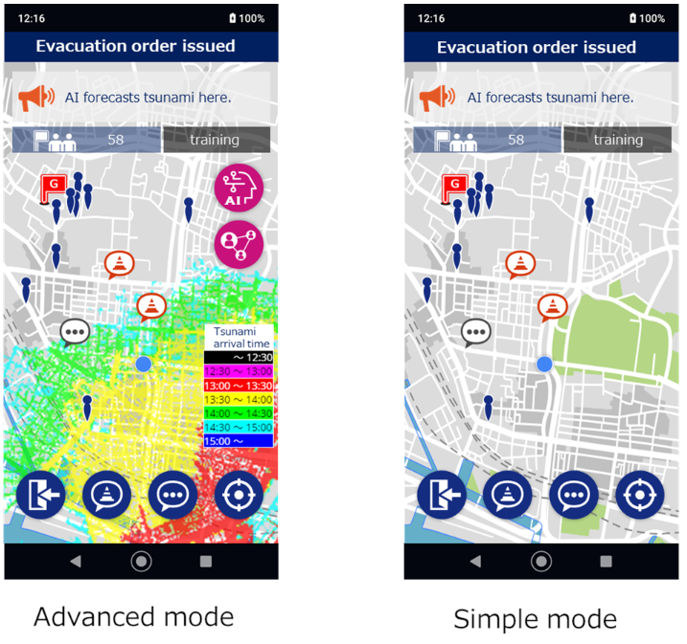
Flooding Prevention
Bringing real-time data to individuals and organisations
  Processed high-resolution real-time data
  Displayed inclusively and effectively
  Allow further information sharing amongst citizens, for example alerting on points along evacuation routes that are assumed to be damaged and difficult to pass
Revolutionising decision-making
  Emergency services deployment
  Critical infrastructure resilience
  Safe and efficient evacuation
  Disaster prevention
Fujitsu built and run the UK Flood Warning System that enables the Environment Agency to alert citizens much more quickly about potential threats, while automatically targeting multiple at-risk groups via familiar channels, which, ultimately, will save lives.
Screenshots of the Fujitsu App used in Kawasaki flood warning drill

Slide 5
Our Work and Future
Ongoing work with cognitive and advanced technologies
  Fujitsu’s Centre for Cognitive and Advanced Technologies, £22m investment
  Digital Twin, quantum, neurosymbolic AI technologies development
Building an innovation bridge between Japan and the UK
  Fujitsu’s commitment to Society 5.0
  Continuous collaboration with Fujitsu Research across the globe
Supporting collaboration between national programmes around the globe
  Benchmarking Digital Twin programmes worldwide
  Build a network of global subject matter experts

Slide 6
Press Releases & Further Reading
[1] Fujitsu leverages world’s fastest supercomputer and AI tech in joint field trial for safe and efficient tsunami evacuations in Kawasaki City
[2] Fujitsu commits to the UK’s science and technology superpower potential
[3] Environmental Agency: Modernizing its flood warning service, adding new features and flexibility
[4] Kawasaki City and Fujitsu in June 2021 further strengthened their collaboration to promote various initiatives utilizing cutting-edge digital technology, focusing on the four priority themes of “health,” “safety and security,” “environment,” and “work and living” that will further increase the value of communities by making them more livable.
"Fujitsu, City of Kawasaki Strengthen Cooperation to Realize a Sustainable “Future City”"
[5] Prior field trials :
"Fujitsu Leverages AI Tech in Joint Project to Contribute to Safe Tsunami Evacuation in Kawasaki"
"Fujitsu Optimizes Evacuation Center Management to Mitigate COVID-19 Risk with AI in Joint Field Trial in City of Kawasaki"

