Slide 2


Shaping the Future of
Urban Transformation
Global Digital Twin City:
empowering urban transformation
2021-2024

Slide 3

The World Economic Forum
        The World Economic Forum is the international organization for public-private cooperation.
        Our mission is to improve the state of the world.
        We are global, independent, impartial and future-oriented.
        Through a holistic, multi-stakeholder approach, the Forum engages the foremost leaders from business, government, civil society and academia to shape global, regional and industry agendas.

Slide 4
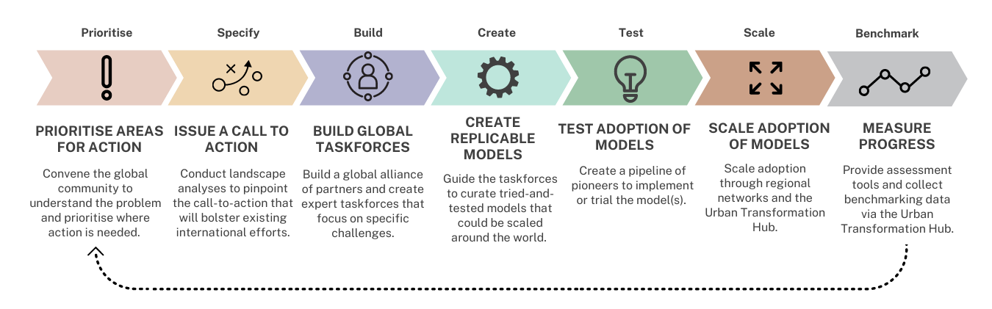
Impact Model
Our operating model is designed to create impact at both a global and local level.

Slide 5

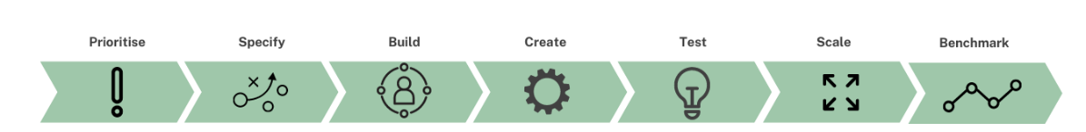
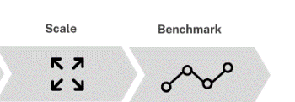
About global digital twin city initiative
The digital twin city is a new concept and model of urban planning and construction for future sustainable development, an effective combination of digital technology innovation and urban operation mechanism innovation, and a feasible pathway for urban upgrading.
Currently, the digital twin city is still in the early exploration stage, facing many challenges such as inconsistent understanding, immature technology, and unclear business models.
At the beginning of 2021, the World Economic Forum and the China Academy of Information and Communication Technology (CAICT), together with key global stakeholders, launched a three-year initiative that seeks to make digital twin technology accessible to the public, promote social equity and inclusiveness, help cities achieve digital and low-carbon transformation, and jointly shape the future of digital twin city development.

Slide 6



























Global Partners
Anchor partners
Global partners

Slide 7
3 Year strategy and plan
Methodology and
key outcome
Roadmap to Construction
Roadmap to development
Roadmap to
Sustainable business
Framework
Guideline
Evaluation
Operation
WHAT:
Concept, Value and key drivers
HOW:
Guideline of Design and Construction
WHAT:
Maturity evaluation model
HOW:
Sustainable business model
Show cases and
business
Select:
Use cases
Incubate：
Pioneers
Benchmark:
Industry
Toolbox:
Policy, Tech, Finance, training
Phase I
2021-2022
Phase II
2022-2023
Phase III
2023-2024

Slide 8
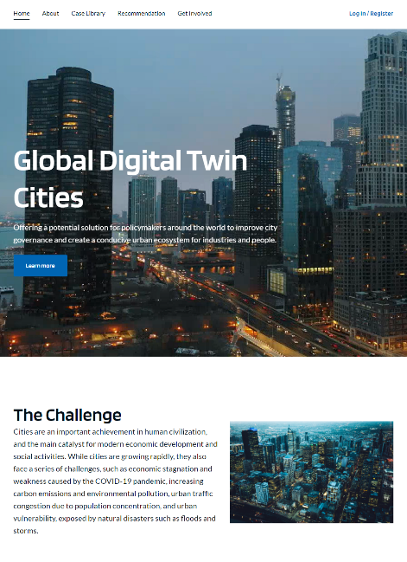




Summary of Phase I achievements
4 Technical Characteristics
3 Visions
“4+5”Key Elements
7 Cases
2 Sets Recommendations
  Project Website
  Insight Report
https://initiatives.weforum.org/digital-twin-city

Slide 9
Action plan of Phase II – Key Action Plan and major achievement
Global Community and Advisory Committee
Insight report
Impact
Reputation
Strategy
Selection
Evaluation
Fostering
Year Achievement
Business
Experience
Know-how
Events
Advice
Participation
Insight
Experience
Design and Construction Guideline
Select and foster Pioneer Projects*
Methodology
Roadmap
Recognition
Projects interaction
Feedback
Improvement
*industry parks, CBD and other urban district level projects

Slide 10


Action plan of Phase II – Global Advisory Committee (GAC)
Co-chairs
Zhifa Xu, Director, Institute of Planning, China Academy of Information and Communications Technology （CAICT）
Mark Enzer OBE FREng, CTO, Mott MacDonald and Head of the National Digital Twin programme, UK
Project Leads
Cai Chen, Director, Department of Information Application Research, CAICT
Yamin Xu, Lead of Greater China, Urban Transformation Platform, World Economic Forum
Committee Members
Deren Li, Academician, Chinese Academy of Sciences and Chinese Academy of Engineering
Yanli Gao, Chief Engineer, Institute of Planning, CAICT
Aohan Chen, Chief Executive Officer, Beijing Uinnova Technology
Xiufeng Ni, General Manager and Vice-President, Smart City Technology Platform Department, IFLYTEK
Jacques Beltran, Vice President, Cities & Public Services, Dassault Systèmes
Michael Jansen, Chief Executive Officer, Cityzenith
Yi Li, Chief Executive Officer, Beijing 51World Digital Twin Technology
Junwei Liu, Chief Executive Officer, Terra Info Tech (Beijing)
Fei Tao, Professor, School of Automation Science and Electrical Engineering, Beijing University of Aeronautics and Astronautics
Junjie Ma, CEO, Shanghai Digitwin Technologies
Hung-Chih Liu, SVP, AECOM
Andre - Ka Ming Kwok, Co-founder and CEO, Good City Foundation
Raymond Zhao, Corp VP, AIMS Tech
Luis Mao, Greater China Area CEO, Smart City Expo World Congress
Paul Lam, Strategy and Policy Officer (Digital & Technology), Asian Infrastructure Investment Bank
Philippe Obry, Co-Founder & General Manager, Akila
Digital Twin Cities Project Global Advisory Committee
The Digital Twin Cities Advisory Committee is a group of global industry leaders from government, industry, entrepreneurship, and academia.
The membership of the Committee is nominated and decided by the World Economic Forum and the China Academy of Information and Communications Technology (CAICT). The Committee will hold 1-2 all hands meetings in the year to discuss and decide on the strategic direction, share progress, and solve key issues of the project, while the project team will form specialized working groups to complete the working plan under the leadership of the Committee.

Slide 11

Action plan of Phase II – Design and Construction Guideline
Technical capability
and Platform
Digital twin tech core capability (IoT, Visualization, Modelling and Simulation etc.) and consolidated digital platform to serve future construction and operation purpose.
Application and Value
The key application scenarios, relevant public benefits and business value.
Infrastructure and Data
Critical ICT infrastructure, data consolidation, usage and governance
Business and Operation Model
Key stakeholders and business model during different phases (design, construction and operation).
Strategy and Talent
Strategy and plan of digital twin tech empower parks’ business, the relevant policy, organization and talent foster & promotion plan.

Slide 12

Action plan of Phase II – Pioneer Projects
Online submission
Document selection
June 2022
WEF website submission
July 2022
GAC review the documents
Engage with selected projects.
Site visit and
evaluation
July - September 2022
Onsite visit, evaluation by Project team and GAC
Fostering
July 2022 – March 2023
Foster projects with guidelines, experts, finance (TBD) and training program with guidance of GAC
Nomination
May 2023
Final Evaluation by GAC
Announcement & Reword of 2023 Global Digital Twin Pioneer projects
Case promotion in annual report and website

Slide 13


Contact Details
Yamin XU
Lead of Greater China, Urban Transformation Platform, World Economic Forum
yamin.xu@weforum.org

Slide 14
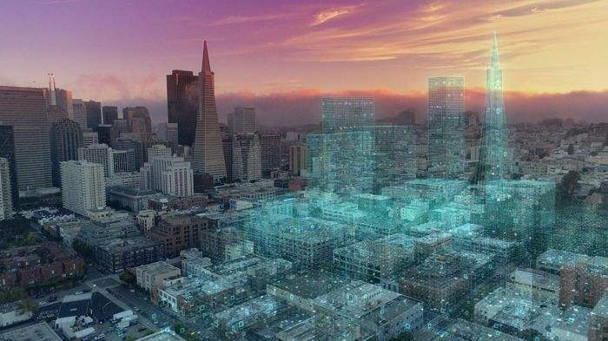
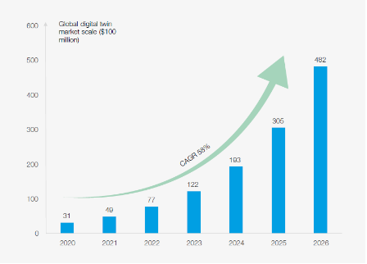
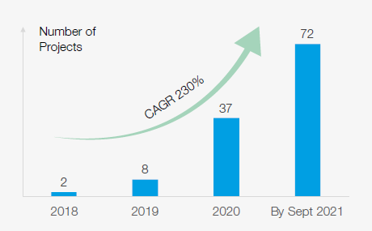
Phase I Achievement: Concept and market
Booming and disordered Market
A digital twin is a digital copy of a real-world place or object. Artificial intelligence and machine learning technologies enable the creation of digital twins, which are dimensionally accurate 3D digital models that can be updated quickly to reflect changes with its physical counterpart. Its goal is to:
Solve the complexity and uncertainty of urban planning, design, construction, management and services through simulation, monitoring, diagnosis, prediction and control;
Establish the simultaneous operation of and interaction between the physical and digital dimensions of the city.
It is predicted that by 2030, the application of digital twin technology will save $280 billion for urban planning, construction and operation, the digital twin market is expected to reach $48.2 billion by 2026 and grow at a 58% CAGR (compound annual growth rate)*.
The total investment scale of China’s new smart cities in 2020 was about RMB 2.4 trillion ($0.38 trillion). In particular, China’s City Information Modelling (CIM) construction projects have shown a trend of rapid growth year on year, with the number of projects growing from 2 in 2018 to 72 in 2021, the average investment of the projects reached RMB 28 million ($ 4 million).
* Source: Marketsandmarkets, collated by CAICT
* Source: Project research

Slide 15

Phase I Achievement: Vision and challenges
3 Visions:
3 Challenges:
Resources and Business
1
Urban production and operation are highly efficient and intensive
There is a lack of composite human resources.
Intra-city algorithm model resources is inadequate.
Too much dependence on government funding.
Value Cognition
2
There is a lack of rational, objective awareness on digital twin cities.
Too much dependence on visual modeling techniques hampers the realization of the ultimate value of simulation extrapolation and the optimization of reality.
Urban space is liveable and convenient
3
Urban environment is sustainable
Data Governance
Limited IOT sensing data collection hinders the depth of application.
There is a lack of standardized governance on multi-source heterogeneous data.
Centralized processing of massive amount of data increases the risk of data breach.

Slide 16
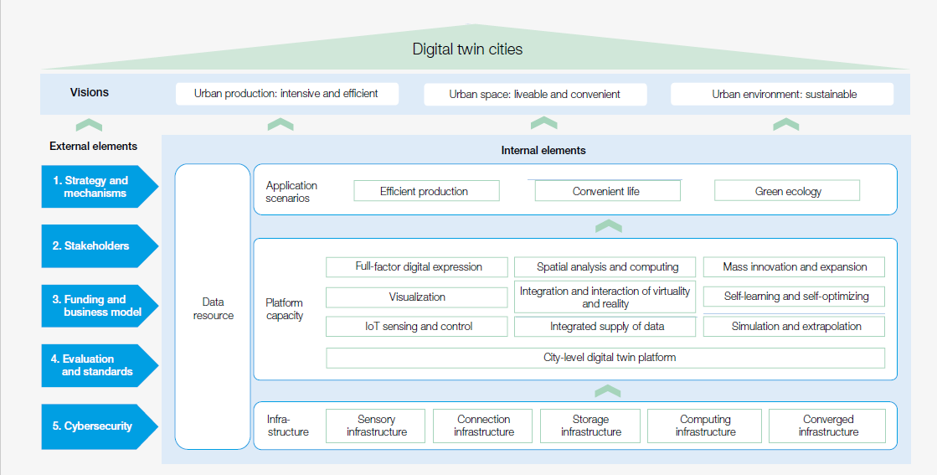
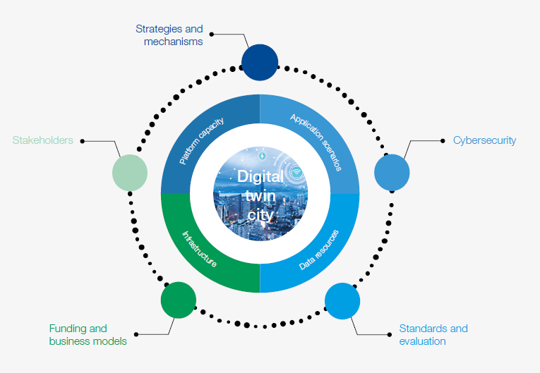
Phase I Achievement: 4*5 Key elements as internal and external drivers

Slide 17
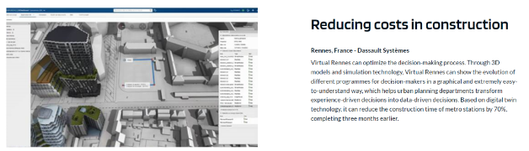
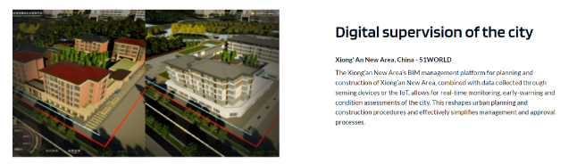
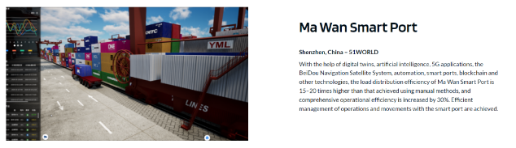
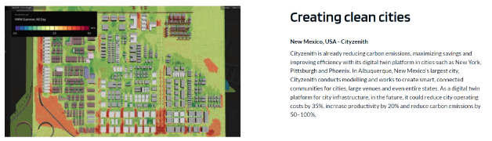
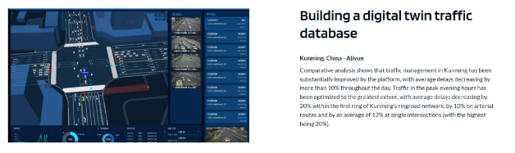
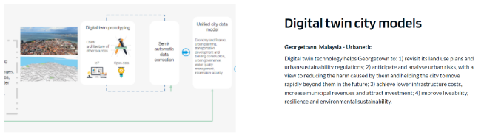
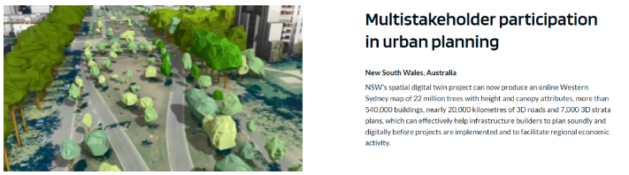
Phase I Achievement: 7 global use cases in 4 continents

Slide 18
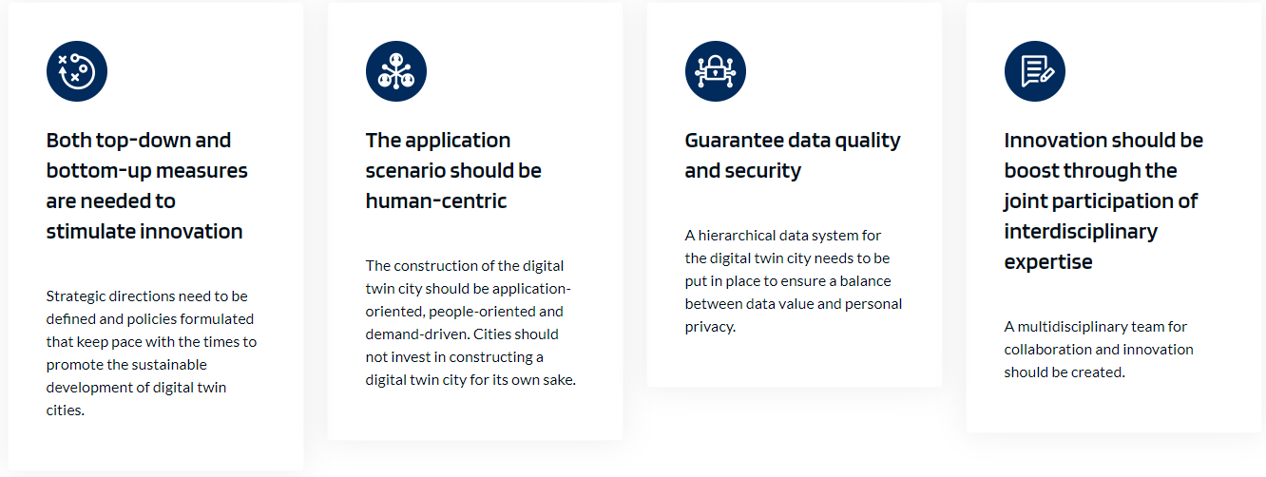
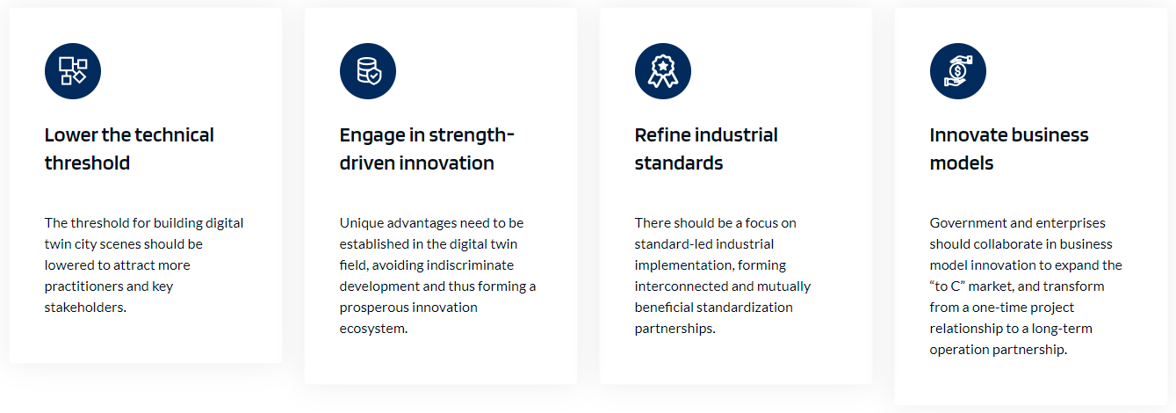
Phase I Achievement: Recommendations to Key stakeholders
Recommendations for Government
Recommendations for Industries

