Slide 1
Making Digital Twins a Reality
Waste Water Case Study
David Ogden
Gemini call June 2022

Slide 2
Agenda
Aim of the project
Our approach
Challenges & Lessons

Slide 3
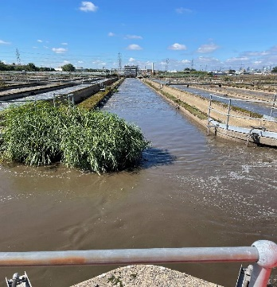
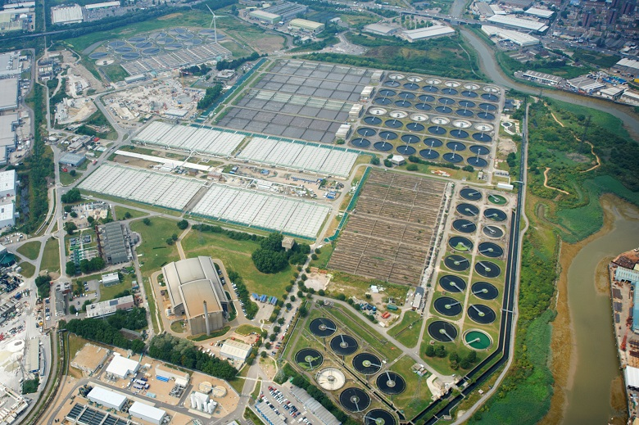
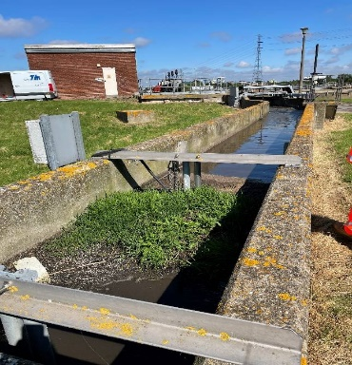
Objective
Beckton Sewage Treatment Works
Largest Sewage plant in Europe
Over 250 Acres
Treating the waste of > 3.5m customers
Currently undergoing a £120m capital investment project
Built in 1864
Notes:
In other words develop a Digital Twin for WasteWater treatment
Me
Engineer
Water sector 20
Client side 18
Last 10 transforming the way water companies operate
focus on exploiting emerging digital technologies to drive the changes.
Digital twin terminology used a lot – strategies - presentations
But today I’m showing approach and project –that brought it to life for me brings it life for me – and hopefully you
Journey, - not have all the answers.
Sparks ideas and thoughts come and find me really value your views
0.5 - 1min

Slide 4
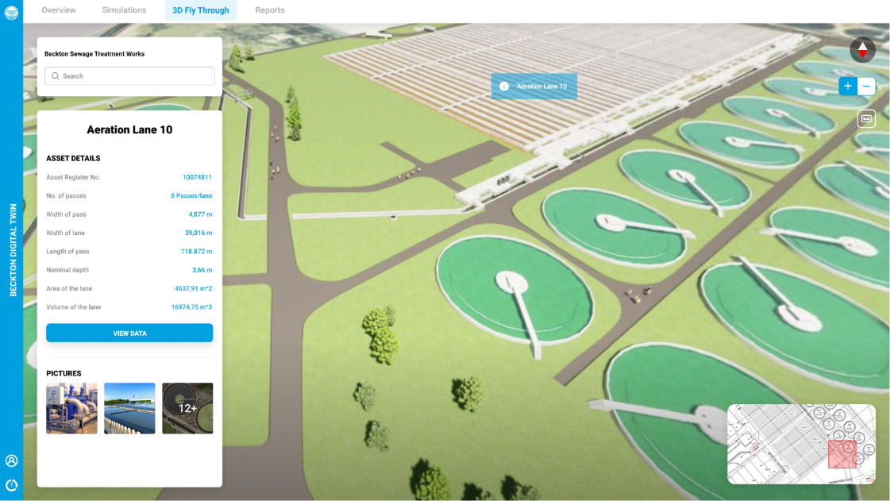
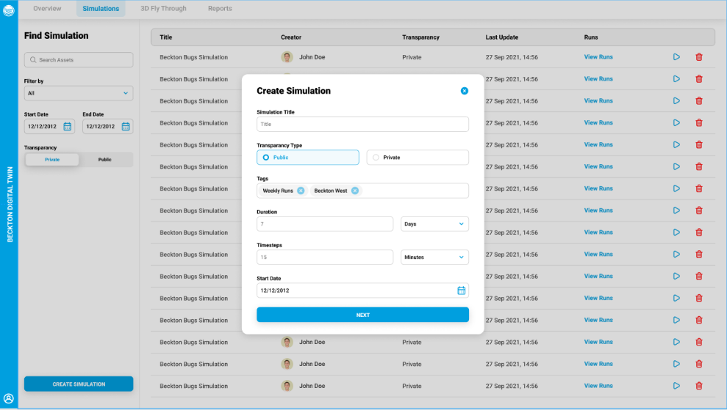
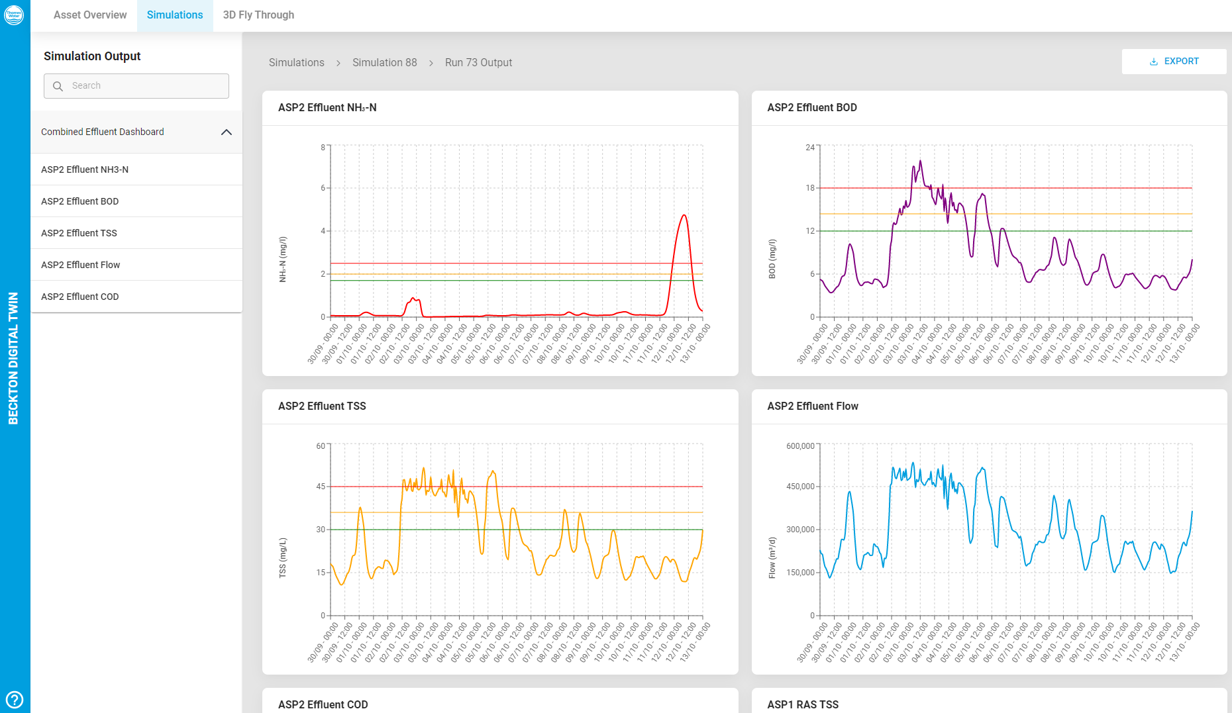
Objective
Project Brief:
Develop a tool (Digital Twin) that will:
Dynamically inform Thames Waters risk-based investment decisions
Facilitate performance optimisation of the site
Enhance the asset maintenance strategy
Notes:
In other words develop a Digital Twin for WasteWater treatment
Me
Engineer
Water sector 20
Client side 18
Last 10 transforming the way water companies operate
focus on exploiting emerging digital technologies to drive the changes.
Digital twin terminology used a lot – strategies - presentations
But today I’m showing approach and project –that brought it to life for me brings it life for me – and hopefully you
Journey, - not have all the answers.
Sparks ideas and thoughts come and find me really value your views
0.5 - 1min

Slide 5
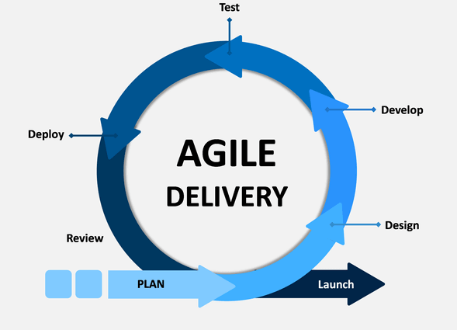
Our approach
Discovery
Digital / Engineering / Operations
User stories - Functional & non-functional requirements
Implementation
Scaling and deployment
Lifecycle Services
Ongoing Development & maintenance
Gap analysis – current state Vs To Be
Roadmap, strategy and business case
Minimal Viable Product
Using Agile delivery principles

Slide 6
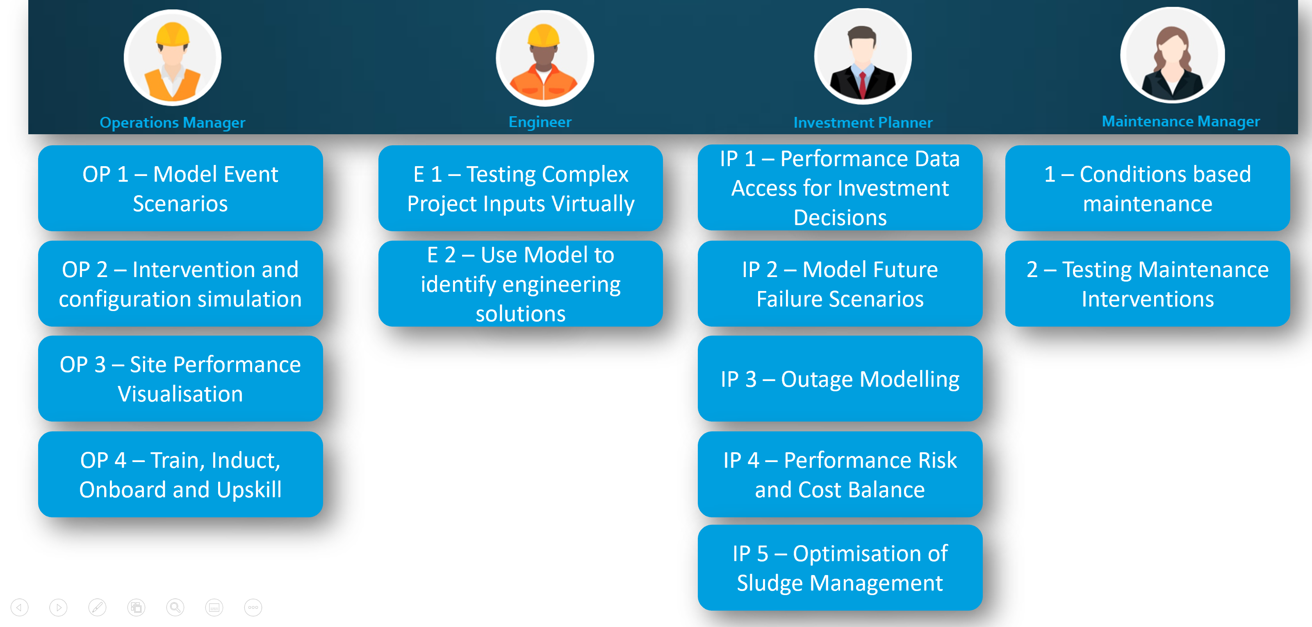
Approach - Discovery outputs
Roadmap, strategy and business case
User Story development
4 Personas.
13 key User Stories
Strategic Benefit Areas
Health and safety
Enhanced environmental performance
Optimal Capital investment decision making
Reduced Operation costs
Improved resilience
Improved Stakeholder Engagement
Benefits identified
6 strategic level benefit areas.
Split into 19 business categories
Quantified 36 specific benefits

Slide 7
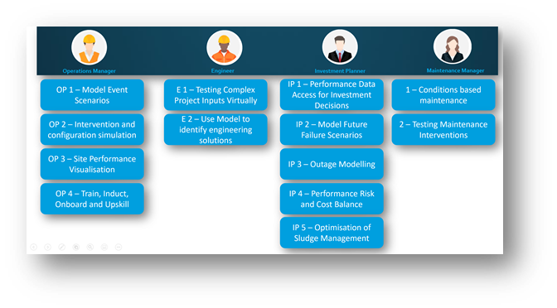

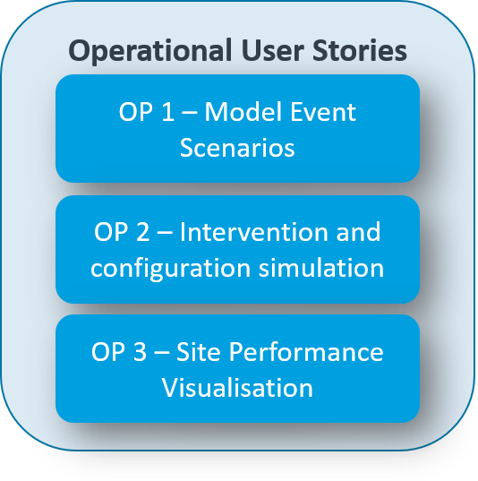
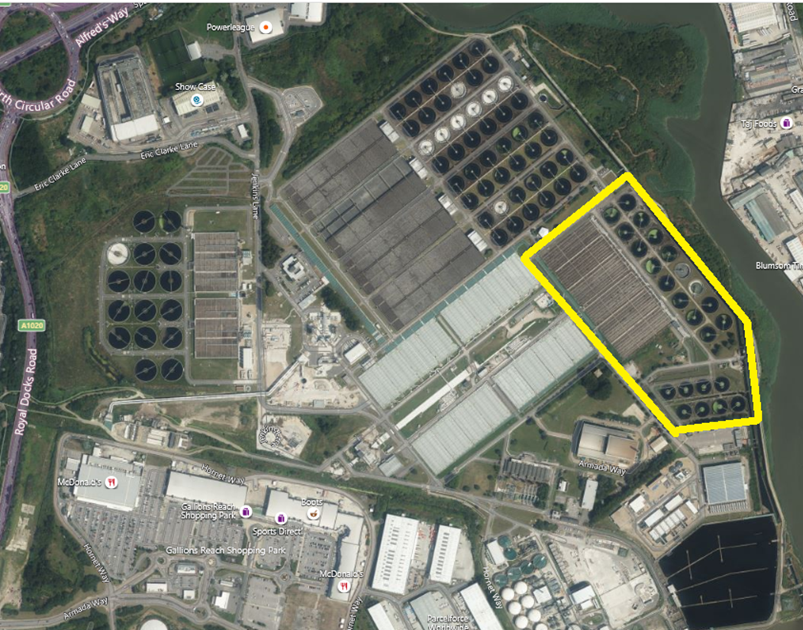
Approach - Implementation
Minimal Viable Product
Identify the key capabilities
Product Vision
3D
model
Operations Manager
Performance Dashboard
Simulation model
Beckton STW
Single Effluent Stream

Slide 8

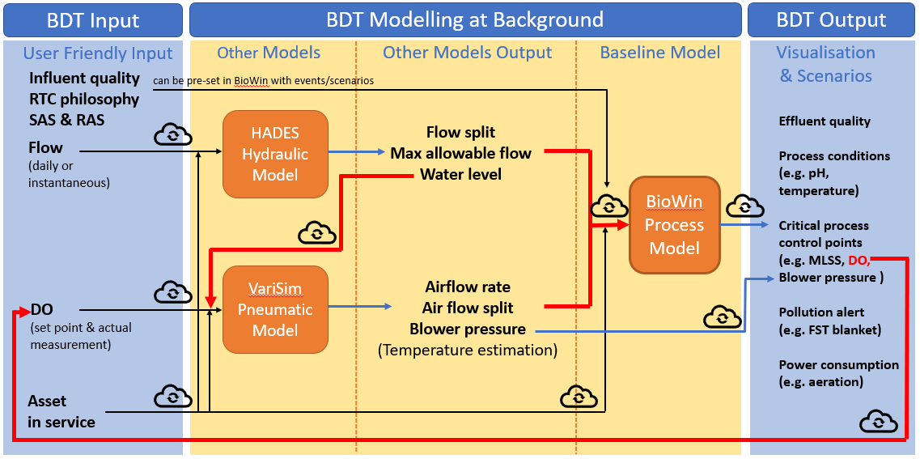
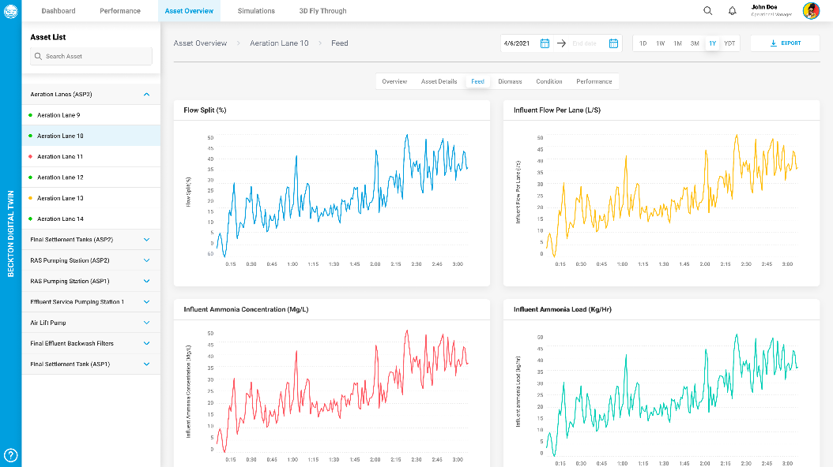
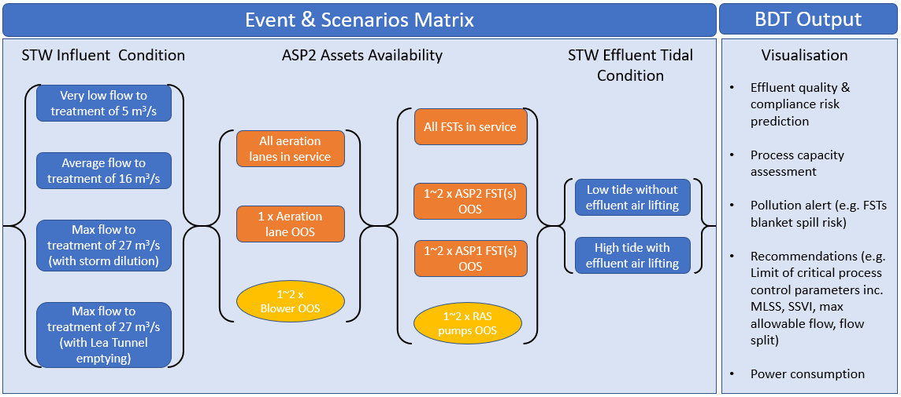
Simulation model – the engine of the Twin
3 key engineering models are integrated in the cloud to form the engine of the DT
First time this has been attempted and is stretching the capabilities of the existing Engineering models
Model interactions are automated using “robots” to do the work
Allows different scenarios to be run to understand impact on site performance

Slide 9
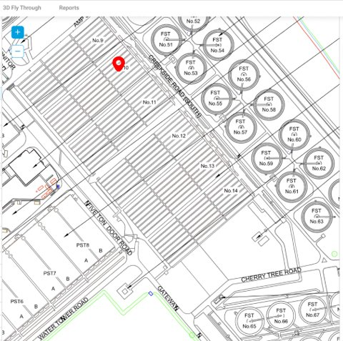
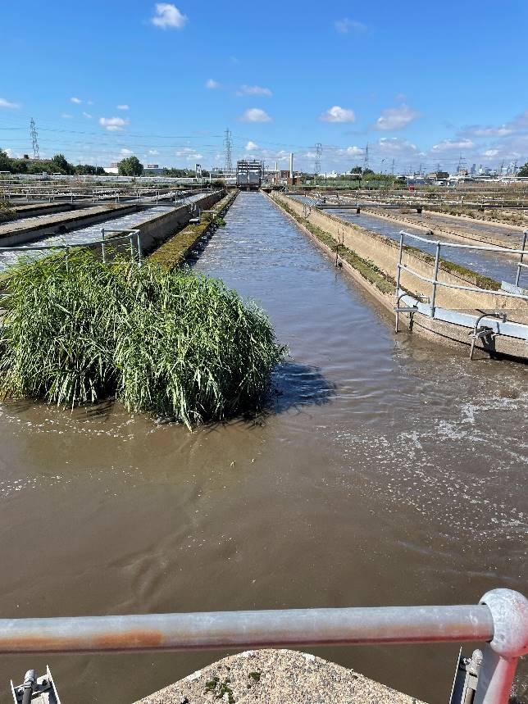
Challenges
Adapting existing digital tools to perform outside of their normal design
Missing Information
Quality and availability of Operational Data
Historical configuration management
Digital, data science, domain Engineering and Operations working together.
Stakeholder management
Benefits realisation
The real world is often different than the drawings

Slide 10
Lessons
Understand the use before you implement
Identify the key capabilities needed
Define a manageable MVP – prove it – then scale it
Identify foundational work and start early
Focus on value and benefits as soon as you can
It’s not an IT project (or a 3D model), – Users, Engineering, Operational Technology, Information Technology, Data Science,
Don’t be a slave to the process – Agile will need to flex
You can start now – DT ready
You can place a 150 year old asset into the virtual world

Slide 11
Questions

