Slide 1
Digital Twins enabling multi-party
dynamic data sharing, today
ANY QUESTIONS? GEMMA.BEARD@IOTICS.COM

Slide 2
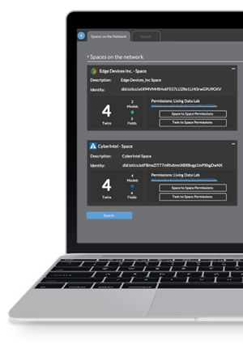
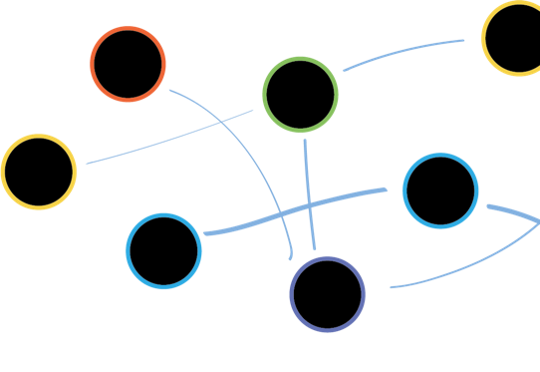




Where we play
IOTICS’ role
“IOTICS facilitates cross-boundary data exchange between multiple parties”
– Vikki Williams, Digital Lead Water, Arup

Slide 3

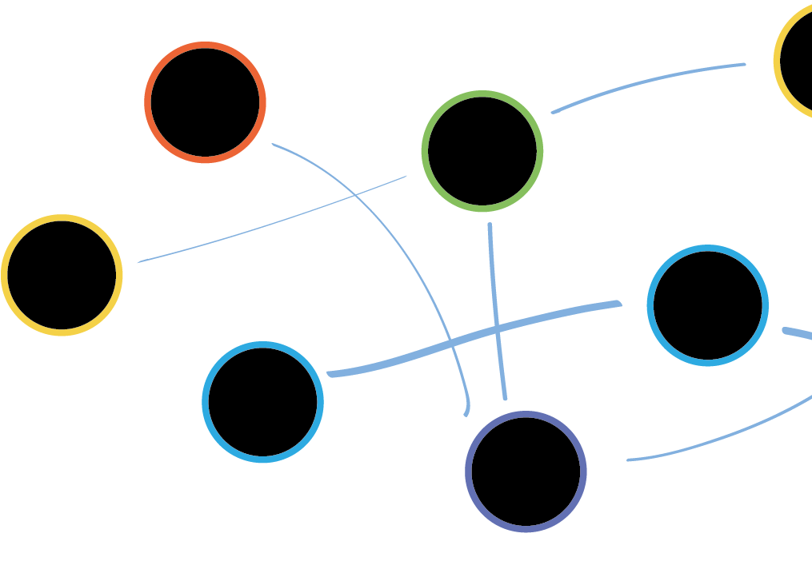
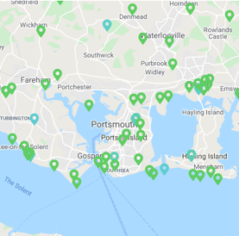
Multi-Party Data Sharing
Secure, selective at scale
“What makes the digital twin aspect so exciting is how it can be seen to work commercially across so many different parties and environments. To make this even possible without people raising concerns over IP and data sharing is significant”

Slide 4


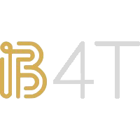


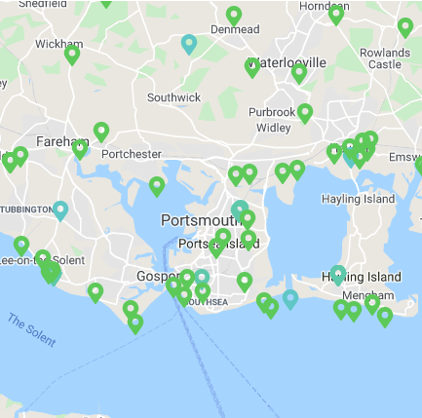





Consortium
Shipping, Hydrogen & Port Ecosystem UK (SHAPE UK)

Slide 5
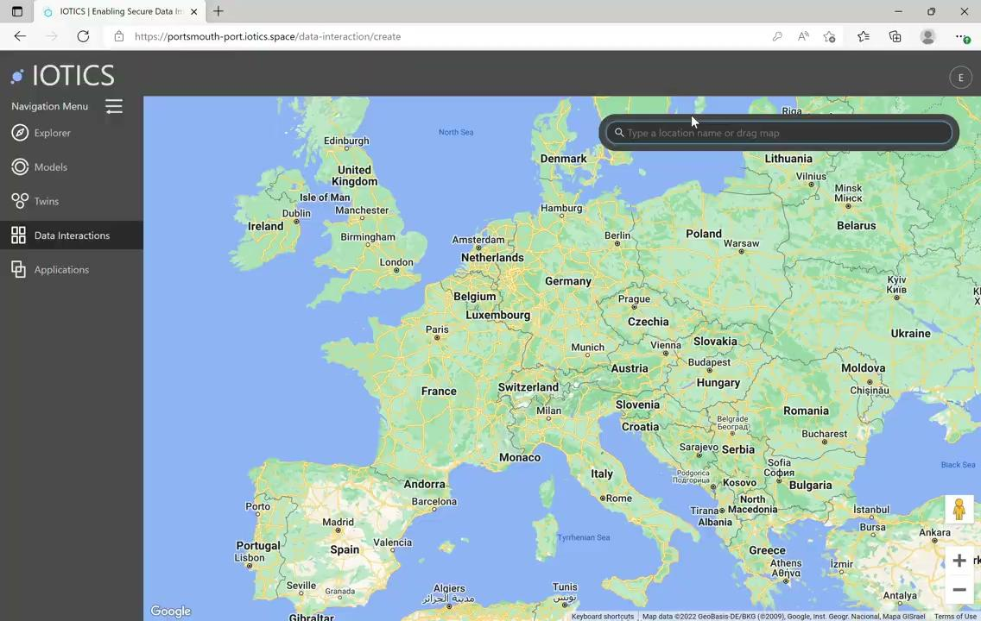

Slide 6
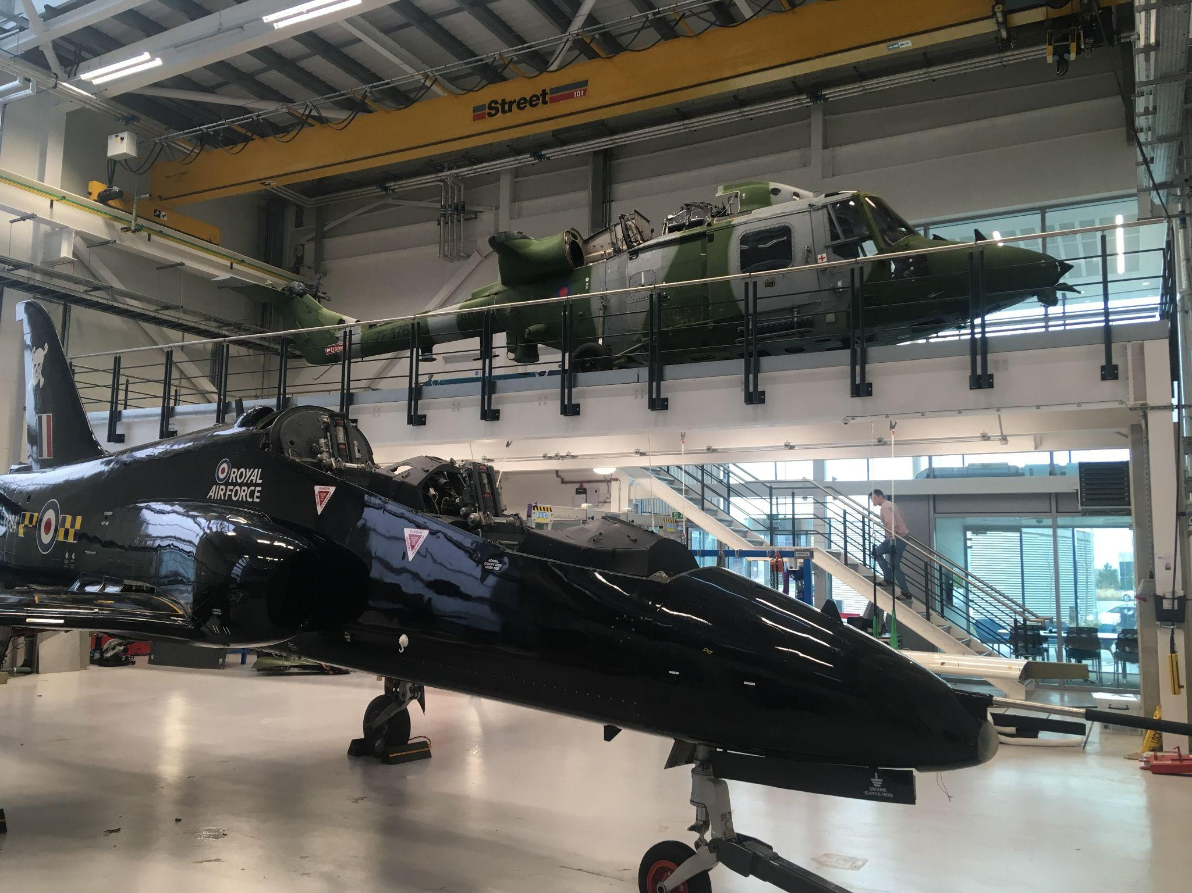
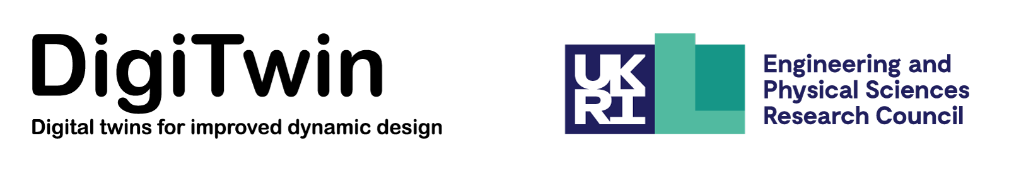
Data for Good
DigiTwin Consortium
"Effective data sharing between multiple geographic locations and organisations is crucial to building productive digital twins. Working with the IOTICS platform has enabled our research team to do this for our Hawk aircraft digital twin project".
Prof. David Wagg, Professor of Nonlinear Dynamics, University of Sheffield

Slide 7




Solving cross-boundary data exchange
What does this mean to you?
No wait for up front standards
In Maritime, Transport, Utilities, Defense and Academia organisations
are already using digital twins to share securely and selectively
Cooperation rather than collaboration
Focus on your own goals, cooperating with data to support others
Incremental evolution of trust
Ability to selectively share data means that both use cases
and trust can develop over time

Slide 8
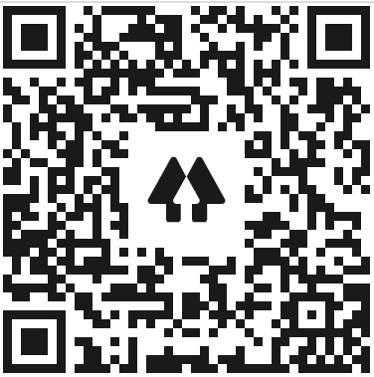
Involved in a ‘good’ data project
Get in touch about our programme
Thank you
ANY QUESTIONS? GEMMA.BEARD@IOTICS.COM

