Slide 1


Max Gamrat
RECOMMENDATIONS WATER DATA TASKFORCE SURVEY
DT Hub Gemini Call
19 April 2022
Chair BIM4Water
Water Data Taskforce
Bob Styles
Co-Chair BIM4Water
Water Data Taskforce

Slide 2
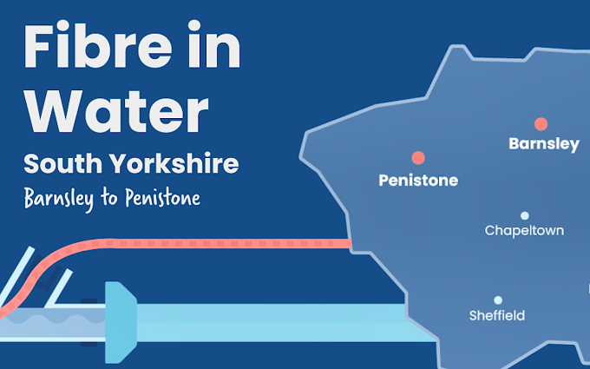
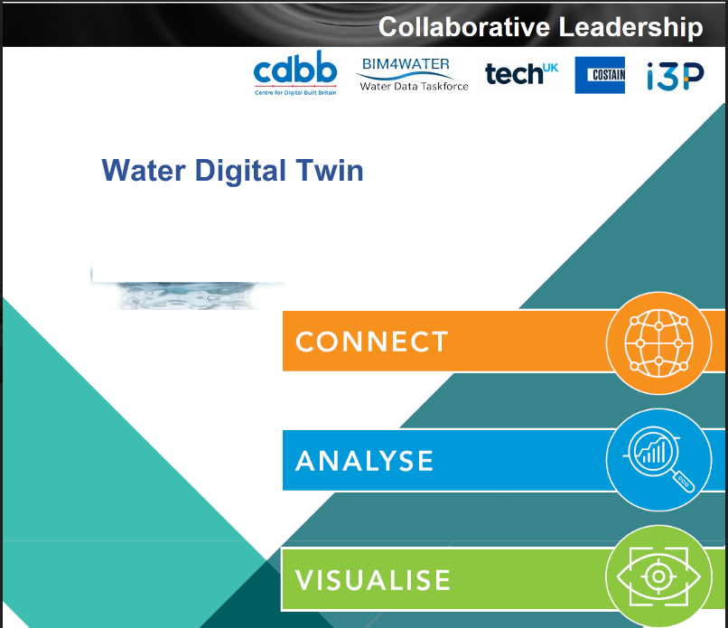










Water Data Taskforce – What is it?
To unlock the value of infrastructure data in the water sector and to promote stronger collaboration in data sharing initiatives in the UK.
What do we do?
Respond to consultations (GC, National Data Strategy, Ofwat Open Data Strategy)
Engage water companies and wider industry on data sharing projects / cross utility collaboration.
Develop material on industry views, company projects.
Events organisation for digital transformation.
Members/Partners
Affinity Water, Yorkshire Water, Thames Water, Thames Tideway, Anglian Water, United Utilities, Northumbrian Water, Scottish Water, South East Water, Welsh Water.

Slide 3
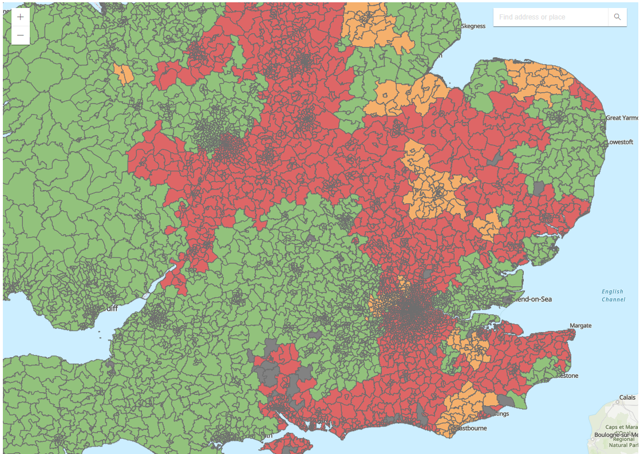
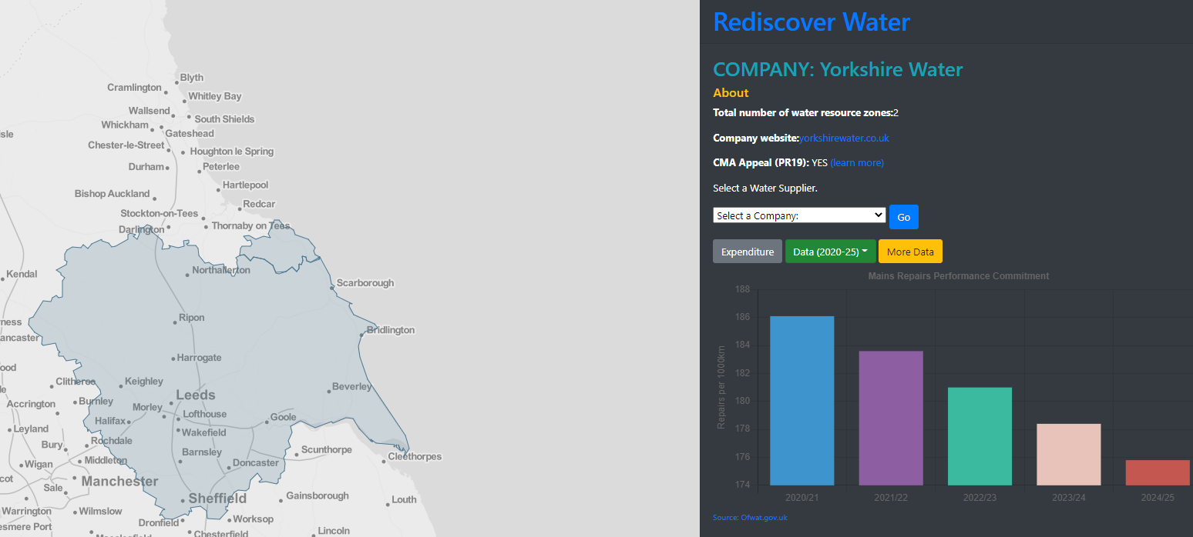
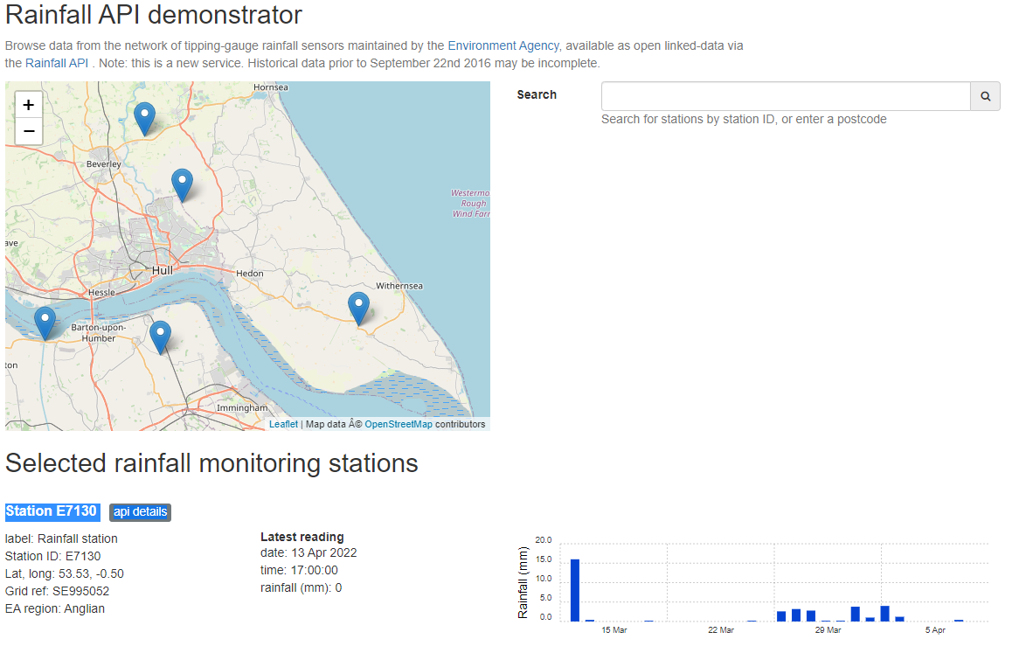
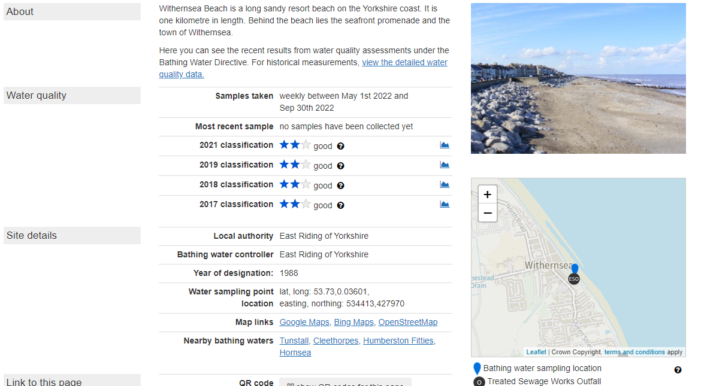
Why digital twinning matters in water
Engaging with our customers on PCC..
Monitoring real time GWL levels in our aquifers.
Discovering your ‘local’ water company
and its regulatory performance drivers.
Looking at river levels and flooding risk..
Which impacts pollution and sewer surcharge risk.

Slide 4
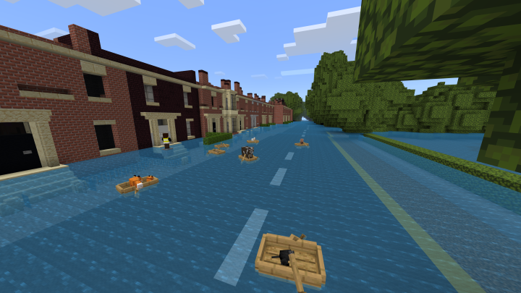

Slide 5

Water Data Taskforce Recommendations
During 2021 the BIM4 Water Data Taskforce researched and developed a number of draft recommendations:
Development of a standard water industry data strategy.
Making published data more open and visible.
Leverage data to promote “collaborative” cross utility use of assets.
Centralise research and innovation activities related to water sector data.
Foster & promote data sharing projects between, government, regulator and the water industry.
Draft report open now for consultation and review
https://cdn.ymaws.com/www.britishwater.co.uk/resource/resmgr/bim4water/publications/Recommendations_Summary__Wat.pdf

Slide 6
Water Data Taskforce Survey
We’ve published a survey with the aim of capturing views on the recommendation and determining a priority for the industry to adopt.
The survey is available for completion via the following URL:
BIM4Water consultation Survey on the 2022 Water Data Taskforce Recommendations (Page 1 of 4) (office.com)

Slide 7
Water Data Taskforce Survey
The survey, after requesting some role based information, asks respondents to place a priority rating with a reason against each of the draft recommendations made.
The second section of the survey explores ownership of the recommendations with respondents requested to propose the best placed stakeholders to take ownership of each recommendation.
The final section looks at collecting feedback on the maturity of infrastructure sectors in adopting digital transformation.
To help us build a clear picture of the recommendation priorities and the industries digital maturity for adopting them, please take the survey.

Slide 8
BIM4 Water - Water Data Taskforce
We need your views!

